Slide 1
ONAP Optimization Framework (OOF)
POC for Physical CellID (PCI) Optimization:
PCI Microservice, Policy & RAN simulator
August 21, 2018

Slide 2
ONAP Optimization Framework (OOF) and PCI
ONAP Optimization Framework (OOF) provides a policy-driven and model-driven framework for creating optimization applications for a broad range of use cases
For Casablanca, OOF enhancements include formulation and solving of optimization problems
We propose an OOF enhancement and Proof of Concept (POC) for Casablanca for
Physical Cell ID (PCI) Optimization
  PCI Optimization is a well-understood problem
  The reading/writing of the Physical Cell ID (PCI) configuration parameter has been included in SDN-R POC
Objective of the POC is to demonstrate disaggregation of the PCI SON functionality, and the data flows needed to implement this in ONAP using OOF
We envision a new PCI-Handler Microservice to facilitate the data flow and trigger mechanism
The focus is on data flow and interfaces, and the role of OOF, PCI-Handler-MS, SDN-C and Policy etc
  Objective is to incorporate an algorithm in ONAP using OOF, not to develop an algorithm

Slide 3
ONAP Casablanca: PCI Optimization using OOF
REST API
7
DMaaP Message
Config Value
Change Notifn
(Netconf/Yang)
4b
4a
6
Simulated RAN
~2000 Cells
Nbr_list, PCI values
OOF
Policy
10
SDN-C
3
1d
1c
8
PCI Handler MS
9
11
1b
1a
Config DB
5
2
Config Value Change
(SDN-C work done in SDN-R team)
Step | Functionality |  | Step | Functionality
1a-1d | All modules loaded to support PCI |  | 6 | OOF gets PCI optimization policies from Policy
2 | PCI-Handler MS fetches configuration policies from Policy |  | 7 | OOF queries SDN-C database to fetch data for cells in the region (REST API call)
3 | Config change notification from RAN to SDN-C (e.g. Nbr list change) |  | 8 | OOF provides PCI Optimization result to PCI Handler MS (REST API call)
4a | SDN-C publishes config data change on DMaaP to PCI-Handler-MS. |  | 9 | PCI-Handler-MS provides PCI recommendation to Policy on DMaaP
4b | PCI-Handler MS obtains relevant info from SDN-C (REST API call) |  | 10 | Policy sends message to SDN-C with instruction for PCI configuration changes on DMaaP
5 | PCI-Handler MS invokes OOF for pre-defined workflow for PCI Optimization (REST API call) |  | 11 | SDN-C applies config changes via Netconf

Slide 4
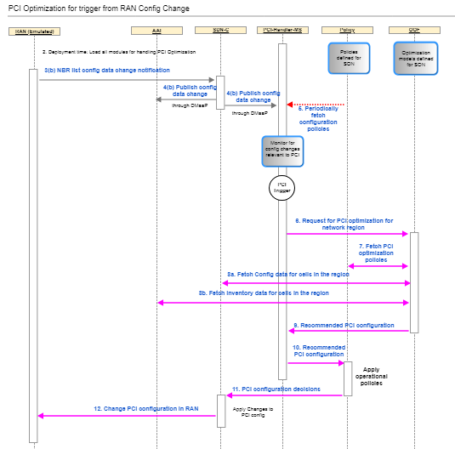
Flow / test case
See latest flow and test case at:
ONAP OOF-based PCI wiki page
https://wiki.onap.org/display/DW/5G+-+OOF+(ONAP+Optimization+Framework)+and+PCI+(Physical+Cell+ID)+Optimization

Slide 5
Assumptions
PCI optimization output from OOF will only be the list of cells with their modified PCI values. No additional configuration changes (e.g., power level change) are expected.
SDN-R will keep local config DB and update it based on config-change notification from RAN-Simulator.
For the current PoC, only one algorithm is exposed by OOF for PCI Optimization. This name is fetched by PCI-Handler MS from Config Policy, and passed towards OOF. Selecting PCI optimization policy based on certain criteria will be considered later.
SDN-R can bunch notifications and/or send info for > 1 cell in a single notification to PCI-Handler MS.

Slide 6
DMaaP notifications: Principles
Send only the relevant information in the notification, any additional details can be queried by the recipient.
Owner of the topic shall be the publisher.
    Option 1: Use unsecure mode (i.e., no keys)
    Option 2: Generate keys(which will be used for managing the topic in DMaaP) and store it in a config file, contents should be common for publisher and subscribers.
    Option 3 (not preferred): Publisher to expose an API for the subscriber to request subscription to be created (similar to current approach with SDC).

Slide 7
PCI-Handler Micro-service (PCI-MS)

Slide 8
PCI-MS architecture
Spring boot application
Core Logic
Upon notification from SDN-R, process it appropriately, including:
  Waiting for more notifications
  Buffering notifications if OOF has been triggered for same cluster
  Checking if OOF has to be triggered, and triggering OOF
  …
Upon receiving response from OOF, trigger policy
Fetch and store policy updates
Core Logic
Database
REST Interface
DMaaP client
OOF
SDN-R
Policy
Other ONAP components
Note: This architecture depicts a standalone PCI micro-service. When this is moved to DCAE, the interfaces will be adapted appropriately.
Config information
Processed notifications (but not sent to OOF)
Buffered notifications
State information
RAN-Sim

Slide 9
PCI: Workflow overview
Initialization and policy fetch
Notes:
Every time when coming to this state, the queue is checked for any buffered SDN-R notifications.
‘Existing’ – a cluster for which a notification has already been received & under processing.
While fetching additional data if a new notification is received, it will be buffered.
Wait state (Note 1)
A
SDN-R notification for an ‘existing’ cluster (over DMaaP) (Note 2)
SDN-R notification for a ‘new’ cluster
(over DMaaP) (Note 2)
Policy update notification received (over DMaaP)
OOF response received (REST)
B
Fetch additional info as required from SDN-R (e.g., neighbor’s neighbor) (REST)
(Note 3)
Fetch policy (REST)
Trigger policy module
OOF triggered for this cluster?
No
A
Any queued notifications?
Process notification, determine collision/ confusion and next action
No
A
Yes
Queue notification
OOF can be triggered?
Yes
B
Store relevant data and wait; (re)start relevant timer
No
Yes
Trigger OOF (REST) for PCI optimization
A

Slide 10
PCI-MS - Functions
Setup and initialization, fetch policy via REST interface
Fetch config policy upon DMaaP message (notification) from Policy (do this whenever notification is received)
Upon reception of notification from SDN-R
  Fetch additional info (via REST)
  Pre-processing logic: determine if OOF has to be triggered, wait for more notifications in a given time period, temporary storage of notifications in database, wait for new results to get assimilated, etc.
  If OOF has to be triggered, invoke a REST API call to OOF to trigger PCI optimization, along with relevant details (algorithm name, impacted cells, etc.).
While waiting for response from OOF
  Buffer/queue any new notifications from SDN-R for the same cluster
Upon receipt of response from OOF, prepare DMaaP notification for Policy and send it
After sending DMaaP message to Policy, check for any pending notifications in the buffer/queue, if present, go to Step 3, else wait for next notification/policy fetch action.

Slide 11
PCI-MS – Interfaces & Dependencies
SDN-R
  DMaaP message topic and json contents (PCI, anr list, cell id) for notification from RAN
  REST call to fetch additional info
OOF
  REST API contents for PCI optimization trigger
  REST API contents for PCI optimization response
Policy Module
  Config policy input format and contents (REST)
  DMaaP notification json contents for PCI config policy update
  DMaaP message and CL format for config changes recommendation by PCI-MS to Policy

Slide 12
PCI-MS interface to SDN-R: Proposal
Message Source/ Producer | Message Destination/Consumer | Purpose | Type | Topic/REST call | Contents
SDN-R (owner) | PCI-MS | Step 4a: Pass notification received from RAN on neighbor list change(s) | DMaaP message | PCI-NOTIF-TOPIC-NGHBR-LIST-CHANGE-INFO | Network id Cell id Physical cell id NeighborList
PCI-MS (owner) | SDN-R | Acknowledge receipt of notification and fetching of additional info (using REST) | DMaaP message | PCI-NOTIF-STATUS-NGHBR-LIST-CHANGE-INFO
PCI-MS | SDN-R | Fetch required data for pre-processing the notification, and determining if OOF has to be triggered | REST API call | ??? | - List of cells (response contains neighbor list info of each of the cells in the input list)
Notes:
DB path only in notification

Slide 13
PCI-MS interface to OOF: Proposal
Message Source/ Producer | Message Destination/Consumer | Purpose | Type | REST call | Contents
PCI | OOF | Step 5: Request for PCI optimization | REST API | tbd | PCI optimization algorithm name Set of cells requiring PCI optimization - {Cell id, Physical cell id, NR list, trigger}
OOF | PCI | Step 8: PCI optimization result | REST API | tbd | PCI optimization algorithm result – set of cells requiring PCI change {Cell id, new PCI}
Note: The API details are available on the ONAP wiki https://wiki.onap.org/display/DW/PCI+Optimization+API.
Notes:
DB path only in notification
To discuss
Agree on Producer & Consumer id, and owner/registration – OOF or PCI-MS.
UEB Key generation
Note: Notification contents will be in json format, with fields as AVPs.

Slide 14
PCI-MS: Functional logic
Logic to determine actions upon receipt of a notification from SDN-R with neighbor list
Upon receipt of a CellConfigChange message from SDN-R with NbrList change for cells in CellList
    For each cell Ci in CellList, check whether the info has to be processed or buffered.
    If it has to be processed:
      For each cell Ci in CellList that has a new/changed cell in NbrList, check for potential collision/confusion.
      Store all the Nbr list info obtained from SDN-R (i.e., ‘cluster’ info).
      Determine if PCI-MS has to wait or immediately trigger OOF
    If it has to be buffered, simply store it in the DB (buffer).
  Determining whether to process the notification or buffer it (for Cell Ci in CellList)
  Fetch the PCI_opt requests for which OOF has been triggered, and corresponding ‘cluster’ details
  For each ‘cluster’ for which OOF has been triggered, check if the Nodeid of the Cell Ci or at least one cell in its NbrList matches with any cell in the ‘cluster’
  If there is a match, then the request has to be buffered, along with the cluster indication
  Else it has to be processed.
Note: Nbr => Neighbor

Slide 15
PCI-MS: Functional logic (continued)
  Detection of collision/confusion
  Get NbrList_0 = set of K cells Nbr_1i to Nbr_ki which are Nbr of Ci (immediate neighbors)
  Get NbrList_2 = set of cells which are Nbr of Nbr_1i,…
  up to NbList_K = set of cells which are Nbr of Nbr_Ki
  (Cell Ci, Cells in NbrList_0, NbrList_1i … NbrList_ki form a cluster)
  Get PCI values for all the cells above
  If a cell and its Nbr have same PCI, flag a collision
  If two Nbrs of a cell have same PCI, flag a confusion
Points to discuss
For each cell Ci in CellList that has a decrease/increase/change in neighbors (no collision/confusion), ???
Decision to wait for notifications or trigger OOF immediately – based on collision/confusion detected, and for the Cells which haven’t yet reported the neighbor list change (i.e., compare collision/confusion list with list of cells in notification in SDN-R) (threshold), ???
Buffering of notification – should we consider only 1st level neighbors or 2nd level neighbors also
Attaching a cell to an existing cluster (when waiting for more notifications before triggering OOF)

Slide 16
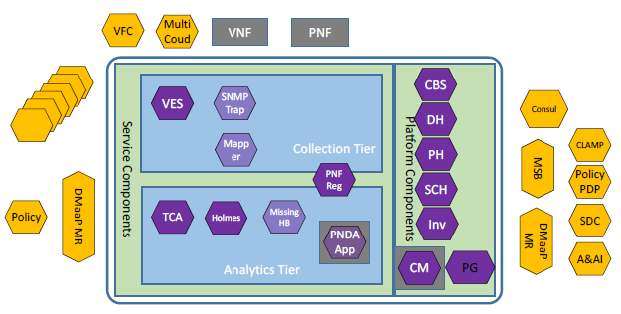

PCI-MS as part of DCAE (based on ONAP R2)
SDN-C
PCI
K8s pod
New PCI microservice

Slide 17
PCI-MS as part of DCAE – initial actions
Ref: https://wiki.onap.org/pages/viewpage.action?pageId=36963506
Action | Status | Remarks
Review new service proposal with architecture team and project team. | Not started
Identify use case this service will be targeted under (optional). | Ongoing | Use case identified as SON PCI optimization.
Capture external and internal dependencies and API consumed/provided. | Ongoing | Interface impacts identified and being discussed.
Repository creation (PTL will submit request to RM, who will coordinate with TSC/LF support) | Not started
After completion of above actions, subsequent implementation and integration actions as described in the ONAP wiki page to be carried out.
Query: Database for storing state and other data (redis, pg or ??? – any recommendations?)

Slide 18
Policy component

Slide 19
Policy Component
Provision new config policies for PCI-MS operation (PCI opt. algo name, conditions for triggering OOF) via REST; condition for approving PCI changes, etc.) as Drools policy via REST/GUI, and store it in DB (no code change foreseen).
Upon reception of new PCI config policy, send a DMaaP notification to PCI-MS.
Subscription to new DMaaP topic for ‘PCI change action trigger’ (PCI-MS notification).
Upon reception of information from PCI-MS on ‘PCI change action trigger’ (via DMaaP), check if SDN-R needs to be triggered for PCI changes (based on config policies).
If SDN-R has to be triggered for PCI change, invoke relevant SDN-R recipes.

Slide 20
Policy: Inputs (Proposal)
Policy (Drools)
Policy GUI
VNFs, NW
Template
Notification
PolicyConfig :
{
Type:Config,
ConfigPolicyType: Base,
Param1: Value1,
Param2, Value2
}
Template
PCIAction:
{
Type: Action
RuleAlgo: {
Source: PCIHandler,
Target:SDNR,
Action:updateConfig}
actionPerformer:{
Actor: SDNR,
Action: updateConfig
}
Data Change Notif
OOF
SDN-R
PCI HandlerMS
Note: DMaaP is not shown here.
Call Recipes of SDN-R

Slide 21
Policy Interfaces: Proposal
Message Source/ Producer | Message Destination/Consumer | Purpose | Type | Topic/REST call | Contents/Remarks
PCI-MS | Policy | Step 1b: Fetch PCI-MS configuration parameters | REST API call | /getConfig (existing API)
Policy (owner) | PCI-MS | Notify upon PCI-MS config policy update | DMaaP message | Tbd
PCI-MS (owner) | Policy | Acknowledge receipt of config policy update notification | DMaaP message |  | Send this message after successful fetch of updated Policy via REST.
PCI MS (owner) | Policy | PCI optimization recommendation | DMaaP message (CL format) | PCI-NOTIF-TOPIC-PCI-OPT-RECMD | Contents: PCI optimization algorithm result – set of cells requiring PCI change {cell id, new PCI}
Policy (owner) | SDN-R | Trigger SDN-R to implement PCI modifications | DMaaP message (CL format) | SDNR-CL | Contents: List of {cell id, new PCI} for the cells whose PCIs have to be changed.
SDN-R (owner) | Policy | Acknowledge receipt of PCI modification trigger & acting | DMaaP message (CL format) | SDNR-CL-RSP | Send this after sending update to RAN
Notes:
DB path only in notification

Slide 22
Policy Component - changes
Name | Status | Description
policy/parent | New in Casablanca | Parent repository containing the POM and any other information required to build all the sub-projects
policy/core | New in Casablanca | Core code shared among all policy repositories
policy/common | Used in Beijing | Policy common shared modules
policy/models | New in Casablanca | This repository will hold model code agnostic to PDP engines
policy/pap | Unused in Beijing, used in Casablanca | Policy Administration
policy/distribution | New in Casablanca | This repository will hold the SDC Service Distribution code
policy/pdp | Unused in Beijing Used in Casablanca | Common code shared between PDP engines
policy/xacml-pdp | New in Casablanca Code moved from engine repository | The XACML PDP implementation
policy/drools-pdp | Used in Beijing and Casablanca | The Drools PDP implementation
policy/apex-pdp | New in Casablanca | This repo will hold the next generation Apex PDP engine
policy/drools-applications | Used in Beijing | APIs and helper code for accessing other ONAP components from PDPs
policy/docker | Used in Beijing | Policy Docker support
policy/engine | Used in Beijing, will be deprecated | Contains the Policy GUI, client SDK, API's and XACML PDP Engine
Code changes involved
Apart from above docker/config/pe/push-policies.sh needs to be updated to create BRMSParamvPCI initial default policy. This will be created and pushed when the "pap" container starts.

Slide 23
RAN Simulator

Slide 24
Approach for RAN Simulator
Simulated Network
  Yang model defined by SDN-R module will be used for simulation
  ConfD* Basic Netconf Server will be used to simulate the RAN. C- API extension will be used to update the phy-cell-id values , to send ran-neighbor-list changes
  Each netconf server will run as standalone process or Docker container
  The netconf servers will be spawned by RANSim Controller based on the topology specified.
  Python scripts and client will seed the initial configuration for each Node.
  Each netconf server can send a mount request to SDN-R when they are spawned.
  ran-neighbor-list update notification will be sent by netconf server to SDN-R based on the trigger from RANSim Controller
  Will be able to accept phy-cell-id update trigger from SDN-R and forward same to RANSim Controller
ONAP
PCI MS
Policy
Web GUI
Robot Framework/
Python scripts
SDN-R
Simulated Network
Netconf server 1
RANSim
Controller
Netconf server n
ConfD
ConfD*
Extension
Config DB
Extension
Yang Model
Yang Model
Initial configuration
Python Script
*ConfD alternates are being evaluated

Slide 25
Approach for RAN Simulator
ONAP
RANSim Controller
  Spring Boot based micro service
  RAN topology of ~2000 nodes to be simulated is defined into a Config DB
  RAN Simulator spawns the Nodes based on this topology
  Exposes following rest APIs to
    Retrieve the current topology
    Update phy-cell-id of a node to simulate collision or confusion
    Drop a cell or create a new cell
    Retrieve the new phy-cell-id set by SDN-R to a node
    Start/Stop the network simulation
  MariaDB will be used as the config database to store the topology
  Robot scripts will drive the complete test sequences
  Web GUI will show the current topology, phy-cell-id collision/confusions, ran-neighbor-list changes, updates from SDN-R, etc. Pictorial representation will be a stretch goal
PCI MS
Policy
Web GUI
Robot Framework/
Python scripts
SDN-R
Simulated Network
Netconf server 1
RANSim
Controller
Netconf server n
ConfD
ConfD*
Extension
Config DB
Extension
Yang Model
Yang Model
Initial configuration
Python Script
*ConfD alternates are being evaluated

Slide 26
RAN simulator interfaces (Proposal)
Message Source/ Producer | Message Destination/Consumer | Purpose | Type | Contents
RAN-sim | SDN-R | Any new netconf server should send mount request to SDN-R | RESTCONF API
RAN-sim | SDN-R | Any change in ConfigDB (e.g., ran-neighbor-list , new PCI, cell down, etc) to be informed to SDN-R | Netconf Notification | Network Id, cell id, pci, (new) Neighbor list
SDN-R | RAN-Sim | Set new PCI value | Netconf request | Network id, cell id, new PCI value
Notes:
DB path only in notification

Slide 27
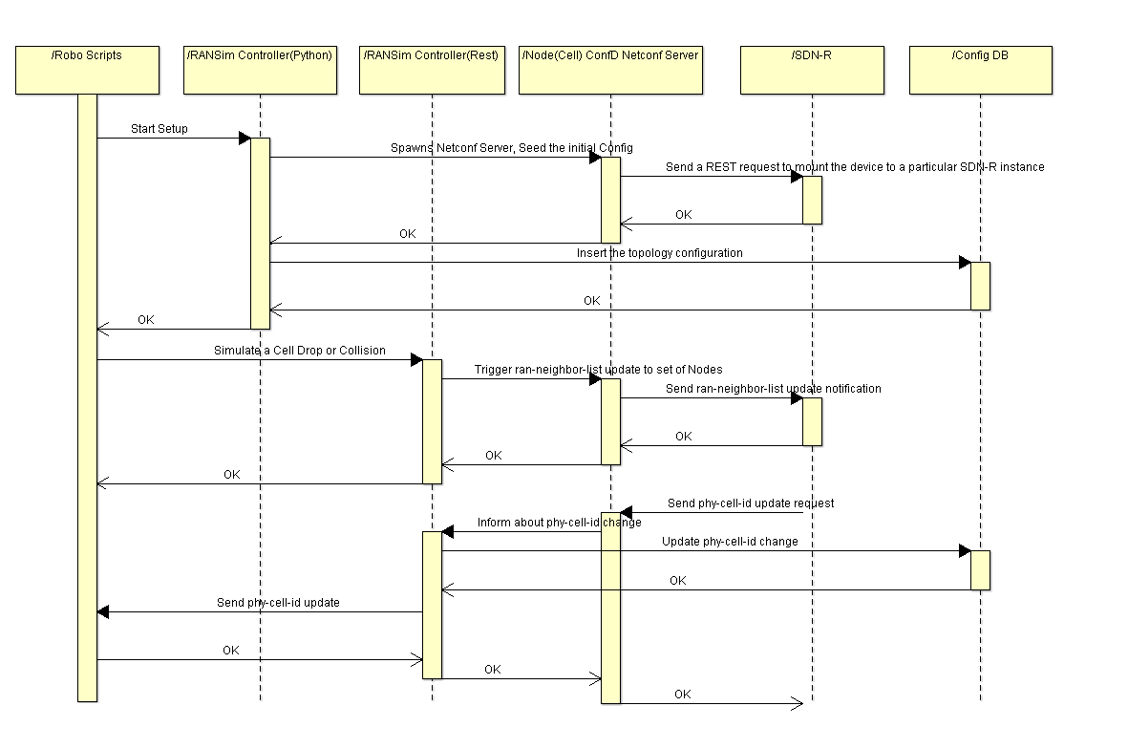
Illustrative sequence for a test scenario

Slide 28
Thank You!

Slide 29
Backup

