Slide 1
ECOMP Information Model
A Quick Look
Kevin Scaggs
AT&T

Slide 2
Agenda
Information Model Scope
Mission & Objectives
Model Sampling
Patterns
Issues and Plans

Slide 3
Information Model Scope
Domain: A logical Grouping of related classes that represent a distinguishable share of the enterprise
Information Model Domains
Catalog | Cloud | Customer | Market & Sales
Network | Party | Product | Resource
Revenue Assurance | Security | Service
Common Business
Business Interaction | Capability | Capacity | Configuration
Event | Location | Policy | Project
Root
The ECOMP Information Model has a strong correlation with the TMF SID

Slide 4
Mission & Objectives
Mission
  Establish and evolve one common and coherent Information Model for all of ECOMP
Objectives
  Define the required components and relationships to drive ECOMP software development, and
  Facilitate self-service VF onboarding to implement a rapidly changing software defined network.

Slide 5
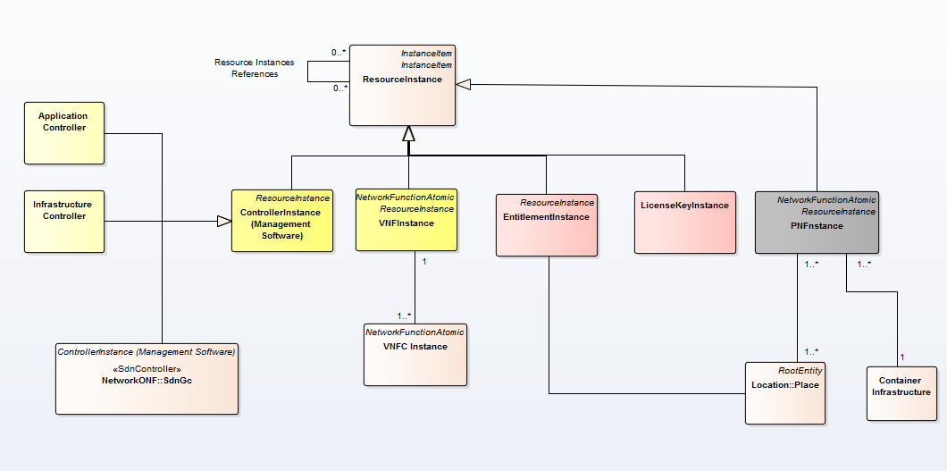
Model Sampling: Resource Types

Slide 6
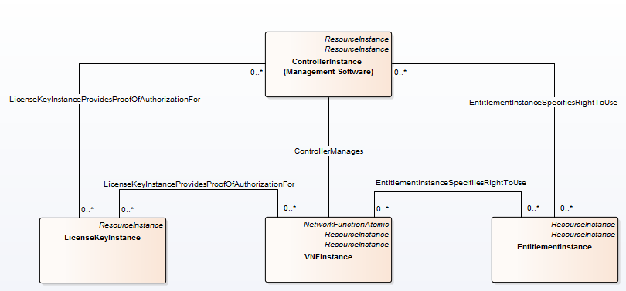
Model Sampling: Resource Instance Interrelationships

Slide 7
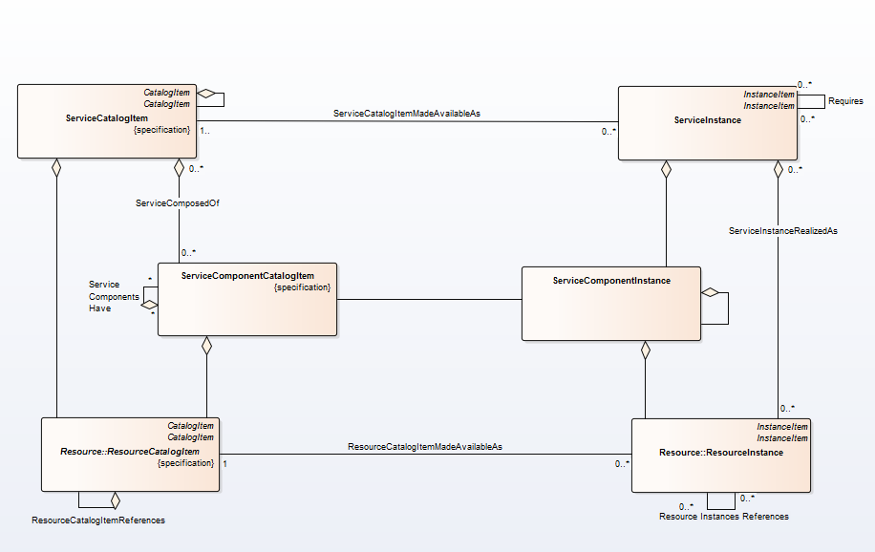
Model Sampling: Service & Service Components / Design Time & Runtime

Slide 8
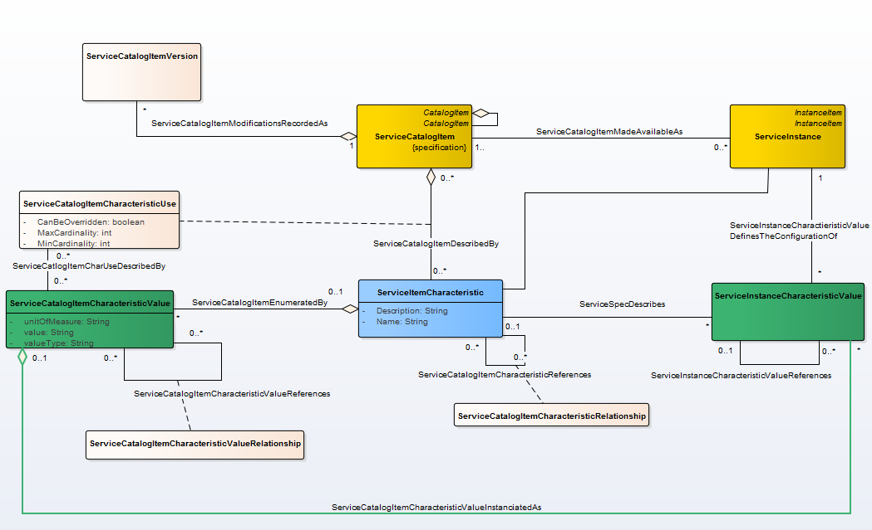
Patterns: Characteristic
CatalogItem Class Contains Characteristics
  Fixed
  Dynamic (0 - *)
Characteristics Can Have Characteristics
(Dynamic) Characteristics Have Possible Values
When Instantiated, Actual Value Selected
Allows for catalog items and related attributes to be added/modified without model being changed
Based on TMF SID

Slide 9
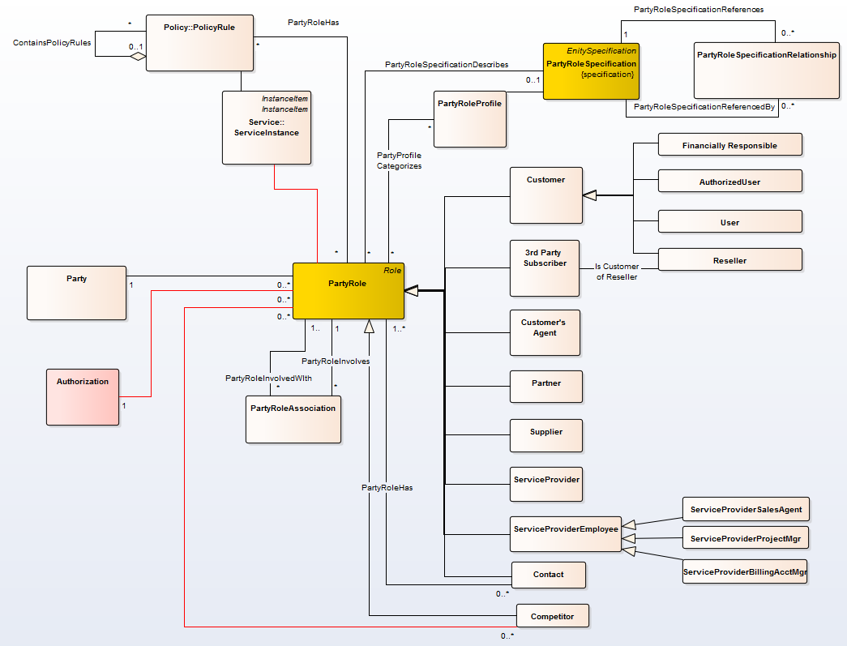
Pattern: Specification
Problem
Could Have Large Number Of Specializations
Each Time A New Specialization Is Added Requires A Model Change
Solution
Specification Concept
A Specification is an abstract class used to dynamically define characteristics of an object
New Party Roles can be added without model updates.
Specification can have dynamic characteristics
Based on TMF SID

Slide 10
Gaps and Plans
Gaps Between Information Model and Component Data Models
Component Development Started at Different Times Without Common Model
SDC Development Started Later
Integration & Quality Issues
Customized for Openstack Using Heat
Plans
Reduce Gap
Drive Toward Common Model
Make Appropriate Use of ETSI, OSM, TMF, MEF, …
Using
Appropriate Tools & Governance
A Hybrid Top-Down / Bottom Up Approach

