Slide 1
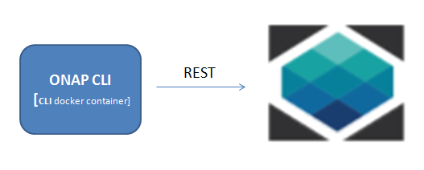
ONAP CLI (Command-Line Interface )
Architecture
Kanagaraj.Manickam@huawei.com
@mrkanag

Slide 2
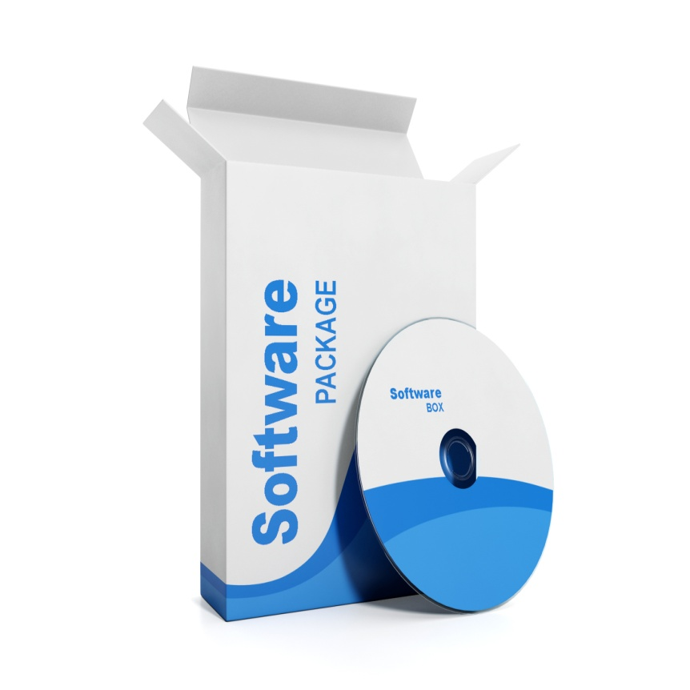
Software End points
Graphical User Interface (GUI)
Application Programming interface (API)
HTTP Representational State Transfer (REST)
Command-line interface (CLI)
Notes:
GUI: User operations
API & REST: Integration
CLI: Automation , CI, admin operations
CLI -> Docker, git (best examples)

Slide 3
Command-Line Interface (CLI)
Command
  Examples: Git, svn (developers)
  ipconfig, hostname, apt-get, dir, ping, ssh (admins)
  openstack, openo, docker, npm (users)
Use-case
  Automation, admin operations, C&I, user operations too
CLI requirements
  Argument parsing & validation
    Short and long option
    Positional args
  Man document/ Help
  Different Output formatting
  Error reporting / Exit code
  Debug/Verbose support/Audit logging
  Environment support
  Versioning
  Password mask/ SSL certificate/Auth plug-in
Modeled into YAML schema
open_cmd_schema_version:1.0
ONAP CLI

Slide 4





OPEN CLI
OPEN CLI plug-in framework
Schema Validator
Help Generator
Input Handler
Http Connection
Output formatter
Auth plug-in
MAIN
Command
Registrar
OPEN
Command
Command Plug-ins
Command Plug-ins
ONAP
Command Plug-ins
JAVA client
Command
Discoverer
HTTP Command
HTTP API
ONAP
Command
YAML(s)
open_cli_schema_version:1.0

Slide 5
OPEN CLI YAML Schema
open_cli_schema_version: 1.0
name: deploy-service
description: Deploy VSP
parameters:
- name: name
description: VSP name
scope: short
type: string
short_option: n
long_option: name
is_optional: false
......
results:
direction: portrait
attributes:
- name: id
description: service instance id
scope: short
type: string
.......
HTTP Command needs additional sections.
service:
name: vid
version: v1
no_auth: true
http:
request:
uri: /vid/rest/service
method: POST
body: '{"name":"${name}", ...... }‘
result_map:
id: $b{$.vimId}
Notes:
Explore the Open-O command YAML schemas
-- No Plug-in, only YAML is sufficient

Slide 6
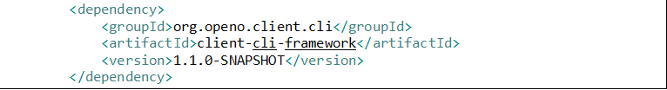
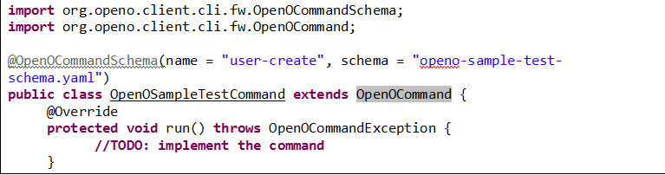
Developer guide
This needs migration of code from open-o to onap namespace
Add dependency to the maven onap cli framework
Create the YAML template using open_cli_schema_version: 1.0 and place it under resources/open_cli_schema/onap-sample-test-schema.yaml
Implement the Command Plug-in
Notes:
Explore the Open-O command YAML schemas

Slide 7
Thank you https://wiki.open-o.org/display/CLIEN/Open-O+CLI
“One Command to command whole Open-O !!”

