Slide 1
ONAP
Security Enhancements for Casablanca
Suggestions

Slide 2
PNF (legacy eNB/gNB) Autointegration
As defined in 3GPP
The Initial Root Credential (Vendor Credential Certificate) in the node HW is used for authentication and authorization, during the integrating into the operator network.
Trusted certificate (operator root or intermediate CA) is configured in the node
The operator credential (issued by operator CA) is then enroled for the permanent node identity
  CRL, certificate renewal, CMPv2 enrolment are supported

Slide 3
PNF (legacy eNB/gNB) Root-of-trust
Secure boot is performed during node startup, prior to autointegration.
  The Trusted Anchor (including the public key) in the node HW is used to validate the Signed SW (initial boot SW)
Only validated SW is allowed on the node
  Validation of SW signature is done by all SW upgrade packages

Slide 4
VNF Integration
eNB/gNB consists of several VNFs, including the S-VNFM by ETSI
The S-VNFM is onboarded and instantiated first, for the MNO tenant
  The S-VNFM is then used for instantiation of all other eNB/gNB VNFs
Initial credentials e.g. One-time password or PKCS#12 container is inserted into the S-VNFM during instantiation
  Inserted manually (by NFVO adm) or possibly by the MNO Network Manager (over SOL005, ETSI) when instantiating the S-VNFM.
    To get a M2M certificate to handle S-VNFM – NM i/f (ETSI SOL 002 and 3GPP Mul)
  If OTP then S-VNFM performs a CMPv2 request towards the tenant CA, using the OTP as id (potentially short expiration time for the OTP)
Same procedure towards the MANO CA
  for the S-VNFM – MANO i/f (ETSI SOL003/IFA007 and IFA006)
The S-VNFM instantiate the other eNB/gNB VNFs

Slide 5
VNF Root-of-trust
Signing and validation of the VNFP during onboarding
  Defined by ETSI SOL 004
  The Trusted Anchor certificate (including the public key) must be pre-loaded into the cloud infrastructure
  According to ETSI, the validation is to be done by the NFVO, the “onboarder”.
Validation during instantiation not yet in ETSI
  Work in progress
Relies on procedure, VNF does not know if it is validated or not
Trust chain
  Signed VNF SW and VLAN configuration
  Validation of above using vendor root certificate, both during onboarding and instantiation
  All the VNFs are instantiated using their shared key created in tenant NM
  The VNFs sends CMPv2 requests towards the Certificate Authority
  The enrolled certificate is thereafter used as VNF ID when authenticating TLS

Slide 6
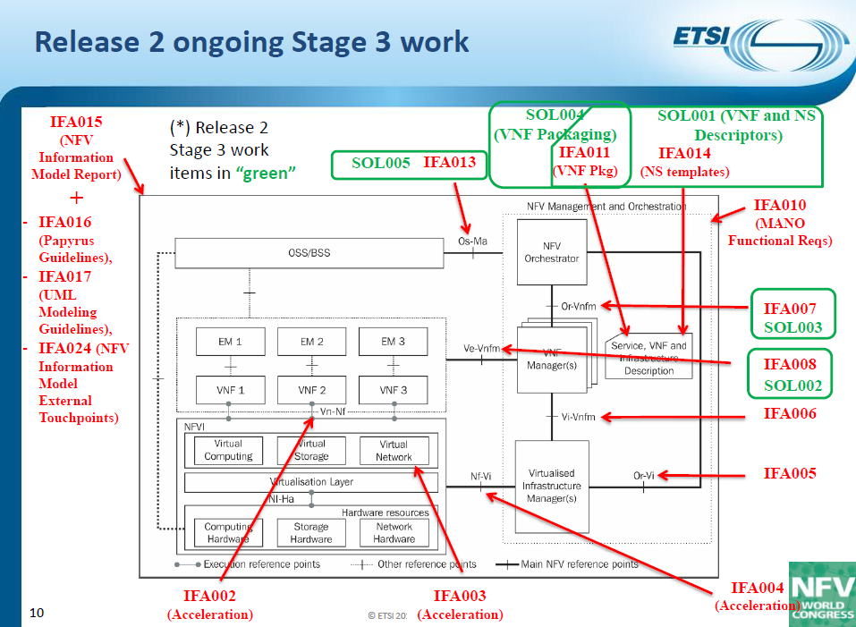
BACKGROUND :: ETSI MANO
Quote from ETSI SOL 003, chapter 4.2
  All APIs shall support and use HTTP over TLS (also known as HTTPS) (see IETF RFC 2818 [3]). TLS version 1.2 as defined by IETF RFC 5246 [7] shall be supported.
Thus, HTTPS (TLS 1.2) is always used for this interface
  Applicable to SOL 002, 003, 005

