Slide 1


VNF Activation with
Initial Certificate Enrollment
Security Subcommittee
Casablanca
July 28, 2018

Slide 2
Problem Statement
When a VNF is instantiated, it needs a way to obtain a certificate from the operator’s CA that allows it to communicate with DCAE (via HTTP/TLS).
PNFs generally come with vendor certificates issued by the vendor’s factory CA that uses its serial number or MAC address as the identity. This allows an operator to pre-provision the vendor’s factory root certificate into its CA and even pre-provision the PNF identity to authorize the PNF to request a certificate.
This pre-provisioning is not possible for a VNF. A VNF has no vendor certificate and no identity.
Two options are supported by 3GPP for VNFs using CMPv2 as described in RFC 4210.
Option 1: PKCS#12 bundle is installed on the VNF at instantiation time.
  A proxy entity performs Certificate Enrollment with the CA on behalf of the VNF to request a PKCS#12 bundle from the CA and this is installed in the VNF during or after instantiation.
Option 2: VNF performs certificate enrollment with a one time use Initial Authentication Key (IAK)
  A proxy entity requests an IAK and Reference Value (RV) from the CA on behalf of the VNF. The IAK and RV are provisioned on the VNF during or after instantiation.
  After instantiation, VNF performs certificate enrollment with the CA via CMPv2 using the IAK to protect the Certificate Signing Request (CSR). The RV identifies the IAK to the CA.
Option 2 is the preferred solution.
  AAF Cert Manager acts as the RA for the VNF in commercial deployments. Cert Manager acts as the CA for the VNF in an ONAP test environment.
  AAF Cert Manager requests an IAK and RV on behalf of the VNF during the instantiation workflow and passes these to the VNF during instantiation.
  VNF FQDN is used as the identity in the VNF certificate.

Slide 3
Impacts
Proposal discussed AAF CertMan acting as the Registration Authority (RA) for the Operator CA.
  During ONAP deployment, AAF CertMan becomes RA to Operator CA. Impacts: AAF.
  During VNF instantiation, SDN-C assigns an IP address and FQDN to the VNF and updates VNF AAI entry. Impacts: SDN-C, AAI.
  During VNF instantiation, SO triggers AAF CertMan to request an IAK/RV on behalf of the VNF and updates AAI or other security storage location. Impacts: SO, AAF, AAI.
  During VNF instantiation, SO retrieves the SSH public key for the appropriate controller and updates VNF AAI entry. Impacts: SO, AAI.
  Security credentials (Controller SSH public key, IAK, RV, IP address, FQDN, CA signing chain, CA URL) are passed to VNF during instantiation. Impacts: SO, M-VIM.
Proposal also discussed AAF creating a role and permissions for each VNF Type at onboarding.
  During Design Time, SDC publishes a YAML artifact of NF Events to DMaaP (existing functionality). AAF subscribes. AAF creates a Role and Permissions for the VNF Type for the events in the YAML file. Impacts: AAF.
  During VNF Instantiation, SO triggers AAF to add the VNF instance to the Role created at Design Time. Impacts: SO. AAF already has an API for this.
  Precondition: DCAE VES Collector has integrated the CADI module. During Run Time, when VES Collector receives an event from a VNF, VES uses the CADI module to query AAF for the roles and permissions of this VNF in order to determine if the VNF is authorized to send the event. Impacts: DCAE VES Collectors. CADI already has an API for this. DCAE Project is assessing integrating with CADI for Casablanca.

Slide 4
Impacts – AAF CertMan acting as the Registration Authority (RA) for the Operator CA
Phase | Use Case | Impacted Components
ONAP deployment | AAF CertMan initialized as RA to the Operator CA | AAF
VNF instantiation | SDN-C assigns an IP address and FQDN to the VNF and updates VNF AAI entry. | SDC-C, AAI
VNF instantiation | SO triggers AAF CertMan to request an IAK/RV on behalf of the VNF and updates AAI or other security storage location. | SO, AAF
VNF instantiation | SO updates AAI or other security storage location. | SO, AAI
VNF instantiation | SO retrieves the SSH public key for the appropriate controller and updates VNF AAI entry. | SO, AAI
VNF instantiation | SO populates VNF AAI entry with Controller SSH keys | SO, (maybe AAI)
VNF instantiation | Security credentials (Controller SSH public key, IAK, RV, IP address, FQDN, CA signing chain, CA URL) are passed to VNF. | SO, M-VIM
VNF instantiation | SO requests AAF to add the VNF instance to the VNF type role created at design time | SO (will use existing AAF API)

Slide 5
Impacts – AAF creating a role and permissions for each VNF Type at onboarding
Phase | Use Case | Impacted Components
Precondition | DCAE VES Collector has integrated the CADI module. | DCAE VES Collectors
Design time | SDC publishes a YAML artifact of NF Events to DMaaP (existing functionality). AAF subscribes. AAF creates a Role and Permissions for the VNF Type for the events in the YAML file. | AAF
VNF instantiation | SO triggers AAF to add the VNF instance to the Role created at Design Time. | SO AAF has an existing API
Run time: | VES Collector receives an event from a VNF. VES uses the CADI module to query AAF for the roles and permissions of this VNF in order to determine if the VNF is authorized to send the event. NOTE: DCAE Project is assessing integrating with CADI for Casablanca. | DCAE VES Collectors CADI has an existing API

Slide 6
Preferred solution
Option 2:
CA supports near real-time CMPv2 initial registration of end entity.
IAK/RV created and passed to VNF during instantiation. VNF performs certificate enrollment after activation.

Slide 7

Stage A: VNF and Service Modeling
VNF Modeling Design Time
Precondition: At ONAP deployment time, AAF CertMan is configured to be a Registration Authority (RA) for the operator’s CA. AAF will request IAK/RV in near real time from the CA for instantiated VNFs
RESOURCE DEFINITION SDC User can provide the following information about the VNF :
RESOURCE TYPE– Type of resource; VNF in this case
NAME – Name of the VNF type; e.g. 5gCu
CATEGORY – VNF category; e.g. Mobility
TAGS – User-defined tags
DESCRIPTION – Text description
CONTACT ID – Designer of the resource
VENDOR – VNF vendor; e.g. Nokia
VENDOR RELEASE – Vendor release
EVENTS – Monitoring event definitions
SERVICE DESIGN – User can design a Service that uses a VNF type. For VNF, VNF package is onboarded which moves the VNF Type into the SDC Catalog. From there, VNF Type can be used to build services.
ARTIFACTS DISTRIBUTION – When User is satisfied with the service design, User can promote the Service and the artifacts are distributed to the appropriate run time components. These artifacts include the YAML file for the events (fault, measurements, heartbeat, syslog, etc.), Metadata and schema files to describe the VNF-specific data (FM, PM, CM).
ROLE & PERMISSION CREATION – AAF creates a role and permissions for the VNF-type
SDC
DMaaP
SO
Controller
DCAE
AAI
AAF
Precondition: AAF CertMan is a Registration Authority (RA) for the Operator Certificate Authority (CA)
A1
A1
Resource Definition
VNF type
A2
Service Design
A2
A3
Artifact distribution via DMaaP
A4
A3
AAF creates a role for the VNF type and a set of permissions for that role
A4

Slide 8
Stage B : Service Instantiation Part 1
Service Instantiation Part 1
Service Provider (SP) decides to instantiate a new service instance in ONAP.
VID User or BSS/OSS system triggers Service Instantiation which includes a VNF.
SO triggers OOF for Homing and Network assignments. This assigns cloud resources to VNF.
SO creates AAI entries for Service and VNF and updates network assignments. Resulting AAI entry for VNF contains the VNF Controller.
SO triggers SDN-C to create the network connections that Service needs.
SDN-C creates network connections, assigns UUID, IP address and FQDN
SDN-CVNF AAI entry. Can SDN-C also provision DNS?
SDN-C notifies SO that connections are created.
SO triggers AAF to gets an IAK/RV for the VNF, the CA signing chain, and the CA URL
  AAF gets an IAK/RV for the VNF, the CA signing chain, and the CA URL.
SO triggers AAF to assign VNF to proper role based on VNF Type.
  AAF assigns VNF authorizations that allow VNF to send events to DCAE.
Next slide.→
BSS / OSS / VID
SO
OOF
SDN-C
AAF
AAI
CA
B1
B1
B2
New Service
B2
B3
Service Instantiation
B3
Homing & NW Assignments
B4
B4
Create AAI Entry for Service and VNFs and populate Controller public key, FQDN of Controller
B5
B5
Create NW connections
B6
B6
SDN-C creates IP address, FQDN, UUID
B7
B7
Update NW connections
B8
B8
NW connections complete
B9
B9
Request VNF IAK/RV, CA signing chain, CA URL
C1
C1
Get IAK/RV for VNF, CA signing chain, and CA URL
B10
B10
Request VNF authorization assignment
C2
C2
Create VNF Authorizations

Slide 9

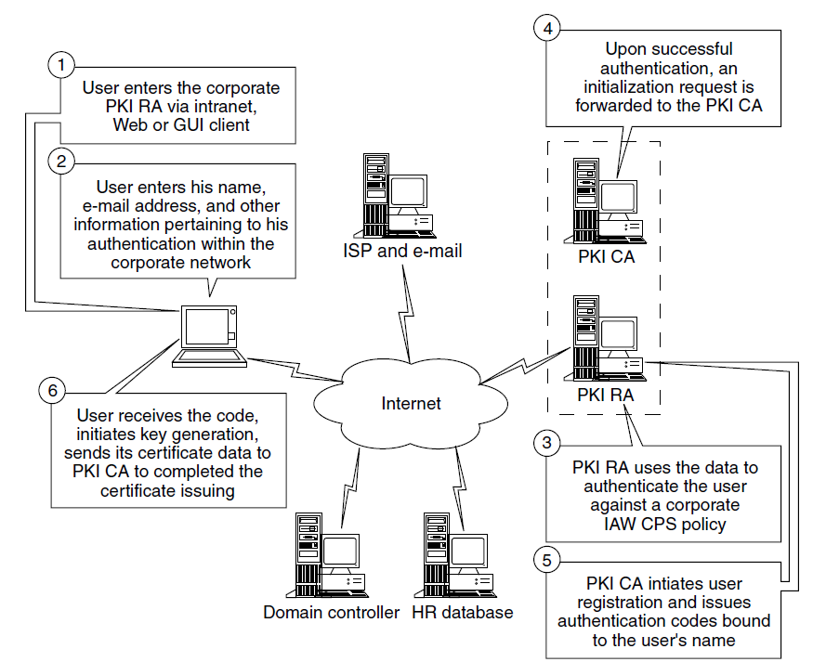
Stage C: VNF Security Credentials
VNF Certification and Role Assignment
SO triggers AAF to request IAK/RV from CA.
AAF creates a request for IAK/RV.
AAF submits request to CA.
CA verifies request is from the RA and creates response containing IAK and RV.
CA sends response containing IAK, RV.
AAF returns IAK, RV, CA signing chain, and CA URL to SO
SO triggers AAF to assign VNF authorizations.
AAF assigns VNF identity (fqdn) to the role of the VNF type.
AAF responds to SO.
B9
SO
AAI
AAF
CA
C1a
Precondition: AAF has created a role and permissions for the VNF type based on the YAML file defining the VNF type
C1b
C1c
B9
Request VNF IAK/RV
C1d
C1a
Create request for IAK/RV
C1e
C1b
Submit initialization request (ir) to CA
B10
Verify request came from AAF
Create IAK and RV
C2a
C1c
C2b
This flow is based on Exhibit 92.3 of Information Security Handbook
C1d
IAK, RV
C1e
IAK, RV, CA signing certificate chain, and CA URL
B10
Request VNF authorization assignment
AAF assigns VNF identity to the role of the VNF type.
C2a
C2b
AAF notifies SO that assignment is complete.

Slide 10

Stage D : Service Instantiation Part 2
Service Instantiation Part 2
SO triggers Multi-VIM (M-VIM) to instantiate the VNF. (pass IAK, RV, CA signing chain, CA URL)
M-VIM retrieves the VNF instantiation and security information from AAI (controller SSH key, FQDN of Controller, IP address, FQDN).
M-VIM instantiates the VNF passing this data to the VNF as part of instantiation.
M-VIM updates AAI with instantiation info.
M-VIM notifies SO that instantiation is complete.
SO triggers the appropriate Controller to activate the service.
Controller configures the VNF for service via Ansible/SSH or NetConf/SSH (or NetConf/TLS). The service configuration is VNF specific. SSH uses public key authentication.
VNF activates itself according to the service configuration from the Controller. VNF uses the IAK/RV to perform certificate enrollment.
Controller updates AAI with configuration.
Controller notifies SO that service is configured.
SO triggers DCAE to monitor this new service.
DCAE queries AAI for information about the service and starts monitoring.
DCAE notifies SO that service is monitored.
SO informs service initiator (VID user or OSS/BSS) that service is active.
VNF
M-VIM
Controller
SO
AAF
DCAE
AAI
D1
D2
D1
Instantiate VNF
D2
Retrieve VNF Instantiation and Security Information
D3
D3
Instantiate VNF
D4
D4
Update Instantiation Information
D5
D6
D5
Instantiation Complete
D7
D6
Activate Service
SSH or TLS
D7
Service Configuration
D8
D8
Activate
D9
Update Service Configuration
D9
D10
D10
Service Configured
D11
D11
Monitor Service
D12
D12
Monitoring Info
D13
Service Monitored
D14
D13
D14
Inform User

Slide 11
Stage D8 : VNF Certificate Enrollment
Certificate Enrollment with IAK/RV
VNF generates a key pair and Certificate Signing Request (CSR), and protects CSR with the IAK.
VNF submits IAK protected CSR to CA using the CMPv2 protocol.
CA verifies CSR using the IAK and RV and creates response containing a certificate bundle. RV is used by CA to identify the IAK.
CA sends certification response containing the signed certificate.
VNF sends certificate confirmation. If CA does not receive the certificate confirmation within the prescribed time period, the certificate is revoked.
CA sends confirmation ack.
Note that VNF must automatically perform this certificate enrollment during activation if the CA URL address and CA signing chain is provisioned.
VNF
CA
D8a
Generate key pair
Create CSR with VNF FQDN as CN and SAN
Sign CSR with private key
Protect CSR with IAK
D8a
D8b
D8c
D8b
Request IAK protected signed CSR
Initial registration/certification (ir)
Verify IAK/RV
Verify possession of private key
Sign certificate
D8d
D8c
D8e
D8d
Certification response (ip), Signed certificate
D8e
Cert Confirmation
D8f
D8f
Confirmation ack

Slide 12
Stage E: VNF Run-time
DCAE authenticates and authorizes the VNF instance at run-time
Preconditions: AAF created a role for the VNF type, assigned permissions to the role, and assigned the VNF to the role for the VNF type. CADI is integrated into DCAE.
VNF sends an event to DCAE. All transactions to DCAE will first to through the CADI component integrated to DCAE.
CADI authenticates the VNF using the VNF certificate and standard PKI validation.
CADI requests the role and permissions for the VNF.
CADI provides the role and permissions of the VNF to DCAE.
DCAE compares the event to the permissions.
NOTE: CADI is integrated into DCAE
VNF
CADI
AAF
DCAE
Precondition 1: VNF has been assigned to the VNF type role
Precondition 2: CADI is integrated into DCAE
E1
VNF sends event to DCAE
E1
E2
CADI authenticates VNF using VNF certificate
E3
CADI requests the role and permissions for the VNF
E2
E4
CADI provides DCAE with the role and permissions of the VNF
E3
DCAE checks that the event is in the permissions and accepts (or rejects) the event
E5
E4
E5

