Slide 1
Edge Automation through ONAP WG
TSC Update – May 10th 2018
Leads: Ramki Krishnan (VMware), Raghu Ranganathan (Ciena)
Wiki: https://wiki.onap.org/display/DW/Edge+Automation+through+ONAP
Meeting Date/Time: Monday, 3:00pm UTC - 5:00pm UTC

Slide 2
WG Scope & Progress
Edge Application Profile Definition – Casablanca & Beyond
  Status: Complete
    Defines the use cases
Edge Infrastructure Profile Definition – Casablanca & Beyond
  Status: Complete
    Defines the IaaS/PaaS attributes needed from Cloud Providers
Define hierarchical ONAP Central/Edge Architecture – Casablanca & Beyond
  Support Edge Application/Infrastructure profile
  Support Any "Cloud" (internal Business Unit or external Partner) at Any "Location" (edge, regional or central)
  Identify MVP components for ONAP Edge for Casablanca
  Status: Near Completion
Deep Dive on Functional Interactions (API reference points) - Casablanca
  Work closely with Project Teams
  Status: To Start
Note: This is expected to be a multi-release project

Slide 3
ONAP requirements for Edge Automation
ONAP Hierarchical Architecture (under discussion)
  Option 1: Separate ONAP instances at Central and Edge Locations
  Option 2: One ONAP instance and with some ONAP Components in Edge Cloud
ONAP Activity Goals towards Requirements
  ONAP SP <IaaS/PaaS API> Edge Cloud SP
  ONAP Central <API> [ONAP Edge/Cloud Orchestrator]
Potential Casablanca Requirements
  Enhancements to Multi-Cloud and External API models
  MVP for ONAP Edge
    Only Operational Components: DCAE, Multi-Cloud, DMaaP, MSB, etc.; Centralized Design/Deployment

Slide 4
BACKUP

Slide 5
WG Scope & Progress
Edge Application Profile Definition – Casablanca & Beyond
  Status: Complete
    Defines the use cases
Edge Infrastructure Profile Definition – Casablanca & Beyond
  Status: Complete
    Defines the IaaS/PaaS attributes needed from Cloud Providers
Define hierarchical ONAP Central/Edge Architecture – Casablanca & Beyond
  Support Edge Application/Infrastructure profile
  Support Any "Cloud" (internal Business Unit or external Partner) at Any "Location" (edge, regional or central)
  Identify MVP components for ONAP Edge for Casablanca
  Status: Near Completion
Deep Dive on Functional Interactions (API reference points) - Casablanca
  Work closely with Project Teams
  Status: To Start

Slide 6
Next Steps
Edge Application/Infrastructure Profile
  Further Feedback from End User Advisory Group much appreciated
    Review Profiles
    Scale numbers for Casablanca
Hierarchical ONAP Central/Edge Architecture
  Further Feedback from End User Advisory Group much appreciated
    Casablanca S3P requirements for ONAP Edge
    Additional Casablanca S3P requirements for ONAP Central

Slide 7
Edge Application Profile Summary
No | Application Classification (RTT) | Application Examples | Network / Service Behavior Type | Deployment Component/ APIs | ONAP Managed | Edge Location Constraint (RTT) | Potential Application Provider | Casablanca Candidate
1 | Real-time (20ms -100ms) | In service path optimization applications which run in open CU-CP platform (also known as RAN Intelligent Controller, or SD-RAN controller). | Real-Time Network State Control | Open 5G CU-CP (CU - Control Plane) – VNFC. | Yes | Hard | NF Vendor/Service Provider/3rd Party | Yes
2 | Near-real-time (500ms and above) | Slice monitoring, performance analysis, fault analysis, root cause analysis, centralized SON applications, Optimization (SON Drive Test Minimization etc.), ML methodologies for various apps. | Network Analytics & Optimization | DCAE | Yes | Soft | NF Vendor/Service Provider | Yes
3 | Near-real-time (500ms and above) | Video Analytics, Video Optimization, Customer geoLocation information, Anonymized customer data etc. | Workload Analytics, Optimization & Context processing | Cloud Edge or Cloud Central | No | Soft | 3rd Party | Out of scope for ONAP
4 | Real-time (10-20 ms) | Third party applications that directly interacts with the UEs, like AR/VR, factory automation, drone control, etc. | Workload Automation / AR-VR / Content, etc. | UE or Cloud Edge | No | Hard | 3rd Party | Out of scope for ONAP
5 | same as 3) | same as 3) | Value Added Services + same as 3) | same as 3) + MEC/Cloud APIs (Note 1) | Yes | same as 3) | same as 3) | Stretch
6 | same as 4) | same as 4) | Value Added Services + same as 4) | same as 4) + MEC/Cloud APIs (Note 1) | Yes | same as 4) | same as 4) | Stretch
Source: “Edge Scoping,” https://wiki.onap.org/pages/editpage.action?pageId=28381325

Slide 8
Edge Infrastructure Profile Summary (1)
Distributed
  1000's of edge locations of varying capacity
  Casablanca - Implementation
    10-100 edge locations (simple starting point)
Peformance-awareness
  GPU, FPGAs, SR-IOV etc.
  Casablanca - Implementation
    SR-IOV desired for Data Plane (5G CU-UP)
    NIC offload desired for tunnel encap/decap e.g. 5G CU-UP GTP tunnel
Resource Isolation through fine-grained QoS
  Support both Latency-sensitive and General purpose applications
  Support ONAP Management plane components in the same cloud with Workloads
  Casablanca - Implementation
    Min/Max resource reservation model desired
Source: “Edge Scoping,” https://wiki.onap.org/pages/editpage.action?pageId=28381325

Slide 9
Edge Infrastructure Profile Summary (2)
Security
  Workloads are often deployed in external (non-dc-type) locations and need HW security (TPM etc.)
  3rd party applications which need additional HW security (VM, Containers in VM etc.) and SW security (Inter-component TLS etc.)
  Casablanca - Implementation
    Edge Clouds with private IP addresses, i.e. reachable via private connections
    For example, edge cloud in a public cloud provider reachable via AWS direct connect or Azure express route or Google partner interconnect
Capacity constraints
  Very small footprint (few nodes per physical location), Medium footprint (10's of nodes per physical location), Large footprint (100's of nodes per physical location)
  Casablanca - Deployment
    Need number of cores per servers; Need storage capacity/pool
Cloud Diversity
  Private and Public Cloud Providers
  Casablanca - Implementation
    Note: ONAP currently supports private edge clouds based on VMware VIO, Wind River Titanium Cloud, Upstream OpenStack
    Desire to have at least one Public Cloud Provider (Azure, AWS, GCE etc.) as an Edge Cloud Provider
      ONAP central instantiates an Edge Cloud instance (blue cloud provider in gliffy) via a IaaS API to cloud provider
      ONAP central instantiates one or more ONAP edge components as need, e.g. DCAE
      ONAP central instantiates one or more NFs, e.g. 5G CU-UP/CP
Configuration Diversity
  5G Factory Automation, 5G General Mobility Services etc. – User Plane components (DU, CU-UP, UPF etc.)
Source: “Edge Scoping,” https://wiki.onap.org/pages/editpage.action?pageId=28381325

Slide 10
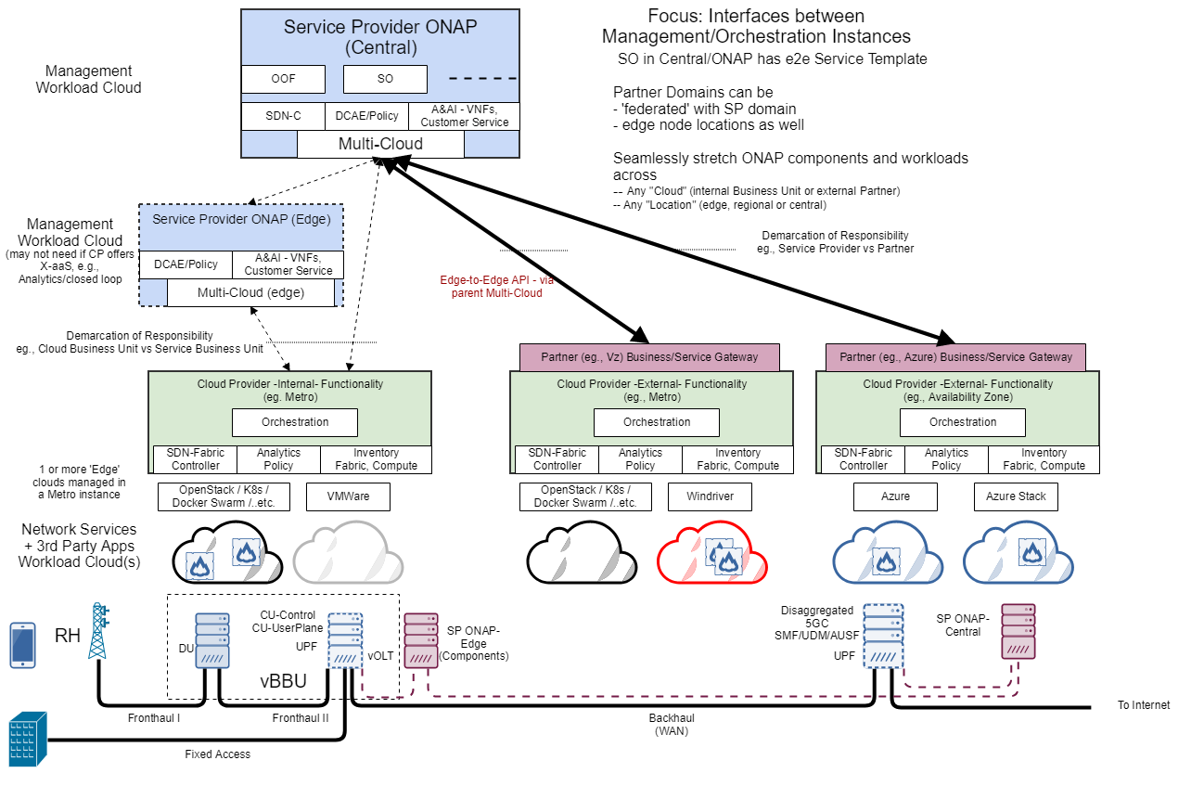
Hierarchical ONAP Central/Edge Architecture
Minimum Viable ONAP Edge (assuming operational aspects only, i.e., in Design/Deploy/Operate)
ONAP Edge - DCAE with RT-collector/Batch-collector:
ONAP Multi-Cloud: can use a Data Router to forward to local only and/or replicate to central also.
ONAP DMAAP
ONAP Edge - Policy: PDP/PEP....
ONAP Edge - A&AI - TBD? may not be needed if only closed loop decisions based on policies for given customer instances
TBD - other ONAP components?
Source: “Edge Scoping,” https://wiki.onap.org/pages/editpage.action?pageId=28381325

