Slide 1

VNF Certification Test Framework for VNF SDK
2018-01-05

Slide 2
Project Background
  OPNFV Dovetail
  Provides the testing framework for testing across projects in OPNFV
    Used Across ~20 OPNFV Test Projects
    Development Available for 3 OPNFV Releases
    Applicable to VNF Certification Testing
  Can provide test framework for ONAP VNF Tests
    On Boarding Tests in VNF Marketplace
    SP Certification Tests in ONAP VVP

Slide 3
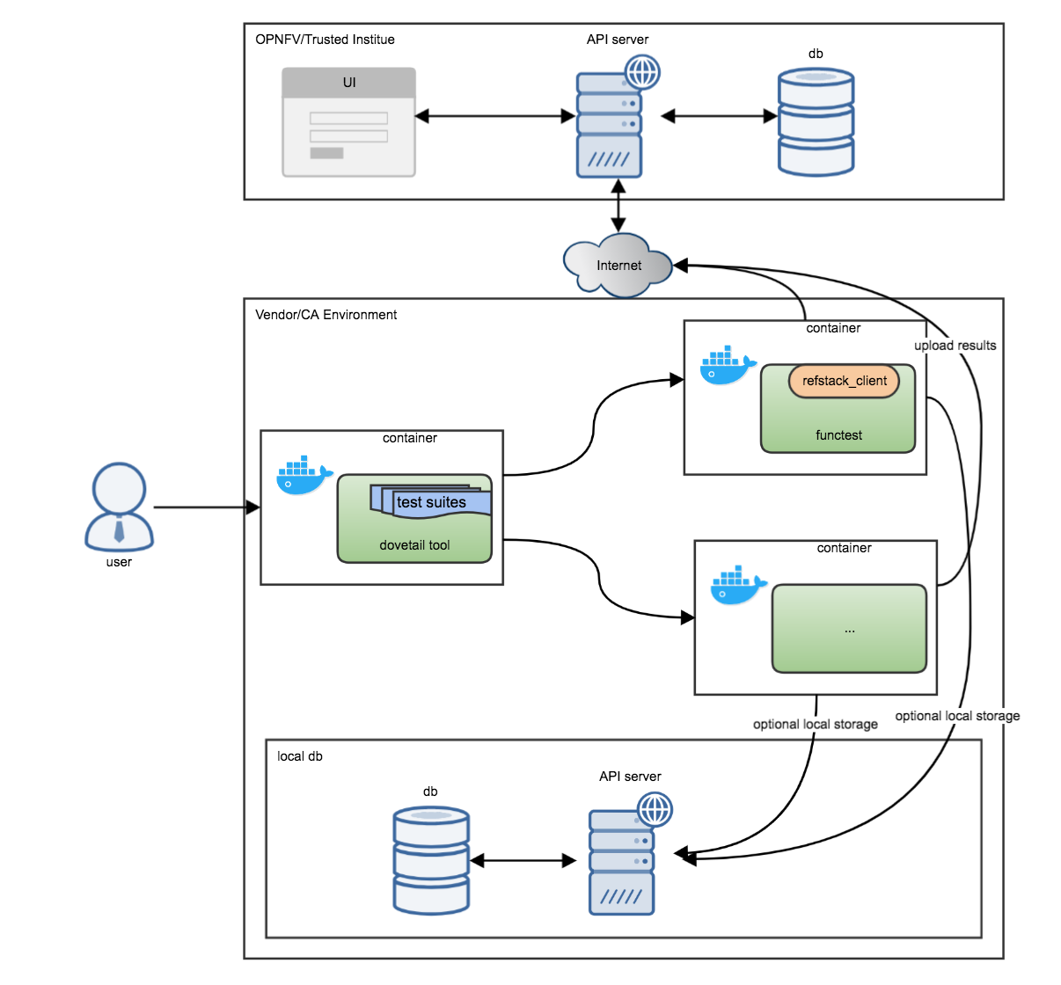
OpNFV Dovetail Test Framework Architecture
Separates
Vendor and Certification
Authority Environment
Generic Test Framework
Test in Separate Environment from Test Framework

Slide 4
Project Proposal Scope
Short term – Beijing – Building a framework + VNF package on-boarding tests
Integrate OPNFV Dovetail with VNFSDK
  Marketplace connects to Dovetail when VNF is Uploaded
  Run VNF Validation Tests in the Marketplace
  Report Results thought Dovetail
Augment VNF Validation Tools with Additional Tests from ICE
  Examine the VNF package to ensure it includes all required elements:
    TOSCA entry-definition template , VNFC images, integrity, authenticity (SOL004) etc.
  Examine the TOSCA templates checking for syntax errors, etc.
  Virus scan on VNFC Images
  Start building a “light” version of ONAP as a precursor for LCM and functional tests
Long term – Casablanca+ - Functional and Lifecycle management tests
Building a “light” version of ONAP
Easily extensible for SP specific additional testing

Slide 5
High Level Architecture
Vendor Premises
ONAP Marketplace
<deploy VNF package>
3
Vendor’s cloud
VNF X
Test passed
VNF
package
Dovetail
Client
<download package>
VNF Y
6
2
8
<produces>
Test client
<update results>
VNF Z
VNF-SDK
Client
Test suite
<Instantiate VNF>
<initiate test>
7
4
<download>
ONAP-Lite
<download>
ONAP/OPNFV Community
<instantiate ONAP>
5
1

Slide 6
Thank you !

