Slide 1
VNFSDK Amsterdam kickoff
Chris Donley
June 23, 2017

Slide 2
Key links
Mailing list: let’s use discuss with [vnfsdk] tag
Wiki: https://wiki.onap.org/display/DW/VNF+SDK+Project
  https://wiki.onap.org/display/DW/Resources+and+Repositories
Jira: https://jira.onap.org/projects/VNFSDK
Gerrit: https://gerrit.onap.org/r/#/admin/projects/vnfsdk

Slide 3
Weekly calls
Date/Time:
  Stick with 6 am PDT Friday?
  Other?
Bridge:
  Join from PC, Mac, Linux, iOS or Android: https://zoom.us/j/454599760
  Or iPhone one-tap (US Toll): +14086380968,,454599760# or +16465588656,,454599760#
  Or Telephone:
  Dial: +1 408 638 0968 (US Toll) or +1 646 558 8656 (US Toll)
  Meeting ID: 454 599 760
  International numbers available: https://zoom.us/zoomconference?m=viiAIbYha1FHOg4qZy9wY3LoQsy9Ut2P

Slide 4
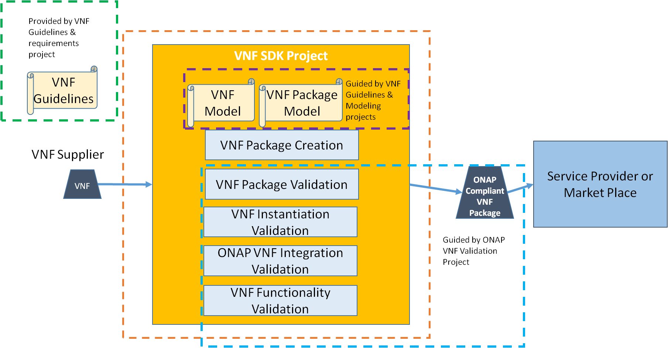
Scope

Slide 5
Release Milestone Dates
M1 - Planning: June 29 (next week)
M2 – functionality freeze: August 3
M3 – API freeze: August 24
M4 – Code freeze: September 14
RC0: 9/28
RC1: 10/12
RC2: 10/26
Release: 11/2

Slide 6
Backlog (epics) for Amsterdam (for discussion)
Model:
  Develop ONAP VNF packaging model (combining OPEN-O and ECOMP)
Packaging tools:
  Align VNF packaging tools with new model
Validation tools:
  Align VNF validation tools with new model
  Evaluate ETSI security spec (SOL-004) and consider implementing
Refrepo:
  Support handoff to SDC for VNF onboarding (may need TOSCA/HEAT translator – related to modeling project)
  Update metadata (as needed) to align with validation program
Compliance:
  Align VNF SDK tools (from OPEN-O) with ICE tools (from ECOMP)
  Support VNF Validation project tooling requirements

Slide 7
Sub-projects? (for discussion)
Shall we work through sub-projects?
  Model
  Packaging tools
  Validation tools
  Reference repo/marketplace
  Compliance
Point of contact (committer) for each?
Meeting logistics?

