Slide 1
vCPE Demo
Integration Team

Slide 2
What has been accomplished
We made it work
  Service design & distribution
  Service instantiation
  Closed loop control
We made it simple and fast
  A python program to automate instantiation and closed loop test
  People can repeat the test in their own environment
  Help ONAP regression testing

Slide 3


vCPE in a nutshell
Internet
BRG
vG
BRG: bridged residential gateway
Simple, low cost, low maintenance
Virtual Gateway in the cloud
Dynamically created for each BRG

Slide 4
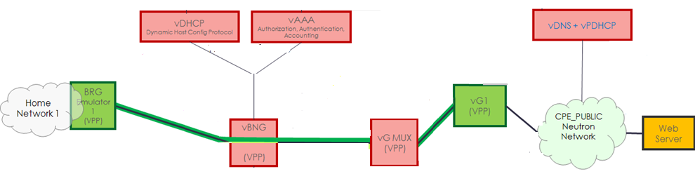
Detailed architecture
CPE_SIGNAL
BRG_BNG
MUX_GW
BNG_MUX
VxLAN
VxLAN
ONAP

Slide 5
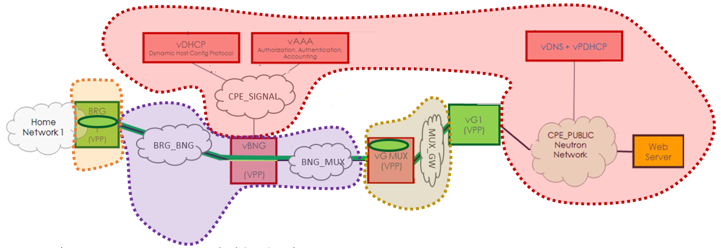
vCPE is divided into five services
1
4
2
3
5

Slide 6
Dividing into multiple services allows dynamic orchestration
Internet
vBRG
vBNG
vGMUX
vG

Slide 7
Dividing into multiple services allows dynamic orchestration
vBRG
vG
Internet
vBRG
vBNG
vGMUX
vG

Slide 8
Dividing into multiple services allows dynamic orchestration
vBRG
vG
Internet
vBRG
vBNG
vGMUX
vG
vBRG
vBNG
vG

Slide 9
Dividing into multiple services allows dynamic orchestration
vBRG
vG
Internet
vBRG
vBNG
vGMUX
vG
vBRG
vBNG
vG
vBRG
vBNG
vGMUX
vG

Slide 10
Part 1: Customer service instantiation -- create vG and configure VxLANs
CPE_SIGNAL
BRG_BNG
MUX_GW
BNG_MUX
VxLAN
VxLAN

Slide 11
Part 2: Closed loop -- restart vGMUX
DMaaP
DCAE VES Collector
DCAE TCA
Policy
APPC
Packet loss rate
Method 2
Method 1
MultiCloud
Trigger packet
loss event
vGMUX VNF
restart
Openstack
vServer

Slide 12
Part 3: Instantiation infrastructure -- spin up 7 VMs and 5 networks
CPE_SIGNAL
BRG_BNG
MUX_GW
BNG_MUX

Slide 13
Thank You!

