Slide 1
ONAP API Documentation analysis of process to use swaggerhub

Slide 2
Terminology
OpenAPI Specification –OAI/S (fka swagger spec)
  helps define the API’s contract for API development teams and its end consumers
  sets clear expectations for the experience of integrating with the API
  language agnostic human-readable format for describing API operations
Swaggerhub
  provides the open source framework toolset for OAS implementation
    Swagger UI – human readable version provides interaction with API without coding
    Swagger Editor – document and validate API according to OAS
    Swaggerhub – team collaboration, maintains secure version repository, integration to other dev and management tools
    Swagger Codegen – generate client/server sample code in 30+ programming languages

Slide 3
OpenAPI purpose
“The Open API Initiative (OAI) was created by a consortium of forward-looking industry experts who recognize the immense value of standardizing on how REST APIs are described. As an open governance structure under the Linux Foundation, the OAI is focused on creating, evolving and promoting a vendor neutral description format. SmartBear Software is donating the Swagger Specification directly to the OAI as the basis of this Open Specification.”
Provides API description format for APIs regardless of the language they are developed and implemented in.
https://www.openapis.org/about

Slide 4
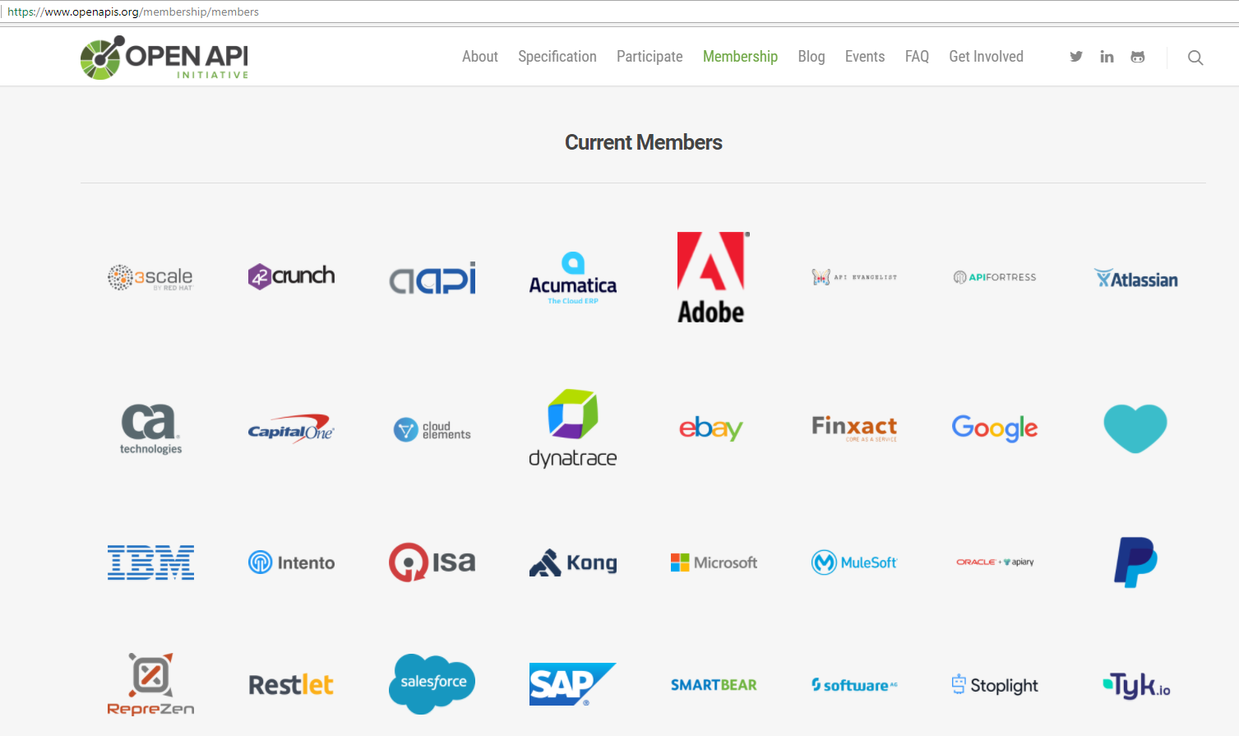
OpenAPI Members

Slide 5
Swaggerhub purpose
“SwaggerHub is an integrated API Development platform, built for teams, that brings the core capabilities of the Swagger framework to design, build, document and deploy APIs. SwaggerHub enables development teams to collaborate and coordinate the entire lifecycle of an API with the flexibility to integrate with the toolset of your choice.”
Purpose specific tooling for API Lifecycle Management
http://app.swaggerhub.com

Slide 6
Swaggerhub pre-requisites
Identify team –API clients, API providers, API governance
  Sign up for team or enterprise plan https://app.swaggerhub.com/prices?_ga=2.71334490.893424181.1517237482-936456995.1511884392
Establish process
  PayPal example:
Issue guidelines
  Security
  Naming of resource, parameters, responses
  Error handling
  Data format handling
  Versioning
  Zalando example: http://zalando.github.io/restful-api-guidelines/index.html#general-guidelines

Slide 7
Swaggerhub –getting started
Setup environment
  Define Organizations and Teams
  Create APIs under Organizations
  Invite Collaborators
Training
  Create, import, document, version, fork, merge API
  Sync API definitions with GitHub, GitLab, Bitbucket
  Mock API
  Generate server stub and client SDK
Details for above steps: https://app.swaggerhub.com/help/tutorials/getting-started

Slide 8
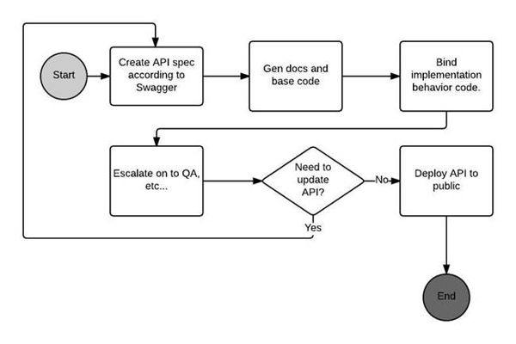
Swaggerhub workflow –API 1st approach
Diagram from: https://www.codeguru.com/cpp/frameworks/the-value-of-specification-first-development-using-swagger.html

Slide 9
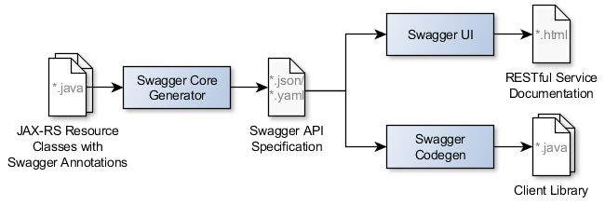
Swaggerhub workflow –Code 1st approach
https://blog.philipphauer.de/enriching-restful-services-swagger/

Slide 10
Background
Each ONAP subsystem is independently defining & maintaining their APIs
API guidelines and tools are desired to enable consistent API documentation that will:
  Reduce interdependencies, allow teams to work at their own pace
  Faster development and delivery
  Easier expansion to different interfaces, clients and views
  Developer friendly services to build ecosystems and platforms

Slide 11

swaggerhub
Design | Cloud-based YAML editor with predesigned templates, simultaneous style feedback, mocking, and hosting for API definitions
Develop | Code generation in 20+ server languages, which can automatically sync with source control hosts like GitHub, Bitbucket, and GitLab
Document | Interactive API documentation and sandbox, and auto-generation for client SDKs, all hosted in the cloud with privacy controls
Mock | Generate a mock of your API to virtualize operations without writing any code
Host | Secure cloud-based hosting for Swagger definitions and API documentation, with built-in access controls
Collaborate | Real-time issue tracking and conversations, team management, role assignment, and permission/access controls
Deploy | Quickly deploy your API definitions to API Gateways such as AWS , Microsoft Azure and IBM API Connect. Automatically generate AWS Lambda functions for serverless deployments.
Version | Manage multiple versions of API definitions, and retire outdated APIs
Source: https://swaggerhub.com

Slide 12
Why SwaggerHub?
Cloud-Based Editor with Advanced Design Capabilities
  Write and edit your Swagger definition in a cloud-based editor with built-in style validation to reduce errors, and auto-mocking that lets you preview how your API will behave and validate design decisions without writing any code.
Integrated Documentation Workflow
  Write your Swagger definition, work with your documentation, and generate code and client SDKs in one intuitive interface, without the need to work across multiple tools. SwaggerHub keeps everything in sync and seamlessly integrates with source control and API management platforms.
Secure Cloud-Hosting
  Store all of your API definitions, and associated documentation, in a platform built for APIs. SwaggerHub auto-saves your work throughout the design process and provides a central place to host your documentation, without the need to setup a server.
Privacy and Access Control
  Control who can access your APIs, and keep sensitive information secure with SwaggerHub’s built-in privacy controls. Use access controls when designing new APIs, or documenting an existing Swagger definition.
Versioning and Publishing
  Update and iterate continuously, with the ability to manage multiple versions of your API in SwaggerHub. New versions copy existing syntax from the last updated version so you’ll never have to start building from scratch.
Collaboration & Team Management
  SwaggerHub provides a central platform for teams to collaborate throughout the design and documentation of your API. Securely share your APIs with internal and external contributors, and track issues in real-time with comments in the SwaggerHub editor. SwaggerHub will automatically notify collaborators whenever a change is made the definition.
Sync with Source Control and API Management Platforms
  Manage the entire lifecycle of your API from a central platform, which syncs the different versions of your API definitions with source control tools and API management platforms — allowing you to update your Swagger definition and automatically update your documentation, server code, and deployment.
Reuse Common Models
  Store all your common components in Domains, which can then referenced from all your APIs, standardizing work and saving time and effort.

