Slide 1
AAF Casablanca M3 Arch Review
August 28, 2018

Slide 2
Content
Architecture Changes
S3P
  Security
  Stability
  Resiliency
API Change

Slide 3
Architecture & Model Changes
No architecture changes since Beijing.
  7 Microservices make up AAF
Primary activity for Casablanca is enabling ONAP Apps to utilize AAF more easily
  Generating Configurations and Certificates to Persistent Volumes
No Model changes that impact AAF clients at this point; AAF does not parse TOSCA Model. AAF APIs are described in Documentation (GUI and https://wiki.onap.org/display/DW/AAF+API)
  Note: created internal API in order to get Properties needed to auto-generate configurations
  Properties stored in Cassandra.
DB - AAF continues to use Cassandra.
  Added “props” table to support internal API as stated

Slide 4
Security
There are three areas we are working on:
CII Keeping Security topmost in mind (being security service).
  AAF passed rigorous independent test 2016 (company version)
Resolving security issues from Nexus IQ report by M4
  Security issues resolved
  bouncy castle, good
  jetty, updated to good, but now has another failing
  guava (dependency), needs updating, waiting for “Oparent” strategy.
  Plan is to utilize Oparent strategy to keep up to date dependencies.
Code Coverage
  50% is R3 goal; AAF up to 32.3% (Coverage), as of 8/28/2018
    Reasons for missing Goal
      Lost a resource (left group)
      Most of AAF is not conducive to Junit tests (ID validation)
      Junit tests written for Beijing too often fail during Jenkins Load… Having to be redone.
      Focusing on Certificate Generation, CLM, better deployment into Multi-Environments and Client help.

Slide 5
Stability
AAF has excellent track record in Production at AT&T, running for months and months without any issue.
  The Issues that might arise have not been stability.
AAF, (outside of ONAP) runs potential releases through the following before Production
  JMeter
  DEV Env
  TEST Env
  IST Env
Given the low loads of ONAP, do not know how to replicate the loads and diversity of data seen in Real Environments yet.
  Talking to TSC about appropriate STABLE envs for AAF.
  Focused on meeting other ONAP requirements before figuring out how/where to do this in ONAP itself.
  For now, running real time in 4 REAL environments is more advantageous.

Slide 6
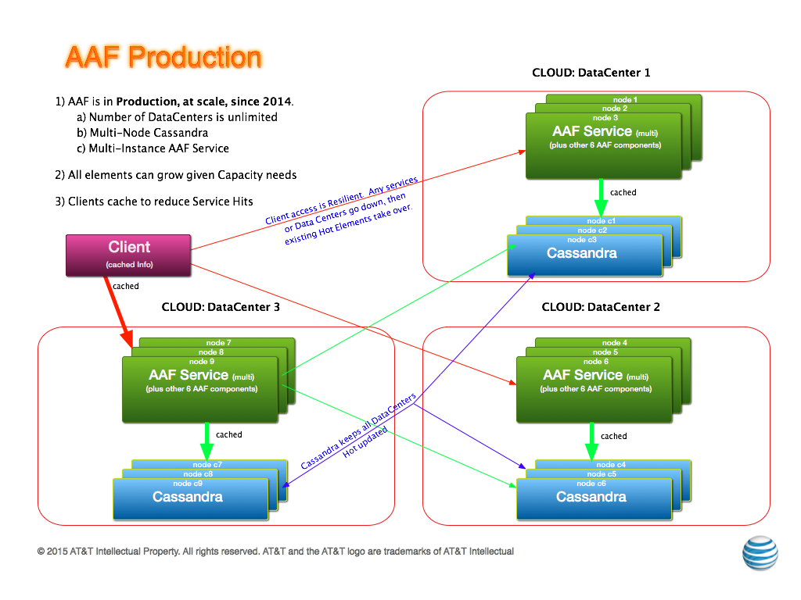
Resiliency

Slide 7
API Changes
No existing Public APIs are changed
The following new private API is added to R3:
  AAF_LOCATE: GET,"/configure/:id/:type” – used to get configurable Properties for Services.
Public APIs are documented in the GUI and https://wiki.onap.org/display/DW/AAF+API.

