Slide 1
ONAP WAN Modeling Draft
Zhuoyao Huang
zte

Slide 2
Design Time Model Behind VoLTE Use Case Approach for R1
vnfmInfo
controllerinfo
HSS(VNF)
IMS(VNF)
ID(invariantUUID)
CSCF(VNF)
IMS(Service)
SBC(VNF)
VoLTE E2E(Service)
WAN(VNF)
....(VL)
EPC(VNF)
ID(invariantUUID)
Service template For Network Service
Service template For E2E
xGW(VNF)
MME(VNF)
Design the VoLTE service and IMS/EPC as VF node
Design the IMS/EPC/... services and HSS/.... as VF node
Design the IMS/EPC/... services close loop
EPC(Service)
PCRF(VNF)
....(VL)
Service template For Network Service
Subsititution_mappings function alternative For R1
Node properties such as ID(invariantUUID) can be used to correlate the E2E service(VoLTE) and Network services(IMS,EPC) or WAN services
B. The IMS/EPC VNF node in the E2E service should support controllerinfo and ID(invariantUUID) as properties or metedata
SO will choose the workflows via controllerinfo, such as heat or vfc or ....
C. The HSS/.. VNF node in the network service should support vnfmInfo as properties
VFC will parser the model and choose the SVNFM via vnfminfo

Slide 3
How WAN modeling for Volte works
TOSCA packages
inputs
portal
Distribution
SDC
import
SO
GENERIC-RESOURCE-API
CSAR(Volte e2e)
SDN-C?
Rest Conf
run time
portal send input to SO
SO combine input and model
SO invoke GENERIC-RESOURCE-API of SDN-C
SDN-C execute DG
DG activate adaptor and send command to 3rd party controller
DG file
design time
TOSCA imported to SDC
CSAR distributed to SO
3rd party Controller

Slide 4
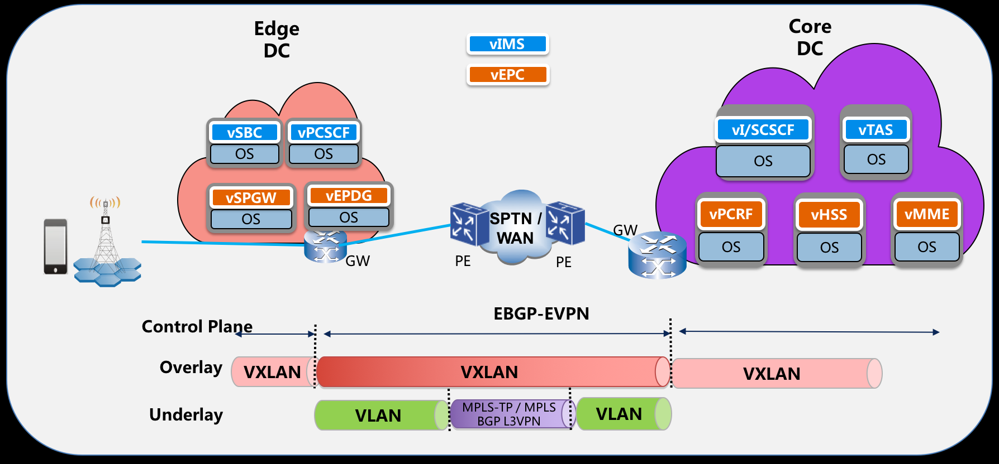

Slide 5
Open-o underlay l3vpn modeling
pe1
pe2
binding
binding
vpnService
ac1
ac2
pe1
endPoint
ac1
ac2
endPoint
pe2
vpnConnection
vpnConnection
realizes
tp1
tp2
endPoint
tp1
tp2
endPoint
+
-

Slide 6
Onap underlay l3vpn modeling draft
Same inputs as Open-o modeling
Simple node type, no more complicated structure as Open-o, only properties of all inputs

Slide 7
Questions
Which property or parameter of a TOSCA model is corresponding to module-name or rpc-name of GENERIC-RESOURCE-API?
How are the properties of TOSCA model node mapped into the sli-parameter of GENERIC-RESOURCE-API? An example is needed.

