Slide 1
PNDA integration into ONAP DCAE
September 25, 2018

Slide 2
Platform for Network Data Analytics PNDA.io
Overview
Visualisation
and Exploration
PNDA
Applications
Simple, scalable open data platform
Provides a common set of services for developing analytics applications
Accelerates the process of developing big data analytics applications whilst significantly reducing the TCO
PNDA provides a platform for convergence of network data analytics
Processing
Query
ODL
Real
-time
SQL Query
Data
Exploration
Unmanaged
App
Logstash
Stream
OLAP Cube
Metric Visualisation
Unmanaged
App
Data Distribution
OpenBPM
Batch
Search/
Lucene
Event Visualisation
PNDA Managed App
pmacct
File
Store
NoSQL
Time
Series
PNDA Managed App
Telemetry
PNDA
Plugins
Platform Services: Installation, Mgmt,
Security, Data Privacy
App Packaging and Mgmt
PNDA
Producer API
PNDA
Consumer API

Slide 3
ONAP Data Collection, Analytics, Events (DCAE)
Overview
Open, plug-able platform for “sensing and making sense” for ONAP
Functional requirements
  Of ONAP
    Interfacing with other ONAP components
    ”Model driven”
      DCAE service components are modeled
      Generated events are modeled
      Operations are modeled
  For ONAP
    Able to incorporate the best collection and analytics technologies into a catalog
    Able to collect, analyze, and generate actionable events following the requirements of control applications, e.g. delay, bandwidth, resource constrains, etc

Slide 4
DCAEgen2 – Overview
DCAE Platform Core
DCAE Control Platform (Docker Hosts)
DCAE
PGaaS
ONAP Lifecycle Manager
(Cloudify Manager)
Dispatcher
(NB API)
Service Change Handler
Service & Config Registry
(Consul)
Policy
Handler
Inventory
DCAE Collector Services (Docker Hosts)
DCAE Service Infrastructure
(CDAP + Haddop Cluster)
CDAP Broker
Collector
(VES)
Collector
SNMP
Collector
Telemetry
Analytics
(TCA)
Analytics
(Data Norm)
Analytics
(Correlation)
DCAE Platform Components
DCAE Service Components

Slide 5
DCAEgen2 Components in R1 (Amsterdam)
Cloudify Manager: Cloudify, through its army of plugins, is capable of relationship topology base resource orchestration in many levels and cross different technologies. It is the lifecycle management engine of DCAE. Various resource deployment, change, allocation, configuration, etc, operations are all done through Cloudify. [Note: This component is part of the Common Controller SDK, or ccsdk project.]
Consul: Consul is a service discovery technology for distributed fault detection and KV store. DCAE uses Consul for service and configuration registry. [Note: This component is part of the Common Controller SDK, or ccsdk project. ]
Service infrastructure: DCAE platform supports two kinds of infrastructures, the Docker container hosts and CDAP/Hadoop clusters. The former is for running containerized applications and services. And the latter is for running CDAP-Hadoop based big data analytics.
Dispatcher: Dispatcher is a NB API provider for the DCAE Services. Service related triggers, such as deploying/undeploying services, changing configurations, etc all arrive at the Dispatcher, which then enriches the request, and invokes the right Blueprints and calling Cloudify Manager plugins to complete the necessary changes in virtual resources.
Inventory: Inventory tracks DCAE related resource information such as various Blueprints and templates that are used by Cloudify Manager to deploy and configure components, as well as inventory information extracted from A&AI that is related to but not really part of DCAE, such as the relationships between virtual network resources and their physical infrastructures.
PGaaS: Inventory is backed by a PostgreSQL database for data storage.
Policy Handler and Service Changing Handler: They are the interfacing modules for specific external components such as Policy, SDC,..
CDAP Broker: CDAP Broker interfaces between CDAP and Cloudify Manager, supporting carrying out various Cloudify CDAP operations onto the CDAP.
See also: https://wiki.onap.org/pages/viewpage.action?pageId=3247121

Slide 6
PNDA – ONAP DCAE Integration
Perspectives
Analytics/Big Data Processing for ONAP:
DCAE in ONAP releases 1 and 2 (Amsterdam, Beijing) offers Hadoop with CDAP
  CDAP provides abstraction layer on top of Hadoop
  CDAP applications are written for CDAP and not transferable
PNDA is a platform which streamlines the processing of developing analytics applications, is infrastructure and Hadoop distribution agnostic, and is 100% open source – making it similar in objective to CDAP
Why PNDA in DCAE?
  Customers have voiced a need to enable support for generic Hadoop applications in ONAP DCAE
  Customers see PNDA‘s ease of install & use as a benefit

Slide 7
PNDA – ONAP DCAE Integration
Objectives
Enable choice of big-data platforms within ONAP DCAE:
Offer PNDA as an option for big-data processing for ONAP
within the DCAEgen2 framework, providing an alternative to CDAP.
Note: Objective is to offer PNDA as a real big data platform (incl. Hadoop), as opposed to integrate a developer focused option (e.g. offer “Red-PNDA”).

Slide 8
PNDA within DCAEgen2
DCAE Platform Core
DCAE Control Platform (Docker Hosts)
DCAE
PGaaS
ONAP Operations manager
(OOM)
Dispatcher
(NB API)
Service Change Handler
Service & Config Registry
(Consul)
Policy
Handler
Inventory
DCAE Collector Services (Docker Hosts)
DCAE Data Platform - PNDA.io
PNDA Deployment Manager [1]
Collector
(VES)
Collector
SNMP
Collector
Telemetry
* Analytics ZTT
(Data Norm)
* Analytics (TCA)
(Grafana)
Analytics
(Correlation)
* Existing PDNA Capabilities
DCAE Platform Components
DCAE Service Components
[1] Replaces CDAP Broker

Slide 9
PNDA Analytics Application within DCAEgen2
ONAP vFWCL Components
DCAE Data Platform - PNDA.io
PKG
SINK
Monitoring
* Analytics ZTT
(Data Norm)
Timeseries Storage
(OpenTSDB)
VES-Agent
10 [s]
ONAP DCAE Collector Services
VES Collector
(DCAE)
DMaaP
Message Router
(Kafka)
Logstash
(Data Encoding
AVRO)
topic
ves.avro
Message Broker
(Kafka)
* Analytics (TCA)
(Grafana)
External Component
ONAP vFWCL Use-Case Components
DCAE Platform Components
DCAE Service Components

Slide 10
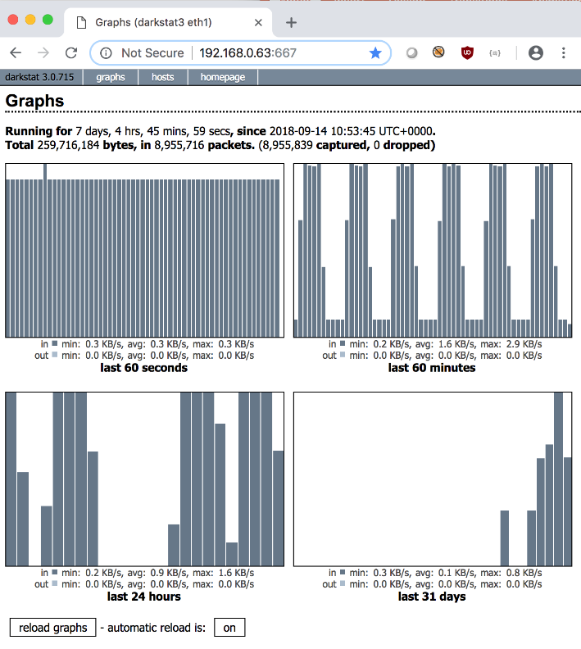
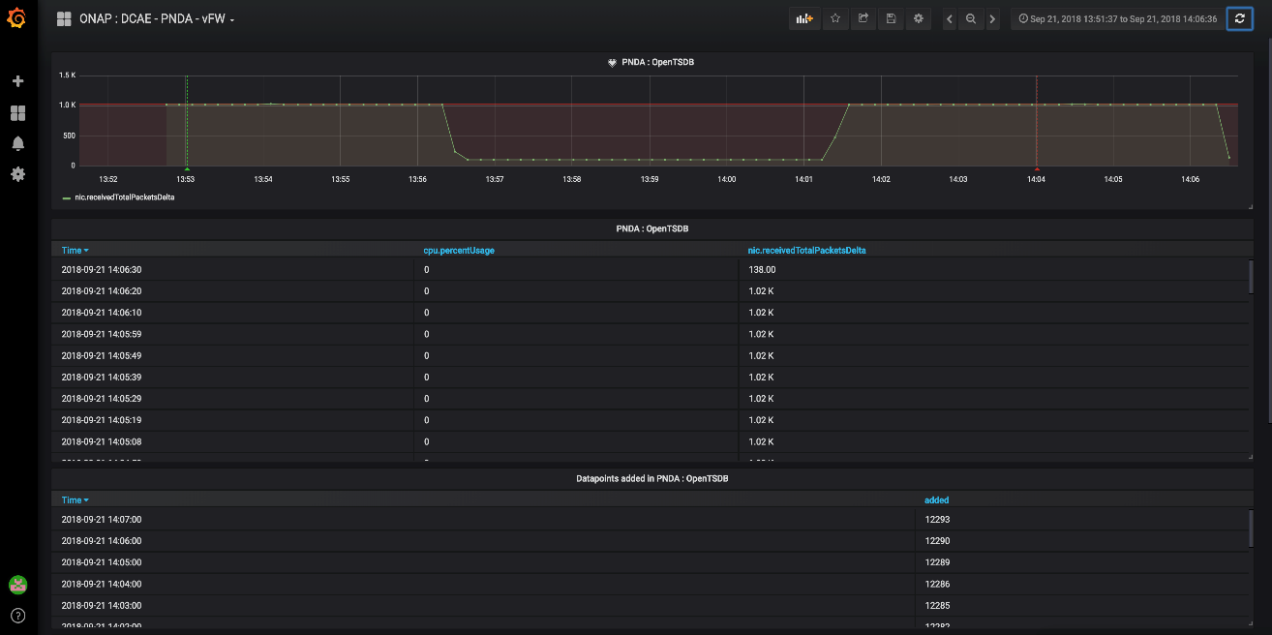
PNDA Analytics Application within DCAEgen2
vFWCL SINK Monitoring
PNDA Grafana-based Monitoring

