Slide 1
Multiple Languages for ONAP Portal
2018-06-18

Slide 2

Reason
Why we need Multi-Language
Multi-Language significantly affects the ease of the product's localization. It occurs as a fundamental step in the design and development process, rather than as an afterthought that can often involve awkward and expensive re-engineering.

Slide 3
Benefit
There are many benefits to Multi-Language, including:
Easier adaptation of software applications (or other content) to multiple locales
Reduced time and cost for localization
Simpler maintenance
Reduced overall cost of ownership of the multiple versions of the product
Adherence to international standards

Slide 4
Proposal
ONAP is an open source community product, so it is not only for English users, but also for users of many languages in the world. But at present, ONAP is not supporting multiple language GUI.
In order to achieve this goal, it requires the support of Portal Platform and other application portals.
I suggest that Portal Platform supports multiple language GUI in Casablanca Release. And UUI project will implement this requirement as an example project.

Slide 5
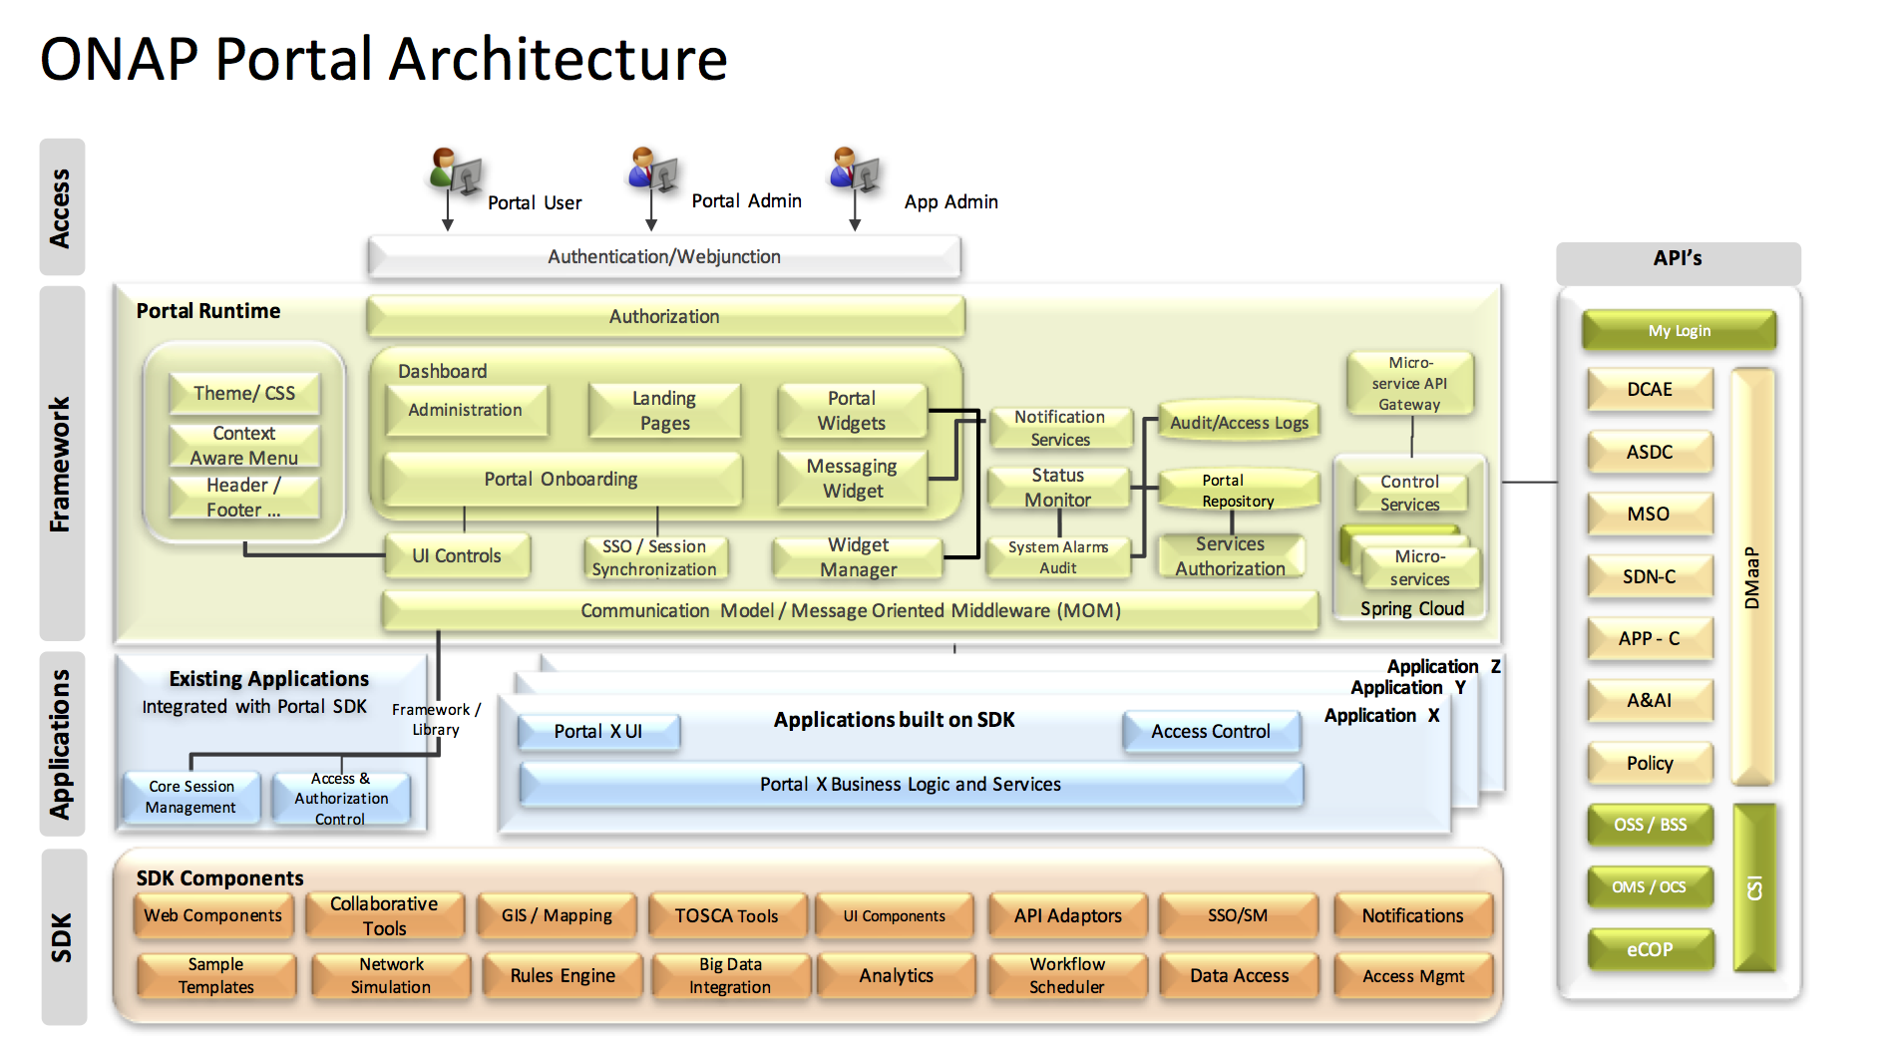
Scope
Multi-Language Support
Multi-Language Support
Multi-Language SDK

Slide 6
Portal Platform
Portal Platform
Add language selection function.
Support multiple-language display for Portal Platform pages.
Provide multiple-language SDK.
No impact to application portals which can’t support multi-language.

Slide 7
Application Portals
Application Portals
Support multiple-language display for application pages.
Using multi-language SDK provided by Portal Platform (recommend).
No impact to application functionalities.

Slide 8
Thank you !

