Slide 1
ONAP Optimization Framework (OOF)
POC for Physical CellID (PCI) Optimization
July 24, 2018

Slide 2
ONAP Optimization Framework (OOF) and PCI
ONAP Optimization Framework (OOF) provides a policy-driven and model-driven framework for creating optimization applications for a broad range of use cases
For Casablanca, OOF enhancements include formulation and solving of optimization problems
We propose an OOF enhancement and Proof of Concept (POC) for Casablanca for
Physical Cell ID (PCI) Optimization
  PCI Optimization is a well-understood problem
  The reading/writing of the Physical Cell ID (PCI) configuration parameter has been included in SDN-R POC
Objective of the POC is to demonstrate disaggregation of the PCI SON functionality, and the data flows needed to implement this in ONAP using OOF
We envision a new PCI-Handler Microservice to facilitate the data flow and trigger mechanism
The focus is on data flow and interfaces, and the role of OOF, PCI-Handler-MS, SDN-C Controller and Policy etc
  Objective is to incorporate an algorithm in ONAP using OOF, not to develop an algorithm

Slide 3
Casablanca - Optimization Framework Enhancements
TOPIC | ICON | DESCRIPTION
Optimal placement of vNF |  | Placement of Mobility Virtual Network Elements (CUs) across the highly distributed edge clouds is a fundamental requirement. Service Providers must also optimize the performance of the 5G RAN in real-time.
Optimization problem formulation |  | Ability to model the problem as a constrained optimization problem, that is driven by policies – Potential use case examples: formulation of optimization problems at various levels: Customer (e.g. provisioning), Service (e.g. slice optimization ), Network (e.g. Routing, problems at the network planning level), Infrastructure (e.g. Placement) & Resource (e.g. License)
Optimization problem solving |  | Ability to use and deploy appropriate analytics, algorithms and solvers to solve the problem in acceptable time frames at various levels: Customer, Service (e.g. Slice Optimization Analytics), Network (e.g. SON network planning analytics), Infrastructure (e.g. Placement) & Resource
 |  | Impacted systems: SDC, SO, Policy, AAI, DCAE, SDN-R, MultiCloud (possibly)

Slide 4
ONAP Casablanca plan for OOF-PCI
Minimum viable product to make incremental progress in ONAP core modules
  The POC will help to develop details of ONAP interfaces and flows needed:
(a) to get the required network data to OOF for optimization,
(b) compute an optimization,
(c) apply policies, and
(c) execute it using the Controller
Casablanca test cases involve:
New PCI-Handler-MS (on boarded on DCAE) – interfaces to OOF, Policy, DMaaP
OOF – interfaces to PCI-Handler-MS, Policy, SDN-C, (A&AI?)
Policy – interface to PCI-Handler-MS, OOF, SDN-C
SDN-C – interface to RAN, OOF, Policy, DMaaP

Slide 5
ONAP Casablanca: PCI Optimization using OOF
7
4
Config change
Change Notifn
6
Simulated RAN
~2000 Cells
Nbr_list, PCI values
OOF
Policy
10
SDN-C
1d
(Netconf/Yang)
1c
8
PCI Handler MS
9
1b
1a
Config DB
2
3
11
5
Step | Functionality |  | Step | Functionality
1a-1d | Modules loaded to support PCI |  | 6 | Fetch PCI optimization policies
2 | PCI-Handler MS fetches configuration policies |  | 7 | OOF fetches data for cells in the region.
3 | Config change notification from RAN to SDN-C (e.g. Nbr list change) |  | 8 | OOF provides PCI Optimization result
4 | SDN-C sends config data change to PCI-Handler-MS. |  | 9 | PCI-Handler-MS provides PCI recommendation to Policy
5 | PCI-Handler MS invokes OOF for pre-defined workflow for PCI Optimization via REST API. |  | 10 | Policy sends message to SDN-C with instruction for PCI configuration changes
 |  |  | 11 | SDN-C applies config changes

Slide 6
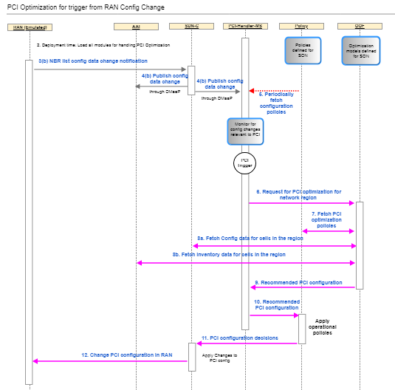
Flow / test case
See latest flow and test case at:
ONAP OOF-based PCI wiki page
https://wiki.onap.org/display/DW/5G+-+OOF+(ONAP+Optimization+Framework)+and+PCI+(Physical+Cell+ID)+Optimization

Slide 7
Support Needed
New PCI-Handler-Microservice
  Develop microservice and onboard on to DCAE
  Interfaces to OOF, Policy, DMaaP
  Programmed to trigger PCI optimization request based on message from SDN-C
  Fetches and applies configuration policies, which specify rules for processing input messages from SDN-C
  Gets message from SDN-C (via DMaaP)
  Requests PCI Optimization from OOF
  Receives PCI Optimization result, and forwards recommendation to Policy
OOF
  New interface to PCI-Handler-MS
  Use new API in SDN-C to query database – could be via DMaaP
  Modify existing interface to Policy to fetch PCI optimization policy
  Modify models to incorporate solver for optimization of PCI
  Host solver algorithm (existing)

Slide 8
Support Needed
Policy
  New interface to PCI-Handler-MS; provide configuration policies
  Modify existing interface to OOF: provide PCI optimization policies
  DMaaP: send message to SDN-C with action request
SDN-C (in SDN-R team)
  Modify existing Yang model, DG to support PCI use case
  Netconf interface to RAN: accept change notification, change PCI value
  DMaaP: Publish config change on DMaaP
  DMaaP: get/process message from Policy with action request
  Maintain database with RAN element / config data
  Provide API for database query – could use DMaaP interface

Slide 9
Support Needed
RAN Emulator
  Simple simulator program with about 2000 cells
  Cellid, Nbr_List, PCI value, location (?)
  Create nbr_list among cells
  Initial PCI value computed offline and assigned
  Ability to (manually) change nbr_list to create potential for PCI conflict/confusion
  Ability to send config change notification to SDN-C
  Ability to accept PCI value change from SDN-C

Slide 10
Thank You!

Slide 11
Backup

