Slide 1
ONAP Casablanca Architecture (v3.0.1)
For TSC Approval
Chris Donley

Slide 2
Casablanca Deployability Focus
Deployability: ONAP can be deployed in multiple operator environments
  Does not imply level of quality
  Continuous improvement, similar to S3P
ARC priorities supporting deployability
  Microservices
  Modular
  Standards alignment
  API standardization/improvement
  VNF/PNF Onboarding
  Containers
  External controllers

Slide 3
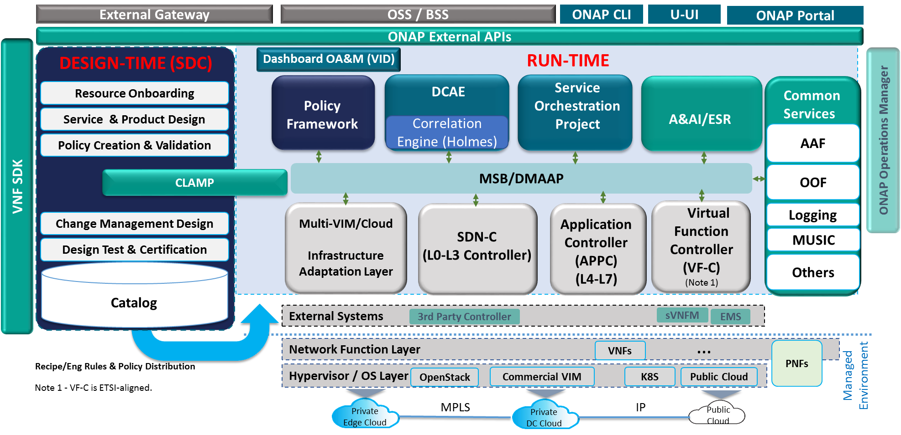
ONAP Beijing Architecture for Reference
(High-Level View with Projects)
Version 2.0.3
3/15/2018
Modeling (Utilities)
Integration
VNF Requirements
VNF Validation Program

Slide 4
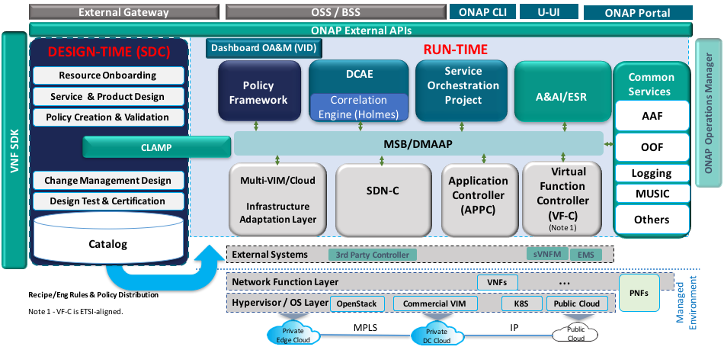
ONAP Casablanca Architecture
(High-Level View with Projects)
Version 3.0.1 7/10/2018
Modeling (Utilities)
Integration
VNF Requirements
VNF Validation Program
Notes:
Drop L0-3 for SDNC and 4-7 for APPC.

Slide 5
Casablanca ARC Recommendations RTSA/μS
Real-time streaming analytics
  DCAE enhancements to support real-time streaming analysis:
  Enhance DCAE collector to support high volume streaming data collection (Using Socket and/or DDS)
  Add Bulk data collector to DCAE
  Add real-time streaming analytic framework (Flink)
  Support AAF for VNF to DCAE secure communication
  DMaaP Enhancements:
  Add file routing capabilities for bulk data movement
Microservices:
  Identify and harmonize common components
    For example, reduce number of databases in ONAP using OOM. Projects should use common DB where appropriate or clearly state why they need an alternate approach. A lot of this work occurred in Beijing release.
  Initial support for K8S VNF in Multi VIM/Cloud
  Include OPNFV Clover project (Spinnaker) in CD pipeline (part of Integration)
  Interest (but no consensus) regarding service mesh/Istio – no recommendation for Casablanca
    Projects are free to experiment with Istio on their own.
    Constrained PoC in MSB with zero impact to other projects

Slide 6
Casablanca ARC Recommendations APIs & Cloud Region
External APIs: External actors view ONAP as a black box. This should simplify the ONAP architecture/interfaces, leveraging the APIs developed by the Ext API project (eg, MEF LSO, TM Forum etc).
  MEF: Legato, Interlude (new functionality for orchestration federation)
  TMF: the API as NBI to BSS and West-East API with another ONAP instances, include (service catalogue-633, service inventory-638, and service order -641)
API Improvements: Currently, ONAP internal interactions are mostly handled via REST-like APIs.
  All APIs between internal components & external APIs should be generated by Swagger,
  APIs align with ONAP-published DM,
  Messages exchanged in JSON format.
API Versioning Support
  https://wiki.onap.org/display/DW/ONAP+API+Common+Versioning+Strategy+%28CVS%29+Proposal
Cloud Region
  Enhancements in the interactions between OOF and Multi-Cloud for optimal selection of registered cloud regions for ONAP workload (VNF etc.) deployment
  Multi-Cloud assists OOF by summarizing cloud-specific capability, capacity & cost metrics
  Enhancements in Multi-Cloud while maintaining the separation of concerns between the ONAP service provider and cloud region provider.
  Multi-Cloud does dynamic modification of the cloud specific VNF deployment template based on specified intent.

Slide 7
Casablanca ARC Recommendations PNF, Controller, CPU
PNF Support:
  PNF Registration
  PNF Packaging guideline and verification
  PNF orchestration and lifecycle management (including monitoring, closed loop automation, change management)
Physical network discovery
  Register 3rd party controller in ESR
  Sync up the abstract topology in A&AI
  Onboard yaml file for the resource in the physical network in SDC.
CCSDK Enhancements:
  Support configuration and lifecycle management
  Use single controller persona to support (L0-L7) for 5G RAN
Multi-CPU architecture
  Develop common Docker templates which include multi-CPU arch support

Slide 8
Casablanca ARC Recommendations SO/SDC/ETSI
Integrated design environment (SDC) – take incremental steps towards target:
  Run-Time Catalog
  DCAE-DS enhancements to support CLAMP flow design
  Policy Designer integration to support Control Loop MS configuration policies (Xacml) and Operations Policies (drools).
  Flow Designer - GUI and BPMN artifact generations for SO Change Management support.
SO Enhancements
  Extend the SO “decomposition” Building Block to support decomposition of Services that include VNFs and PNFs.
  Model the “Service Instantiation” sequencing relationships [in SDC] that SO must enforce among the Resources within a Service.
ONAP to leverage ETSI SOL specifications in applicable projects
  VNF Onboarding (external to ONAP): SOL-001, SOL-004
  Plugged-in VNFM (external to ONAP): SOL-003
  SO-VFC (internal to ONAP): SOL-005

Slide 9
Functional Description of Project Components
Note – The detailed description of features/capabilities/interfaces for each component planned for the Beijing release will be provided by respective projects.

Slide 10
SO: Service Orchestrator (1/2)
Definition:
Provides functionality for the execution of specified process and automated sequencing of activities, task, rules and policies needed for creation, modification, removal of network application, infrastructure services or resources.
Supports different specializations with specific orchestration scopes.
  Specialization scopes include, but are not limited to, PNF orchestration, Service and VF scaling, Homing and placement.
Service Management Interface
Network Service LCM Interface
Actuation Request Interface
Service Definition Reception interface
Service
Orchestrator
Provided Interfaces:
Service Management Interface
  Provides the interface to manage the services that orchestration provides.
LCM interfaces
  interfaces for service LCM.
  interfaces for VNF LCM.
Actuation Request Interface
  Provides support of actuation requests towards the services.
Service Management Interface
VNF LCM Interface
NF Config Interface
Optimization request Interface
Inventory Service Interface
Transport Service Interface
Network Service LCM interface

Slide 11
SO: Service Orchestrator (2/2)
Service Management Interface
Network Service LCM Interface
Actuation Request Interface
Service Definition Reception Interface
Consumed interface Interfaces:
VNF LCM Interface, from: Application controller
Optimization Request Interface, from: Optimization Framework
NF Config Interface, from: Application controller
Inventory Service Interface, from: Available and Active Inventory
Transport Service Interface, from: SDN Controller.
Network Service LCM interface, from: Virtual Function Controller
Service Distribution interface, from: Service Design and Creation
Service
Orchestrator
Service Management Interface
VNF LCM Interface
NF Config Interface
Optimization request Interface
Inventory Service Interface
Transport Service Interface
Network Service LCM interface
Consumed Models:
Network Service Descriptor (from SDC)

Slide 12
SDC: Service Design and Creation (1/2)
Definition:
SDC is the Integrated development platform for modeling.
SDC provides set of functionalities starting from the VNF onboarding and up to the service distribution.
SDC provides a set of modeling capabilities including VNF modeling, Service modeling.
As part of the work for Beijing SDC is adding the Monitoring template modeling capabilities and work flow modeling capabilities.
VNF-SDK
Dmaap
Provided Interfaces:
External API’S
  Retrieve artifacts.
  Query catalog.
  Upload artifacts.
Distribution client
  Java based client for subscribing and receiving notifications from Dmaap regarding Services.
  The client provides a way to define what artifacts need to be retrieved from the service.
  The client downloads the artifacts from SDC and publishes a notification regarding its success or failure.
SDC parser
  A java based parser for Tosca.
  The parser allows components to parse the CSAR artifact provided by SDC.
Generic Designer Frame work
  Infrastructure to support easy integration of new designers into SDC.
  SDC-UI a set of ui components and styles to allow designers the same look and feel as SDC.
Service Design and Creation
AA&I
APPC
VFC
SO
SDN-c
CLAMP
VID
UUI
DCAE

Slide 13
SDC: Service Design and Creation (2/2)
Consumed interface Interfaces:
VNF SDK – SDC can query VNF’s from the marketplace and onboard them into SDC.
Publish and subscribe to notifications using Dmaap.
VNF-SDK
Dmaap
Service Design and Creation
AA&I
APPC
VFC
SO
SDN-c
CLAMP
VID
UUI
DCAE
Consumed Models:
VNF packages Heat based and Tosca based

Slide 14
Data Collection, Analytics, and Events
Definition:
DCAE is the ONAP subsystem that supports closed loop control and higher-level correlation for business and operations activities. DCAE collects performance, usage, and configuration data; provides computation of analytics; aids in trouble-shooting and management; and publishes event, data, and analytics to the rest of the ONAP system for FCAPS functionality.
Data collection interface
Deployment interface
Config binding interface
Provided Interfaces:
Interface 1: Data collection interface (provided by DCAE collectors, consumed by VNFs and others)
  Interface for various FCAPS data entering DCAE/ONAP.
Interface 2: Deployment interface (provided by DCAE Deployment Handler, used by CLAMP and other northbound applications/services)
  Interface for triggering the deployment and changes of a control loop
Interface 3: Configuration Binding Service
  Interface for querying the information of the services that are registered to DCAE Consul
Data Collection, Analytics, and Events
Consumed Interfaces:
Interface 1: Data movement platform interface (provided by DMaaP)
  Interface for data transportation between DCAE subcomponents and between DCAE and other ONAP components
  This interface can also be used for publishing events to other ONAP components.
Interface 2: Data enrichment interface (provided by A&AI)
  Interface used by DCAE collectors and analytics for querying A&AI for VNF information for the purpose of enriching collected raw data by adding information not contained in original data.
Interface 2: Service model change interface (Provided by SDC)
  Interface for DCAE Service Change Hander fetching control loop models and model updates.
Interface 4: Policy interface (Provided by Policy)
  Interface for DCAE Policy Hander fetching configuration and operation policies on control loop and control loop components from Policy.
Data movement platform interface (DMaaP)
Data enrichment interface (A&AI)
Service model change interface (SDC)
Policy interface (Policy)
Consumed Models: TOSCA models descripting control loop construction (e.g. collection and analytics apparatus)

Slide 15
Holmes
Definition:
Maintains a series of rules inside to support different kinds of correlation analysis scenarios and control loops.
It publishes the analysis result to the data bus to feed any components that need the data.
Interface 1
Holmes
Provided Interfaces:
Rule Management Interface
  Provides the ability to create, updae, delete or query rules.
Interface N
Consumed interface Interfaces:
Data pub/sub interfaces, from: DMaaP
Service info query interfaces, from: DCAE
Service registration and locating interfaces, from: MSB
Inventory info query interfaces, from: A&AI
Consumed Models
VES Model
Inventory Model

Slide 16
Active & Available Inventory, External Registry
Definition:
AAI maintains a live view of services and resources in the network, providing the state and relationships of the service components
Maintains the view of the managed systems services and resources, as well as information of the external systems that ONAP will connect to.
It provides real-time views of a managed systems resources, services and relationships with each other.
AAI provides a GUI to provide users the ability to find and inspect inventory data. This includes a free-text search, inspection of specific entities and their relationships, and aggregated views of data.
AAI also provides a GUI to manage the external system information, including the register/update/delete and query external system.
Inventory Service Interface
External Register Interface
Active & Available Inventory, External Registry
Provided Interfaces:
Inventory Service Interfaces:
  AAI Resources REST API - Provides the ability to store, read, update inventory information
  Gizmo: a low-level REST CRUD API that provides targeted and simple access to entities, relationships, and their properties. Gizmo also provides lightweight collections, and transactional bulk write support
Complex Query Interface: AAI Traversal REST API – Provides the ability to perform complex traversals of the AAI Graph
External Register interface
  Provides the ability to register/update/delete and read external system information
Interface N
Consumed interface Interfaces:
DMaaP
SDC
Multivim
Consumed Models: TOSCA Service and Resource Models

Slide 17
AAF Functional Description
The purpose of AAF (Application Authorization Framework) is to organize software authorizations so that applications, tools and services can match the access needed to perform job functions. This is a critical function for Cloud environments, as Services need to be able to be installed and running in a very short time, and should not be encumbered with local configurations of Users, Permissions and Passwords.
To be effective during a computer transaction, Security must not only be secure, but very fast. Given that each transaction must be checked and validated for Authorization and Authentication, it is critical that all elements on this path perform optimally.
AAF contains some elements of Role Based Authorization, but includes Attribute Based Authorization elements as well.
Essential Functional Components:
The core component to deliver this Enterprise Access is a RESTful service, with runtime instances backed by a resilient Datastore (Cassandra as of release 1.3)
The Data is managed by RESTful API, with Admin functions supplemented by Character Based User interface and certain GUI elements.
The Service accessible by provided Caching Clients and by specialized plugins
CADI (A Framework for providing Enterprise Class Authentication and Authorization with minimal configuration to Containers and Standalone Services)
Cassandra (GRID Core)
Additional Functional Components:
Secret Management service : This service provides a way to add/delete/retrieve secret domains and secrets within each domain
Security of private keys using PKCS11 based HSMs: Secures the private keys of CA using PKCS11 based HSMs. Also show cases the HSM integration with softHSM2.0 and optionally provide a way to secure the softHSM using TPM 2.0 hardware entity.

Slide 18
AAF Functional Description
CADI stands for Code, Access, Data and Identity, This Framework addresses the Runtime Elements of Access and Identity.
Many other tools address elements of this vision. For instance, Sonar and Fortify evaluate code for maintainability and security problems, while Voltage provides encryption for Data at Rest.
However, CADI Framework contributes to these for runtime applications by:
Code - CADI provides reusable Security Client code, and ties in with appropriate Security Interfaces (i.e. J2EE Standard Filters)
Access - CADI provides links to Authorization tool(s) (AAF) for Fine-grained Authorization. Also, data from Identity servers is also made available to Coders easily. For instance, CADI provides a clean API to read the Course Grained Authorization information available within the CSP Cookie.
Data - CADI provides simple setup for certificates needed for TLS connectivity, so that barriers to using HTTPS are greatly reduced. It also ensures that no one using CADI uses clear-text passwords in Configuration files.
Identity - CADI Framework obtains the Identity of any callers by delegating to CSO approved Identity servers on behalf of the client, so that Applications can be assured of who is talking to them.

Slide 19
AAF Functional Description
Entities within AAF
Namespaces
A Namespace, in AAF, is the ensemble of Roles, Permissions and Identities controllable within the domain assigned to a member of the Organization's chain-of-command.
Namespaces are known by domain, in dot-delimited form. ex: com.att.aaf or com.att.wfa, and they are hierarchically managed.
People in Namespaces
Owner (Responsible)
A key feature of how AAF works for an Enterprise is by supporting federated responsibility. This responsibility is clearly delineated by the owner entry. Organizations (i.e. companies) may establish their own policies
Roles
I) "Roles" is a bit of an overloaded term in Security software. It has unfortunately been typically used as a flat, unscoped Group, known only to the Application.
Typical examples such as "user" and "admin" have no meaning outside the immediate context of the application. "admin"??? "admin" of what? What are the behaviors allowed for "admin"? Is the "admin" of Application A, the same as Application B? (answer, no!)
Permissions
Permissions are the other side of the decoupled Authorization equation. Permissions represent some resource that needs to be protected by the Application in question. examples:
A GUI Admin page should be available to only those who job function is to administer this app.
SPI Data that this App accesses should only be accessible to those who are allowed to see SPI data.
Full data reporting dumps should only be accessible to Audit teams.

Slide 20
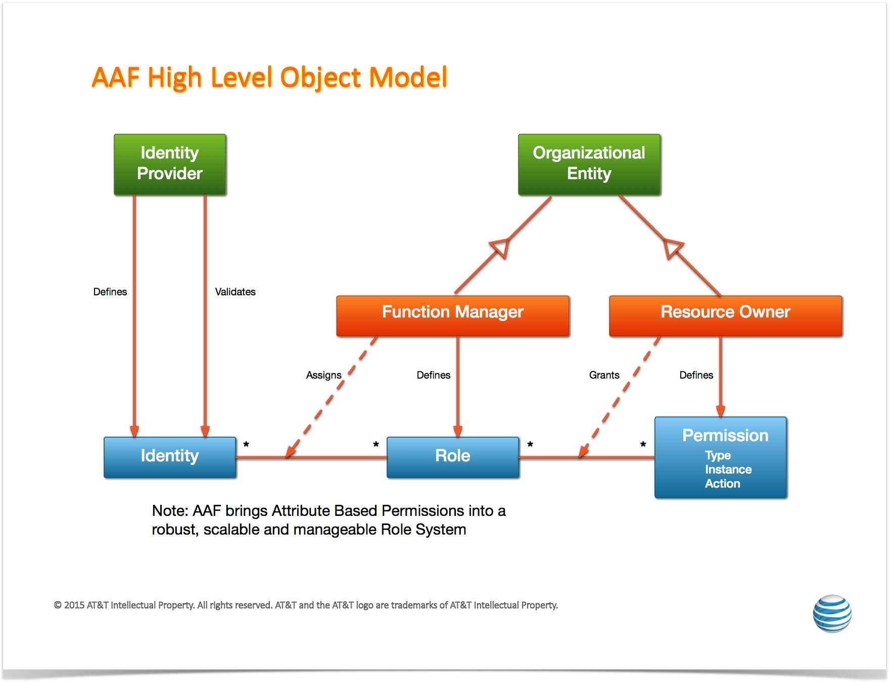
AAF Object Model

Slide 21
DMaaP Functional Description
Data movement as a platform(DMaaP) is a premier platform for high performing and cost effective data movement services that transports and processes data from any source to any target with the format, quality, security, and concurrency required to serve the business and customer needs.
DMaaP consists of three major functional areas:
  Data Filtering - the data preprocessing at the edge via data analytics and compression to reduce the data size needed to be processed.
  Data Transport - the transport of data intra & inter data centers. The transport will support both file based and event based data movement. The Data Transport process needs to provide the ability to move data from any system to any system with minimal latency, guaranteed delivery and highly available solution that supports a self-subscription model that lowers initial cost and improves time to market.
  Data Processing - the low latency and high throughput data transformation, aggregation, and analysis. The processing will be elastically scalable and fault-tolerant across data centers. The Data processing needs to provide the ability to process both batch and near real-time data.
This service is build using Apache Kafka and Restful API is created for message publishing, subscribing and admin activities

Slide 22
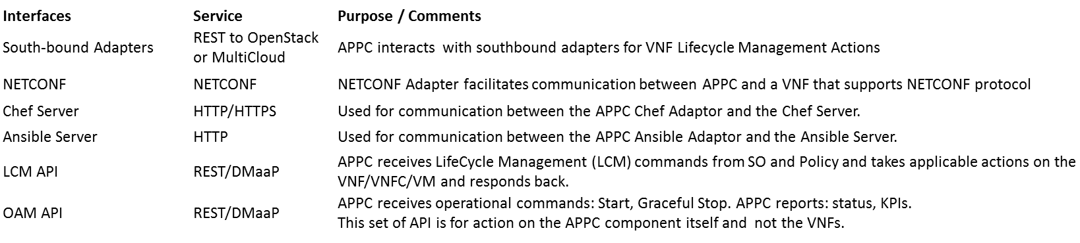
APPC (1/2)
Definition:
Application Controller (APPC) performs the functions to manage the lifecycle of VNFs and their components.
It provides a comprehensive set of controller actions such as Configure, Modify Configuration, Start, Stop, Migrate, Restart, Rebuild, and so on. Consult readthedocs documentation for the full set of APIs offered/supported.
It supports a set of standard VNF interfaces (Netconf, Chef, Ansible.), and
Is designed to be self-service using a model driven architecture that provides a layer of abstraction making APPC completely service, VNF, and site agnostic.
Information about the APPC architecture and provided APIs can be found in the APPC User Guide and LCM & OAM API Guides on readthedocs
.
Provided Interfaces: (refer to APPC User Guide for details)
APPC

Slide 23
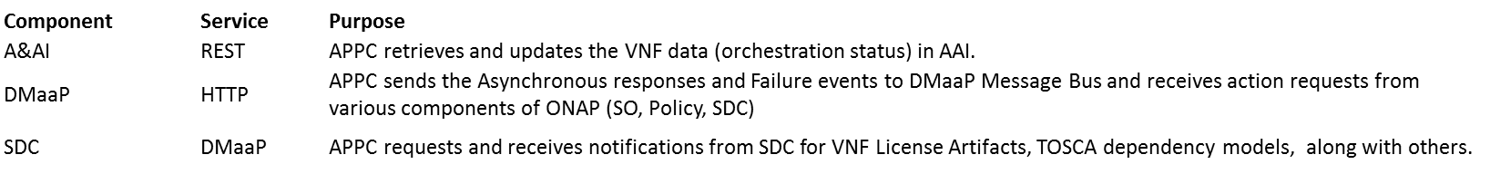
APPC (2/2)
Consumed Interfaces
APPC
Consumed Models:
TOSCA Dependency Model
APP-C also support a variety of models, most of which are created by the APPC Configuration Design Tool (CDT). Examples are:
  Reference Data Model (json)
  VNF Capabilities Model (json)
  Template Model (json or xml)
  Parameter Definition Model (yaml)

Slide 24
CLAMP (1/2)
Definition:
CLAMP is a platform for designing and managing control loops.
It is used to design a control loop, configure it with specific parameters for a particular network service,
then It interacts with other systems to deploy/undeploy and execute the control loop.
Information about the CLAMP architecture and provided APIs can be found in the CLAMP User Guide and LCM & OAM API Guides on readthedocs
Provided Interfaces: (CLAMP doesn’t expose functional relates API’s except the one below, refer to CLAMP documentation for more details)
Interfaces Service Purpose/Comments
HealthCheck REST Health Check of CLAMP instance
CLAMP

Slide 25
CLAMP (2/2)
Consumed Interfaces:
Interfaces Service Purpose/Comments
SDC REST Distribution of service to DCAE
DCAE REST Common Controller Framework
Policy REST(JSON data) Create Configuration and Operational policy
CLAMP
Consumed Models: (No specific models were used in the above interface except for Policy(json))

Slide 26
Use-case UI
Definition:
Provides portal for service life cycle management
Provides portal for VNF alarm and performance
Provides portal for VM alarm and performance
None
Usecase UI
Provided Interfaces:
None
Catalog Synchronization Interface
Service Orchestrator Interface
Inventory Service Interface
NS/VNF Onboard Interface
Service Registration Interface
Data Subscription Interface
Note: Can be more than one page

Slide 27
Use-case UI
Consumed Interfaces:
Catalog Synchronization Interface, from: SDC
Service Orchestrator Interface, from: SO
Inventory Service Interface, from: Available and Active Inventory
NS/VNF Onboard Interface, from: VF-C
Service Registration Interface, from: MSB
Data Subscription Interface, from: DMaaP
None
Usecase UI
Consumed Models:
Network Service Descriptor
VNF Descriptor
Catalog Synchronization Interface
Service Orchestrator Interface
Inventory Service Interface
NS/VNF Onboard Interface
Service Registration Interface
Data Subscription Interface
Note: Can be more than one page

Slide 28
ONAP CLI
Definition:
Provides Open CLI Platform (OCLIP) – Industry first Model-driven command line interface platform
Provides commands for performing end-end service on-boarding and life cycle management
Provides command console for Linux and web platforms.
micro-service discovery commands
external system and VNF cloud on-boarding commands
customer and subscription management commands
resource on-boarding commands
Product and service management commands
network service life-cycle management commands
Provided Interfaces:
micro-service discovery
  Provides commands for micro service discovery and registration
external system and VNF cloud on-boarding
  Provides commands for registering/unregistering VIM, VNFM, EMS and SDNC
customer and subscription management
  Provides commands for subscription and service-type life cycle management
resource on-boarding
  Provides commands for adding VNF modules
Product and service management
  Provides commands for design time creation and management of VF and NS
network service life-cycle management
  Provides commands for creating and managing Network services (NS)
ONAP CLI
micro-service discovery Interface (MSB)
external system and VNF cloud on-boarding interface (AAI)
customer and subscription management interface (AAI)
resource on-boarding interface (SDC)
Product and service management interface (SDC)
network service life-cycle management interface (SO)
Consumed interface Interfaces:
REST API from SDC, SO, AAI, MSB.
Consumed Models:
- Open Command Specification (OCS) 1.0

Slide 29
Microservices Bus (1/2)
Service Registration REST Interface
Service Discovery RES Interface
JAVA SDK for Service Registration/Access
Swagger SDK
Definition:
Provides a reliable, resilient and scalable communication and governance infrastructure to support ONAP Microservice Architecture(OMSA).
Provides RESTFul API for service registration/discovery
Provides JAVA SDK for service registration and access
Provides a transparent service registration proxy with OOM-Kube2MSB
Provides a transparent service communication proxy which handles service discovery, load balancing, routing, failure handling, and visibility-Internal API Gateway(Implemented) and Mesh Sidecar(WIP)
Provides an External API Gateway to expose ONAP services to the outside world
Swagger SDK for auto-generate the client SDK in different languages for every micro-services in ONAP. Also it deploys the generated SDK into the nexus.
Micro Services Bus / Data Movement
Interface N

Slide 30
Microservices Bus (2/2)
Service Registration REST Interface
Service Discovery RES Interface
JAVA SDK for Service Registration/Access
Swagger SDK
Provided Interfaces:
Service Registration REST Interface
  Provides the RESTFul interface to register ONAP services.
Service Discovery REST Interface
  Provides the RESTFul interface to discover ONAP services.
JAVA SDK
  Provides JAVA SDK to register ONAP services.
  Provides JAVA SDK to access ONAP services.
  Note: ONAP components don' t need the MSB interfaces to leverage the transparent service registration proxy (kube2msb) and communication proxy (API Gateway).
Swagger SDK
  provides Mvn plug-in settings for (JAVA)client sdk generation
Micro Services Bus / Data Movement
Interface N
Consumed interface Interfaces: (None)
Consumed Models:
Swagger for RESTFul APIs definition
Service definition in kubernetes config files for automatically service registration by kube2MSB

Slide 31
Optimization Framework - R2 (1/4)
Definition:
ONAP Optimization Framework (OOF) provides functionality for creating and running optimization applications by leveraging a policy-driven, declarative approach.
Supports different specializations (applications) with specific domain and optimization needs.
Initial specialization scopes include, but are not limited to, VNF placement support via Homing and Allocation Service (HAS) with different use cases, and change management scheduling service.
  For R2, the OOF will support vCPE use case (as a MVP).
  For R2, the OOF will demonstrate an example of Change Management Scheduling Optimization using the OOF design framework with simple, representative constraints.
Service Orchestrator (SO)
Change Management Portal
Optimization Framework (OOF)
Provided Interfaces:
Placement Optimization Interface
  Provides functionality for the Service Orchestrator to specify placement services [vCPE use case]
Change Management Portal Interface
  Provides functionality for calculating schedules that satisfy time constraints and conflicts [R2 focus on a demonstration of the design framework; alignment with Change Management scheduling use case]
Policy Interface
Inventory Service Interface
Service/Policy Models Interface
Infrastructure Metrics Interface
Consumed Interfaces:
Policy Interface, from: Policy
Inventory Service Interface, from: Available and Active Inventory
Service/Policy Models Interface, from: SDC
Infrastructure Metrics Interface, from: Multi Cloud
Consumed Models:
Policy Models (constraints) and License Models from: SDC
Infrastructure Metrics Models, from: Multi Cloud

Slide 32
Optimization Framework - R3+ (2/4)
Note on Functionality for R3 and beyond:
While the items listed below are not part of MVP for R2, the OOF team is initiating discussions and collaborations on these during the R2 time frame, so that the OOF is aligned with the use cases that will mature in R3 and beyond.
Service Orchestrator (SO)
Change Management Portal
Additional Definitions for R3 and beyond:
For R3 and beyond, the OOF will focus on supporting multiple R3 and beyond use case (along with R2 use cases)
[supporting VoLTE, VNF/Service scale-in/out (higher order control loop), and RAN-5G].
Synchronization with Change Management Scheduling use case.
Providing additional sample/example optimization applications as documentation.
Proving initial Knowledge Base on OOF (building blocks and recipes for creating complex applications).
Further alignment with S3P objectives.
Optimization Framework (OOF)
Additional Provided Interfaces for R3 and beyond:
Placement Optimization Interface
  For R2, the focus is on supporting vCPE use case;
  for R3 and beyond, the OOF will also support VoLTE, VNF/Service scale-in/out (higher order control loop), and RAN-5G.
Change Management Portal Interface
  For R2, the focus is on a demonstration of OOF with simple, representative constraints;
  this effort will be aligned with the Change Management scheduling use case (for R3 and beyond)
Policy Interface
Inventory Service Interface
Service/Policy Models Interface
Infrastructure Metrics Interface
R3 and Beyond
Application Metrics Interface
Additional Consumed Interfaces for R3 and Beyond:
Application Metrics Interface, from: DCAE [R3 and Beyond]
These are in addition to Policy, Inventory, SDC Models, and Infrastructure metrics from R2
Additional Consumed Models for R3 and beyond:
Application Metrics Models, from: DCAE

Slide 33
Optimization Framework - Interface Definitions (3/4)
Optimization Request Interface
Provided Service | Homing Service API (HAS-API)
Supplementary Information | The OOF will provide a list of possible candidates for placement, which the service orchestrator can use to instantiate the service
Interface Provider(s) | Optimization Framework
Provided Capabilities | Optimization Information Request

Slide 34
Optimization Framework - Interface Definitions (4/4)
Scheduling Optimization Request Interface
Provided Service | Change Management Scheduling API (CMSO API)
Supplementary Information | The OOF will provide a possible schedule of VNF actions (e.g. upgrades) that satisfy the constraints on availability periods and constraints related to conflicts
Interface Provider(s) | Optimization Framework
Provided Capabilities | Optimization Information Request

Slide 35
VNF SDK (VNF package validation) (1/2)
Definition:
Provides functionality to upload, verify, and download VNFs
VNF Vendors upload VNFs through the Marketplace portal
Marketplace runs package validation tests
VNFs are made available for Onboarding
Marketplace API
Marketplace API:
Upload/Re-upload VNF
  Upload VNFs to the Marketplace
Download VNF
  Download VNFs
Query VNF
  Query VNFs by CSAR ID or conditions (name, version, type, provider)
Delete VNF
  Delete VNF from the Marketplace
VNF SDK Marketplace
Consumed Models: SOL-004 (Beijing)
Note: Can be more than one page

Slide 36
VNF SDK - Interface Definitions (2/2)
Marketplace API
Provided Service | Upload, Download, Query, Delete
Supplementary Information | The VNFSDK APIs are documented on the ONAP Wiki: https://wiki.onap.org/display/DW/API+Documentation
Interface Provider(s) | VNF SDK Marketplace
Provided Capabilities | VNF Pre-onboarding upload/download/validation/query/delete

Slide 37
VF-C Components
SO
Policy
UUI
NFVO Functions
Support NS Lifecycle Management including NS instantiate, scale, heal, operate (query /update/…)and terminate. Most of NSLCM interfaces align with SOL005 Os-Ma-nfvo reference point
Support integration with multi VNFMs via drivers which include vendors VNFM and generic VNFM. The interfaces between NFVO and driver comply with Or-Vnfm reference point.
Support integration with multi VIM via Multi-Cloud
NFVO also supports integration with vendor EMS via driver
GVNFM Functions
Support VNF Lifecycle Management, including VNF deploy, scale, heal, operate (start/stop/restart/…), update and terminate, etc
Support multiple VNFs and multi-type VNFs from different vendors
Support multiple VIM environments and multi-type VM environments based on VM or Docker
Os-Ma-nfvo
NFVO
VNF Package
( VNFD)
NS Package
( NSD)
Instantiate
Terminate
Scale
Operate
Heal
Or- Vnfm
Or- Vnfm
Driver
VNF Package
( VNFD)
Driver
SVNFM
Or-Vi
GVNFM
EMS
Vi-Vnfm
Multi-Cloud
Vi-Vnfm
Vi-Vnfm
NFVI&VIM

Slide 38
VF-C – NFVO (1/2)
Network Service LCM Interface
VNF Operation Granting Interface
NS package management Interface
VNF package management interface
Definition:
Provides reference implementation of NFVO in ETSI MANO architecture
Provides Network service life cycle management
Provides NS/VNF layer’s FCAPS management
NFVO
Provided Interfaces:
Network Service LCM interface
  Provides Network Service LCM interface
  (NS instantiate/scale/heal/terminate/query/…)
VNF Operation Granting interface
  Provides VNF Operation Granting interface and make granting decision
NS package management interface
  Provides runtime NS package management interface
VNF package management interface
  Provides runtime VNF package management interface
VNF LCM Interface
Inventory Service Interface
Catalog Synchronization interface
Generic VIM Interface
Date report interface
Tosca parser interface
Optimization Request Interface
Note: Can be more than one page

Slide 39
VF-C – NFVO (2/2)
Network Service LCM Interface
VNF Operation Granting Interface
NS package management interface
VNF package management interface
Consumed Interfaces:
VNF LCM Interface, from: Generic VNFM controller, SVNFM
Inventory Service Interface, from: Available and Active Inventory
Catalog Synchronization Interface, from: SDC
Generic VIM Interface, From: Multi-cloud
Data report Interface, From: DCAE
Tosca parser Interface, From: Modeling
Service registration and discovery, From: MSB
Optimization Request Interface, from: Optimization Framework -TBD
NFVO
VNF LCM Interface
Inventory Service Interface
Catalog Synchronization interface
Generic VIM Interface
Data report interface
Tosca parser interface
Optimization Request Interface
Consumed Models:
Network Service Descriptor
VNF Descriptor
VES data format
Bpmn Workflow
Note: Can be more than one page

Slide 40
VF-C - GVNFM
Definition:
Provides the Generic VNFM
Provides the VNF life cycle management
Supports NFVO to implement Network service LCM management
VNF LCM Interface
GVNFM
Provided Interfaces:
VNF LCM interface
  Provides the VNF LCM interface (VNF instantiate/terminate/query/…)
Consumed interface Interfaces:
Catalog and notification Interface, from: NFVO
Inventory Interface, from: A&AI
Tosca parser Interface, From: Modeling
Generic VIM Interface, From: Multi-cloud
Service registration and discovery, From: MSB
VNF Config interface: from VNF -TBD
:
Catalog and notification Interface
Inventory Interface
Tosca parser Interface
Generic VIM Interface
VNF config interface
Consumed Models
VNFD
Note: Can be more than one page

Slide 41
ONAP Portal
Definition:
Portal is a platform that provides the ability to integrate different ONAP applications into a centralized Portal Core.
It allows decentralized applications to run within their own infrastructure while providing common management services and connectivity.
It provides capabilities including application onboarding & user management, and hosted application widgets.
Using the provided SDK, application developers can leverage the built-in capabilities (Services / API / UI controls) along with bundled tools and technologies.
Portal Admin Interfaces
SDK Jars (Policy, VID, AAI, and SDC)
ONAP Portal
Provided Interfaces:
Portal Admin Interfaces
  Onboarding and User management
SDK Module
  SDK will be used as a base for any ONAP application being built.
  Components using SDK jars: Policy, VID, AAI, and SDC
  SDK bundles together a host of different tools, technologies, and standards that will assist the teams during the development phase.
  SDK includes reusable UI components, authentication & authorization components, visualization & reporting engine, collaborative services, workflow manager, GIS / Map, web component, and widget development framework.
AAF
Consumed interface Interfaces:
Restful APIs for fetching available roles to portal’s onboarded application users. from: AAF
41

Slide 42
Logging-analytics (1/2)
Definition:
Provides ELK stack where logs are streamed from filebeat sidecar containers per component
Kibana
Logging-analytics
Provided Interfaces:
Kibana UI:
  dashboard for indexed logs
Logstash:
  Consumes logs pushed by filebeat containers into elasticsearch indexer
filebeat
Consumed interface Interfaces:
Filebeat container per microservice exposing logs through a Kubernetes PV:
Consumed Models: none

Slide 43
Logging-analytics (2/2)
Logging-analytics Interface
Provided Service | Kibana dashboard, search service on top of elaticsearch index of ONAP logs – via filebeat
Supplementary Information
Interface Provider(s) | AA&I, APPC, SO, Policy, Portal, SDC, SDNC, VID
Provided Capabilities | Search logs using lucene search format Dashboard of configurable search views of logs

Slide 44
Multi-Cloud Adaptation (1/2)
Definition:
enable ONAP to deploy and run on multiple infrastructure environments, including OpenStack and its different distributions, public and private clouds, and micro services containers, etc.
provide a Cloud Mediation Layer supporting multiple infrastructures and network backends so as to effectively prevents vendor lock-in.
decouple the evolution of ONAP platform from the evolution of underlying cloud infrastructure, and minimizes the impact on the deployed ONAP while upgrading the underlying cloud infrastructures independently.
Resource LCM Interface
VIM registry/un-registry Interface
VIM FCAPS management Interface
  VIM capacity/capability query
Multi-Cloud adaptation
Provided Interfaces:
Resource LCM interface
    Support VNF instantiation/termination
    (Resource create/delete/update/query)
VIM registry/un-registry Interface
  Support registry/un-registry of multiple clouds
  (VIM create/delete/update)
VIM FCAPS management Interface
  Support FCAPS required data collection, event/alert/metrics federation functions
  (message pub/sub)
  VIM capacity/capability query
    Support placement and scheduling purpose
    (capacity/capability query/report)
ONAP Interface
  Inventory Service Interface
  DMAAP interface
  Logging interface
The third party Cloud interface
  OpenStack Interface
  VMware VIO interface
  Wind River Titanium Interface

Slide 45
Multi-Cloud Adaptation (2/2)
Consumed Interfaces:
ONAP
  Inventory Service Interface from Available and Active Inventory
  Message pub/sub interface from DMAAP
  Logging interface from Logging project
The third party Cloud API
    OpenStack Interface
      Ocata
      Mitaka
    VMware VIO interface (Ocata)
    Wind River Titanium Interface (Mitaka)
Resource LCM Interface
VIM registry/un-registry Interface
VIM FCAPS management Interface
  VIM capacity/capability query
Multi-Cloud adaptation
ONAP Interface
  Inventory Service Interface
  DMAAP interface
  Logging interface
The third party Cloud interface
  OpenStack Interface
  VMware VIO interface
  Wind River Titanium Interface
Consumed Models:
Existing
  VES data format
Underworking
  Hierarchical Infrastructure Resource Information Model
  FCAPS Data Model

Slide 46
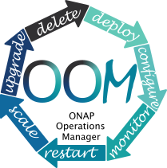
ONAP Operations Manager (OOM)
Definition: OOM is the life cycle manager of the ONAP platform (i.e. SDC, SO, SDNC, etc.). OOM uses the Kubernetes container management system and Consul to provide the following functionality:
  Deployment - with built-in component dependency management (including multiple clusters, federated deployments across sites, and anti-affinity rules)
  Configuration - unified configuration across all ONAP components
  Monitoring - real-time health monitoring feeding to a Consul GUI and Kubernetes
  Restart - failed ONAP components are restarted automatically
  Clustering and Scaling - cluster ONAP services to enable seamless scaling
  Upgrade - change-out containers or configuration with little or no service impact
  Deletion - cleanup individual containers or entire deployments
OOM supports a wide variety of cloud infrastructures to suit your individual requirements.
Interface 1
ONAP Operations Manager
Provided Interfaces: Consul GUI for health monitoring, Kubernetes CLI for platform management
Consumed interface Interfaces: None
Consumed Models: ONAP Deployment Specifications, ONAP Component Configuration Artifacts
Interface N

Slide 47
Policy Framework (1/2)
Policy CRUD interface
Policy deployment interface
Policy model CRUD interface
Definition:
Provides a logically centralized environment for the creation and management of modifiable configurations, rules, assertions and/or conditions to provide real-time decision making on conditions and events that underlie ONAP’s control, orchestration, and management functions
Supports specification, decomposition, distribution and enforcement for various types of policies such as microservice configuration policy, operational policy, decision policy, guard policy, etc.
Policy scopes include, but are not limited to, infrastructure/network management, products and services, operation automation, and security.
Policy Framework
Provided Interfaces:
Policy CRUD interface:
  Provide UI and API options to create/query/update/delete configuration, decision and operational policies
Policy deployment interface:
  - Provide UI and API options to deploy configuration, decision and operational policies
Policy model CRUD interface:
  Provide UI and API options to create, query, update and delete policy models
Message Router Pub/Sub Service Interface
Service Registration/Discovery Interface
VNF/VM LCM Interface
NF Config Interface
Inventory Service Interface
Network Service LCM Interface
Service Distribution Interface

Slide 48
Policy Framework (2/2)
Policy CRUD interface
Policy deployment interface
Policy model CRUD interface
Consumed interface Interfaces:
Message Router Pub/Sub Service Interface, from: Data Movement as a Platform
Service Registration/Discovery Interface, from: Microservices Bus
VNF/VM LCM Interface, from: Generic NF controller
NF Config Interface, from: Generic NF controller
Inventory Service Interface, from: Available and Active Inventory
Network Service LCM Interface, from: Service Orchestrator
Network Service LCM Interface, from: Virtual Controllers (APPC and VFC)
Service Distribution Interface, from: Service Design & Creation
Policy Framework
Message Router Pub/Sub Service Interface
Service Registration/Discovery Interface
VNF/VM LCM Interface
NF Config Interface
Inventory Service Interface
Network Service LCM Interface
Service Distribution Interface
Consumed Models
Operational policy model
Configuration policy model
Resource model in the catalog
Service model in the catalog

Slide 49
SDN-C Functions
Key
CE-x
Controller External API
CI-x
Controller Internal API
SDN-C configures and maintains the health of L1-3 VNFs/PNFs and network services throughout their lifecycle
Programmable network application management platform
  Behavior patterns programmed via models and policies
  Standards based models & protocols for multi-vendor implementation
  Extensible SB adapter set supporting various network config protocols, including 3rd party controllers
  Operational control, coordinated state changes across devices, source of telemetry/events, etc.
Manages the health of network services & VNFs/PNFs in its scope
  Policy-based optimization to meet SLAs
  Event-based control loop automation to solve local issues near real-time
  Action executor for outer control loop automation
Local source of truth
  Manages inventory within its scope
  All stages/states of lifecycle
  Configuration audits
Key Attributes of Controllers
  Intimate with network protocols
  Manages the state of services
  Single service/network domain scope per instance
Artifact Distribution
Orchestration
Closed Loop Actions
Inventory
Updates
Policy
Service Design & Creation
Orchestration
Data Collection, Analytics & Events
Active & Available Inventory
MSB/Data Movement
SDN-C
CE-1
CE-2
CE-3
CE-4
API Handler
CI-1
CI-2
CI-3
Repository
Service Control
Processing
Operational Tree/
Config Tree
(Service Model)
CI-5
NB Service/Network Yang Models
CI-4
IP/VRF Assign
L2 Service Create
L3 VPN Service Create
SD-WAN Create
TE Tunneling
BGP Config
SW Upgrade
…
Service Logic
Service Logic
Configuration Templates
Service/Network Design & Engineering Rules
Service Logic
MSB/Data Movement
…
Assigned Resources Inventory: Service* Topology &
VNF/PNF State
Policies
CI-7
SB Device Yang Models
Service Logic
*Not E2E service view. The “Service” view in the SDN Controller is limited its scope of control
CI-6
Adapters
Multi-Cloud Network Adapter
NetConf/ YANG
OpenFlow
BGP LS/
PCEP
…
Others
External System Adapter (s)
CE-5
CE-6
MSB/Data Movement
External
3rd Party Controllers
Element Mgt. Systems
Multi-VIM/Cloud
VNFs
PNFs

Slide 50
SDN-C External/Internal Interface Definitions
Key
CE-x
Controller External API
CI-x
Controller Internal API
 | Interface Definitions | Beijing Release
CE-1 | Distribution of artifacts from Service Design and Creation (SDC) | Yes - TOSCA only
CE-2 | Service requests from Orchestration (SO) | Yes
CE-3 | Closed Loop action requests from Data Collection, Analytics & Events (DCAE)/Policy | Not in scope
CE-4 | Inventory retrieval from Active & Available Inventory (A&AI) by Service Logic Inventory updates to Active & Available Inventory by Assigned Resources Inv | Yes – push/pull (no DMaaP topic subscription)
CE-5 | Configuration requests for cloud infrastructure networking Lifecycle management requests to Multi-Cloud (e.g., stop/start VM) | Not in scope
CE-6 | Lifecycle management or configuration requests to an external controller or system that has responsibility of the target VNF | Yes
CI-1 | API Handler looks up or retrieves the corresponding Service Logic instance that maps to NB service request (service/network yang) | Yes
CI-2 | API Handler calls Service Control Processing to perform the Service Logic on the target service or network | Yes
CI-3 | Prior to CI-2, API Handler might query the (in-memory) Operational/Config Trees for the network or service details (if already existing) | Yes
CI-4 | Service Control Processing retrieves the Service Logic, Config Templates, Engineering rules, and Policies as part of processing the requested action | Yes
CI-5 | Service Control Processing queries and/or updates Operational/Config Trees as part of making changes to the network (VNFs/PNFs) | Yes
CI-6 | Service Control Processing requests adapter layer to update/configure VNF/PNF update using the appropriate adapter for the VNF/PNF | Yes
CI-7 | Service Control Processing updates the local Assigned Resources Store/Inventory once network updates are made successfully | Yes

Slide 51
External API Definition & Interfaces (1/2)
Definition:
ONAP External APIs expose the capabilities of ONAP. They allow ONAP to be viewed as a “black box” by providing an abstracted view of the ONAP capabilities.
External APIs support that an external consumer of ONAP capabilities can be authenticated and authorized. These APIs can also be used for connecting to systems where ONAP uses the capabilities of other systems.
Provides a clear and unambiguous ONAP service abstraction so that the BSS/OSS can exchange service requirements and service capabilities in a common and consistent fashion.
Service Catalog
Service Ordering
Service Inventory
External APIs
Provided Interfaces:
Service Catalog Interface
  Provides an external view of requestable ONAP Services and the retrieval of the associated Service template (model)
Service Ordering Interface
  Provides a mechanism for placing a service order with all of the necessary order parameters represented on the Service template. It allows users to create, update & retrieve Service Orders and manages related notifications.
Service Inventory Interface
  Provides a consistent mechanism to query the Service inventory from an external perspective.
SDC: Catalog
SO: Service Instantiation
A&AI: Inventory Service Interface

Slide 52
External API – Consumed Interfaces/Models (2/2)
Consumed Interfaces:
SDC: Catalog
SO: Service Instantiation
A&AI: Inventory Service Interface
Service Catalog
Service Ordering
Service Inventory
External APIs
SDC: Catalog
SO: Service Instantiation
A&AI: Inventory Service Interface
Consumed Models:
Service Descriptor (TOSCA YAML Service Descriptor)

Slide 53
External API – Service Catalog (1/3)
Service Catalog
Provided Service | Provides an external view of requestable ONAP Services and the retrieval of the associated Service template (model)
Supplementary Information | Service Models are TOSCA representations of the Services that may be requested.
Interface Provider(s) | External API
Provided Capabilities | Query Service Catalog Retrieve Service Model

Slide 54
External API – Service Ordering (2/3)
Service Ordering
Provided Service | Provides a mechanism for placing a service order with all of the necessary order parameters represented on the Service template. It allows users to create, update & retrieve Service Orders and manages related notifications.
Supplementary Information | Service Models are TOSCA representations of the Services that may be requested.
Interface Provider(s) | External API
Provided Capabilities | Place Service Order Query Service Order Retrieve Service Order Delete Service Order Retrieve Service Order State Subscribe to Service Order Notifications Receive Service Order Notifications

Slide 55
External API – Service Inventory (3/3)
Service Inventory
Provided Service | Provides a consistent mechanism to query the Service inventory from an external perspective.
Supplementary Information
Interface Provider(s) | External API
Provided Capabilities | Query Service Inventory Retrieve Service Retrieve Service State

Slide 56
MUSIC- Multi-Site State Coordination Service
Definition: MUSIC is a multi-site state coordination/management service for a single operator with a rich suite of recipes that ONAP components/micro-services can simply configure and use for their state-management needs both within and across sites. At its core, MUSIC provides a scalable sharded eventually-consistent data-store (Cassandra) wherein the access to the keys can be protected using a locking service (built on Zookeeper) that is tightly coupled with the data-store.
MUSIC also supports Consul based distributed KV Store and its features include ability to store default configuration settings, dynamic changes to the configuration and propagating the changes to running service instances
MUSIC API
MUSIC (Multi-site State Coordination Service )
Provided Interfaces:
The MUSIC API is a REST API used to read and write state and manage access to it through a locking service.
API to manage (Add/Modify/Delete) configuration/settings.
None.
Consumed Interfaces - None.
Consumed Models - None.

