Slide 1
ONAP Models,
R2 State of Affairs

Slide 2

Real R2 Model = “R2 Model” + SDC
“SDC Model” – Model 1
  Based on ECOMP
  Documented here
  ~40 node types, ~60 data types, drives X*5(?) lines of code
  Onboarded as HEAT + TOSCA
  Consumed by SDC, SO, SDN-*, VID, AI&I, APP-C, CLAMP
“R2+ Model” – Model 2
  Based on Open-O, NFV profile, SOL001 in mind
  Documented here
  ~10 node types, ~40 data types, drives X(?) lines of code
  Onboarded as TOSCA
  Consumed by SDC, VF-C, UUI, dispatched by SO
Almost all apart
  2 different onboarding flows
  2 different orchestration flows
  2 separate “populations” of VNFs, never mixed in one service
Use cases:
  VoLTE – Model 2
  vCPE – Model 1 (there is a TOSCA-based vCPE, but it has never been officially supported)

Slide 3
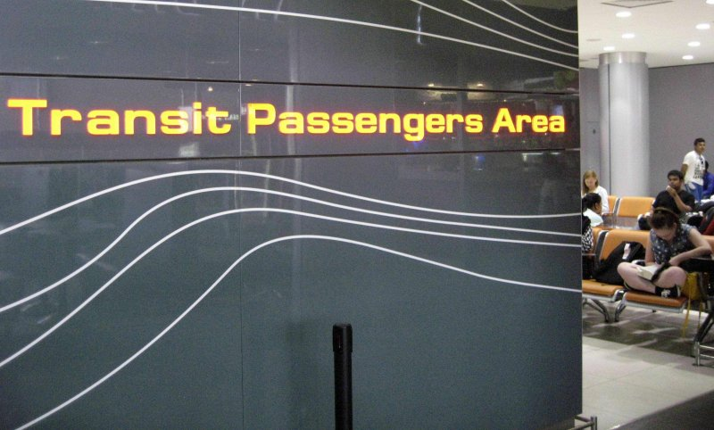
SDC and SO as Integration Points
SDC
  2 different onboarding flows
  2 actually separate “populations” of VNFs:
    stored together
    Theoretically, a composition of both types is possible
    Practically, models 1 and 2 are never mixed in one service
  CSAR
    Types – all
    Templates – based on a half of the types
SO
  Full orchestration for Model1-based services
  Quick delegation to VF-C for Model2-based of services

Slide 4
Model support across ONAP
ONAP Component | Model 1 | Model 2
SDC | ☺ | ☺
SO | ☺ | 😐 (Delegates to VF-C)
SDN-* | ☺ | ☹
APP-C | ☺ | ☹
VID | ☺ | ☹
CLAMP | ☺ | ☹
VF-C | ☹ | ☺
UUI | ☹ | ☺

