Slide 1
SOL001 updates and key points
Thinh Nguyenphu, Nokia thinh.nguyenphu@nokia.com
June 25, 2018

Slide 2
SOL001 (VNFD Status), as June 14
The VNFD part of SOL001 is considered stable, with known gaps. Latest https://docbox.etsi.org/ISG/NFV/SOL/05-CONTRIBUTIONS/2018//NFVSOL(18)000325r1_Draft_GS_NFV-SOL001v080_contribution.zip
  The remaining gaps are about Monitoring and VNF indicators
Once the stability is confirmed, SOL WG will start a document review focused on the VNFD aspects for a 4-week period (2 weeks for collecting contributions and 2 weeks for approving them.
Reference | Stable Draft | Final Draft | WG App | TB App
SOL001 "TOSCA-based NFV descriptors spec“ (VNFD & NSD) | 2018.07.01 | 2018.08.26 | 2018.08.31 | 2018.09.30

Slide 3
SOL001 (VNFD): key concepts
SOL001 (VNFD): is based on TOSCA Simple YAML v1.2.
In the case of one or multiple deployment flavours (DFs), TOSCA Simple YAML v1.2 shall be used
In the case of one DF only, TOSCA Simple YAML v1.1 may be used.
There are two methods of service template design:
  2 levels service templates: in cased of 1 or more multiple DFs (see example)
  1 level service template: in case of 1 DF only. (see example)
AffinityRule, AntiAffinityRule: tosca.policies.nfv.AffinityRule
Instantiation Levels: tosca.policies.nfv.InstantiationLevels:
  tosca.policies.nfv.VduInstantiationLevels & tosca.policies.nfv.VirtualLinkInstantiationLevels
Scaling Aspect: tosca.policies.nfv.ScalingAspects
  tosca.policies.nfv.VduScalingDeltas & tosca.policies.nfv.VirtualLinkBitrateScalingDeltas:

Slide 4
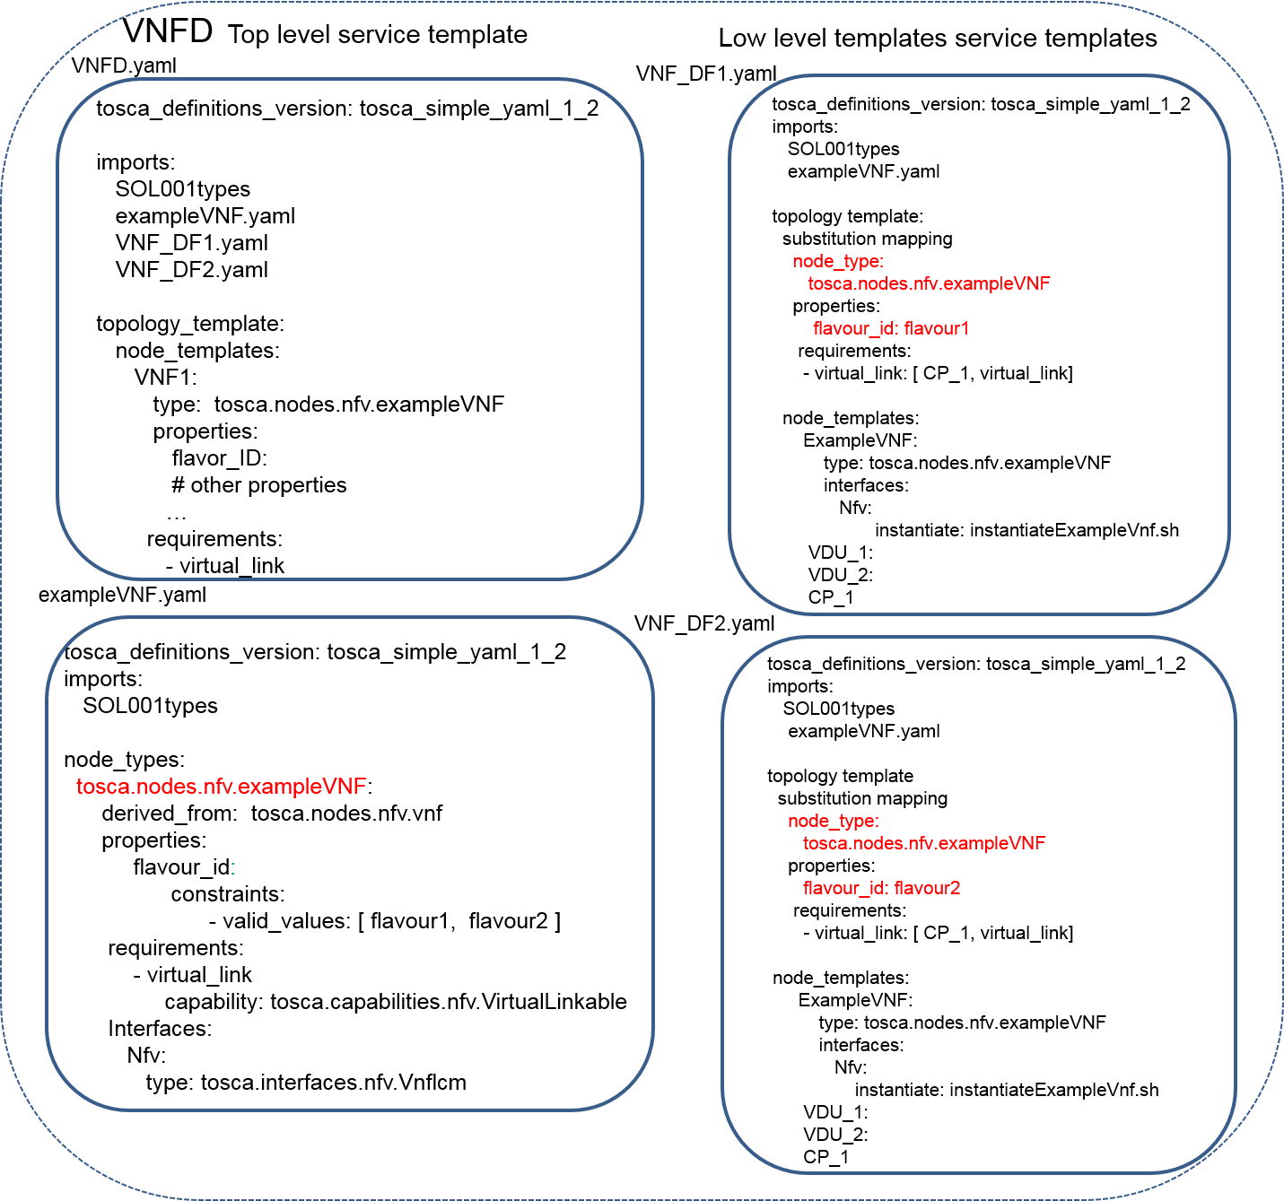
2 Levels service template design: key points
topology template describing the internal topology of the VNF with: substitution_mappings indicating:
a) the same node type as defined in the top level service template,
b) a flavour_id property value which identifies this DF within the VNFD and c) the mapping of the virtual_link requirement
a node template of the abstract VNF node type with implementations of the LCM interfaces of the VNF
tosca_definitions_version: tosca_simple_yaml_1_2
Imports: lower STs, VNF specific, and SOL001 types
SOL001 types: file name shall be structured as follows: etsi_nfv_sol001_vnfd_x_y_types.yaml, where x and y represents the version of this file. Pending EA
Flavor_id : required
Separate ST for VNF specific

Slide 5
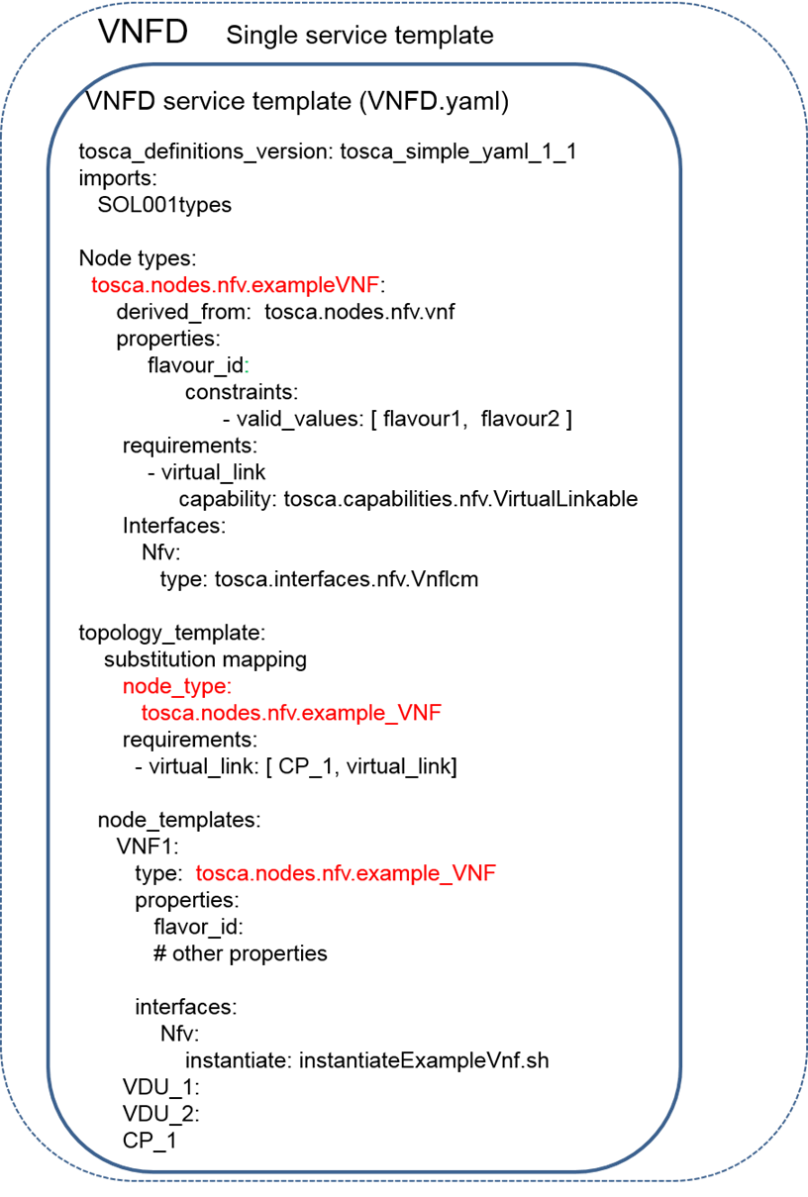
1 service template design: based on tosca_simple_yaml_1_1
tosca_definitions_version: tosca_simple_yaml_1_1
Imports: SOL001 NFV types
Flavor_id : required
VNF specific node type: derived from tosca.nodes.nfv.vnf

Slide 6
1 and 2 level service template design: examples
Single DF
1 level service template
Multiple DFs
2 level service template

Slide 7
SOL001 NFV Types definitions file
SOL001 GS will includes SOL001 NFV Types definitions file: vnfd & nsd
Naming convention: etsi_nfv_sol001_vnfd_x_y_types.yaml (for VNFD)
File version convention: tbd
Whether “etsi_nfv_sol001_vnfd_x_y_types.yaml” file must be included in the VNF package and/or can be referenced via URI is for further study.

Slide 8
VnfLcmOperationsConfiguration (1/2)
Per IFA011, VnfLcmOperationsConfiguration serves two purposes: setting parameters and pre-defined properties of LCM operations.
  Setting parameters: to be used as input values to be passed in the SOL003 VNF LCM APIs
  Pre-defined: LCM parameters values assignments to pre-declared configuration parameters.
SOL001 mapping:
  Setting parameters: interfaces types: additional_parameters: tosca.datatypes.nfv.VnfOperationAdditionalParameters
  Pre-defined: tosca.nodes.nfv.VNF: lcm_operations_configuration: tosca.datatypes.nfv.VnfLcmOperationsConfiguration

Slide 9
VnfLcmOperationsConfiguration (2/2)
tosca.nodes.nfv.VNF: derived_from: tosca.nodes.Root properties: descriptor_id: # instead of vnfd_id type: string # GUID required: true configurable_properties: type: tosca.datatypes.nfv.VnfConfigurableProperties required: false modifiable_attributes: type: tosca.datatypes.nfv.VnfInfoModifiableAttributes required: true lcm_operations_configuration: type: tosca.datatypes.nfv.VnfLcmOperationsConfiguration required: false ... capabilities: ... requirements: ... interfaces: Nfv: type: tosca.interfaces.nfv.Vnflcm
tosca.interfaces.nfv.Vnflcm derived_from: tosca.interfaces.Root instantiate: description: Invoked upon receipt of an Instantiate VNF request inputs: additional_parameters: type: tosca.datatypes.nfv.VnfOperationAdditionalParameters required: false instantiate_start: description: Invoked before instantiate instantiate_end: description: Invoked after instantiate ...
Setting parameters:
Pre-defined:

Slide 10
VnfConfigurableProperties & VnfInfoModifiableAttributes
VnfConfigurableProperties: (tosca.datatypes.nfv.VnfConfigurableProperties)
  additionalConfigurableProperty: To be defined by the VNF provider to allow functional blocks such as the NFVO to instruct the VNFM to set certain properties of the VNF instance.
  must be declared in VNFD and default value may be declared. These default values will be part of the VnfInfo object, once the VNF instance is created.
  It must be set by Modify VNF Information operation via SOL003 API.
  Key point: this property is to be consume by VNF instance, via VNFM pass this information to VNF instance via Modify VNF Information operation.
  Applicable to tosca.datatypes.nfv.VnfcConfigurableProperties
VnfInfoModifiableAttributes: (tosca.datatypes.nfv.VnfInfoModifiableAttributes):
  These will allow an external functional block to set information that is typically for consumption by the VNFM, but will not be sent to the VNF instance. It can be used by VNF LCM script.

Slide 11
Scaling Aspect & ElementGroup IEs
Scaling Aspect: introduces a general mechanism for deltas that allows to represent the different types of deltas to be applied to one aspect separately from the sequence of their application. As result, deltas and stepDeltas are introduced and uniformDelta is removed.
VnfElementGroup IE is removed, because the information is provided by ScalingDelta.
Scaling Aspect is modeled as policies:
  tosca.policies.nfv.ScalingAspects:
  tosca.policies.nfv.VduScalingDeltas
  tosca.policies.nfv.VirtualLinkBitrateScalingDeltas

Slide 12
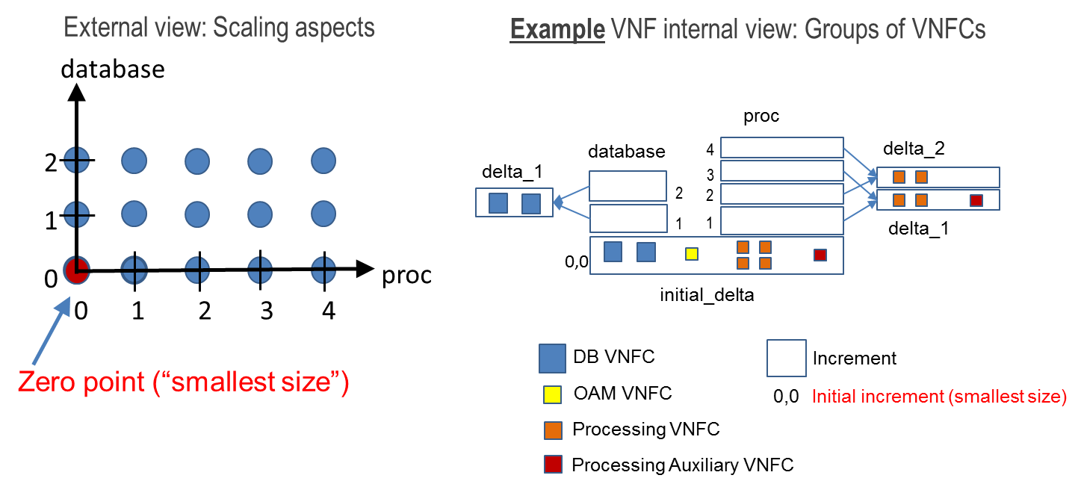
Scaling Aspect

