Slide 1
MultiCloud for Edge Automation
Bin Yang
ONAP Multi-VIM/Cloud PTL, Wind River,
Xi’An China, August 2018

Slide 2
Agenda
Challenges of Edge Automation
Automating the on-boarding process for Edge Infrastructure
Automating the discovery/representation of Infrastructure Resources
Supports to policy based VNF placement/homing
Near real-time and aggregation of FCAPS data streaming

Slide 3

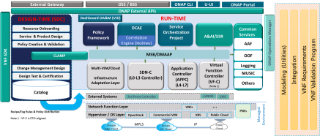


Challenges of Edge Automation
Edge Infrastructure for NFV
  Could consist of hundreds of physical data centers of small scale
  With dynamic changes during their lifecycles
  Comes with very limited resources which requires good utilization by various intelligent and automated orchestration
  Requires near real-time close loop automation and aggregation of FCAPS data streaming
The challenges
  LCM of Edge Infrastructure: On-Boarding, De-Commissioning.
  LCM of Resource of Edge Infrastructure: Discovery/Updating/Representing.
  Increase resource utilization while remains flexible
  Near real-time collecting/aggregating/reacting to FCAPS data/events

Slide 4
MultiCloud automates the on-boarding process for Edge Infrastructure
Edge Infrastructure with Hundreds of Physical Data Centers
  Could be a burden for Infrastructure providers.
  Multi-Region could be one of solution to mitigate the pain of O&M for Infra. Providers.
  ONAP could leverage this multi-region solution to automate the on-boarding process of hundreds of Physical Data Centers into ONAP.
    ONAP user will fill the access information for the primary region only
    MultiCloud plugin will discover all secondary regions and register the corresponding cloud regions into AAI.
  Will be realized in ONAP Multi-VIM/Cloud in Casablanca Release
    https://gerrit.onap.org/r/#/c/56697/

Slide 5
MultiCloud automates the discovery/representation of Infrastructure Resources
ONAP needs local inventory representing Infra. Resources
  This is critical to decouple the VNF and Infrastructure Resource for approaching the model driven and policy driven orchestration
  MultiCloud comes up with a solution to discover the resources (including HPA) by specifying the requirement to Infrastructure’s provider.
    http://onap.readthedocs.io/en/latest/submodules/multicloud/framework.git/docs/specs/MultiCloud-HPA-Discovery-design.html
  MultiCloud plugin explores 3 ways to discover resources
    https://wiki.onap.org/display/DW/Discovery+of+HPA+related+informaiton+in+MultiCloud
  MultiCloud plugin registers discovered resources into AAI for OOF consuming
    https://wiki.onap.org/display/DW/HPA+Policies+and+Mappings
  Refer to backup slides for further details

Slide 6
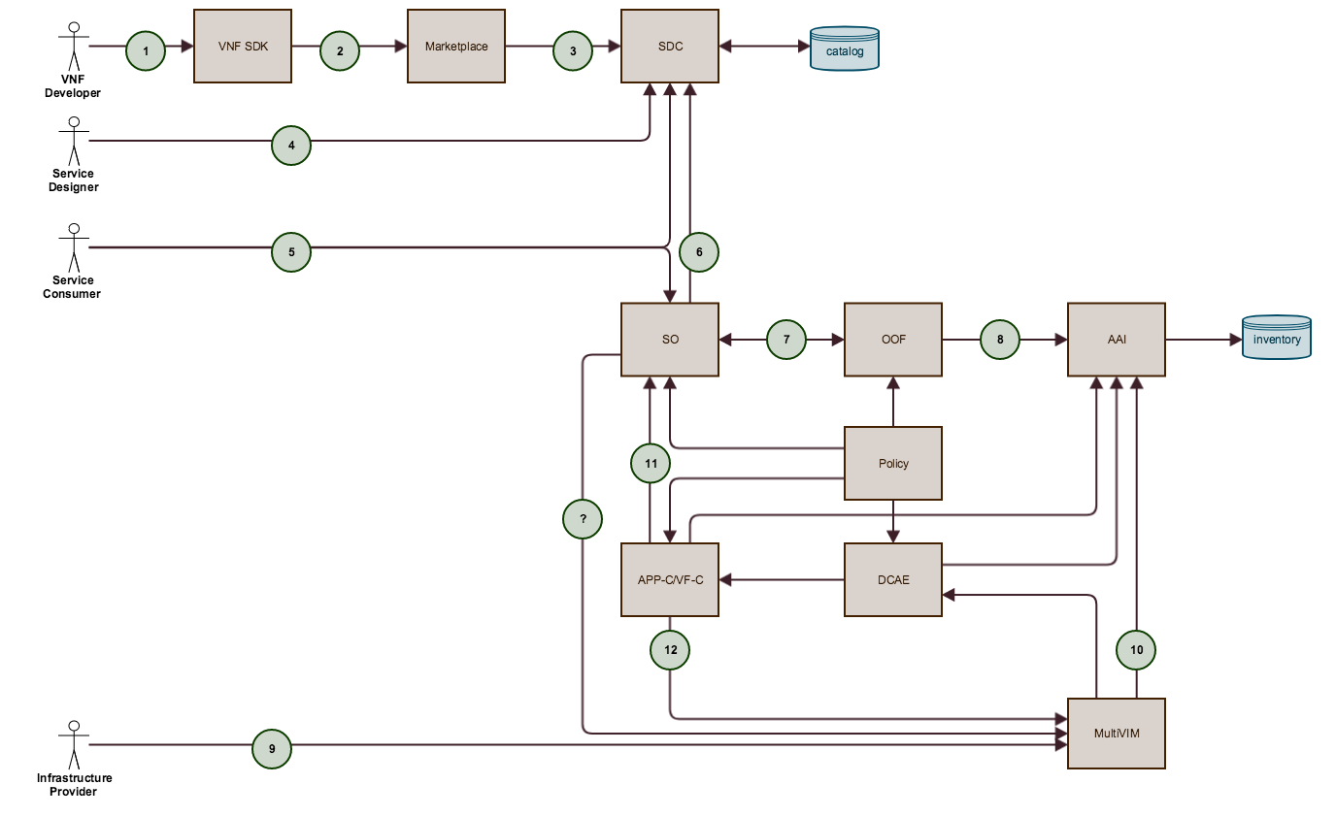
HPA enablement, End to end workflow
Top down for HPA requirement specifying
  VNFD, SDC, Policy
Bottom up for HPA discovery/registration
  MultiCloud
  AAI, ESR
Matchmaking in the middle
  OOF
Wiki:
  https://wiki.onap.org/pages/viewpage.action?pageId=20874679

Slide 7
HPA Discovery & Registry, Design & implementation
VIM/Cloud provider
  Provide HPA resource
  Expose HPA complying to ONAP HPA discovery specification
    Flavor’s extra-specs will be the vehicle to carry HPA information to ONAP MultiCloud
    Special flavor name convention needed. Prefix with “onap.”
  On board the VIM/Cloud to ONAP and trigger the ONAP HPA discovery process
    Cloud region allows inputting extra information with property: “cloud-extra-info”
HPA discovery by ONAP MultiCloud Plugins
  How to
    Automatically discovery: retrieve HPA information via REST API to VIM/Cloud,e.g. read flavor’s extra-specs
    Manually discovery: retrieve HPA information via cloud region’s “cloud-extra-info”
    Hard-coded discovery: MultiCloud Plugins can be tightly bound to specific VIM/Cloud type/release,e.g. plugin for windriver is bound to Titanium Cloud
  When to
    First discovery
    On-demand discovery
wiki:
  https://wiki.onap.org/display/DW/Discovery+of+HPA+related+informaiton+in+MultiCloud

Slide 8

HPA Discovery & Registry, Workflow
Step 1: provision cloud region
  Dedicated resource to ONAP: project, user, quota, flavors
  Flavors’ name should be prefixed with ‘onap.’, add HPA metadata to flavor’s extra-specs
Step 2: on board the cloud region
  Multiple ways to on board the cloud region,
    ESR VIM registration portal, Curl commands to AAI, etc.
  ESR portal is recommended
    ESR portal will trigger the multicloud to discover and register HPA information
    Otherwise you have to trigger this registration manually (e.g. with curl command)
Step 3: verification
  Debugging purpose only
  Postman or curl command to perform query to AAI
Postman
ONAP
Dump cloud region
Step3: Verify
(debugging purpose)
A&AI
2.1 Create cloud region
ESR
2.4 Resource update
Step2: Onboard
2.2 Trigger registration
Step1: Provision
MultiCloud
2.3 Resource discovery
OpenStack Instance

Slide 9
MultiCloud supports to policy based VNF placement/homing
ONAP OOF helps intelligent placement/homing of VNF
  OOF will select the best edge infrastructure to place the VNF
  This is done by comparing the requirement of VNF to the capability/capacity of Infrastructure
  Requirements are specified with VNFD/Policy with regarding to generic resource as well as HPA
  Capability of HPA are provided by AAI which was populated by MultiCloud during on-boarding of Infrastructure
  Capacity of generic resource are checked by OOF to MultiCloud interaction directly
    http://onap.readthedocs.io/en/latest/submodules/multicloud/framework.git/docs/specs/multicloud_resource_capacity_check.html
  There has been proposal to abstract some infrastructure’s capability/capacity with “Cloud-agnostic Intent Placement/networking & Homing policies”
    https://wiki.onap.org/display/DW/Edge+Scoping+MVP+for+Casablanca+-+ONAP+Enhancements#EdgeScopingMVPforCasablanca-ONAPEnhancements-ONAPEnhancements-Cloud-agnosticPlacement/Networking&HomingPolicies(Phase1-CasablancaMVP,Phase2-StretchGoal)

Slide 10

MultiCloud offers aggregation of FCAPS data streaming and Near Real-Time close loop control
MultiCloud@Edge
  MultiCloud micro-services could be deployed approaching to edge infrastructures
    Local cache of part of AAI inventory.
    Synchronization
  VESagent in the MultiCloud@Edge
    Collect FCAPS data of local edge infrastructures
    Aggregate the data and events according to configuration/policy rules
    Convert data/events conforming to VES specs, send them back via DMaaP/RESP
    Policy based Near Real-Time close loop control
MultiCloud VESagent
MultiCloud VESagent

Slide 11
VESagent for close loop automation
Brief on design & implementation
  Monitor Infrastructure’s status and report events to VES collector
  backlog describes which target to monitor, what VES event to generate and associated parameters.
    Support VES fault domain with event name “Fault_MultiCloud_VMFailure” for Beijing Release
    A framework to support more VES events in future
  User could specify VES endpoint, backlogs per cloud region through multicloud API:
    POST api/multicloud-titanium_cloud/v0/{vim-id}/vesagent
    openstack/windriver/titanium_cloud/vesagent/event_domain
Guide
  https://wiki.onap.org/display/DW/MultiCloud+component
Hands on
  https://wiki.onap.org/download/attachments/8227952/mc_features_hands_on.txt?version=1&modificationDate=1529463119722&api=v2
VES collector
1, Provision: backlogs, VES endpoint, etc.
Report VES events
MultiCloud Plugin for OpenStack
scheduler
API handler
3, Dispatch backlogs
Vesagent worker
2, Build backlogs
backlog1
Vesagent worker
backlog2
backlog3
backlog4
Periodically polling status/alarm/fault/perf.
OpenStack Instance 1
OpenStack Instance 2

