Slide 1
ONAP Security Concerns
Aug 03, 2018

Slide 2
Topic
1
Open Source Security Risks
2
ONAP Security Status
3
Security Enhance Suggestions

Slide 3
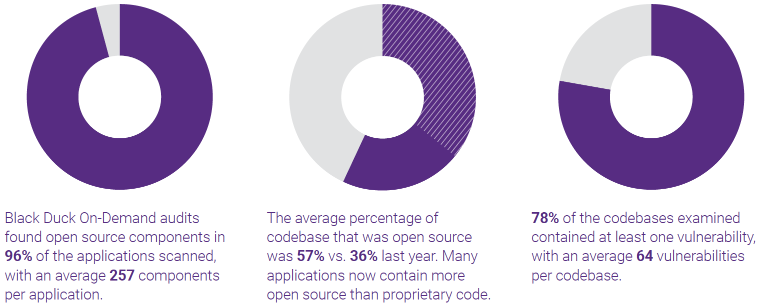
Open Source Security Risks-most applications have open source components
open source components in 96% of the applications scanned, with an average 257 components per application
The average percentage of open source code rose from 36% to 57%
average 64 vulnerabilities per codebase
Data is from BLACKDUCK report ：https://www.synopsys.com/blogs/software-security/infographic-2018-open-source-security-and-risk-analysis-report/

Slide 4
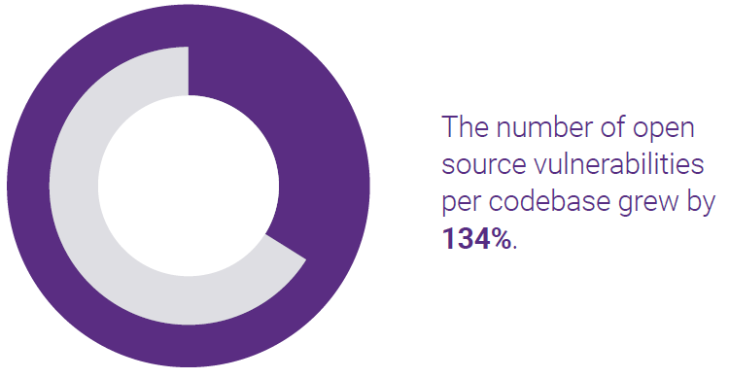
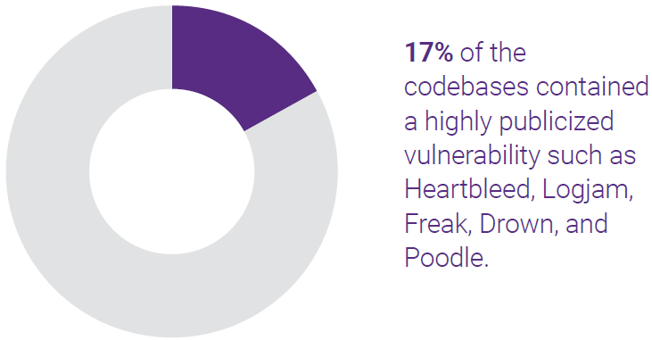
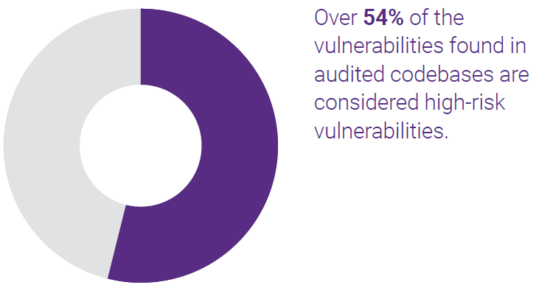
Open Source Security Risks- vulnerabilities grew rapidly, and repair time prolonged
vulnerabilities per codebase grew by 134%
More than half of the vulnerabilities are high-risk
17% of the codebases contained a highly publicized vulnerability
On average vulnerability were disclosed nearly 6 years ago
Data is from BLACKDUCK report ：https://www.synopsys.com/blogs/software-security/infographic-2018-open-source-security-and-risk-analysis-report/

Slide 5
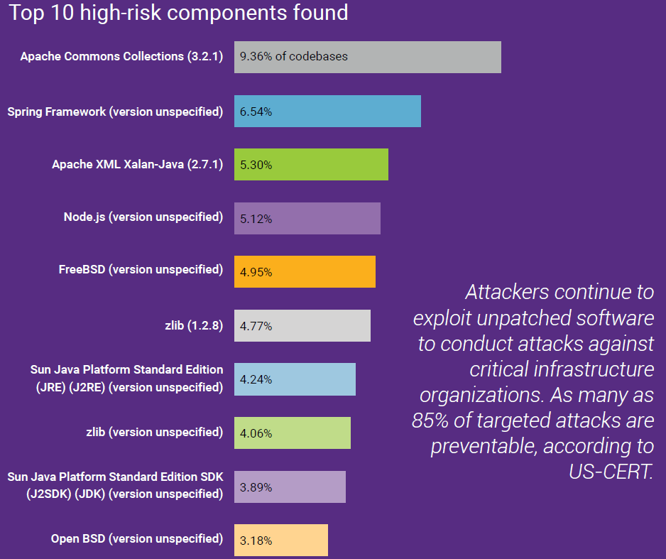
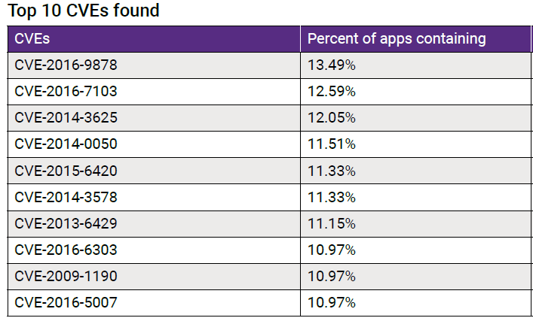
Open Source Security Risks-Top 10 high-risk components
6 high-risk components of top 10 found in ONAP
5 vulnerabilities of top 10 found in ONAP
Data is from BLACKDUCK report ：https://www.synopsys.com/blogs/software-security/infographic-2018-open-source-security-and-risk-analysis-report/

Slide 6
Open Source Security Risks- wide impact
OpenSSL HeartBleed：
  At the time of disclosure, some 17% (around half a million) of the Internet's secure web servers certified by trusted authorities were believed to be vulnerable to the attack, allowing theft of the servers' private keys and users' session cookies and passwords.
  Heartbleed is the worst vulnerability found (at least in terms of its potential impact) since commercial traffic began to flow on the Internet.——Forbes
  Although evaluating the total cost of Heartbleed is difficult, eWEEK estimated US$500 million as a starting point.
Further investigations revealed ：
  OpenSSL was maintained by a handful of volunteers, only one of whom worked full-time.
  Yearly donations to the OpenSSL project were about US$2,000.

Slide 7
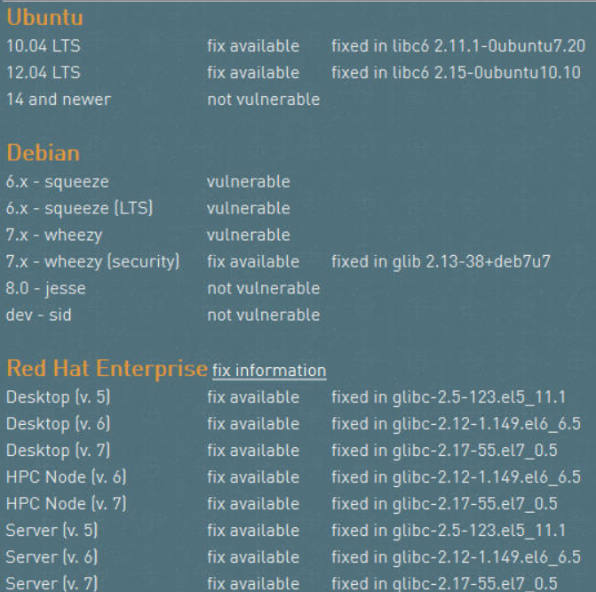
Open Source Security Risks-wide impact
Glibc GHOST：
  The GHOST vulnerability is a serious weakness in the Linux glibc library. It allows attackers to remotely take complete control of the victim system without having any prior knowledge of system credentials.
  The GNU C Library or glibc is an implementation of the standard C library and a core part of the Linux operating system. Without this library a Linux system will not function.

Slide 8
Topic
1
Open Source Security Risks
2
ONAP Security Status
3
Security Enhance Suggestions

Slide 9
ONAP Security Status-many open source components, many vulnerabilities
Many open source components are found in ONAP，and many vulnerabilities are introduced: 171 vulnerabilities found in 718 components in SO, 398 vulnerabilities in 705 components in AAI…
All the vulnerabilities are listed in NVD

Slide 10
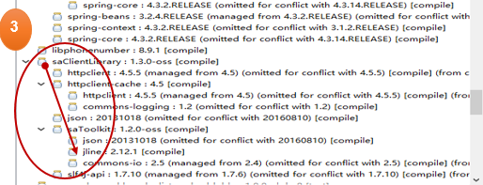
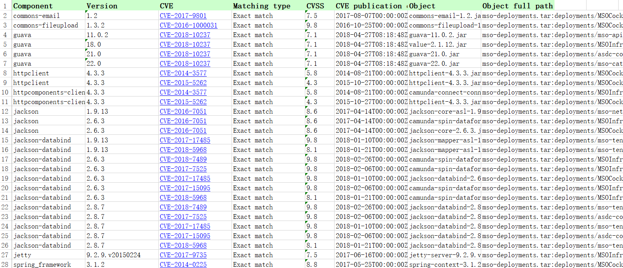
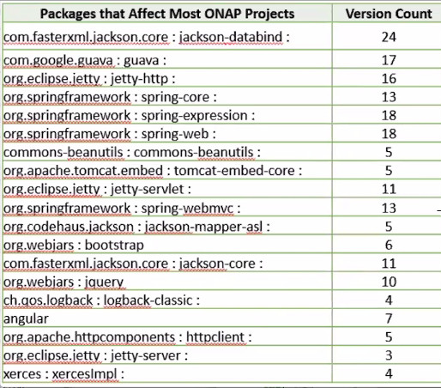
ONAP Security Status- open source components status
1
2
293 open source components scanned in SO source code, and introduce 45 vulnerabilities & 26 high-risk vulnerabilities which referenced 126 times
Multiple versions in the same component: Jackson-databind 24 versions, guava 17 versions,jetty-http 16 versions, etc.
About 20% Components nested reference

Slide 11
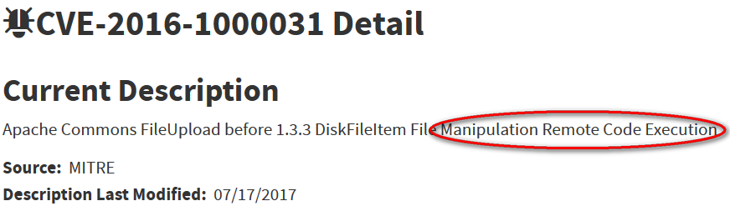
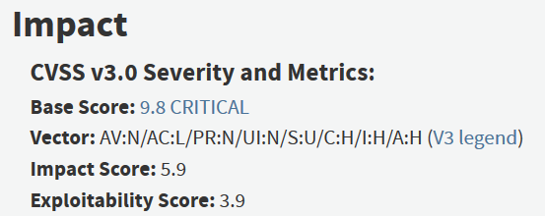
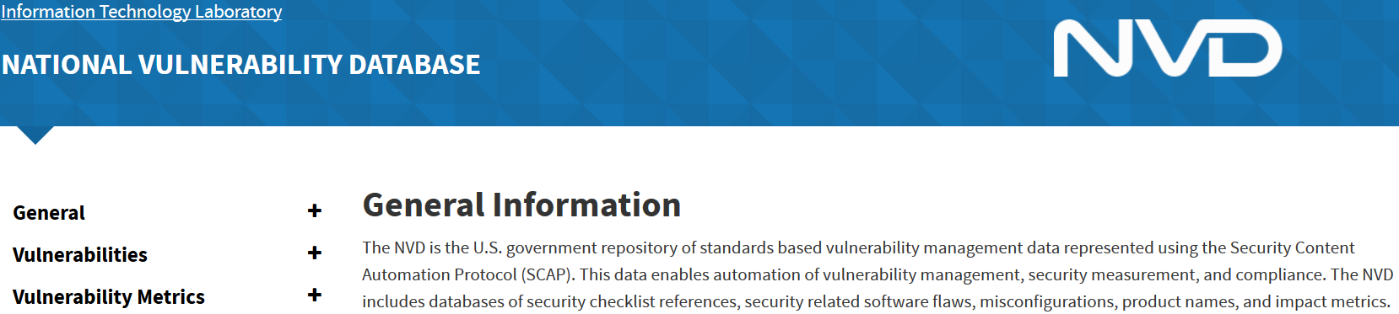
ONAP Security Status -commons-fileupload vulnerability example

Slide 12
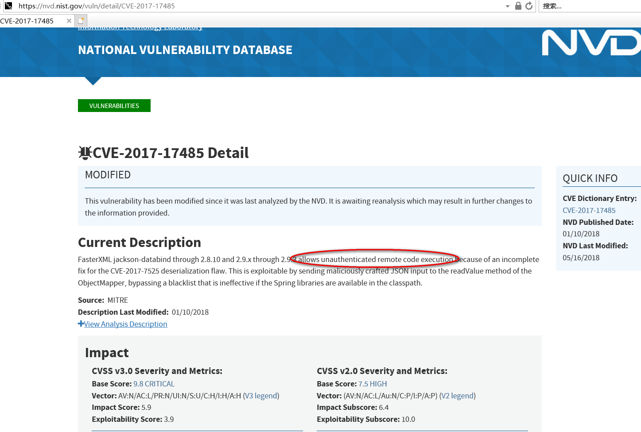
ONAP Security Status- jackson-databind vulnerability example

Slide 13
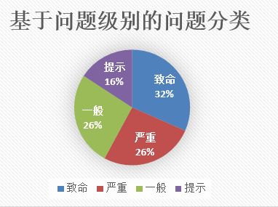
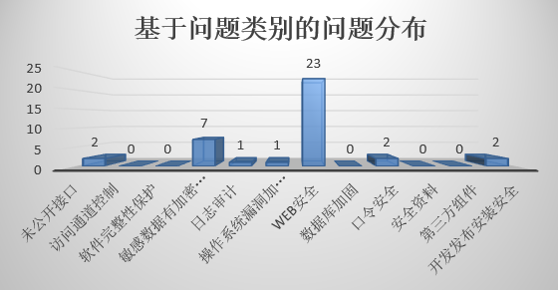
ONAP Security Status– SDC service vulnerabilities status
Many serious low-level vulnerabilities: hard-coded passwords and plaintext storage, weak account database permissions, and a large number of built-in default accounts, etc.
WEB security：ONAP CLI Login without any permission authentication, change user role and modify any user password operation without permission check, serious SQL injection vulnerability and XSS vulnerability, background important file access without permission control, etc.
Weak sensitive data protection
Incomplete log records, no user activity logs, etc.

Slide 14
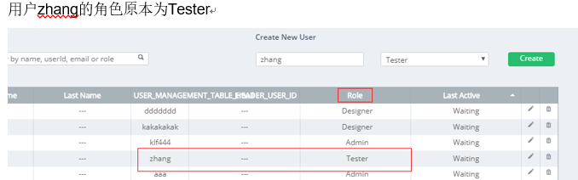
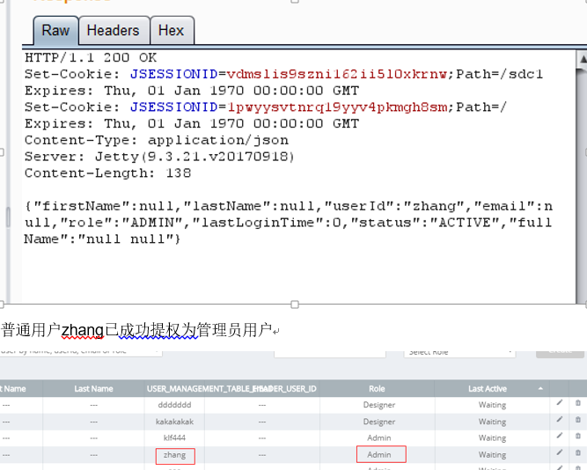
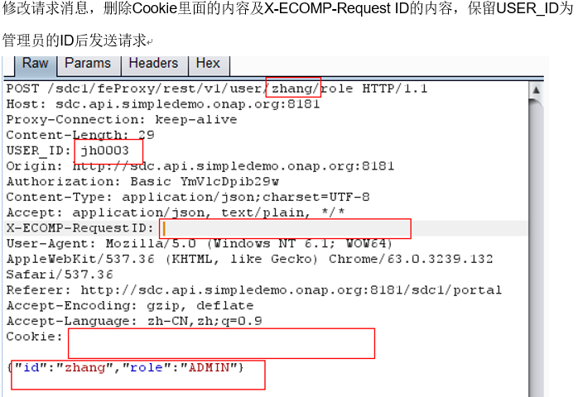
ONAP Security Status- SDC service vulnerability example
No permission check on the change user role operation, and can initiate a request to change without logging in. The normal role can be delegated to the administrator role.

Slide 15
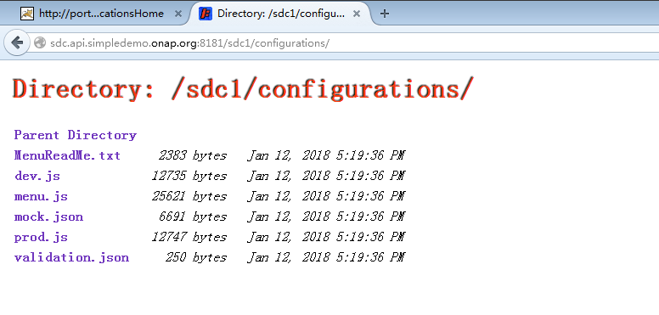
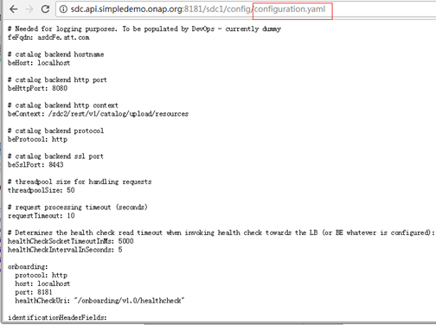
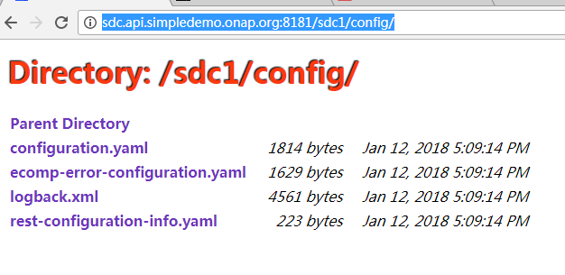
ONAP Security Status- SDC service vulnerability example
Direct access to background related profiles via URL without any permissions：
http://sdc.api.simpledemo.onap.org:8181/sdc1/config/
http://sdc.api.simpledemo.onap.org:8181/sdc1/configurations/

Slide 16
Topic
1
Open Source Security Risks
2
ONAP Security Status
3
Security Enhance Suggestions

Slide 17
Security Enhance Suggestions
High-risk vulnerabilities(CVSS 7+) should be fixed before release
Security rules should be developed to guide Community security coding to ensure community source code does not introduce security issues
Open source security assessment and version management ：
  From the industry's mainstream community
  High activity of the project, vulnerabilities can be fixed in time(Version release frequency ≤ once every six months; High-risk vulnerability resolution time ≤ 1 months)
  Unified open source version
Industry-recognized security scanning tools and methods to validate and evaluate security before release
Pass CII badging Silver level

Slide 18
Thank You!

