Slide 1
5G Midhaul Backhaul Modeling and Orchestrating
Zhuoyao HUANG
ZTE

Slide 2
Agenda
Overview of 5G Midhaul and Backhaul
Modeling proposal for 5G Midhaul and Backhaul
Orchestrating architecture for 5G Midhaul and Backhaul

Slide 3

5G Midhaul and Backhaul --- Multiple Scenarios
Fronthaul
Midhaul
Backhaul
Core
NGC
CU/MEC
DU/BBU中
100GE
FTN
core
nx400GE
普通汇聚
Mesh
NGC
DU/BBU
PTN over OTN
100GE
FTN
nx100GE/400GE
CU/MEC
uRLCC
eMBB
mMTC
Notes:
CU：原BBU的非实时部分将分割出来，重新定义为CU（Centralized Unit，集中单元），负责处理非实时协议和服务。
AAU：BBU的部分物理层处理功能与原RRU合并为AAU （Active Antenna Unit，有源天线处理单元）。
DU：BBU的剩余功能重新定义为DU（Distribute Unit，分布单元），负责处理物理层协议和实时服务。
为了满足5G网络的灵活性和低时延、降低回传负担，核心网下沉和云化成为必然趋势，并引入MEC（移动边缘计算），组成更加分布式的构架。

Slide 4

5G Midhaul and Backhaul --- Multiple Technique
OTN+IPRAN
E2E OTN
FlexEth、SR
SR
标签栈
A
Controller
B
C
D
E
A
B
C
D
E
PDU
Using Segment Routing, the SDN controller only needs to communicate with the source node, and the complete path information has been defined in the form of tag stack on the source node, and only one Touch Point in the network.
Devices only need to maintain topology information without maintaining path information, and can easily achieve million-level connectivity, while maintaining the core device without any connection state.
FlexE Tunnel
IP/MPLS
Routing
IP/MPLS
IP/MPLS
Routing
IP/MPLS
IP/MPLS
Routing
IP/MPLS
MAC
Switching
MAC
MAC
Switching
MAC
MAC
Switching
MAC
FlexE Shim
Switching
FlexE Shim
FlexE Shim
Switching
FlexE Shim
FlexE Shim
Switching
FlexE Shim
PHY
PHY
PHY
PHY
PHY
PHY

Slide 5
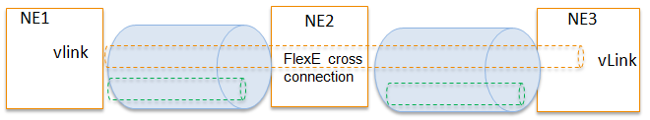
5G Midhaul and Backhaul --- Slicing
Application
layer
3D、Ultra HD video
Voice
Cloud office and games
AR
Smart home
Smart city
Industrial automation
Autopilot
High reliable application
Controller
Business
control
layer
URLLC
eMBB
enterprise
E2E Service
Slice Functions
Cloud RAN
Edge
DC
Slice Controller 1
Slice Controller 2
Slice Controller 3
Ctrl Functions
Physical network
Common Functions

Slide 6
5G Midhaul and Backhaul --- Reqirments for Modeling
Multiple Scenarios
  Scenarios Agnostic
Multiple Technique
  Common Model
  Technique Agnostic
  Vender Agnostic
Slicing
  Abstract
  Recursive

Slide 7
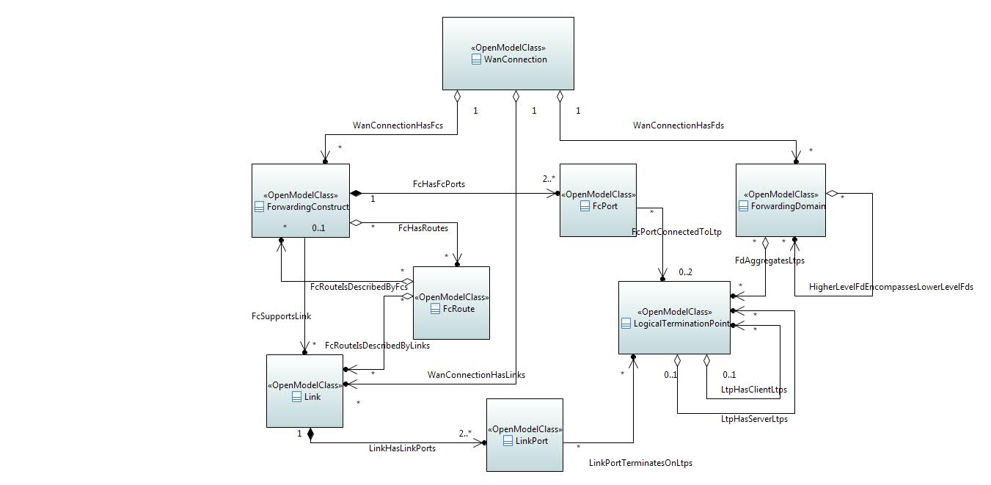
Wan Connection ( ONF CIM based )
Notes:
先介绍class
再介绍关系

Slide 8
Calsses
Wan Connection: The Wan Connection is Resource Composite.
Forwarding Domain: The Forwarding Domain (FD) class models the topological component that represents a forwarding capability that provides the opportunity to enable forwarding (of specific transport characteristic information at one or more protocol layers) between points.
Forwarding Construct: The Forwarding Construct (FC) class models enabled constrained potential for forwarding between interfaces at a particular specific layerProtocol.
FC Port: Fowarding Construct Port. The association of the FC to interfaces is made via FC Ports. The FC Port class models the access to the FC function.
FC Route: Each instance of an FC Route class models an individual route of an FC. The route of an FC object is represented by a list of FCs at a lower level with the implicit understanding that unmodeled link connections are interleaved between the lower level FCs.
Link: The Link class models effective adjacency between two or more ForwardingDomains (FD).
LinkPort: The association of the Link to LTPs is made via LinkPort. The LinkPort class models the access to the Link function.
LTP: The Logical Termination Point (LTP) class encapsulates the termination and adaptation functions of one or more transport layers represented by instances of LayerProtocol.

Slide 9
General scenario
Site
Subnet
Site
FD
CE
CE
Subnet
FD
XC: FC
XC: FC
XC: FC
XC: FC
PE
PE
LC: FC
LC: FC
LC: FC
PE
Subnet
XC: FC
PE
CE
XC: FC
CE
Site
Site
XC: FC
XC: FC
FD
Subnet
FD
PTN L3vpn: FC
OverlayLink: Link
Vxlan: FC

Slide 10

ONF diagram symbol

Slide 11
Modeling --- 5G Midhaul and Backhaul
FrontHaul
MidHaul
BackHaul
Core
NGC
CU/MEC
DU/BBU集中
100GE
FTN
区县核心
市核心
nx400GE
普通汇聚
Mesh化结构
NGC
DU/BBU集中
PTN over OTN
100GE
FTN
nx100GE/400GE

Slide 12
Recursive Modeling
VPN
Supports
SR
Supports
FlexEth
FC

Slide 13

Recursive Modeling
Fc (Client Layer)
Fc Route (Client Layer)
Link (Client Layer)
Fc (Server Layer) Supports Link (Client Layer)
Fc (Server Layer)

Slide 14
Technique Agnostic
WAN Connection classes properties are technique agnostic
WAN Connection is resource, will be deploied by SDN-C
Technique related specification profiles are distributed as artifacts associated with WAN Connection resources ( FC / LTP / FC Port ...).
  Such as: Bandwidth Profile, Policy Profile could be distributed as JSON form artifacts
  Technique related specification profiles will be consumed by SDN-C
Common model for all wan scenarios, reduce new use case impact to SDC and Modeling, less talk and more solid work

Slide 15
WAN Connection deploy flow
UUI
SO
SDN-C
A&AI
3rd Controller
1. create e2e service
2. create e2e service instance
3. decompose service template
4. create wan connection resource instance
5. create wan connection resource instance
6. decompose wan connection resource
7. create wan connection instance

Slide 16
Thank you!

