Slide 1
5G Functional Requirements and Key Issues
Huawei 5G Use Case Team
YU Yijun, WANG Yaoguang

Slide 2
Background
5G Use Case in Beijing
5G Use Case in Casablanca
SDOs alignment for ONAP 5G
Our work in ONAP 5G
Summary

Slide 3

Background of 5G use case in ONAP
ONAP
Management - Design
ONAP
Management - Runtime
5G
Application
Ecosystem
Core Network Elements
RAN Network Elements
Macro Radio
& Small Cell
Antennas
Disaggregated Core
5G
Base Stations
CU-CP-H
UPF
SMF
UDM
AUSF
CU-CP-L
RU
DU
CU-UP
Centralized
Cloud
Internet
UE/CPE
Back Haul
Front Haul
Mid Haul
External Content
Edge
Cloud
RU – Remote Radio Unit
DU – Distributed Unit (5G Base Unit)
CU-UP – Centralized User Plane
CU-CP – Centralized Control Plane (low/high split is FFS)
UPF – User Plane Function
SMF – Session Management Function
UDM – Unified Data Management Function
AUSF – Authentication Service Function

Slide 4
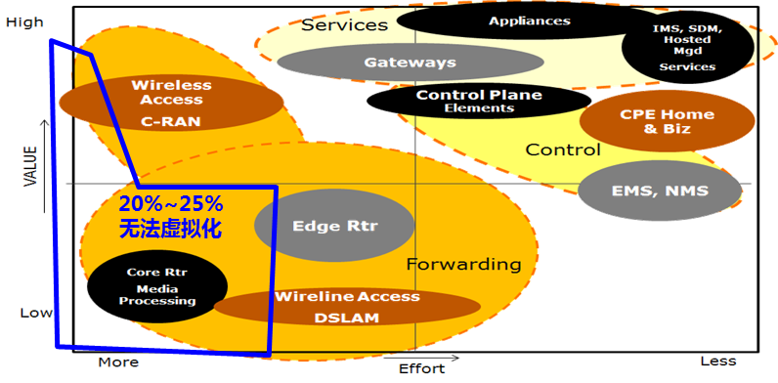
5G Use Case in Beijing
5G Use Case: RAN deployment, Slicing, SON
Sub Case A – 5G RAN Deployment | Expand ONAP capabilities to support different lifecycle management aspects of PNF & VNF
Sub Case B – 5G Slicing | ONAP enhancements in the areas of SDC/AAI modeling and service definition, lifecycle management of slices
Sub Case C – 5G Optimization | Performance optimization, e.g. SON. (conflict resolution, policy-driven optimization capabilities)
Sub Case D – ONAP Optimization Framework and Multi Cloud | OOF enhancements for optimal placement of resources and multi-cloud
https://wiki.onap.org/display/DW/Use+case+proposal%3A+5G-+RAN+deployment%2C+Slicing%2C+SON
PNF support is the most important issue in ONAP 5G use case
PNF support only, e.g. CU/DU split, CU/DU combination
PNF & VNF hybrid support, e.g. DU as PNF, CU as VNF
Slicing is not mature enough for ONAP implementation.
Optimization need more time for study.
Network Virtualization Analysis: PNF vs. VNF is 1:3

Slide 5
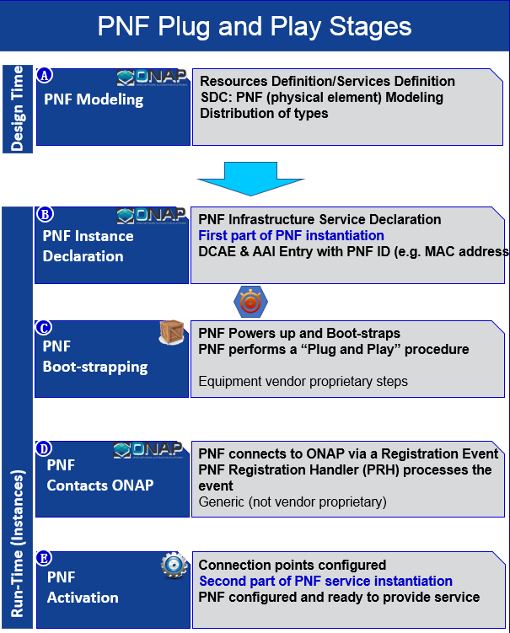
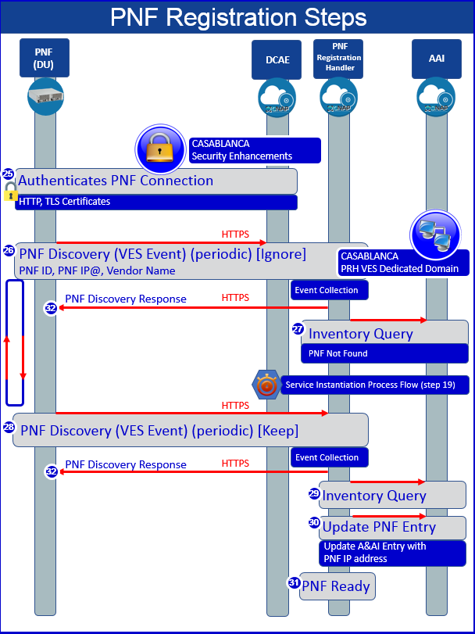
PNF Achievements in Beijing
1. Complete the PNF PnP flows design. 2. Complete parts of the source code, e.g. PRH enhancement.

Slide 6
5G Network Architecture & Casablanca Scope
DESIGN-TIME
Dashboard OA&M
RUN-TIME
Resource Onboarding
Common
Services
Active & Available Inventory
External Registry
Data Collection, Analytics, and Events
Event Correlation
Common Services
Orchestration
Policy Framework
Service Design
ONAP Operations Manager
Policy Creation & Validation
Application
Authorization
Framework
Analytic Application Design
Micro Services Bus / Data Movement
ONAP Optimization Framework
VNF / PNF Certification & Onboarding
Closed Loop Design
Change Management Design
Multi-Cloud
Adaptation
(Data Center & Edge Cloud)
SDN Controller (SDN-C)
App-C
Logging
Configuration & Life Cycle Management
Configuration & Life Cycle Management
Common Controller SDK
Design Test & Certification
Adaptation Layer
Adaptation Layer
Others
Catalog
DU
CU-UP
CU-CP
Front Haul
Mid Haul
Edge Cloud

Slide 7
Casablanca Enhancement Plan Summary
  Enhance ONAP Platform to deploy hybrid 5G Radio Network (PNFs & VNFs)
    Expand Packaging standards to include PNFs
    Enhance VNFDSK to support PNF packages as well (depends on 1)
    Enhance SDC to support PNF onboarding and hybrid network design (using PNF / VNF)
    Need a way to model in SDC the “Service Instantiation” sequencing relationships that SO must enforce for PNF service instantiation.
    Add PNF Plug-n-Play to auto register newly installed PNF
    Enhance SO to support decomposition of Services that include VNFs and PNFs
    Support for Edge deployment (e.g. CUs) – Edge Cloud Automation
    Expand ONAP controllers by adding wireless service yang models, network yang models and service logic to ONAP.
    Add common reusable logic to CCSDK to support wireless
    Support a single controller persona (SDN-C) to support L1-7 network configuration and lifecycle management for 5G network elements
    Integrated controller configuration design tool to capture L1-7 configuration data for radio network elements
    Enhance DCAE for near real-time (order of seconds) streaming performance data collection
    Enhance DCAE for Bulk performance data collection
    Introduce Real-time streaming analytic platform
  OOF enhancements for optimal placement of edge resources & Framework Enhancements to implement selected network optimization (e.g. PCI assignment)
Complete PNF&VNF hybrid support
Study of enhancement on platform & tools
Complete PM data reporting of PNF/VNF
Case & PoC Study

Slide 8
  PNF PnP Enhancements
TOPIC | DESCRIPTION
PNF Registration Handler (PRH) enhancements | Define a New VES Event Domain for PNF registration with the corresponding support in DCAE VES Collector, DMaaP and PRH
SDC Enhancements | Enhance SDC to support PNF onboarding and hybrid network design (using PNF / VNF) with generic workflow to instantiate PNF (i.e. put it in service)
SO Workflow enhancements | Enhance SO to support model driven dedicated workflow for PNF elements
Service Configuration Enhancements | Add needed artifacts in CCSDK to support Radio / Microwave configuration, PNF discovery and registration support
Security enhancements | Authentication and Certificate support for PNF, including registration event and data collection (fault and performance)
Modeling enhancements | Enhance ONAP information and data model to fully support 5G PNF elements, including inheritance and PNF sharing characteristic
PNF onboarding and packaging | Define PNF Package, PNF package validation and onboarding enhancements

Slide 9
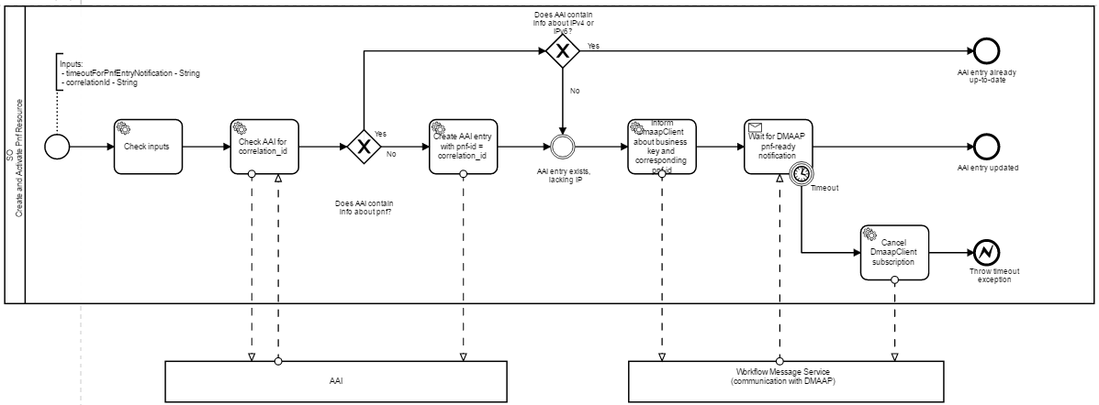
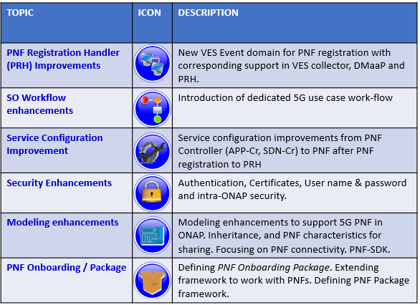
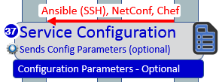
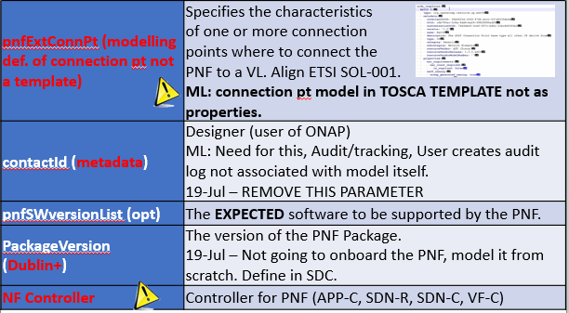
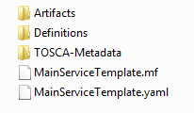

Work plan of PNF PnP in Casablanca
PNF PnP Summary in Casablanca
Need another sub-process to complete PNF activation phase
37 | Service Configuration (ONAP Controller → PNF) - Configuration Parameter (optional) - OAM IP@ (optional) - Transport configuration (optional) - Location (optional) - Software Version (optional)
NF PACKAGE
CSAR file
Only pnfSWversion is approved
Need consider all PNFs

Slide 10
  PERFORMANCE ANALYSIS & OPTIMIZATION
TOPIC | DESCRIPTION
Bulk performance measurement (PM) data collection | Enhance DCAE VES collection layer to support periodic (e.g. every 5 to 15 minutes) bulk data collection from VNFs and PNFs. Support both file-based collection and mapping to VES Events for chosen file content
High Volume and Near Real-time streamed data collection of Performance measurements | Enhance DCAE performance measurement (PM) data collection to support near real-time (order of seconds) data. Introduce a high-volume VES collector using a persistent connection (TCP socket), support a new data encoding (GPB). Distribute DCAE collection at the cloud edge (for scalability)

Slide 11
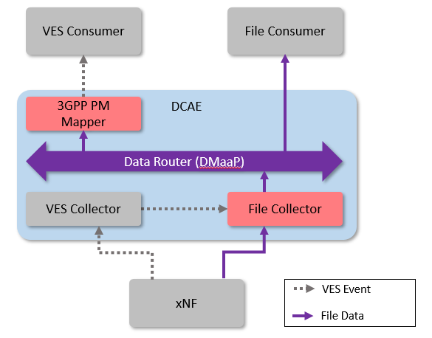
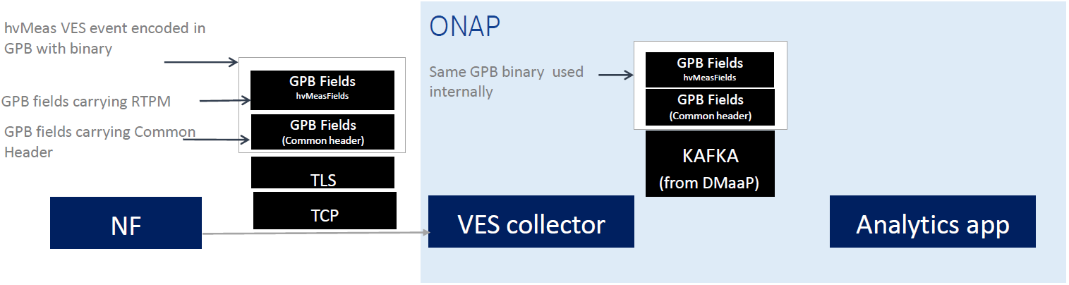
ONAP progress on PNF PM
I: Bulk PM
Event-driven bulk transfer of monitoring data from an xNF to ONAP/DCAE. The collected data files are published internally on a DMaaP Data Router (DR) feed. (File Collector)
An optional 3GPP PM Mapper micro-service is planned that can extract selected measurements from a 3GPP XML file and publish them as VES events on a DMaaP Message Router topic. The mapper receives the files by subscribing to a Data Router feed.
II: Real-time PM
•Event driven high volume data delivery from xNF to ONAP/DCAE.
A new hvMeas event encoded as message length + GPB binary and streamed via TCP Sockets.
A new VES-HV Collector will support GPB over TLS/TCP(committed).
•The collected events will be published to DMaaP and sent directly to the Kafka Cluster.

Slide 12
  Service Configuration Enhancements
TOPIC | DESCRIPTION
Enhance CDT tool to support 5G and integrate into SDC | Integrate App-C focused CDT tool into SDC and enhance it to support 5G network elements configuration design
Capture and Verify PNF Software version | Enhance ONAP controller (SDN-C) to capture and verify PNF software version, Enhance A&AI to store PNF Software version
PNF & CU Application Level Configuration (Controller Enhancements) | Generate a single ONAP controller persona (SDN-C) from CCSDK to support various 5G network elements (Layer 1 through 7 configuration and management)
Lifecycle management Support | Enhance change management support 5G PNF / VNFs (e.g. software upgrade)

Slide 13
ONAP Project Repos & Executables: Casablanca
Repos
SDN-C
CCSDK
App-C
sdnc-logic
Northbound APIs
  VNF-API
  GEN-RESOURCE
  DMaaP
  LCM
  Wireless Services
ccsdk-parent
ccsdk-sli-core
ccsdk-sli-plugins
ccsdk-sli-adapters
ccsdk-distribution
Common microservices
Common health checks
Common APIs
Common logging
Common model management
Common resource management
appc-northbound
spectrum-logic
wireless-logic
ran-logic
New
appc-adapters
New
5G element adapters
appc-logic
Executable Images
SDN-C
App-C
SDN-R Team Contribution

Slide 14
  Optimization Framework Enhancements
TOPIC | DESCRIPTION
Optimal placement of vNF | Placement of Mobility Virtual Network Elements (CUs) across the highly distributed edge clouds is a fundamental requirement. Service Providers must also optimize the performance of the 5G RAN in real-time.
Optimization problem formulation | Ability to model the problem as a constrained optimization problem, that is driven by policies – Potential use case examples: formulation of optimization problems at various levels: Customer (e.g. provisioning), Service (e.g. slice optimization ), Network (e.g. Routing, problems at the network planning level), Infrastructure (e.g. Placement) & Resource (e.g. License)
Optimization problem solving | Ability to use and deploy appropriate analytics, algorithms and solvers to solve the problem in acceptable time frames at various levels: Customer, Service (e.g. Slice Optimization Analytics), Network (e.g. SON network planning analytics), Infrastructure (e.g. Placement) & Resource
 | Impacted systems: SDC, SO, Policy, AAI, DCAE, SDN-R, MultiCloud (possibly)

Slide 15
ONAP Casablanca: PCI Optimization using OOF
7
4
Config change
Change Notifn
6
Simulated RAN
~2000 Cells
Nbr_list, PCI values
OOF
Policy
10
SDN-C
1d
(Netconf/Yang)
1c
8
PCI Handler MS
9
1b
1a
Config DB
2
3
11
5
Step | Functionality |  | Step | Functionality
1a-1d | Modules loaded to support PCI |  | 6 | Fetch PCI optimization policies
2 | PCI-Handler MS fetches configuration policies |  | 7 | OOF fetches data for cells in the region.
3 | Config change notification from RAN to SDN-C (e.g. Nbr list change) |  | 8 | OOF provides PCI Optimization result
4 | SDN-C sends config data change to PCI-Handler-MS. |  | 9 | PCI-Handler-MS provides PCI recommendation to Policy
5 | PCI-Handler MS invokes OOF for pre-defined workflow for PCI Optimization via REST API. |  | 10 | Policy sends message to SDN-C with instruction for PCI configuration changes
 |  |  | 11 | SDN-C applies config changes

Slide 16
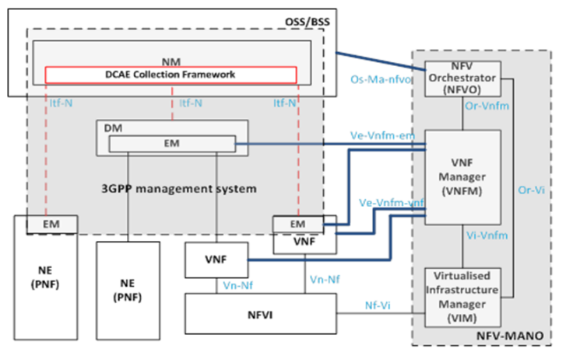
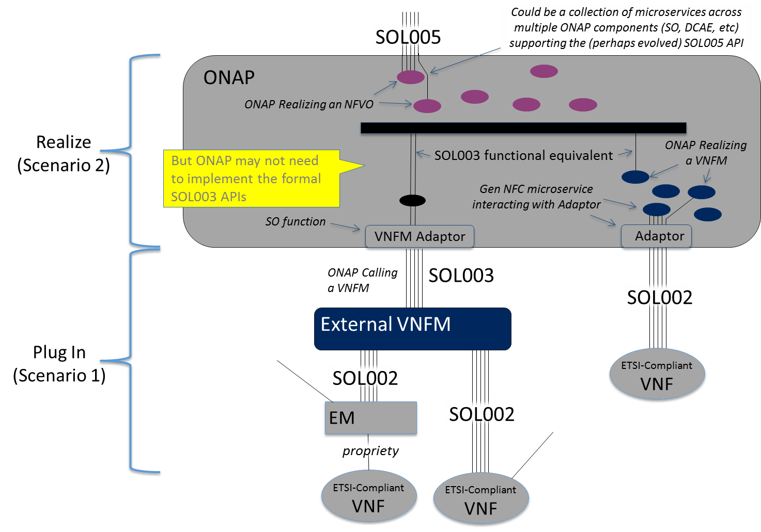
Standard alignment with SDOs
1. Standard alignment work between ONAP and 3GPP
2. Standard alignment work between ONAP and NFV
Scenario-1: Plug-in
  Evolve details on the interface between ONAP and plugged in VNFM, and implications on the adapter
  Evolve the details on the interface between ONAP and the plugged in NFVO and implications on the adapter
  Plan for ONAP Rel-C.
Scenario-2: Realizing
  Work to define the set of ONAP Microservices that would support the ETSI-NFV external APIs
  Plan for ONAP Rel-C/D.
Plan to create a joint expert group between ONAP and ETSI NFV to progress the work
TR 28.900： Study on integration of ONAP and 3GPP reference management for 5G networks
It is planed to align with the achievement of ONAP Casablanca, and finish the study (including CM/PM/FM/LCM and etc) in March 2019.
S5-183597:Study on integration of ONAP DCAE and 3GPP management architecture
S5-183392: Study on integration of ONAP and 3GPP configuration management services for 5G networks
S5-183391：Study on protocol enhancement for real time communication

Slide 17
Our work in ONAP 5G: Overview
Rationale: Providing a layered, multi-domain and scenario-driven operational management platform for service providers.
Aligned to 3GPP/ETSI, the whole management architecture is layered, from OSS/BSS, ONAP, EC and NE.
ONAP handles MV management, while the external controller is domain specific management.
The SBIs of ONAP need to be standardized. It is recommend to achieve that by scenario-driven methods.
Business
OSS/BSS
MV
Network Management (MV)
ONAP
Subnet Management
RAN External Controller
Domain
NE
CU/DU
5G Managed Object
(3GPP 28.532)
E.g. 5G RAN Domain

Slide 18
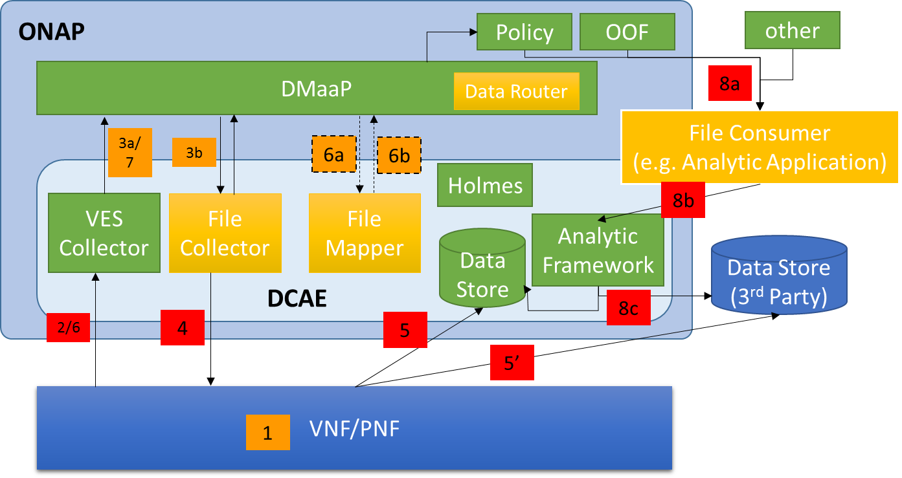
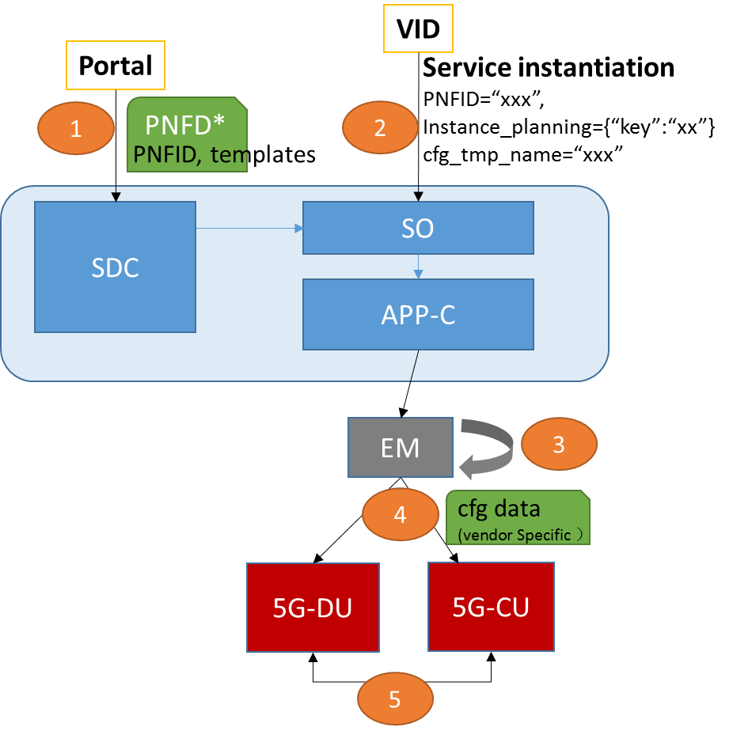
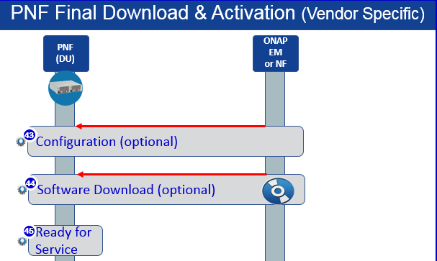
Our work in ONAP 5G: PnP & PM
I: PNF SW Management & Cfg Management in PnP
I: Push-based PM
Software Categories:
ONAP bootstrap software, e.g. VES client
PNF bootstrap software (vendor Specific)
PNF Expected software (vendor Specific)
4. The File Collector tells VNF/PNF the expected locations
  - Knows REST APIs in step 2
5. PM data is sent to the specified location
  - Maybe inside/outside ONAP Data stores
6. FileTransferNotification event is sent to DCAE
  - Indicates success or failure
  - If success, notify the identifier in the store
PNF Software Version is modeled (Information Model, SDC)
PNF final activation support EM-based method
Push-based method
File identifier is transmitted in messages instead of contents

Slide 19
Our work in ONAP 5G: PNF Software Upgrade (w/ CMCC)
Portal
Operator
(e.g. VID/UUI, Timer)
Provisioning. Preparing necessary artifacts, and service register to ONAP.
Upgrade workflow design.
Service Modeling, pnfSwVersionList, pnfSwUpgradeRulesList.
Distribute
Execute workflow with necessary parameters (incl. ExpectedSWVersion).
Assign ONAP controllers to execute actions.
Precheck (skip update AAI entry)
Apply checking rules, collect necessary data for prechecking
Retrieval req/res
S/W upgrade
swDownload to PNF and activate it
postcheck (skip update AAI entry)
Apply checking rules, collect and do comparison
Upgrade Result notification (Succ/Fail)
Send new S/W version to DCAE (like PNF Operation Handler)
Update S/W version in AAI, e.g. ‘active’ version.
(5)
(3)
SO
A&AI
(/)
(2)
(4)
SDC
DMaaP
(16)
(6)
DCAE
ONAP Controller
(SDNC/APPC/VFC)
PRH
POH
(7) (10) (12) (14)
(1)
(8) (11) (13)
External Controller
(e.g. EM)
(15)
(9)
PNF
POH: PNF Operation Handler
Wiki: https://wiki.onap.org/display/DW/5G+-+PNF+Software+Upgrade

Slide 20
Our work in ONAP 5G: PNF Software Upgrade (w/ CMCC)
Functionalities
Key Issues/Items
Leverage in-place software upgrade Beijing use case to demonstrate application to 5G RAN PNFs
Complete generic building blocks for upgrade workflow design
Enhance precheck and postcheck steps with vendor specific rules
Integrate the external controller into ONAP controller, and the EC will handle temporary states retrieval/storage/analysis of PNFs, PNF ID, Expected Software Version, Controller Type, EC type, Rule Name and corresponding parameters can be specified at run time
Update A&AI entry with new PNF software version, as active version
Support Batch software upgrade operations (stretch goal)
  How does the External Controller (EC) register to ONAP?
  Option 1: MSB (Impact configuration file)
  Option 2: AAI-ESR (Impact Netconf server info)
  Option 3: No registration, only pass params (Recommend in R3)
  AAI API and schema support for PNF SW Upgrade
  Update PNF Software version in A&AI when upgrade is completed
  Discussion is ongoing in AAI and SDC team
  How does SO interact with ONAP Controller, e.g. APPC/SDNC/VF-C, ( SO→ONAP Controller）
  a workflow for change management
  VID or UUI to trigger the CM workflow
  How to pass the values for payload
  LCM API support and DGs in APPC? (ONAP controller → EC)
  PreCheck/SoftwareUpgrade/PostCheck/Rollback
  PNF Operation Handler(POH) micro-service in DCAE
  The functionality is similar with PRH
  Stretch goal in Casablanca
  Automated Integration Test in ONAP
  Need work with INT team
Test cases | Description
1 EC registration test | Ensure ONAP controller can find out the EC
2 PreCheck test | Ensure the EC can receive the precheck command from ONAP controller
3 SwUpgrade test | Ensure the EC can receive the software upgrade command from ONAP controller
4 PostCheck test | Ensure the EC can receive the postcheck command from ONAP controller
5 New SW version report test | Ensure the software upgrade completion event can be reported to DCAE
6 New SW version update test | Ensure the new software version can be updated in A&AI
7 E2E Workflow execution test | Ensure the e2e software upgrade workflow can be executed at run time

Slide 21
Summary
5G Use case started from Beijing and had good progress in Casablanca. Several 5G functional requirements passed M2 very well. [M3,30/8]
5G RAN deployment sub-case still needs much work to do. PNF support (e.g. PnP, FM reporting and etc.) is fundamental feature in Casablanca for the Deployable target.
A layered, multi-domain architecture could reuse the industry existing achievements as more as possible, and will help ONAP to be deployed in commercial environment asap.
Scenario-driven could enrich the ONAP capabilities case by case, and is valuable to help ONAP platform to become high maturity.
Function support is more important than optimization at this stage.

Slide 22
Thank You!

