Slide 1
ONAP – PNF requirements

Slide 2
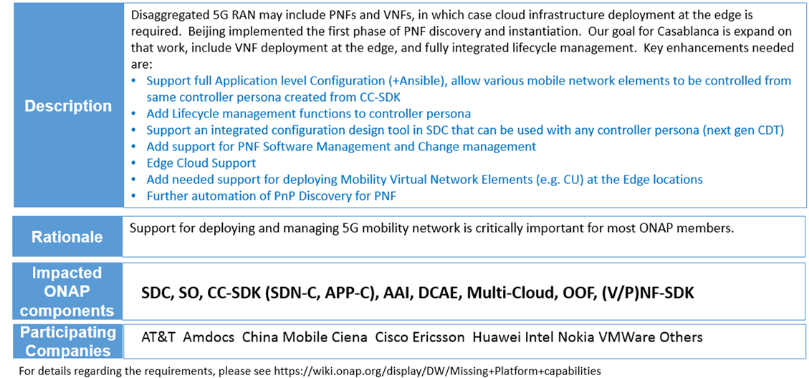
A: 5G Radio Network Deployment Requirements
Based on the Requirements in Casablanca
And demands from RAN Use Case Orchestration
Align with 3GPP&ETSI
Introducing a PNF IM
Potential TOSCA Definition

Slide 3
PNFD Definition in ETSI
PNFD Definition in ETSI-NFV-IFA014v243
PNF management in ETSI-NFV-IFA013v303
AddPnfData is used when instantiating a NS
Attribute | Qualifier | Cardinality | Content | Description
pnfdId | M | 1 | Identifier | Identifier of this Pnfd information element. It uniquely identifies the PNFD.
functionDescription | M | 1 | String | Describes the PNF function
provider | M | 1 | String | Identifies the provider of the PNFD.
version | M | 1 | Version | Identifies the version of the PNFD.
pnfdInvariantId | M | 1 | Identifier | Identifies a PNFD in a version independent manner. This attribute is invariant across versions of PNFD.
name | M | 1 | String | Provides the human readable name of the PNFD.
pnfExtCp | M | 1..N | PnfExtCpd | Specifies the characteristics of one or more connection points where to connect the PNF to a VL. See clause 6.6.4.
security | M | 0..1 | SecurityParameters | Provides a signature to prevent tampering.
geographicalLocationInfo | M | 0..1 | Not specified | It provides information about the geographical location (e.g. geographic coordinates or address of the building, etc.) of the PNF. The cardinality 0 is used when the location is unknown.
NOTE: The provider of the PNFD might be different from the provider of the PNF.
Attribute | Qualifier | Cardinality | Content | Description
pnfId | M | 1 | Identifier | Identifier of the PNF. Assigned by OSS and provided to NFVO.
pnfName | M | 1 | String | Human readable name of the PNF.
pnfdId | M | 1 | Identifier (Reference to Pnfd) | Identifier of (reference to) the PNFD related to this PNF.
pnfProfileId | M | 1 | Identifier (Reference to PnfProfile) | Identifier of (reference to) the PNF Profile to be used for this PNF.
cpData | M | 0..N | PnfExtCpData | Information on the external CP of the PNF.
Contains the address (e.g. IP address) information of the CP.
Table 6.6.2.2-1: Attributes of the Pnfd information element
Table 8.3.4.32.2-1: Attributes of the AddPnfData information element

Slide 4
PNF management ETSI NFV
OSS
NFVO
PNFD design based on the information in IFA014
PNFD “on-boarding”,
  Creating an PNFD information object.
  Uploading the PNFD.
  Processing the PNFD, including validation, inside the NFVO.
PNF “power up” is out of scope of ETSI NFV
Instantiate NS operation (AddPnfData)
response

Slide 5
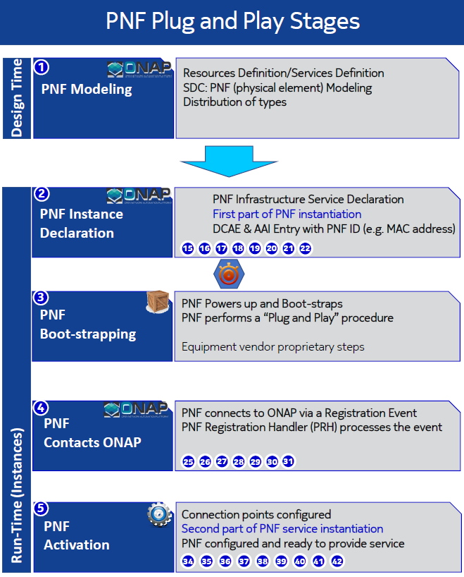
Requirements for PNF
INPUT: PNF Descriptor (PNFD) (Vendor Provider)
ACTION: User builds a resource definition customizing vendor’s PNF description. “blue print” of PNF
OUTPUT: SDC Resource Definition
PNF external connection point:
  The connection information of a PNF,
  the VNF external connection point has
  Already been supported by SDC, PNF can
  Reference the same definition.
VID, DCAE, A&AI
Vender proprietary
DCAE, A&AI
SDC, VID, SO, SDN-R

Slide 6
Requirements for PNF
Scenarios of PNF SW management:
Regular NE software version upgrade. Operator could upgrade the SW to the specific version for several PNFs
To satisfy the radio interface coverage in some area for the specific RAT , operators could change PNF SW between different RATs at some PNFs
To increase the RAN capacity for the specific RAT, operators could change PNF SW between different RATs at some PNFs
BTW: Orchestrator could verify the SW is valid or not
Software_version1
Software_version1
Software_version3
…
ONAP user decides the software version to download to the PNF
Hardware

Slide 7
Requirements for PNF
ONAP Deployment
Associating the ONAP Controller (APP-C, SDN-C, VF-C) for a PNF
Each of categories of PNFs & VNFs will be managed by different Controllers.
SOLUTION (Casablanca)
  Hard-Code controller to PNF.
j
RUN-TIME
VF-C
SDN-C
SDN-R
APP-C
Wireless
RAN
Technology
Domain
Optical
IoT
PNF-A
PNF-B
PNF-C
VNF-A
VNF-B
VNF-C

Slide 8
