Slide 1
ONAP Internal Model Analysis

Slide 2
Internal Data Model - Background
Model Process Flow
Vendor
Package
SDC
ONAP DM
VNF
Onboarding
Service
Design
Refinement
Distribution To
Runtime Components
Vendor
Package
orchestration & operation
Inhouse design
onboarding
design

Slide 3
Internal Data Model - Background
Vendor
Package
SDC
ONAP DM
VNF
Onboarding
Service
Design
Refinement
Distribution To
Runtime Components
Vendor
Package
Standard Based – ETSI NFV
Supported by all vendors
Compatible with multiple platforms
Able to run in commercial environments
Open to multiple input standards (not only ETSI)
Rapid update and development
Being model-driven
Standard doesn’t fulfill the requirement

Slide 4
Internal Data Model - Background
Vendor
Package
SDC
ONAP DM
VNF
Onboarding
Service
Design
Refinement
Distribution To
Runtime Components
Vendor
Package
Multiple Onboarding Options:
Heat
SOL001 (NFV standard)
R2 DM
…
Model Translation:
Translate onboarding model to internal model
Preserve onboarding information
Current solution: make onboarding package as an artifact
Unified Internal Model:
Relatively independent with standard
Guided by IM, SOL001

Slide 5
Internal Data Model - Options
Currently, there’re 3 options for the ONAP internal data model:
  Release 2 Data Model
  ECOMP AID Model (current SDC model)
  Target Internal Model (by Anatoly, ATT)

Slide 6
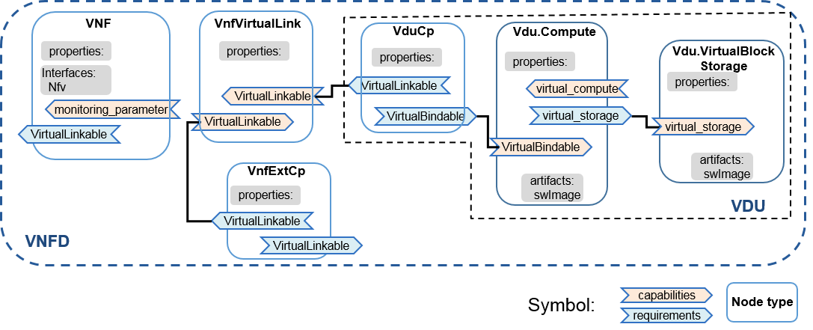
Release 2 DM
Based on SOL001 v0.6.0
Implementing R2 VNFD IM
  Including some enhancements of attributes (e.g., vNIC name, order, inject files, etc.)
  Adding LCM parameters (LCM interface type)
  No DF
  No affinity/anti-affinity rules
  No modifiable attributes / configurable properties

Slide 7
ECOMP AID Model
Similar concept with ETSI
  VNF(VF) is composed of VNFC(VFC), VL and CP
Service is composed of VNF and VL

Slide 8
ECOMP AID Model
Matching Heat

Slide 9
ECOMP AID Model
Matching Heat

Slide 10
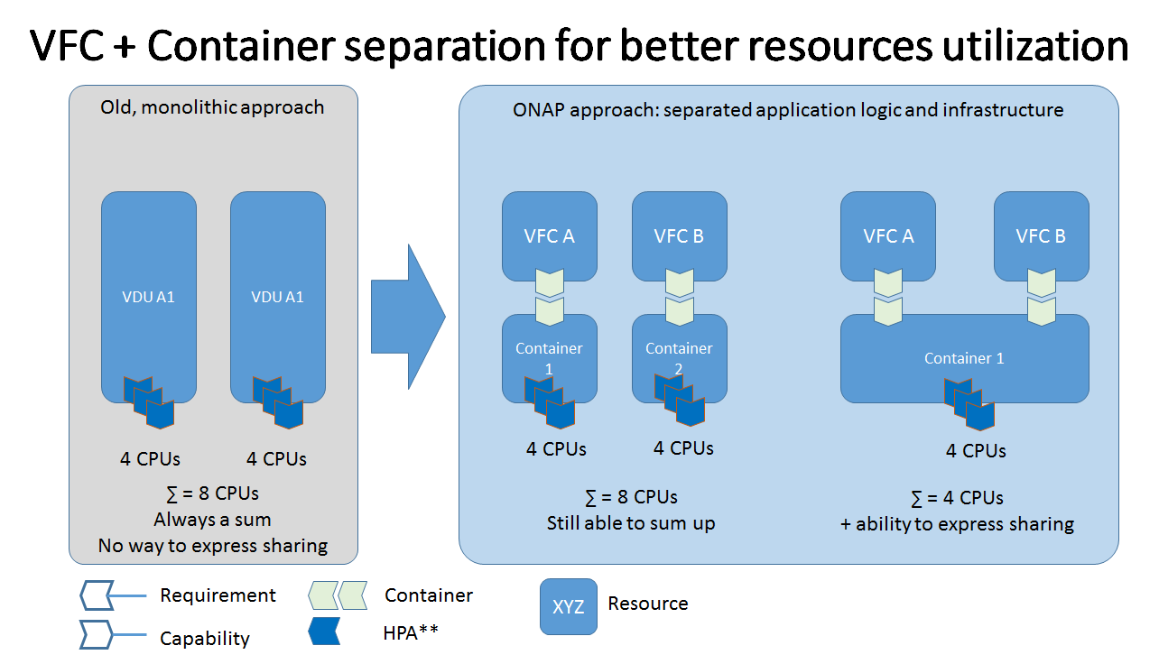
Target Internal Model

Slide 11
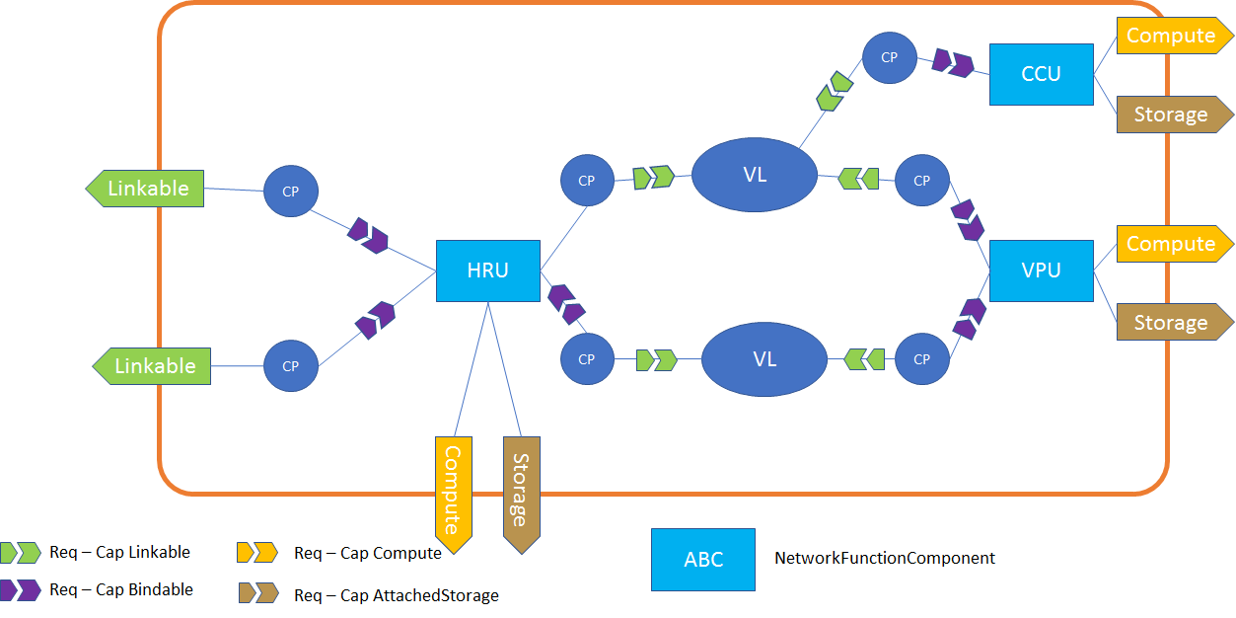
Target Internal Model
Dangling Requirements

Slide 12
Target Internal Model
Abstract type
  Using NF node to represent VNF, PNF and AR
  Distinguish them by the requirements
    Allotted Resources have a requirement for an Allotted Resource Provider service
    PNF Resources have a requirement for a PNF Device
    VNF Resources have neither A-R Provider nor PNF Device requirements.

Slide 13
Comparison
 | Pro | Con
Release 2 DM | Compliant with standard | Relatively slow update progress
ECOMP AID | Well supported by the current ONAP components | ATT internal model, not suitable for standardization
Target DM | Separation of application and container; more agile structure | Lack detail design Few code supporters

