Slide 1
POMBA ONAP Auditing
First Working Group Meeting
Aug 2, 2018

Slide 2
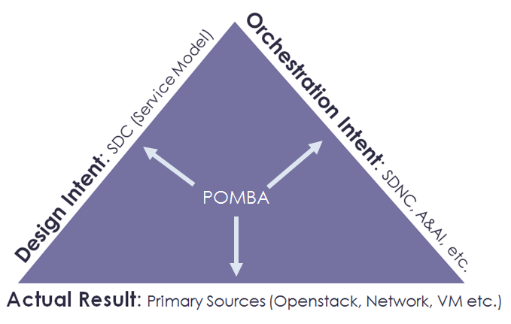
What is POMBA?
Post Orchestration Model-Based Audit (POMBA) is intended to highlight data integrity issues in ONAP.

Slide 3

POMBA
3.
1.
ONAP Portal – Design Studio & Dashboard
OSS
BSS
Service Design
Design-time (SDC)
Run-time
ONAP Operations Management (OOM)
External Data Movement & APIs
Service Audit
2.
Resource Onboarding
Orchestration (SO)
Inventory/Topology (AAI)
Data & Analytics (DCAE)
Policy
VNF/PNF SDK
Service & Product Design
Service Level Orchestration
Active / Available
DCAE Analytic µServices
Policy Execution Engine
Resource Level Orchestration
Entitlements
CDAP
Holmes
…
Policy Creation & Validation
Resource / Service Topology
Data Distribution
Analytic Application Design
ESR
Data Collection Layer
Common
Services
Catalog
DMaaP
AAF
Logging
Micro Services Bus
Service Instantiation
Testing & Certification
Multi-VIM Interface
L0-3 Network Controller (SDN-C)
L4-7 Controller (App-C)
Vendor VNFM
Adaption Layer
(VF-C)
Products
Services
Infrastructure
Adaption Layer
Config
Database
Service Logic
Interpreter
Life Cycle Mgmt Func
Config Database
Service Logic Interpreter
Life Cycle Mgmt funcs
Resources
Policies
Life Cycle Mgmt funcs
Eng. Rules
Analytics
Adaption Layer
Standard Adaption Layer
Vendor OA&M Adaptor
Vendor
A
Vendor
B
Recipe / Engineering Rules & Policy Distribution
Open
Stack
AWS
Azure
MEC
Netconf
Yang
CLI
3rd Party Network
controller
Chef
Netconf
Ansible
sVNFM
sVNFM
sVNFM
Further Rationalization
Opportunities
VNF1
VNF2
VNF3
PNF 1
…
VNFn
Infrastructure
OpenStack
VMware
RackSpace
Azure
Peripherals

Slide 4
POMBA Information
Overview Presentation from Face to Face meeting in Beijing in June
  https://wiki.onap.org/download/attachments/25434845/POMBA%20Introduction.pptx
ONAP Wiki
  https://wiki.onap.org/display/DW/POMBA
Casablanca Stories
  https://jira.onap.org/issues/?filter=11331

Slide 5
Logistics
A subproject running under Logging
  Additional work being done in SDNC and A&AI projects
Amdocs has group of developers actively progressing stories
  Seeding work with prototype work
  Evolving with defined updates
Additional stories are available, should you want to get involved.

Slide 6
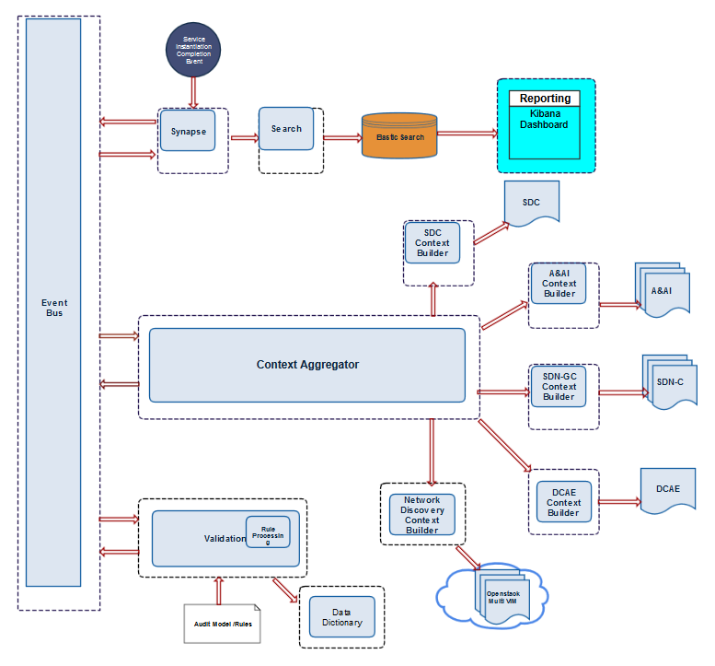
Architecture

Slide 7
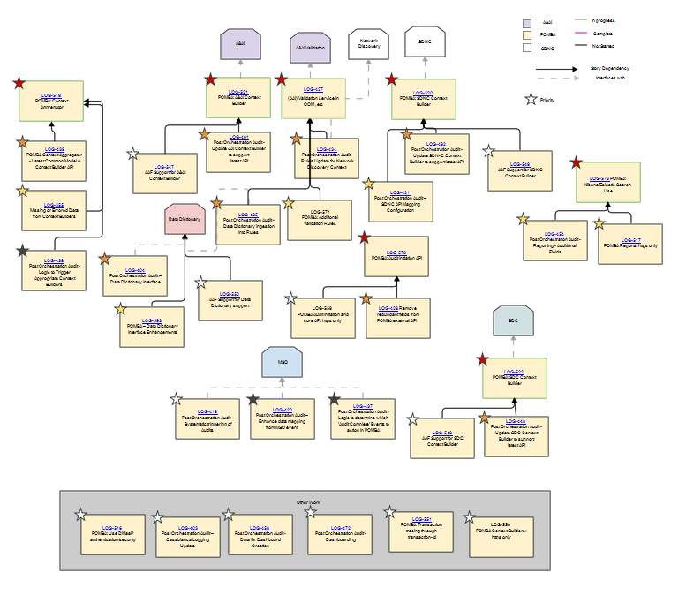
User Story Dependencies

Slide 8
Status and Current Issues
  Seed code in progress
    Some checks and code reviews already
  Current issues with Linux Foundation
    CLM job refactor – wars and jobs not getting pushed Nexus
      Common jar not up, 5 other containers are now blocked
      Once fixed, should unblock code
      Perhaps not fixed yet.
      Other components are also not getting latest version, but may not notice
      Michael and Prudence are working this

Slide 9
Next Steps
Ensure everyone understand the ask and our current status
Anyone looking to get involved, take a look and contact
  Mailing list or Sharon
Agree status of meeting
  Status & Stucks
  Technical Deep dive
    Includes demos, when available
      ONAP demos, even if just in code review
  Making PTL Happy

