Slide 1
5G Network Slicing
Dublin Release
Use Case 1 Ambition Level 1
Patrick Maguire

Slide 2
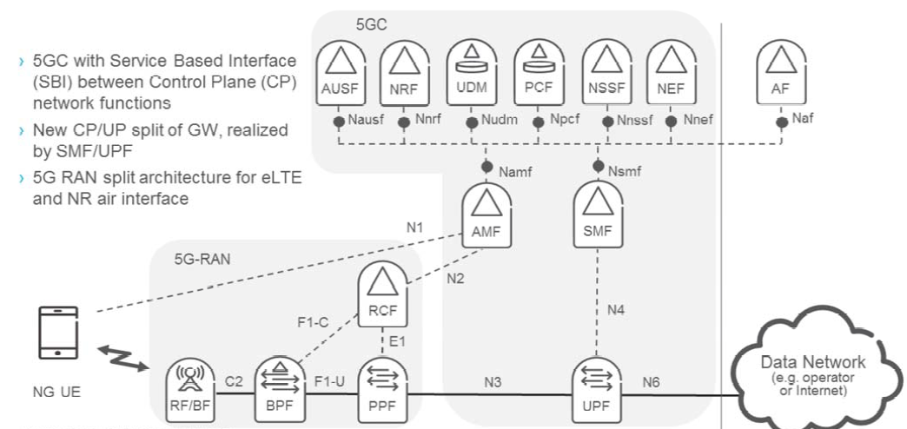
ASSUMED.. - 5G SYSTEM ARCHITECTURE
CU-CP
RU
DU
CU-UP

Slide 3
SCOPE ASSUMPTIONS
A&AI contains inventory of already deployed VNF and PNF and their corresponding service instances
A&AI also contains inventory of available data centre sites with associated constraints
Radio technology is capable of supporting 5G eMBB services
Full network coverage is assumed in all slice creation requests
A full 5GC CP is already deployed in central site
A single 5G radio CU-CP is already deployed in central site and connected to AMF
All Radio PNF’s are already connected to DCGW and
associated single CU-CP in central site

Slide 4
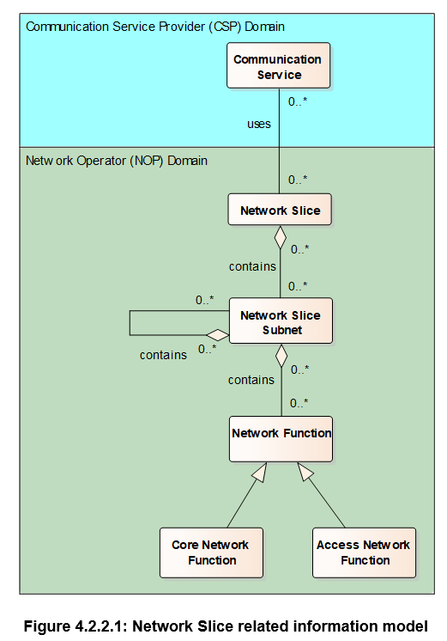
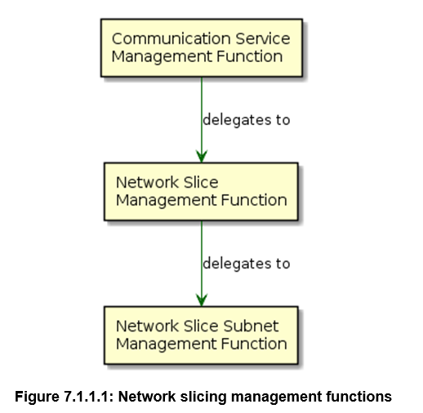
eMBB Use Case – Ambition Level 1
Two service templates are proposed;
  Top level Template (3GPP NST)
    addressing E2E aspects of the service ( 3GPP NW Slice)
  Sublevel Template (3GPP NSST)
    Addressing LCM of the VNF’s to be deployed (3GPP Network Slice Subnet)
3GPP TS 28.801
Contains

Slide 5
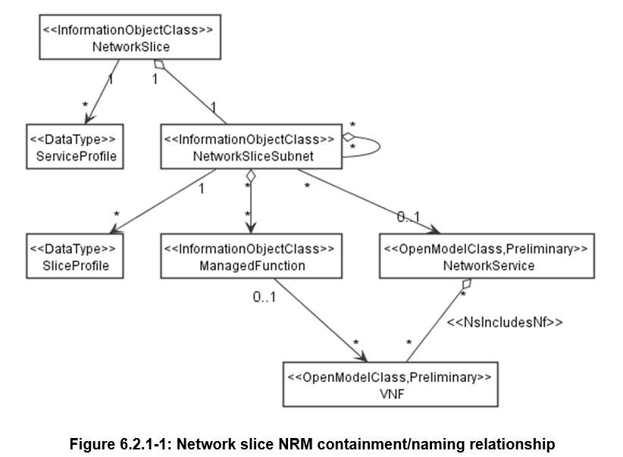
3GPP TS 28.541
Model aspects related to 3GPP NST.
Orchestration of an NST by the NSMF addresses E2E aspects of Service
e.g. VNF placement, coverage determination, E2E parameter coordination
Model aspects related to 3GPP NSST.
Orchestration of an NSST by the NSSMF mainly addresses LCM of the specified VNF’s to be deployed. Some functions of the NSMF may be partly delegated to the NSSMF

Slide 6
NW Slice Design & Onboarding
SDC
SO
Controller
Multi VIM/Cloud
A&AI
It is assumed that VNFD’s for CU-UP and UPF are already created and stored in the catalogue
It is assumed the following are already instantiated from services and available in inventory;
Radio CU-CP and associated PNF’s
5GC CP
Design Day-0, Day-1 and Day-n Config. Templates and store in catalogue.
Distribute Templates
Existing Distribution mechanisms will be used (MSB/Dmaap etc.)
New/Existing Distribution mechanisms will be used (MSB/Dmaap etc.)
New/Existing Distribution mechanisms will be used (MSB/Dmaap etc.)
Store Day-0, Day-1 and Day-n Config. templates
Design a resource service (NSST) referencing the already created VNFD’s, specifying their associated connectivity. Associated CSAR will include all referenced Day-0, Day-1 & Day-n configuration templates. Store.
Distribute CSAR
Unpack CSAR, Create Service Model
All VNF’s must have a modelled representation in E2E template as input to E2E logic in NSMF
Design a E2E Service Template(NST) referencing the previously designed resource service (NSST). Store.
Distribute CSAR
Unpack CSAR, Create Service Model

Slide 7
NW Slice Instantiation (Provisioning)
VID
SO
Controller
Multi VIM/Cloud
A&AI
Service Request
Parse and resolve service model
Create Service Instance
Create Service Instance (NSI)
For each VNFD referenced in the execution plan, select VIM from inventory to deploy VNF in.
Note: May use some common services in VIM selection process
Target VIM lookup
Prepare required input as specified in service model for referenced resource service (NSST).
Parse and resolve service model
Create (Resource)Service Instance (NSSI)
Update Service Instance (NSI)
For each VNFD referenced in the execution plan, build Day-0 configuration
Note: May use some common services to build configuration
Update (Resource) Service Instance (NSSI)
For VNFDs referenced in the execution plan, create VL’s and Connection Points
Create Networks
Update (Resource)Service Instance (NSSI)

Slide 8
NW Slice Instantiation (Provisioning)
VID
SO
Controller
Multi VIM/Cloud
A&AI
For each VNFD referenced in the execution plan, Trigger VNF creation, including Day-0 config.
Create VNF Instance
Update Resource Service Instance (NSSI)
For each created VNF build Day-1 configuration
Configure VNF
Update Resource Service Instance (NSSI)
VNF/PNF Service Lookup
For each PNF & VNF referenced in the execution plan, build Day-n configuration.
Note: May use some common services to find target VNF/PNF
Configure VNF/PNF
Update Resource Service Instance (NSSI)
Service Response

Slide 9
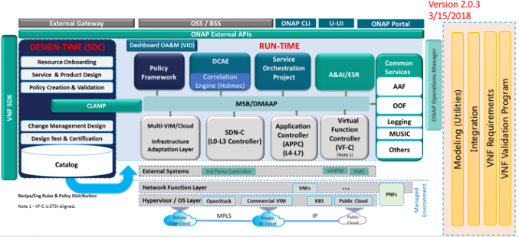

Impacted Areas

Slide 10
Thank You!

