Slide 1




5G Use Cases for R4/Dublin
5G Use Case Subcommittee
Virtual Face to Face (December 10-12, 2018)
Benjamin Cheung, Vimal Begwani
Nov 28, 2018 version 1

Slide 2





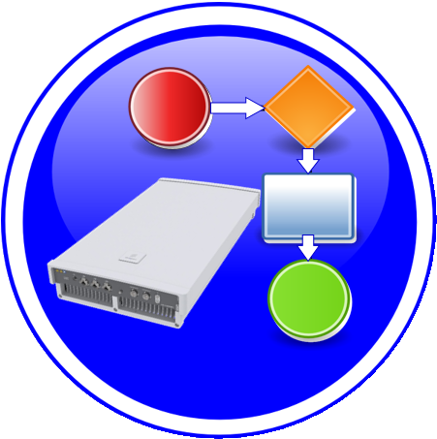


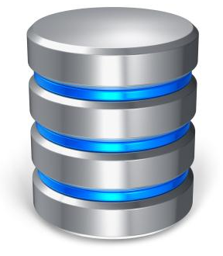
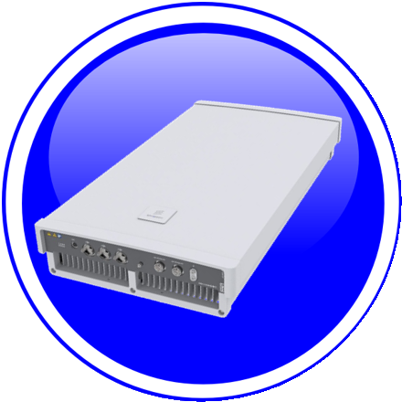



PNF PRE-ONBOARDING/ONBOARDING U/C OVERVIEW
1. PNF ONBOARDING PACKAGE: Create Package with PNF artifacts
1
Dublin Priority
2. PNF SDK: Development to (create) PNF Onboarding Package
& validates of PNF onboarding package
PNF
Descriptor
2
Dublin Priority
NF
Registration
3. PNF Onboarding package: Package loaded
3
PM
Schema
xNF
SDK
CSAR
Package
SDC
Informational
Artifacts
Package
creation
SDC
Catalog
SO, AAI,
DCAE etc.
Onboarding
Distribute
PNF
Onboarding
Package
Configuration
Files
+VENDOR
META DATA
5. ONAP RT Components:
Ingest and use CSAR package
5
Ansible
Playbook
4. SDC: NF OB Package > SDC catalog
4
Package Delivery
Onboarding
Design Time
Run Time
Onboarding Package
NF Descriptor
Platform Model
NF Instance

Slide 3
PNF PRE-ONBOARDING/ONBOARDING U/C IMPACTS
This Use Case will introduce the support for PNF pre-onboarding (PNF Package, PNF descriptor support) and PNF onboarding (SDC, Design Time, PNF-SDK). PNF Package delivery (Pre-onboarding activities) and PNF Onboarding via SDC in Dublin.
U/C DESCRIPTION
Wiki
https://wiki.onap.org/pages/viewpage.action?pageId=45303641
RT COMPONENT | IMPACT | PTL INVOLVEMENT
SDC | Design studio reception of PNF Onboarding Package | Yes (Michael Lando)
Modelling Sub-committee | Definition of Platform Info & Data model | Yes
VNF-SDK | Update to xNF-SDK and (create), parse, validation, of PNF Onboarding Package | TBR (to be reviewed)
SO, AAI, DCAE, Controller | Updates to RT components for proper ingestion of CSAR | TBR
PNF Onboarding Package | Vendor provided PNF onboarding package w/ PNF Registration and PNF-Descriptor. And ETSI SOL 001-007 Alignment | TBR
VNF Requirements | PNF requirements (in the VNF requirements projects) for PNF onboarding | TBR
ONAP RT COMPONENT IMPACTS

Slide 4



PNF Plug and Play U/C Overview
1
Resources Definition/Services Definition
SDC: PNF (physical element) Modeling
Distribution of types
Design Time
PNF Modeling
2
  PNF Infrastructure Service Declaration
  First part of PNF instantiation
  DCAE & AAI Entry with PNF ID (e.g. MAC address)
PNF Instance
Declaration
15
16
17
18
19
20
21
22
3
PNF Powers up and Boot-straps
PNF performs a “Plug and Play” procedure
Equipment vendor proprietary steps
PNF
Boot-strapping
4
PNF connects to ONAP via a Registration Event
PNF Registration Handler (PRH) processes the event
PNF
Contacts ONAP
Run-Time (Instances)
25
26
27
28
29
30
31
5
Connection points configured
Second part of PNF service instantiation
PNF configured and ready to provide service
PNF
Activation
34
35
36
37
38
39
40
41
42

Slide 5
PNF Plug and Play enhancements for R4 Dublin
This Use Case will continue PNF Plug and Play development started in R3 Casablanca. Functionality that was started but not completed, and introduce some enhancements to improve Plug and Play operation.
U/C DESCRIPTION
Wiki
https://wiki.onap.org/pages/viewpage.action?pageId=40206485
RT COMPONENT | IMPACT | PTL INVOLVEMENT
Controller to NF Type Association | Association of Controller to NF Type, so SO knows which controller to use for a particular NF instance | TBR
AAF | Security enhancements used by PNF PnP | TBR
Controller (VF-C, SDN-C/R) | Service configuration to PNF by controller (Step 37). SDN-C already supports DG & Ansible. NetConf introduction (separate U/C) | TBR (to be reviewed)
VID | VID enhancements for PNF PnP. Supporting Work Order. Supported with service specific applications. | TBR
A&AI | PNF Indexing using pnf-id (instead of pnf-name) | TBR
SO | Support of SO for an already existing PNF (active) A&AI Entry | TBR
ESR | Association to External PNF Controller | TBR
ONAP RT COMPONENT IMPACTS

Slide 6
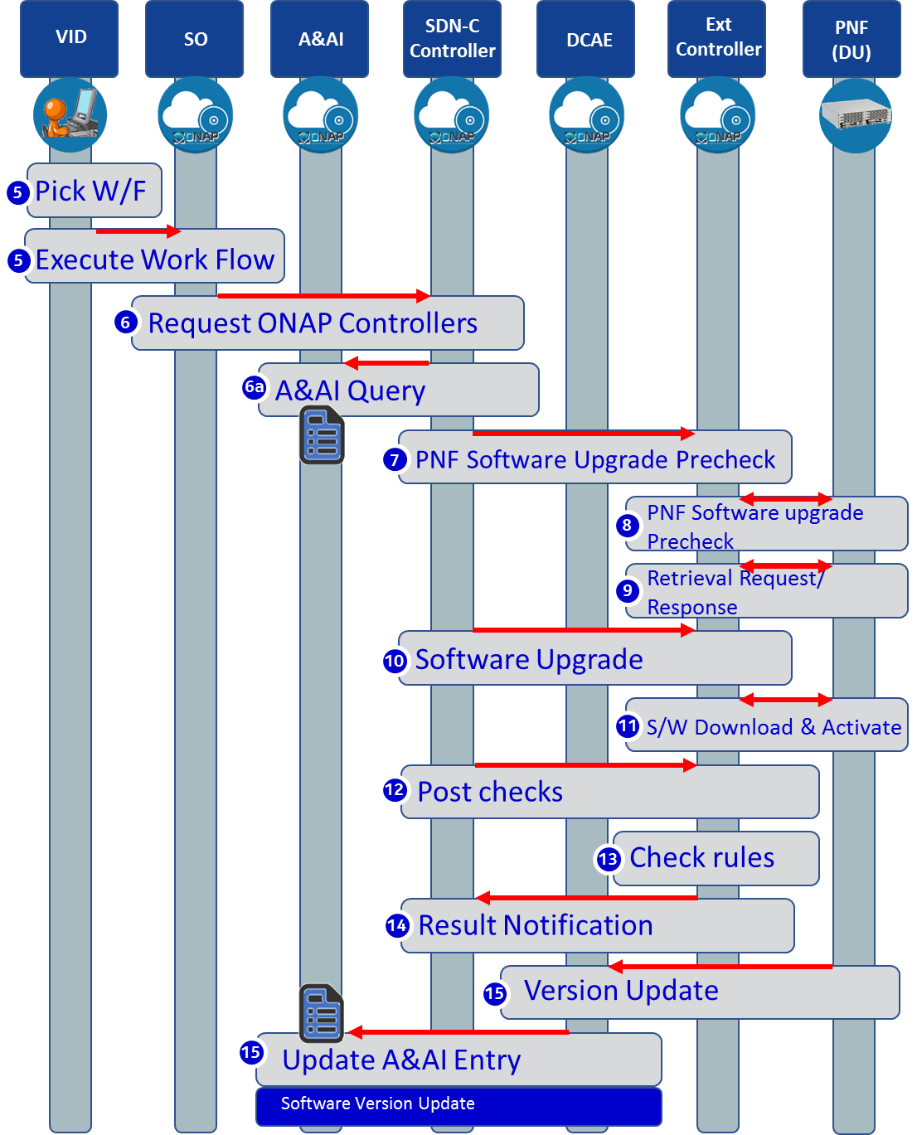
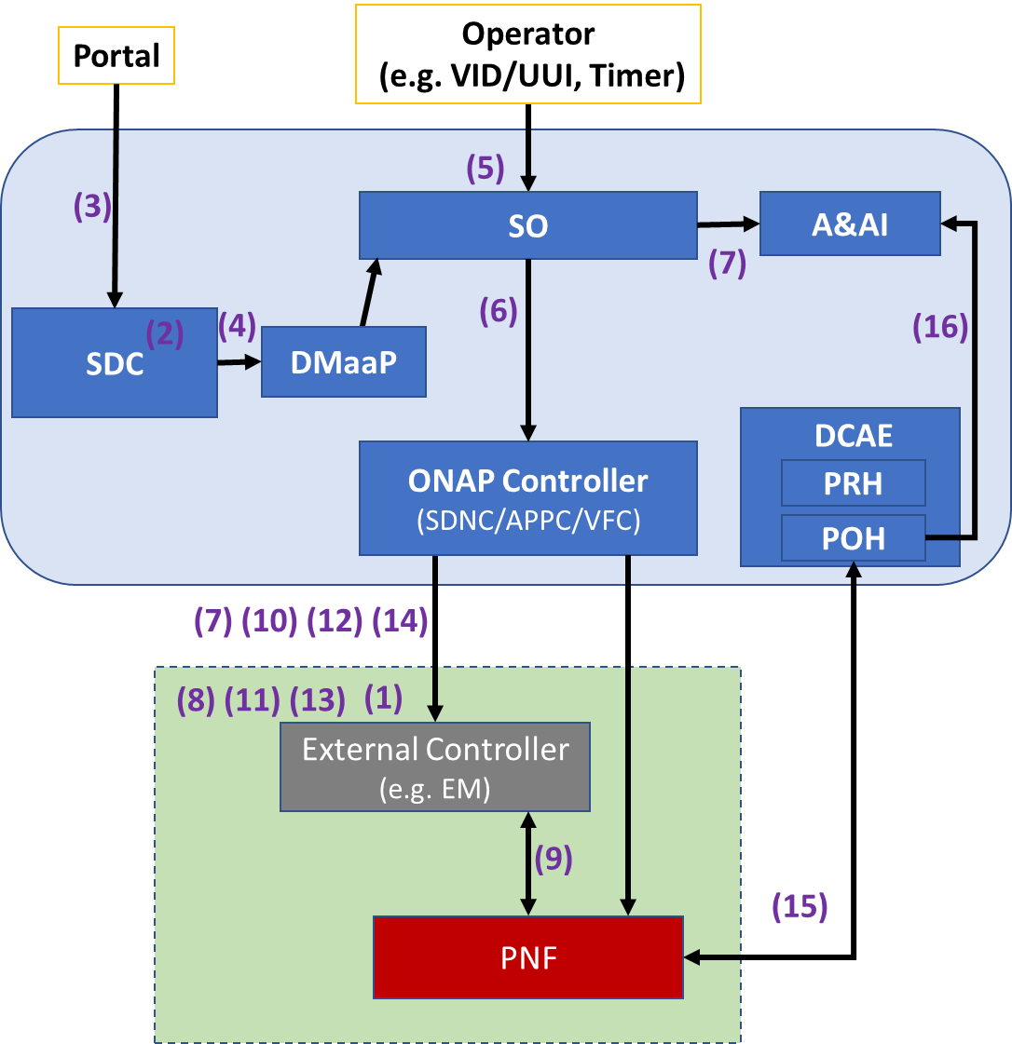
PNF S/W Upgrade

Slide 7
PNF S/W Upgrade for R4 Dublin
PNF Software upgrade is one aspect of Software Management. The purpose is to modify the software running on the PNF. This could be used to update the PNF software to a newer or older version of software.
U/C DESCRIPTION
Wiki
https://wiki.onap.org/pages/viewpage.action?pageId=40206485
RT COMPONENT | IMPACT | PTL INVOLVEMENT
PNF Reporting | PNF sends information regarding its Software Version directly to ONAP through a VES event. | TBR
Design Time Components | PNF software update workflow design, artifact onboarding upgrade rule list, utility of software version list. | TBR
PNF Package Update | A software update may require a change in the PNF Package before the software update or post update or both. | TBR (to be reviewed)
Software Update Coverage Analysis | Find out what services, control loops, etc. are impacted during and post software update before the PNF software update | TBR
Post/Pre PNF SW Update Event Workflows | Deregistration, re-registration | TBR
VNF & PNF in-place software upgrade processes alignment | Currently PNF and VNF entries in A&AI diverge that requires DG branching. Can we unify the process for both? | TBR
VID support | Execute the e2e run time workflow. In Casablanca, the process exists starting from the SDNC Northbound. | TBR
ONAP RT COMPONENT IMPACTS

Slide 8

Bulk PM in R4 Dublin
Bulk PM File Upload and Performance Event Generation
VES
Collector
Message
Router
File
Collector
Data
Router
Analytics
Application
Bulk PM File Upload and Performance Event Generation
Network Function (NF) establishes a HTTP/TLS connection to the DCAE VES Collector.
NF sends FileReady notification Event to DCAE VES Collector. Event is encoded in JSON and sent via HTTP/TLS. HTTP/TLS connection is set up and torn down every time a FileReady notification event is sent.
DCAE VES Collector publishes the event to appropriate topic in DMaaP Message Router (MR).
DCAE File Collector retrieves the FileReady notification event from DMaaP MR.
File Collector uploads PM File from NF using a secure file transfer protocol; FTPES supported in Casablanca. NF authenticates the connection.
File Collector publishes PM Data to DMaaP Data Router (DR).
PM Mapper retrieves PM Data from DR and generates 3GPP Performance events as configured by PM Mapper File.
PM Mapper publishes Performance events to MR.
Analytics Applications (AA) retrieve the 3GPP Performance events of interest from MR. AA analyze the data to produce statistics and KPIs and optimization recommendations.
Authenticate connection
PM
Mapper
VNF
PNF
VES
Collector
HTTP/TLS
1
1
HTTP/TLS
2
2
Send FileReady event
Publish Event
Upload PM file
3
Retrieve Event
3
4
4
FTPES
5
Publish PM Data + metadata
5
6
Publish 3GPP Performance Event
Retrieve PM Data +metadata
Retrieve 3GPP Performance Event
6
7
7
8
8
9
9

Slide 9
PNF Bulk PM
Proposed use cases: UC1: 3GPP PM Counter collection and VES creation in ONAP, UC2: Closed Loop support using 3GPP PM data
Additional requirements for bulk PM enhancements: DFC robustness enhancement (FileReady for all files on the node; DFC retry handling), DMaaP DR enhanced handling of PM feeds (enhancements for DFC metadata; optional DR consumer specified feed encoding; high availability and scaling support)
U/C DESCRIPTION
Wiki
https://wiki.onap.org/pages/viewpage.action?pageId=40206494
RT COMPONENT | IMPACT | PTL INVOLVEMENT
DFC | DFC robustness enhancement (FileReady for all files on the node; DFC retry handling). | TBR
DMaaP | DR enhanced handling of PM feeds (enhancements for DFC metadata; optional DR consumer specified feed encoding; high availability and scaling support) | TBR
ONAP RT COMPONENT IMPACTS

Slide 10
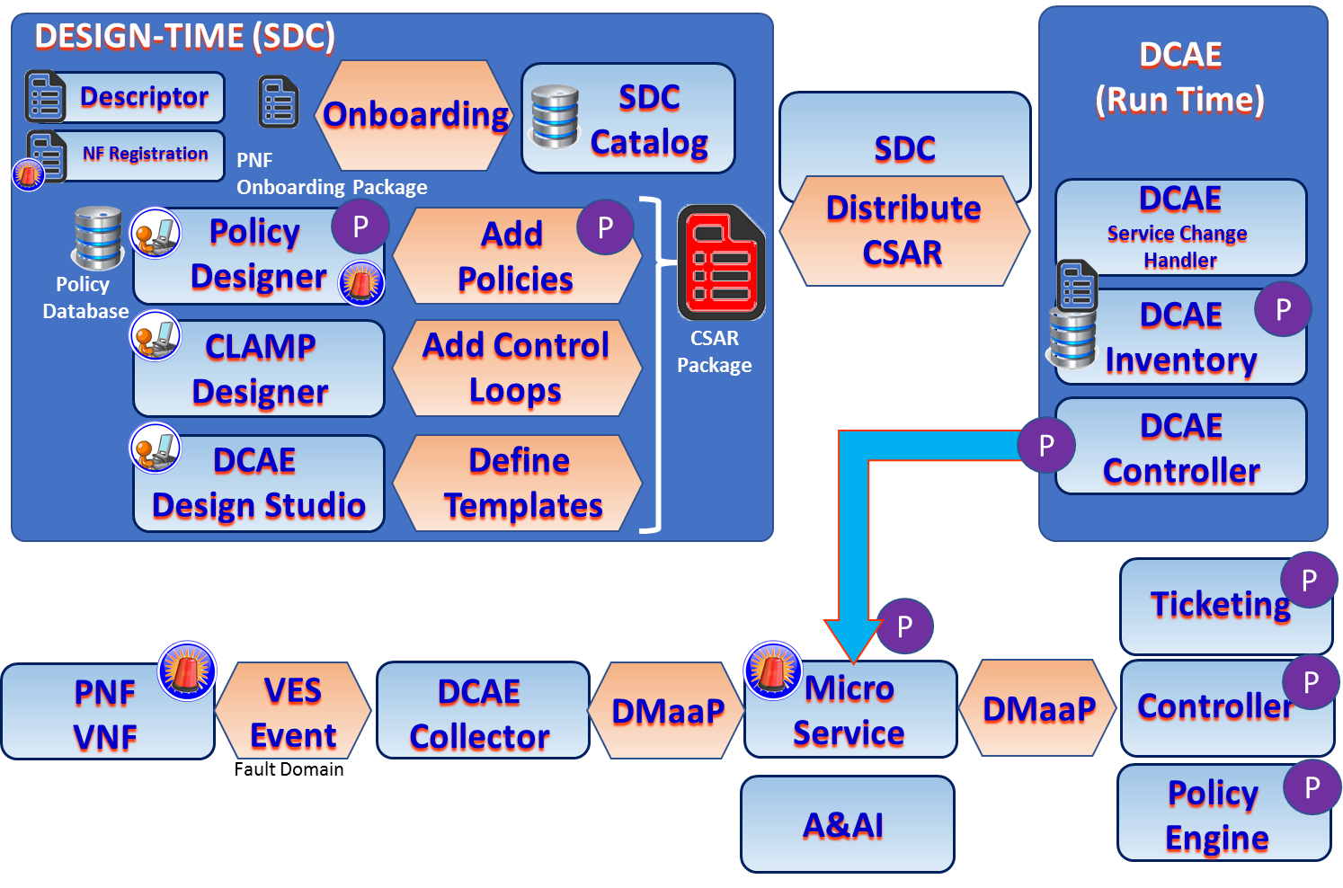
FM Dictionary in R4 Dublin

Slide 11
FM Dictionary
Gain approval for the content and delivery of the FM Meta Data as part of the FM YAML Registration for a 5G NF to ONAP. This assumes that the work to support the collection and publication of PNF artifacts is covered under the PNF Onboarding Package 5G USE Case Work Item—it is not addressed here.
U/C DESCRIPTION
Wiki
https://wiki.onap.org/pages/viewpage.action?pageId=40206485
RT COMPONENT | IMPACT | PTL INVOLVEMENT
VNF Requirements | Update to VNF requirements related to FM dictionary management | TBR
DCAE | (VES Registration Document to be updated) | TBR
Policy | potentially policy so that the processing of the YAML with the use of the dictionary fields is automated (stretch goal) | TBR (to be reviewed)
ONAP RT COMPONENT IMPACTS

Slide 12
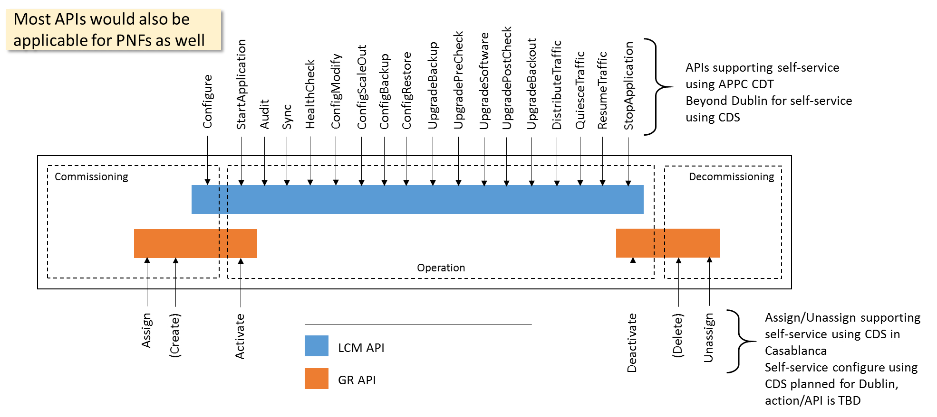
Configuration with NetConf
NETCONF assumes that security is provided by the chosen transport protocol
NETCONF over SSH (RFC6242) is mandatory but other options have also been standardized
  NETCONF over TLS with mutual X.509 authentication (RFC7589)
ONAP security sub-committee has recommended use of NETCONF over TLS: Secure Communication to Network Functions
Authenticated client identity passed to NETCONF layer for access control
Client
Server
NETCONF
Transport
- Authentication
- Data integrity
- Confidentiality
- Replay protection

Slide 13
Configuration with NetConf
Proposed UC to focus on in Dublin for configuration with NETCONF:
Post-instantiation (triggered by SO), Including final configuration step (36/37) in the PNF PnP UC
Configuration modification (e g triggered by Policy)
Specific requirements on NETCONF support in ONAP:
Officially support both PNFs and VNFs for north-bound controller APIs in the use cases
Support for NETCONF over TLS (RFC7589), Support for YANG 1.1 (RFC7950) modules in addition to YANG 1.0
U/C DESCRIPTION
Wiki
https://wiki.onap.org/display/DW/5G+-+Configuration+with+NETCONF
RT COMPONENT | IMPACT | PTL INVOLVEMENT
APPC, SDN-C, CCSDK | Controller north-bound APIs and implementation GR API or LCM API, PNF support Self-service support for APIs in the configuration use cases: Possible to specify NETCONF/TLS in blueprint & YANG XML template Controller south-bound adapter NETCONF/TLS support, YANG 1.1 support, ODL-based? | TBR
SO, Policy | Investigate how to trigger configuration action | TBR
AAF | Investigate AAF impact for NETCONF over TLS Also discuss in SECCOM meeting | TBR (to be reviewed)
VNF Requirements | Update applicable xNF requirements
ONAP RT COMPONENT IMPACTS

Slide 14


Real-Time PM
Authenticate connection
DCAE HV
VES
Collector
PNF
VNF
DMaaP
Analytics
Application
DCAE authenticates new TLS connection using functionality provided by AAF----DONE ONLY ONCE
NF initiates initial VES event and establishes connection. DCAE authenticates connection—connection is persistent so this is only done once.
NF sends hvMeas Event to VES collector. Real Time PM sent with GPB schema. No retries if Real Time data delivery fails. DCAE requires a VES Collector to receive and validate GPB events.
DCAE validates the VES event using the VES_Event.proto file and sends the event to DMaaP for publication. DMaaP publishes the data to a topic. DMaaP enhancements needed to support high volume events in GPB format.
Analytics Application retrieves data. AA uses the VES_Event.proto file, the HvMeasFields.proto file and the PM Content Metadata to process the data.
TCP/TLS
1
NF sends PM data in real time—high volume data to DCAE HVES Collector TCP GPB for performance TLS for security if needed
TCP/TLS
NF sends Real Time PM event
2
DCAE sends event to DMaaP
DMaaP publishes data to topic
Repeat for each event
3
Publish event
AA retrieves data
4
Analytics Application analyzes the data

Slide 15
Real Time PM
Transmission of specific configured PM data which is time sensitive, delivered at frequent intervals, (less than one minute) from many producers to a single entity (DCAE)
U/C DESCRIPTION
Wiki
https://wiki.onap.org/display/DW/xyz
RT COMPONENT | IMPACT | PTL INVOLVEMENT
 |  | TBR
 |  | TBR
 |  | TBR (to be reviewed)
ONAP RT COMPONENT IMPACTS

Slide 16
OOF & PCI

Slide 17
OOF & PCI
x
U/C DESCRIPTION
Wiki
https://wiki.onap.org/display/DW/xyz
RT COMPONENT | IMPACT | PTL INVOLVEMENT
 |  | TBR
 |  | TBR
 |  | TBR (to be reviewed)
ONAP RT COMPONENT IMPACTS

Slide 18
Network Slicing

Slide 19
Network Slicing
x
U/C DESCRIPTION
Wiki
https://wiki.onap.org/display/DW/xyz
RT COMPONENT | IMPACT | PTL INVOLVEMENT
 |  | TBR
 |  | TBR
 |  | TBR (to be reviewed)
ONAP RT COMPONENT IMPACTS

Slide 20
Controller Enhancements

Slide 21
Controller Enhancements
x
U/C DESCRIPTION
Wiki
https://wiki.onap.org/display/DW/xyz
RT COMPONENT | IMPACT | PTL INVOLVEMENT
 |  | TBR
 |  | TBR
 |  | TBR (to be reviewed)
ONAP RT COMPONENT IMPACTS

