Slide 1




5G Use Cases for R4/Dublin
5G Use Case Subcommittee
Virtual Face to Face (December 10-12, 2018)
Benjamin Cheung, Vimal Begwani, et al
Dec 6, 2018 version 4

Slide 2





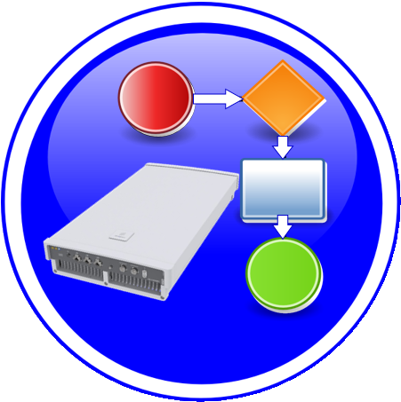



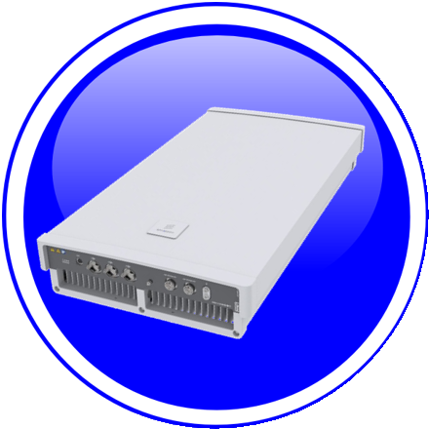



PNF PRE-ONBOARDING/ONBOARDING U/C OVERVIEW
1. PNF ONBOARDING PACKAGE: Create Package with PNF artifacts
1
Dublin Priority
2. PNF SDK: Development to (create) PNF Onboarding Package
& validates of PNF onboarding package
PNF
Descriptor
2
Dublin Priority
NF
Registration
3. PNF Onboarding package: Package loaded
3
PM
Schema
xNF
SDK
CSAR
Package
SDC
Informational
Artifacts
Package
creation
SDC
Catalog
SO, AAI,
DCAE etc.
Onboarding
Distribute
PNF
Onboarding
Package
Configuration
Files
+VENDOR
META DATA
5. ONAP RT Components:
Ingest and use CSAR package
5
Ansible
Playbook
4. SDC: NF OB Package > SDC catalog
4
Package Delivery
Onboarding
Design Time
Run Time
Onboarding Package
NF Descriptor
Platform Model
NF Instance

Slide 3
PNF PRE-ONBOARDING/ONBOARDING U/C IMPACTS
This Use Case will introduce the support for PNF pre-onboarding (PNF Package, PNF descriptor support) and PNF onboarding (SDC, Design Time, PNF-SDK). PNF Package delivery (Pre-onboarding activities) and PNF Onboarding via SDC in Dublin.
U/C DESCRIPTION
Wiki
https://wiki.onap.org/pages/viewpage.action?pageId=45303641
RT COMPONENT | IMPACT | PTL INVOLVEMENT
SDC | Design studio reception of PNF Onboarding Package | Yes (Michael Lando)
Modelling Sub-committee | Definition of Platform Info & Data model | Yes
VNF-SDK | Update to xNF-SDK and (create), parse, validation, of PNF Onboarding Package | TBR (to be reviewed)
SO, AAI, DCAE, Controller | Updates to RT components for proper ingestion of CSAR | TBR
PNF Onboarding Package | Vendor provided PNF onboarding package w/ PNF Registration and PNF-Descriptor. And ETSI SOL 001-007 Alignment | TBR
VNF Requirements | PNF requirements (in the VNF requirements projects) for PNF onboarding | TBR
ONAP RT COMPONENT IMPACTS

Slide 4



PNF Plug and Play U/C Overview
1
Resources Definition/Services Definition
SDC: PNF (physical element) Modeling
Distribution of types
Design Time
PNF Modeling
2
  PNF Infrastructure Service Declaration
  First part of PNF instantiation
  DCAE & AAI Entry with PNF ID (e.g. MAC address)
PNF Instance
Declaration
15
16
17
18
19
20
21
22
3
PNF Powers up and Boot-straps
PNF performs a “Plug and Play” procedure
Equipment vendor proprietary steps
PNF
Boot-strapping
4
PNF connects to ONAP via a Registration Event
PNF Registration Handler (PRH) processes the event
PNF
Contacts ONAP
Run-Time (Instances)
25
26
27
28
29
30
31
5
Connection points configured
Second part of PNF service instantiation
PNF configured and ready to provide service
PNF
Activation
34
35
36
37
38
39
40
41
42

Slide 5
PNF Plug and Play enhancements for R4 Dublin
This Use Case will continue PNF Plug and Play development started in R3 Casablanca. Functionality that was started but not completed, and introduce some enhancements to improve Plug and Play operation.
U/C DESCRIPTION
Wiki
https://wiki.onap.org/pages/viewpage.action?pageId=40206485
RT COMPONENT | IMPACT | PTL INVOLVEMENT
Controller to NF Type Association | Association of Controller to NF Type, so SO knows which controller to use for a particular NF instance | TBR
AAF | Security enhancements used by PNF PnP | TBR
Controller (VF-C, SDN-C/R) | Service configuration to PNF by controller (Step 37). SDN-C already supports DG & Ansible. NetConf introduction (separate U/C) | TBR (to be reviewed)
VID | VID enhancements for PNF PnP. Supporting Work Order. Supported with service specific applications. | TBR
A&AI | PNF Indexing using pnf-id (instead of pnf-name) | TBR
SO | Support of SO for an already existing PNF (active) A&AI Entry | TBR
ESR | Association to External PNF Controller | TBR
ONAP RT COMPONENT IMPACTS

Slide 6
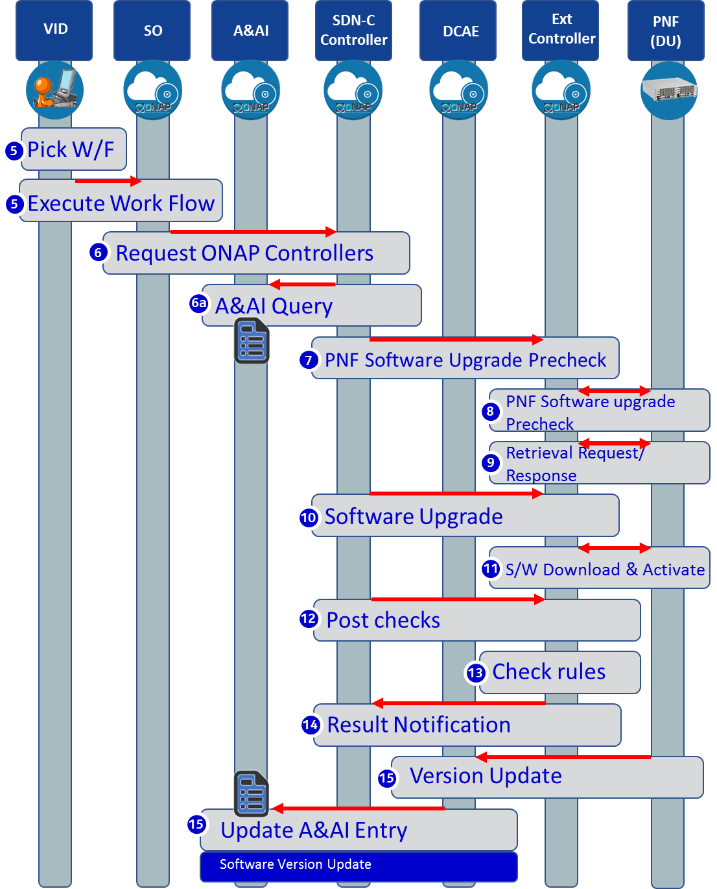
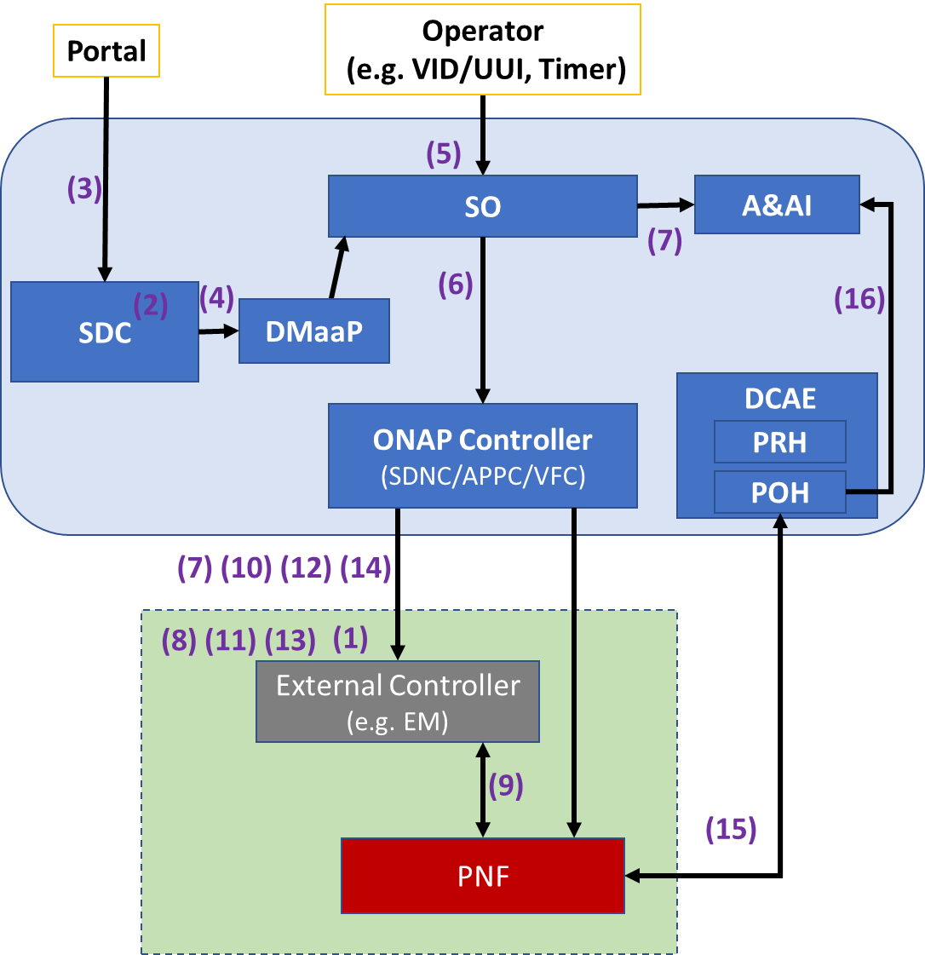
PNF S/W Upgrade

Slide 7
PNF S/W Upgrade for R4 Dublin
PNF Software upgrade is one aspect of Software Management. The purpose is to modify the software running on the PNF. This could be used to update the PNF software to a newer or older version of software.
U/C DESCRIPTION
Wiki
https://wiki.onap.org/pages/viewpage.action?pageId=40206485
RT COMPONENT | IMPACT | PTL INVOLVEMENT
PNF Reporting | PNF sends information regarding its Software Version directly to ONAP through a VES event. | TBR
Design Time Components | PNF software update workflow design, artifact onboarding upgrade rule list, utility of software version list. | TBR
PNF Package Update | A software update may require a change in the PNF Package before the software update or post update or both. | TBR (to be reviewed)
Software Update Coverage Analysis | Find out what services, control loops, etc. are impacted during and post software update before the PNF software update | TBR
Post/Pre PNF SW Update Event Workflows | Deregistration, re-registration | TBR
VNF & PNF in-place software upgrade processes alignment | Currently PNF and VNF entries in A&AI diverge that requires DG branching. Can we unify the process for both? | TBR
VID support | Execute the e2e run time workflow. In Casablanca, the process exists starting from the SDNC Northbound. | TBR
ONAP RT COMPONENT IMPACTS

Slide 8

Perf3gpp Event Generation Overview
Bulk PM File Upload and Perf3gpp Event Generation
VES
Collector
Message
Router
File
Collector
Data
Router
Analytics
Application
Bulk PM File Upload and Performance Event Generation
Network Function (NF) establishes a HTTP/TLS connection to the DCAE VES Collector.
NF sends FileReady notification Event to DCAE VES Collector. Event is encoded in JSON and sent via HTTP/TLS. HTTP/TLS connection is set up and torn down every time a FileReady notification event is sent.
DCAE VES Collector publishes the event to appropriate topic in DMaaP Message Router (MR).
DCAE File Collector retrieves the FileReady notification event from DMaaP MR.
File Collector uploads PM File from NF using a secure file transfer protocol; FTPES supported in Casablanca. NF authenticates the connection.
File Collector publishes PM Data to DMaaP Data Router (DR).
PM Mapper retrieves PM Data from DR and generates Perf3gpp events as configured by PM Mapper File.
PM Mapper publishes Perf3gpp events to MR.
Analytics Applications (AA) retrieve the Perf3gpp events of interest from MR. AA analyze the data to produce statistics and KPIs and optimization recommendations.
Authenticate connection
PM
Mapper
VNF
PNF
VES
Collector
HTTP/TLS
1
1
HTTP/TLS
2
2
Send FileReady event
Publish Event
Upload PM file
3
Retrieve Event
3
4
4
FTPES
5
Publish PM Data + metadata
5
6
Publish Perf3gpp Event
Retrieve PM Data +metadata
Retrieve Perf3gpp Event
6
7
7
8
8
9
9

Slide 9
Bulk PM Enhancements for Dublin R4
Support the following work items for Bulk PM for 5G xNFs:
UC1: Perf3gpp event creation by 3GPP PM Mapper from Bulk PM XML file
UC2: Closed Loop support using 3GPP PM data (stretch goal)
Additional Requirements: DFC robustness enhancements, DMaaP DR enhancements
U/C DESCRIPTION
Wiki
https://wiki.onap.org/pages/viewpage.action?pageId=40206494
RT COMPONENT | IMPACT | PTL INVOLVEMENT
DCAE | UC1 Perf3gpp event creation from PM XML file: implement 3GPP PM Mapper microservice, configure PM Mapper, subscribe to PM XML file and metadata from Data Router, generate Perf3gpp events, publish to Message Router | TBR
DCAE, Policy, Controller (stretch goal) | UC2 Closed loop support using PM data: Analytics Applications subscribe to Perf3gpp event of interest or Bulk PM XML file, analyze the data, notify Policy of desired CM change, Policy triggers CM update to Controller | TBR
Data File Collector (DFC) | DFC robustness enhancements: FileReady for all files on the node, DFC retry handling. | TBR
DMaaP Data Router (DR) | DR enhanced handling of PM feeds: enhancements for DFC metadata, optional DR consumer specified feed encoding, high availability and scaling support. | TBR
ONAP RT COMPONENT IMPACTS

Slide 10
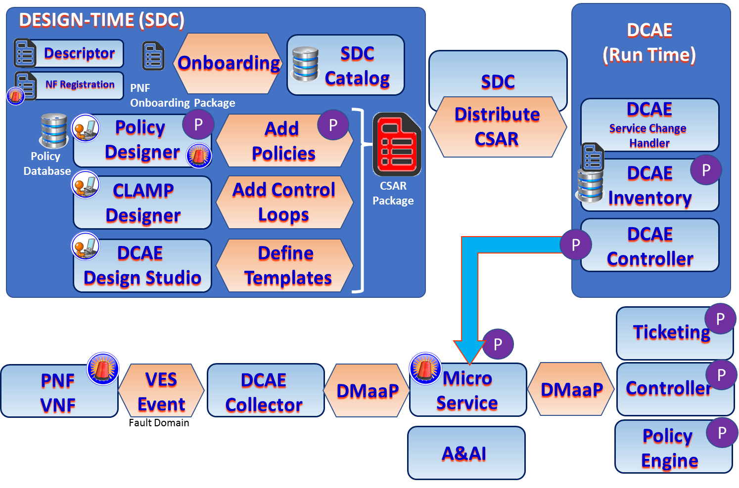
FM Meta Data

Slide 11
FM Meta Data
Support the following work items for FM Meta Data for 5G xNFs:
Review and finalize VES Event Listener Specification v7.1 and VES Event Registration Specification v3.2 which contains the FM metadata format and content.
Onboard the FM metadata for an xNF as part of the VES Event Registration YAML file. Note that the work to support the onboarding and processing of the FM metadata artifact is covered under the PNF Onboarding Package 5G Use Case Work Item. It is not addressed here.
Display the FM metadata in the SDC-DS to allow an ONAP User to create Policies for handling alarms.
Update VNF Requirements for FM metadata artifact.
U/C DESCRIPTION
Wiki
https://wiki.onap.org/pages/viewpage.action?pageId=40206485
RT COMPONENT | IMPACT | PTL INVOLVEMENT
VES Specifications | Review and finalize VES Event Listener Specification v7.1 and VES Event Registration Specification v3.2 | Yes
GUI Display of FM Meta Data | Display the FM metadata in a GUI (either DCAE-DS, Policy GUI and/or SDC-DS GUI) to allow an ONAP User to create Policies for handling alarms | TBR
VNF Requirements | Update to VNF requirements for FM Dictionary metadata artifact creation | TBR
ONAP RT COMPONENT IMPACTS

Slide 12


PM Dictionary
DESIGN-TIME (SDC)
Descriptor
Onboarding
SDC
Catalog
YML Registration
NF
Onboarding Package
Measurement
Service
Designer
Define
Services
CSAR
Package
DCAE
Design Studio
Define
Templates
Dublin Goal is to be able to view the onboarded PM Dictionary (from the PNF onboarding package) in a GUI (either SDC Service Designer or DCAE-DS).

Slide 13
PM Dictionary
Support the following work items for PM Dictionary for 5G xNFs:
Review and finalize VES Event Listener Specification v7.1 and VES Event Registration Specification v3.2 which contains the PM Dictionary format and content.
Onboard the PM Dictionary for an xNF as part of the VES Event Registration YAML file. Note that the work to support the onboarding and processing of the PM Dictionary artifact is covered under the PNF Onboarding Package 5G Use Case Work Item. It is not addressed here.
Display the PM Dictionary in the SDC-DS to allow an ONAP User to create PM Mapper configuration files for Perf3gpp event generation.
Update VNF Requirements for PM Dictionary artifact.
U/C DESCRIPTION
Wiki
https://wiki.onap.org/pages/viewpage.action?pageId=40206485
RT COMPONENT | IMPACT | PTL INVOLVEMENT
VES Specifications | Review and finalize VES Event Listener Specification v7.1 and VES Event Registration Specification v3.2 | Yes
GUI display of PM dictionary | Display the PM Dictionary in a GUI (either DCAE-DS or SDC-DS GUI) to allow an ONAP User to create PM Mapper configuration files for Perf3gpp event generation | TBR
VNF Requirements | Update to VNF requirements for PM Dictionary artifact creation | TBR
ONAP RT COMPONENT IMPACTS

Slide 14
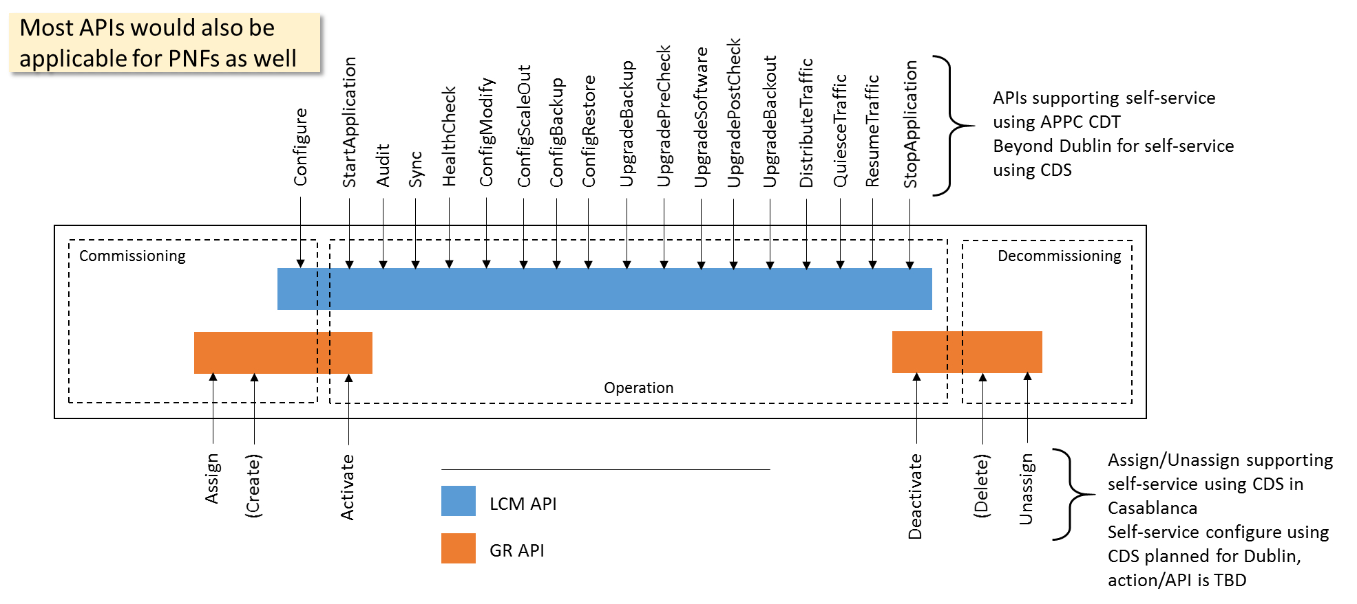
Configuration with NetConf
NETCONF assumes that security is provided by the chosen transport protocol
NETCONF over SSH (RFC6242) is mandatory but other options have also been standardized
  NETCONF over TLS with mutual X.509 authentication (RFC7589)
ONAP security sub-committee has recommended use of NETCONF over TLS: Secure Communication to Network Functions
Authenticated client identity passed to NETCONF layer for access control
Client
Server
NETCONF
Transport
- Authentication
- Data integrity
- Confidentiality
- Replay protection

Slide 15
Configuration with NetConf
Proposed UC to focus on in Dublin for configuration with NETCONF:
Post-instantiation (triggered by SO), Including final configuration step (36/37) in the PNF PnP UC
Configuration modification (e g triggered by Policy)
Specific requirements on NETCONF support in ONAP:
Officially support both PNFs and VNFs for north-bound controller APIs in the use cases
Support for NETCONF over TLS (RFC7589), Support for YANG 1.1 (RFC7950) modules in addition to YANG 1.0
U/C DESCRIPTION
Wiki
https://wiki.onap.org/display/DW/5G+-+Configuration+with+NETCONF
RT COMPONENT | IMPACT | PTL INVOLVEMENT
APPC, SDN-C, CCSDK | Controller north-bound APIs and implementation GR API or LCM API, PNF support Self-service support for APIs in the configuration use cases: Possible to specify NETCONF/TLS in blueprint & YANG XML template Controller south-bound adapter NETCONF/TLS support, YANG 1.1 support, ODL-based? | TBR
SO, Policy | Investigate how to trigger configuration action | TBR
AAF | Investigate AAF impact for NETCONF over TLS Also discuss in SECCOM meeting | TBR (to be reviewed)
VNF Requirements | Update applicable xNF requirements
ONAP RT COMPONENT IMPACTS

Slide 16
OOF & PCI

Slide 17
OOF & PCI
x
U/C DESCRIPTION
Wiki
https://wiki.onap.org/display/DW/xyz
RT COMPONENT | IMPACT | PTL INVOLVEMENT
 |  | TBR
 |  | TBR
 |  | TBR (to be reviewed)
ONAP RT COMPONENT IMPACTS

Slide 18
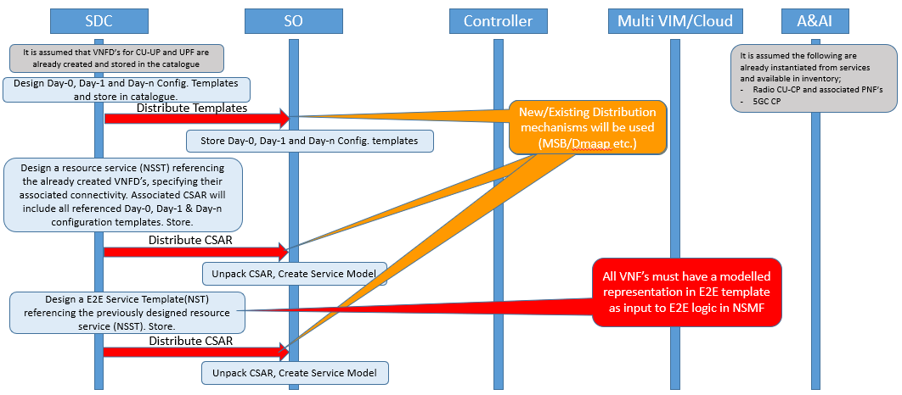
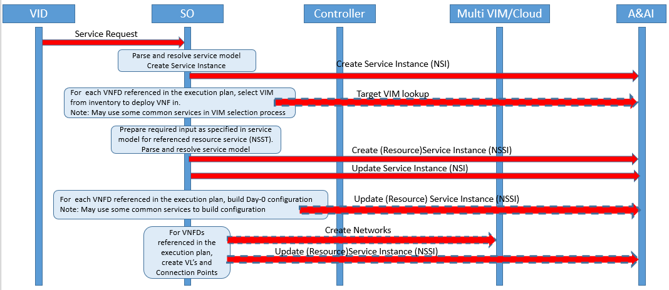
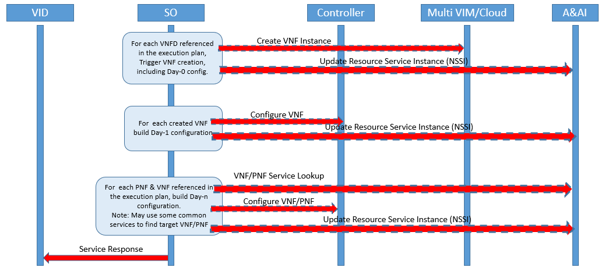
Network Slicing
1
Design Time
Configuration templates are designed and distributed.
Service templates are designed and distributed
Run Time
Create E2E service instance
Determine VNF placement
Build required input for lower level service
Create resource service instance
Create networks
Instantiate VNF(s), applying Day-0 configuration
Configure instantiate VNF(s) with Day-1 configuration
Configure dependent PNF(s) &/ VNF(s) with Day-1 configuration
2
3
4
5
6
7
8
9
10

Slide 19
Network Slicing
..Based on identified Use Cases for NW Slicing in Dublin Release.
First proposal outlines the scope of the identified use cases with ambition levels for each.
Use Case Scope and Ambition Levels
Following proposal focuses on flows for Use case 1, Ambition level 1.
Use Case 1 Ambition level 1
U/C DESCRIPTION
Wiki
https://wiki.onap.org/pages/viewpage.action?pageId=38119661
RT COMPONENT | IMPACT | PTL INVOLVEMENT
SDC | Support the design and distribution of configuration templates Support the design of nested service templates (see ONAP Network Slice Modelling) Support the distribution of service templates | TBR
SO | Support orchestraiton of nested service templates Support integration with common functions for VNF placement decisions Support parameterization of configuration templates | TBR
A&AI | Evolve model to support NW Slicing aspects | TBR
Controllers | Support VNF Day-1 configuration Support VNF&PNF Day-n configuration | TBR
VID | Provide view of all available templates Provide means to trigger and monitor service instance creation and deletion Provide view of service instances and their dependencies | TBR
ONAP RT COMPONENT IMPACTS

Slide 20
Controller Enhancements

Slide 21
Controller Enhancements
x
U/C DESCRIPTION
Wiki
https://wiki.onap.org/display/DW/xyz
RT COMPONENT | IMPACT | PTL INVOLVEMENT
 |  | TBR
 |  | TBR
 |  | TBR (to be reviewed)
ONAP RT COMPONENT IMPACTS

