Slide 1




5G Use Case for R4/Dublin
Use Case Sub-committee Presentation
Virtual F2F Developers Event (December 10-12, 2018)
Benjamin Cheung, Vimal Begwani, Oskar Malm et al
Dec 7, 2018 version 7

Slide 2
5G Use Case Summary for R4/Dublin
The following sub-cases are proposed from the 5G UC for R4/Dublin
  PNF Pre-onboarding & Onboarding (NEW)
  PNF Plug and Play (Carry-over)
  PNF SW Upgrade (Carry-over)
  Bulk PM (Carry-over)
  PM Dictionary (NEW)
  FM Meta Data (NEW)
  Configuration with NETCONF (NEW)
  OOF & PCI (Carry-over)
  Network slicing (NEW)
See also 5G Use Case (Dublin)

Slide 3





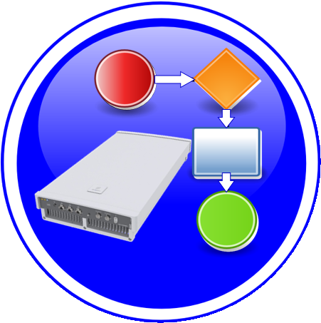



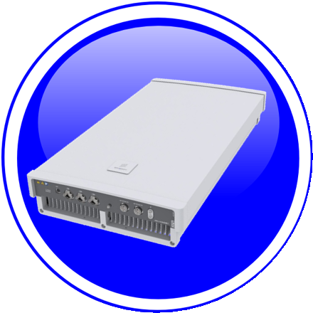


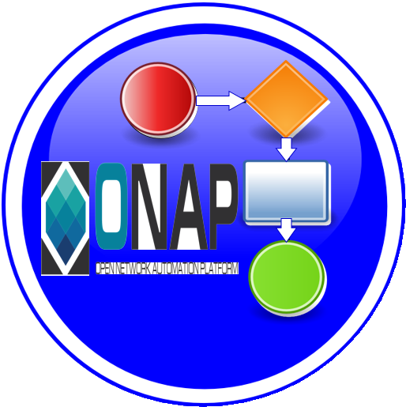
PNF Pre-onboarding & Onboarding Overview
1. PNF Package Delivery: Vendor creates & delivers PNF Package with PNF artifacts
1
Dublin Priority
2. PNF Pre-Onboarding: PNF-SDK ( ) to (create) PNF Onboarding Package & validates of PNF onboarding package
PNF
Descriptor
2
Dublin Priority
NF
Registration
3. PNF Onboarding package: Package loaded
3
PM
Schema
xNF
SDK
CSAR
Package
SDC
Informational
Artifacts
Package
creation
SDC
Catalog
SO, AAI,
DCAE etc.
Onboarding
Distribute
PNF
Onboarding
Package
Configuration
Files
+VENDOR
META DATA
5. ONAP RT Components:
Ingest and use CSAR package
5
Ansible
Playbook
4. SDC: NF OB Package > SDC catalog
4
Package Delivery
Onboarding
Design Time
Run Time
Onboarding Package
NF Descriptor
Platform Model
NF Instance

Slide 4
PNF Pre-onboarding & Onboarding Impacts
This Use Case will introduce the support for PNF pre-onboarding (PNF Package, PNF descriptor support) and PNF onboarding (SDC, Design Time, PNF-SDK).
PNF Package delivery by vendor (during Pre-onboarding activities) and PNF Onboarding via SDC in Dublin.
U/C DESCRIPTION
Wiki
https://wiki.onap.org/pages/viewpage.action?pageId=45303641
RT COMPONENT | IMPACT | PTL
SDC | PNF package format Onboarding PNF package to internal PNF package mapping Onboarding PNFD to internal PNFD mapping Artifact management | Yes (Michael Lando)
Modelling | Definition of Platform Info & Data model | Yes
Resource Data Model | Onboarding PNFD to internal PNFD mapping | Yes
VNF-SDK / PNF-SDK | Update to xNF-SDK and (create), parse, validation, of PNF Onboarding Package | TBR (to be reviewed)
SO, AAI, DCAE, Controller | Updates to RT components for proper ingestion of CSAR | TBR
PNF Onboarding Package | Vendor provided PNF onboarding package w/ PNF Registration and PNF-Descriptor. And ETSI SOL 001-007 Alignment | TBR
VNF Requirements | PNF requirements (in the VNF requirements projects) for PNF onboarding. (1) NF requirements updated to cover PNF package, descriptor and artifacts (2) VNF requirements could be reviewed. | TBR
ONAP RT COMPONENT IMPACTS

Slide 5



PNF Plug and Play Overview
1
Resources Definition/Services Definition
SDC: PNF (physical element) Modeling
Distribution of types
Design Time
PNF Modeling
2
PNF Infrastructure Service Declaration
First part of PNF instantiation
PNF A&AI Entry created
PNF Instance
Declaration
15
16
17
18
19
20
21
22
3
PNF Powers up and Boot-straps
PNF performs a “Plug and Play” procedure
Equipment vendor proprietary steps
PNF
Boot-strapping
4
PNF connects to ONAP via a Registration Event
PNF Registration Handler (PRH) processes the event
PNF
Contacts ONAP
Run-Time (Instances)
25
26
27
28
29
30
31
5
Connection points configured
Second part of PNF service instantiation
PNF configured and ready to provide service
PNF
Activation
34
35
36
37
38
39
40
41
42

Slide 6
PNF Plug and Play Enhancements for R4/Dublin
This Use Case will continue PNF Plug and Play development started in R3 Casablanca. Functionality that was started but not completed, and introduce some enhancements to improve Plug and Play operation.
U/C DESCRIPTION
Wiki
https://wiki.onap.org/pages/viewpage.action?pageId=40206485
RT COMPONENT | IMPACT | PTL INVOLVEMENT
Controller to NF Type Association | Association of Controller to NF Type, so that SO knows which controller to use for a particular NF instance | TBR(to be reviewed)
AAF, DCAE (Collectors) | Security enhancements to use Certificates & TLS | TBR
Controller (VF-C, SDN-C/R) | Service configuration to PNF by controller (Step 37). SDN-C already supports DG & Ansible. NetConf introduction (separate U/C) | TBR
VID | VID enhancements for PNF PnP. Supporting Work Order. Supported with service specific applications. | TBR
A&AI | PNF Indexing using pnf-id (instead of pnf-name) | TBR
SO | Support of SO for an already existing PNF (active) A&AI Entry | TBR
ESR | Association to External Controller (EMS/NMS). | TBR
ONAP RT COMPONENT IMPACTS

Slide 7
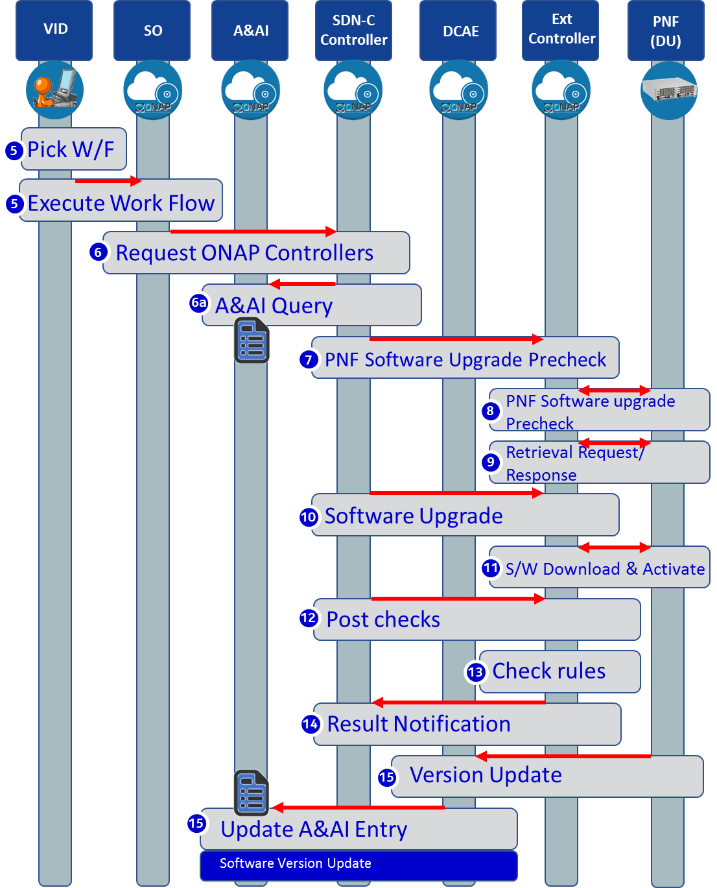
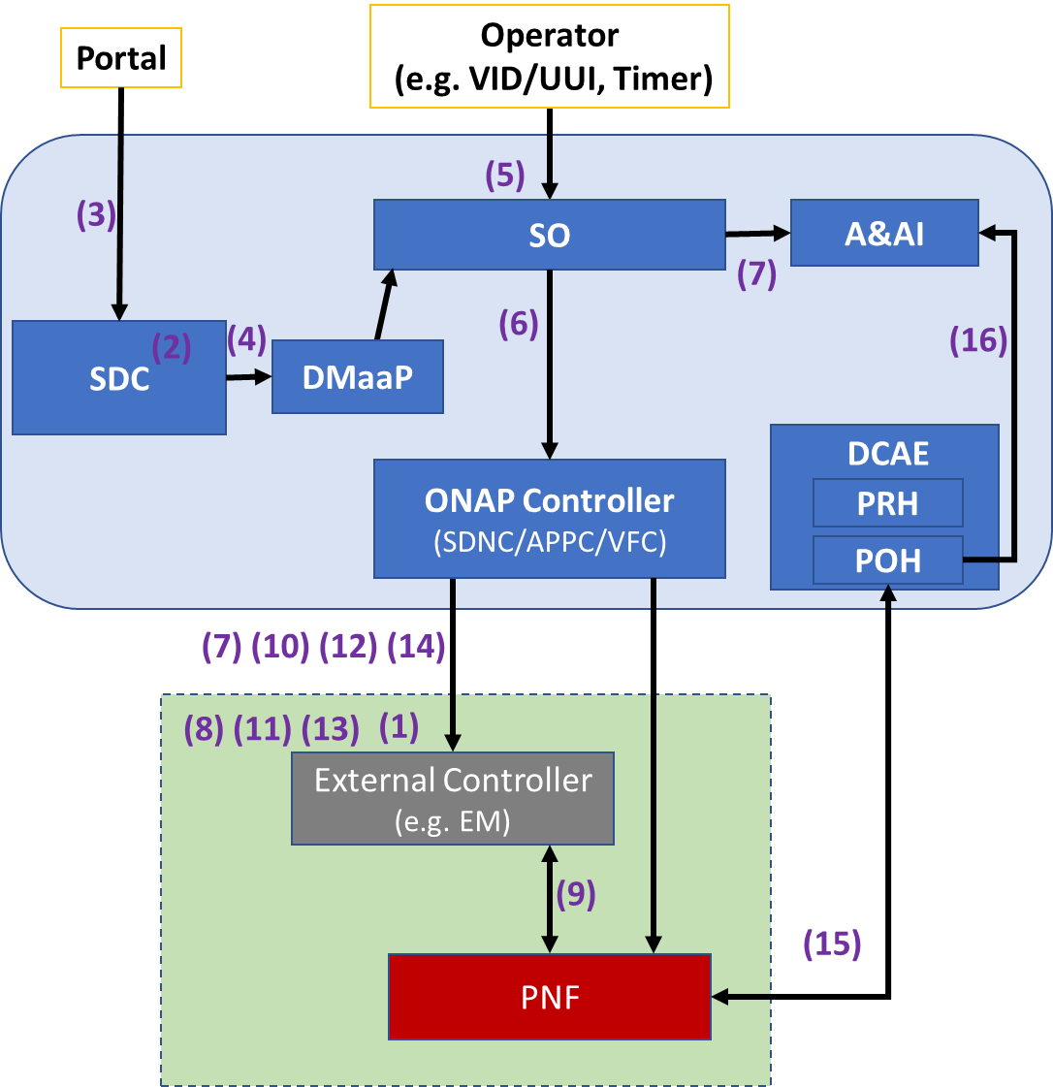
PNF SW Upgrade Overview

Slide 8
PNF SW Upgrade Enhancements for R4/Dublin
PNF Software upgrade is one aspect of Software Management. The purpose is to modify the software running on the PNF. This could be used to update the PNF software to a newer or older version of software.
U/C DESCRIPTION
Wiki
https://wiki.onap.org/pages/viewpage.action?pageId=40206485
RT COMPONENT | IMPACT | PTL INVOLVEMENT
PNF Reporting | PNF sends information regarding its Software Version directly to ONAP through a VES event. | TBR
Design Time Components | PNF software update workflow design, artifact onboarding upgrade rule list, utility of software version list. | TBR
PNF Package Update | A software update may require a change in the PNF Package before the software update or post update or both. | TBR (to be reviewed)
Software Update Coverage Analysis | Find out what services, control loops, etc. are impacted during and post software update before the PNF software update | TBR
Post/Pre PNF SW Update Event Workflows | Deregistration, re-registration | TBR
VNF & PNF in-place software upgrade processes alignment | Currently PNF and VNF entries in A&AI diverge that requires DG branching. Can we unify the process for both? | TBR
VID support | Execute the E2E run time workflow. In Casablanca, the process exists starting from the SDNC Northbound. | TBR
ONAP RT COMPONENT IMPACTS

Slide 9

Bulk PM Overview
Bulk PM File Upload and Perf3gpp Event Generation
VES
Collector
Message
Router
File
Collector
Data
Router
Analytics
Application
Bulk PM File Upload and Performance Event Generation
Network Function (NF) establishes a HTTP/TLS connection to the DCAE VES Collector.
NF sends FileReady notification Event to DCAE VES Collector. Event is encoded in JSON and sent via HTTP/TLS. HTTP/TLS connection is set up and torn down every time a FileReady notification event is sent.
DCAE VES Collector publishes the event to appropriate topic in DMaaP Message Router (MR).
DCAE File Collector retrieves the FileReady notification event from DMaaP MR.
File Collector uploads PM File from NF using a secure file transfer protocol; FTPES supported in Casablanca. NF authenticates the connection.
File Collector publishes PM Data to DMaaP Data Router (DR).
PM Mapper retrieves PM Data from DR and generates Perf3gpp events as configured by PM Mapper File.
PM Mapper publishes Perf3gpp events to MR.
Analytics Applications (AA) retrieve the Perf3gpp events of interest from MR. AA analyze the data to produce statistics and KPIs and optimization recommendations.
Authenticate connection
PM
Mapper
VNF
PNF
VES
Collector
HTTP/TLS
1
1
HTTP/TLS
2
2
Send FileReady event
Publish Event
Upload PM file
3
Retrieve Event
3
4
FTPES
4
5
Publish PM Data + metadata
5
6
Publish Perf3gpp Event
Retrieve PM Data +metadata
Retrieve Perf3gpp Event
6
7
7
8
8
9
9

Slide 10
Bulk PM Enhancements for R4/Dublin
Support the following work items for Bulk PM for 5G xNFs:
UC1: Perf3gpp event creation by 3GPP PM Mapper from Bulk PM XML file
UC2: Closed Loop support using 3GPP PM data (stretch goal)
Additional Requirements: DFC robustness enhancements, DMaaP DR enhancements
U/C DESCRIPTION
Wiki
https://wiki.onap.org/pages/viewpage.action?pageId=40206494
RT COMPONENT | IMPACT | PTL INVOLVEMENT
DCAE | UC1 Perf3gpp event creation from PM XML file: implement 3GPP PM Mapper microservice, configure PM Mapper, subscribe to PM XML file and metadata from Data Router, generate Perf3gpp events, publish to Message Router | Yes
DCAE, Policy, Controller (stretch goal) | UC2 Closed loop support using PM data: Analytics Applications subscribe to Perf3gpp event of interest or Bulk PM XML file, analyze the data, notify Policy of desired CM change, Policy triggers CM update to Controller | TBR
Data File Collector (DFC) | DFC robustness enhancements: FileReady for all files on the node, DFC retry handling. | Yes
DMaaP Data Router (DR) | DR enhanced handling of PM feeds: enhancements for DFC metadata, optional DR consumer specified feed encoding, high availability and scaling support. | Yes
ONAP RT COMPONENT IMPACTS

Slide 11



PM Dictionary Overview
DESIGN-TIME (SDC)
Descriptor
Onboarding
SDC
Catalog
PM Dictionary (YAML)
PNF
Onboarding
Package
Measurement
& Schema
Service
Designer
Define
Services
DCAE
Design Studio
Define
Templates
CSAR
Package
Dublin (R4) Goal is to be able to view the onboarded PM Dictionary (from the PNF onboarding package) in a GUI (either SDC Service Designer or DCAE-DS).

Slide 12
PM Dictionary Impacts
Support the following work items for PM Dictionary for 5G xNFs:
Review and finalize VES Event Listener Specification v7.1 and VES Event Registration Specification v3.2 which contains the PM Dictionary format and content.
Onboard the PM Dictionary for an xNF as a PM Dictionary YAML file. Note: Onboarding of the PM Dictionary artifact is covered under the PNF Onboarding Use Case.
Display the PM Dictionary in a GUI to allow an ONAP User to create PM Mapper configuration files for Perf3gpp event generation.
Update VNF Requirements for PM Dictionary artifact.
U/C DESCRIPTION
Wiki
https://wiki.onap.org/pages/viewpage.action?pageId=40206485
RT COMPONENT | IMPACT | PTL INVOLVEMENT
VES Specifications | Review and finalize VES Event Listener Specification v7.1 and VES Event Registration Specification v3.2 | Yes
GUI display of PM dictionary | Display the PM Dictionary in a GUI (either DCAE-DS or SDC-DS GUI) to allow an ONAP User to create PM Mapper configuration files for Perf3gpp event generation | TBR
VNF Requirements | Update to VNF requirements for PM Dictionary artifact creation | TBR
ONAP RT COMPONENT IMPACTS

Slide 13
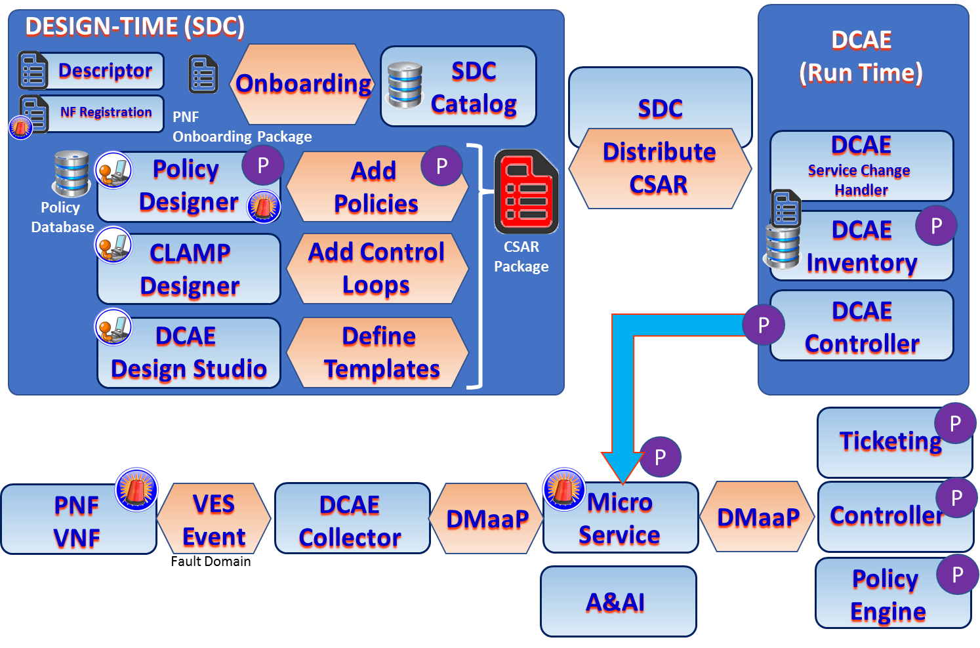
FM Meta Data Overview

Slide 14
FM Meta Data Impacts
Support the following work items for FM Meta Data for 5G xNFs:
Review and finalize VES Event Listener Specification v7.1 and VES Event Registration Specification v3.2 which contains the FM metadata format and content.
Onboard the FM metadata for an xNF as part of the VES Event Registration YAML file. Note: Processing of the FM meta data is covered the PNF Pre-onboarding & onboarding Use Case
Display the FM metadata in a GUI to allow an ONAP User to create Policies for handling alarms.
Update VNF Requirements for FM metadata artifact.
U/C DESCRIPTION
Wiki
https://wiki.onap.org/pages/viewpage.action?pageId=40206485
RT COMPONENT | IMPACT | PTL INVOLVEMENT
VES Specifications | Review and finalize VES Event Listener Specification v7.1 and VES Event Registration Specification v3.2 | Yes
GUI Display of FM Meta Data | Display the FM Meta data in a GUI (either DCAE-DS, Policy GUI and/or SDC GUI) to allow an ONAP User to create Policies for handling alarms | TBR
VNF Requirements | Update to VNF requirements for FM Dictionary metadata artifact creation | TBR
ONAP RT COMPONENT IMPACTS

Slide 15
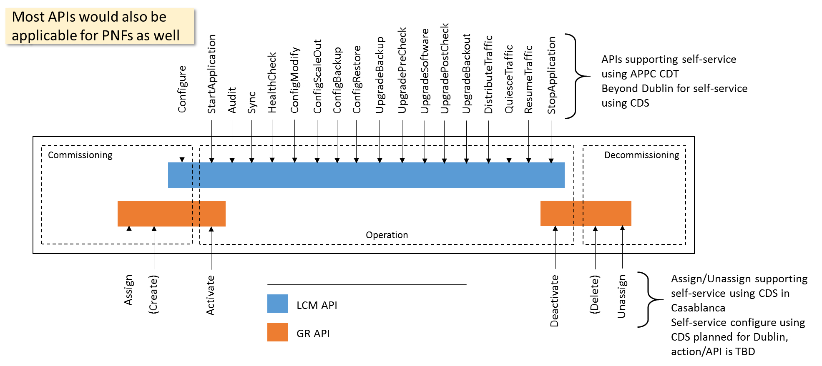
Configuration with NETCONF Overview
NETCONF is expected to be used for management of PNFs and VNFs in 5G networks
  YANG solution set has been defined by 3GPP for the 5G NRM (TS28.541)
NETCONF assumes that security is provided by the chosen transport protocol
  ONAP security sub-committee has recommended use of NETCONF over TLS: Secure Communication to Network Functions
Authenticated client identity passed to NETCONF layer for access control
Client
Server
NETCONF
Transport
- Authentication
- Data integrity
- Confidentiality
- Replay protection

Slide 16
Configuration with NETCONF Impacts
Proposed UC to focus on in Dublin for configuration with NETCONF:
Post-instantiation (triggered by SO), Including final configuration step (36/37) in the PNF PnP UC
Configuration modification (e g triggered by Policy)
Specific requirements on NETCONF support in ONAP:
Officially support both PNFs and VNFs for north-bound controller APIs in the use cases
Support for NETCONF over TLS (RFC7589), Support for YANG 1.1 (RFC7950) modules in addition to YANG 1.0
U/C DESCRIPTION
Wiki
https://wiki.onap.org/display/DW/5G+-+Configuration+with+NETCONF
RT COMPONENT | IMPACT | PTL INVOLVEMENT
APPC, SDNC, CCSDK | Configuration blueprint format Device protocol, YANG template, PNF target Controller north-bound APIs and implementation With PNF support in API definition Controller south-bound adapter NETCONF/TLS, YANG 1.1 Design tool/studio UI support, blueprint distribution | Yes
VID, SO, Policy | Workflow design and invocation Usage of controller API | Notified
AAF | Investigate AAF impact for NETCONF over TLS Also discuss in SECCOM meeting | Notified
VNF Requirements | NETCONF and security requirements shall allow NETCONF/TLS YANG requirements shall allow YANG 1.1 | Notified
ONAP RT COMPONENT IMPACTS

Slide 17
OOF & PCI Overview
SO
Query to allocate PCI for new cell (optional)
REST API
7
DMaaP Message
Config Value
Change Notifn
(Netconf/Yang)
6
4b
4a
ConfigDB
OOF
Policy
10
SDN-C*
3a
Simulated RAN
~2000 Cells
Nbr_list, PCI values
1c
8
DCAE
9
1d
PCI Handler MS
1a
11
1b
2
Config Value Change
5
FM/PM Data
PCI enhancements
ANR function
4d
4c
DCAE
3b
DCAE Database
DCAE Collector
(VES)
FM/PM
1e
FM/PM KPIs
(*SDN-C work done
in SDN-R team)
FM/PM Collector and Database

Slide 18
OOF & PCI Enhancements for R4/Dublin
Carry-over Items From Casablanca:
Onboard PCI Handler MS to DCAE, and include in SDC Catalog
SDN-R use cases moved from Casablanca to Dublin
  SDNC-430: Modify RAN informational model and yang model for RAN
  SDNC-431: Implement config DB and REST API (SDN-R / OOF interface)
  SDNC-432: Interfacing SDN-R with Policy
  SDNC-432: Receive netconf notification from RAN, update configDB, and publish change on DMaaP
Enhancements:
Common RAN Information Model, Configuration Management, Controller Enhancements, SON Coordination
Optimization for ANR (closely coupled with PCI)
U/C DESCRIPTION
Wiki
https://wiki.onap.org/display/DW/OOF-PCI+Use+Case+-+Dublin+Release
RT COMPONENT | IMPACT | PTL INVOLVEMENT
OOF | SON Coordination, Optimization for ANR ANR Handler MS, RAN Simulator | Yes
SDNC | Configuration Database Operational Database Configuration History | Yes
DCAE | Onboard PCI Handler MS to DCAE | ?
POLICY | Enhance the Policy functionality for Control Loop Coordination Implement 2 control loops for POC | Yes
AAI | Models & relationship between Config, Operational DB & AAI | ?
ONAP RT COMPONENT IMPACTS

Slide 19
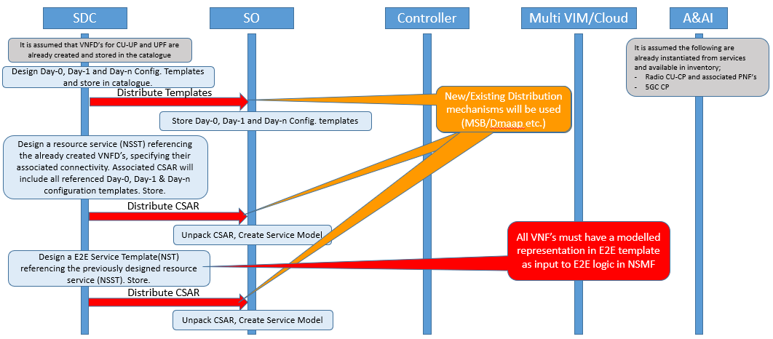
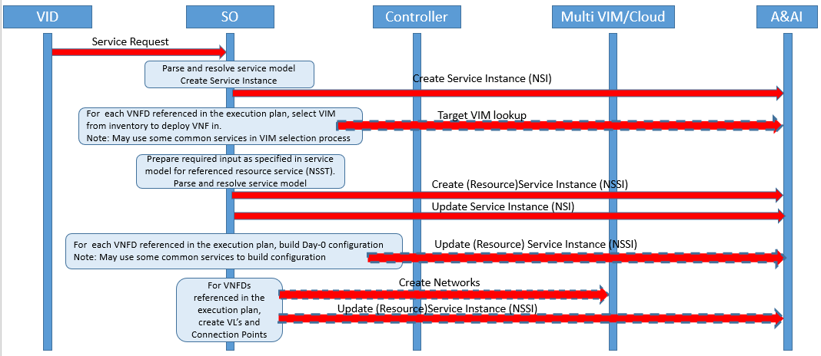
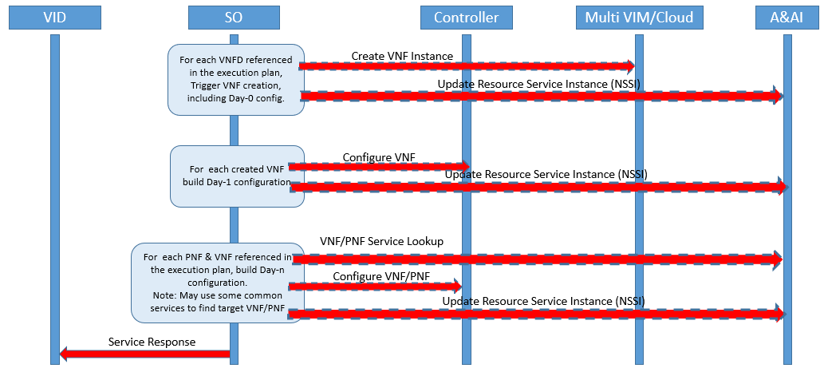
Network Slicing Overview
1
Design Time
Configuration templates are designed and distributed.
Service templates are designed and distributed
Run Time
Create E2E service instance
Determine VNF placement
Build required input for lower level service
Create resource service instance
Create networks
Instantiate VNF(s), applying Day-0 configuration
Configure instantiate VNF(s) with Day-1 configuration
Configure dependent PNF(s) &/ VNF(s) with Day-1 configuration
2
3
4
5
6
7
8
9
10

Slide 20
Network Slicing Impacts
..Based on identified Use Cases for NW Slicing in Dublin Release.
First proposal outlines the scope of the identified use cases with ambition levels for each.
Use Case Scope and Ambition Levels
Following proposal focuses on flows for Use case 1, Ambition level 1.
Use Case 1 Ambition level 1
U/C DESCRIPTION
Wiki
https://wiki.onap.org/pages/viewpage.action?pageId=38119661
RT COMPONENT | IMPACT | PTL INVOLVEMENT
SDC | Support the design and distribution of configuration templates Support the design of nested service templates (see ONAP Network Slice Modelling) Support the distribution of service templates | TBR
SO | Support orchestration of nested service templates Support integration with common functions for VNF placement decisions Support parameterization of configuration templates | TBR
A&AI | Evolve model to support NW Slicing aspects | TBR
Controllers | Support VNF Day-1 configuration Support VNF&PNF Day-n configuration | TBR
VID | Provide view of all available templates Provide means to trigger and monitor service instance creation and deletion Provide view of service instances and their dependencies | TBR
ONAP RT COMPONENT IMPACTS

Slide 21
Impact Matrix (Preliminary)
Likely
VNF Reqs & VES Spec
DCAE
OOF
Possible
Controllers
Policy/CLAMP
VID/Portal
AAI/ESR
VNF SDK
SDC
SO
AAF
DMaaP
PNF Pre-onboarding & Onboarding
PNF Plug and Play
PNF SW Upgrade
Bulk PM
PM Dictionary
FM Meta Data
Configuration with NETCONF
OOF & PCI
Network Slicing

Slide 22
Controller Impacts and Questions
Background
  Several 5G sub-cases involve ONAP controllers and may require enhancements in R4/Dublin
  There are also some questions since Casablanca about role of the different controllers
Design-time
  Need tool alignment: CDT -> CDS? When?
  Blueprint format improvements: per service blueprints, PNF support, additional device protocols (e g NETCONF/TLS), follow API additions
Controller personas and instances
  Which personas will be defined in Dublin, how will clients like SO and Policy known which controller instance to use
Controller (north-bound) APIs
  Existing APIs (GR and LCM) don’t recognize PNF as valid target
  New model-driven “self-service API” also being added in Dublin (CCSDK)
  Config DB API for PCI
  Need to recommend APIs for some use cases: day 1/N configuration, Policy
Implementation features
  Configurable behavior (onboarded or self-service) supporting multiple protocols (Ansible and NETCONF), different vendors, VNFs and PNFs
  Common NETCONF south-bound adapter supporting NETCONF/TLS, YANG 1.1
  Configuration database
  Operational database

