Slide 1
ONAP must own its Data Model
anatoly.katzman@att.com

Slide 2
Multiple Data Models
Onboarding
Translation
Composition
Orchestration
Operation
SOL 001
ONAP DM
ONAP DM
ONAP DM
?
“… why do we need an internal DM
And why R2+ model can’t handle this? “
?
“… why pay for the translation? “

Slide 3
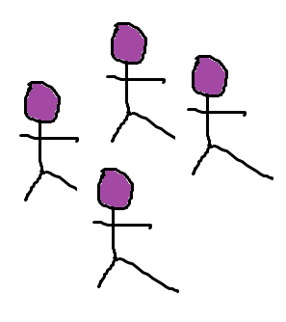
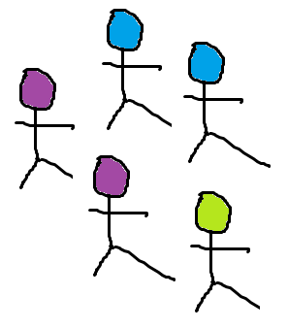
ONAP is not ETSI
ETSI
One Model for All
ONAP
ETSI and ONAP are two different organizations with their own audiences, processes, priorities, schedules
ONAP does not own SOL 01, changes require ETSI involvement
An attempt to have one model for all – tangles, delays, deadlocks
Translation decouples the two processes, lets them both run at their own pace while keeping their priorities and schedules
ONAP should own its Data Model
DM
ETSI
Multiple Models with Translation
ONAP
SOL 01
+ -
+ -
+ -
ONAP DM

Slide 4
Not only ETSI TOSCA to onboard
HEAT
ETSI YANG
??? Helm Charts, etc.
A wireframe translation now is better than painful refactoring later

Slide 5
Friendly Critics of SOL 01 – examples only

Slide 6
Connectivity Properties on Nodes
SOL 01 puts connectivity properties on nodes
### SOL 01 ###
node_types:
tosca.nodes.nfv.VnfVirtualLink:
derived_from: tosca.nodes.Root
properties:
connectivity_type:
type: ….ConnectivityType
# role, protocols, flow_pattern
#....
### ONAP DM ###
capability_types:
onap.capabilities.Linkable:
derived_from: tosca.capabilities.network.Linkable
properties:
cp_roles: #...
flow_patterns: #...
protocols: #...
Inconvenient for dangling requirements, hence bad for abstraction
Obscured by substitution mapping
Complicates run-time substitrution

Slide 7
SOL 01 Messes Up Capabilities and Requirements
### SOL 01 ###
tosca.nodes.nfv.Vdu.Compute:
derived_from: tosca.nodes.Root
properties:
#...
capabilities:
virtual_compute:
type: tosca.capabilities.nfv.VirtualCompute
virtual_binding:
type: tosca.capabilities.nfv.VirtualBindable
monitoring_parameter:
type: tosca.capabilities.nfv.Metric
requirements:
- virtual_storage:
capability: tosca.capabilities.nfv.VirtualStorage
Counter-intuitive, inconsistent modeling
Substitution mapping complicates everything even more
Capability which is a capability
Capability which is a requirement
Requirement which is a requirement

Slide 8
SOL 01 Breaks TOSCA Normative Lineage
tosca.capabilities.nfv.VirtualLinkable:
derived_from: tosca.capabilities.Root
tosca.capabilities.nfv.VirtualBindable:
derived_from: tosca.capabilities.Root
Broken line of inheritance from TOSCA normatives is bad for:
  Connectivity with other models
  Declarative workflows
tosca.relationships.nfv.VnfVirtualLinksTo:
derived_from: tosca.relationships.DependsOn
valid_target_types: [ tosca.capabilities.nfv.VirtualLinkable]
☺

Slide 9
Interfaces
tosca.interfaces.nfv.vnf.lifecycle.Nfv
  Not a Standard TOSCA Lifecycle Interface
  Not aligned with any workflow
  (internal stimuli) cannot be supported by a TOSCA orchestra2/3 of operations tor
  Not backed by the ONAP architecture (ONAP is not MANO)
ETSI LCM != ONAP Lifecycle != TOSCA Lifecycle
Translation is required

Slide 10
Sometimes SOL01 pushes TOSCA too far
VNF with a link
Complex-type properties
### SOL 01 ###
node_types:
tosca.nodes.nfv.VnfVirtualLink:
derived_from: tosca.nodes.Root
properties:
connectivity_type:
type: ….ConnectivityType
# role, protocols, flow_pattern
#....
### ONAP DM ###
capability_types:
onap.capabilities.Linkable:
derived_from: tosca.capabilities.network.Linkable
properties:
cp_roles: #...
flow_patterns: #...
protocols: #...
How do we make a dangling requirements with a node_filter for a complex-type property?
TOSCA currently does not support this!

