Slide 1
ONAP Internal Model for Service
anatoly.katzman@att.com

Slide 2
Service Composition Process
An ONAP service is created and then developed by a service designer in the SDC service composition process
The process starts when the designer either creates a brand-new service or picks from the catalog an already existing service for further editing
On creation, the service is given its name, ID, and a descriptive metadata set, and the initial version number
During the process, the designer chooses built-in and onboarded resources, brings them into the service topology, customizes their properties, establishes relationships between them, etc.
The service version progresses when the designer saves the composition results

Slide 3
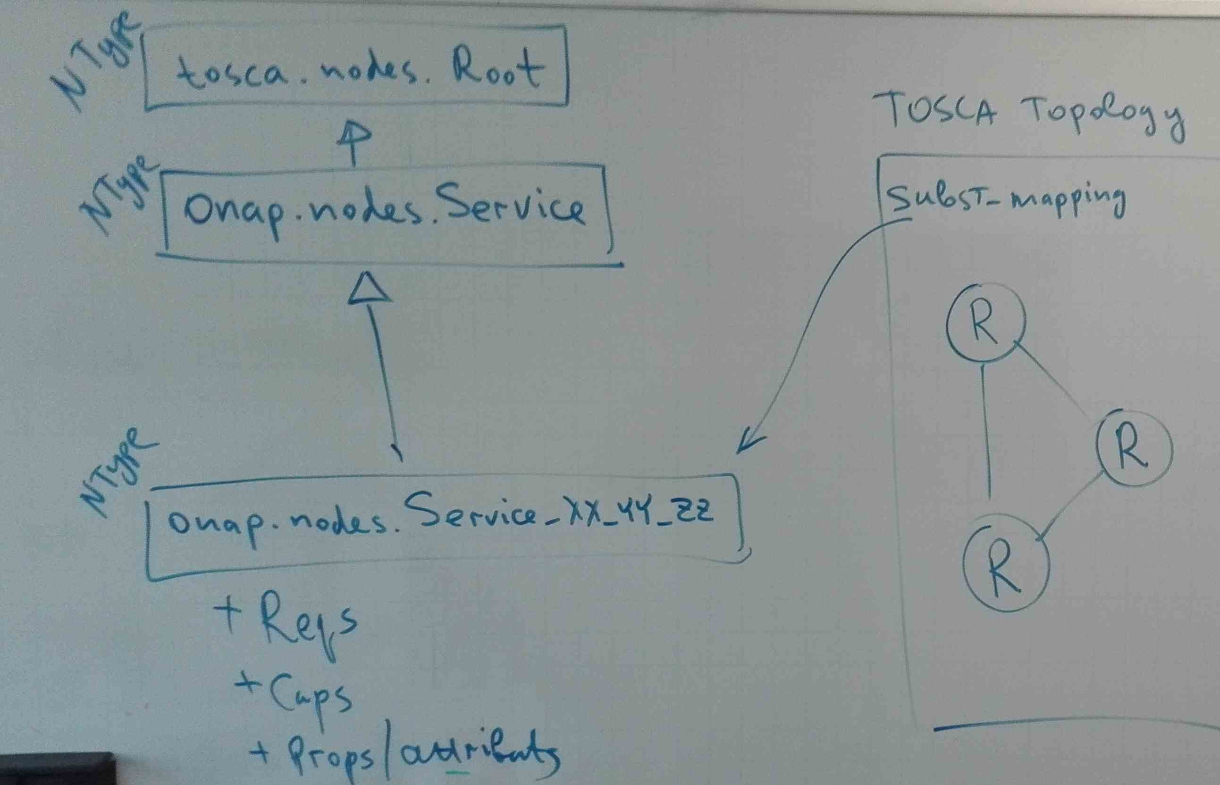
ONAP Simple Service Model
Per service, SDC generates:
A TOSCA topology with the service’s internal items: nodes, relationships, groups, policies. At some point, the service topology will also include imperative TOSCA workflows
A node type:
  Based on the abstract onap.nodes.Services type
  Extends the common base with properties, attributes, capabilities and requirements featuring this specific service
The topology #1 includes a TOSCA substitution_mappings construct, which:
  Targets the node type #2
  Maps the caps&reqs of the node type #2 to the internal nodes’ caps&reqs in the topology #1
  Maps the properties of the node type #2 to the topology #2 inputs

Slide 4
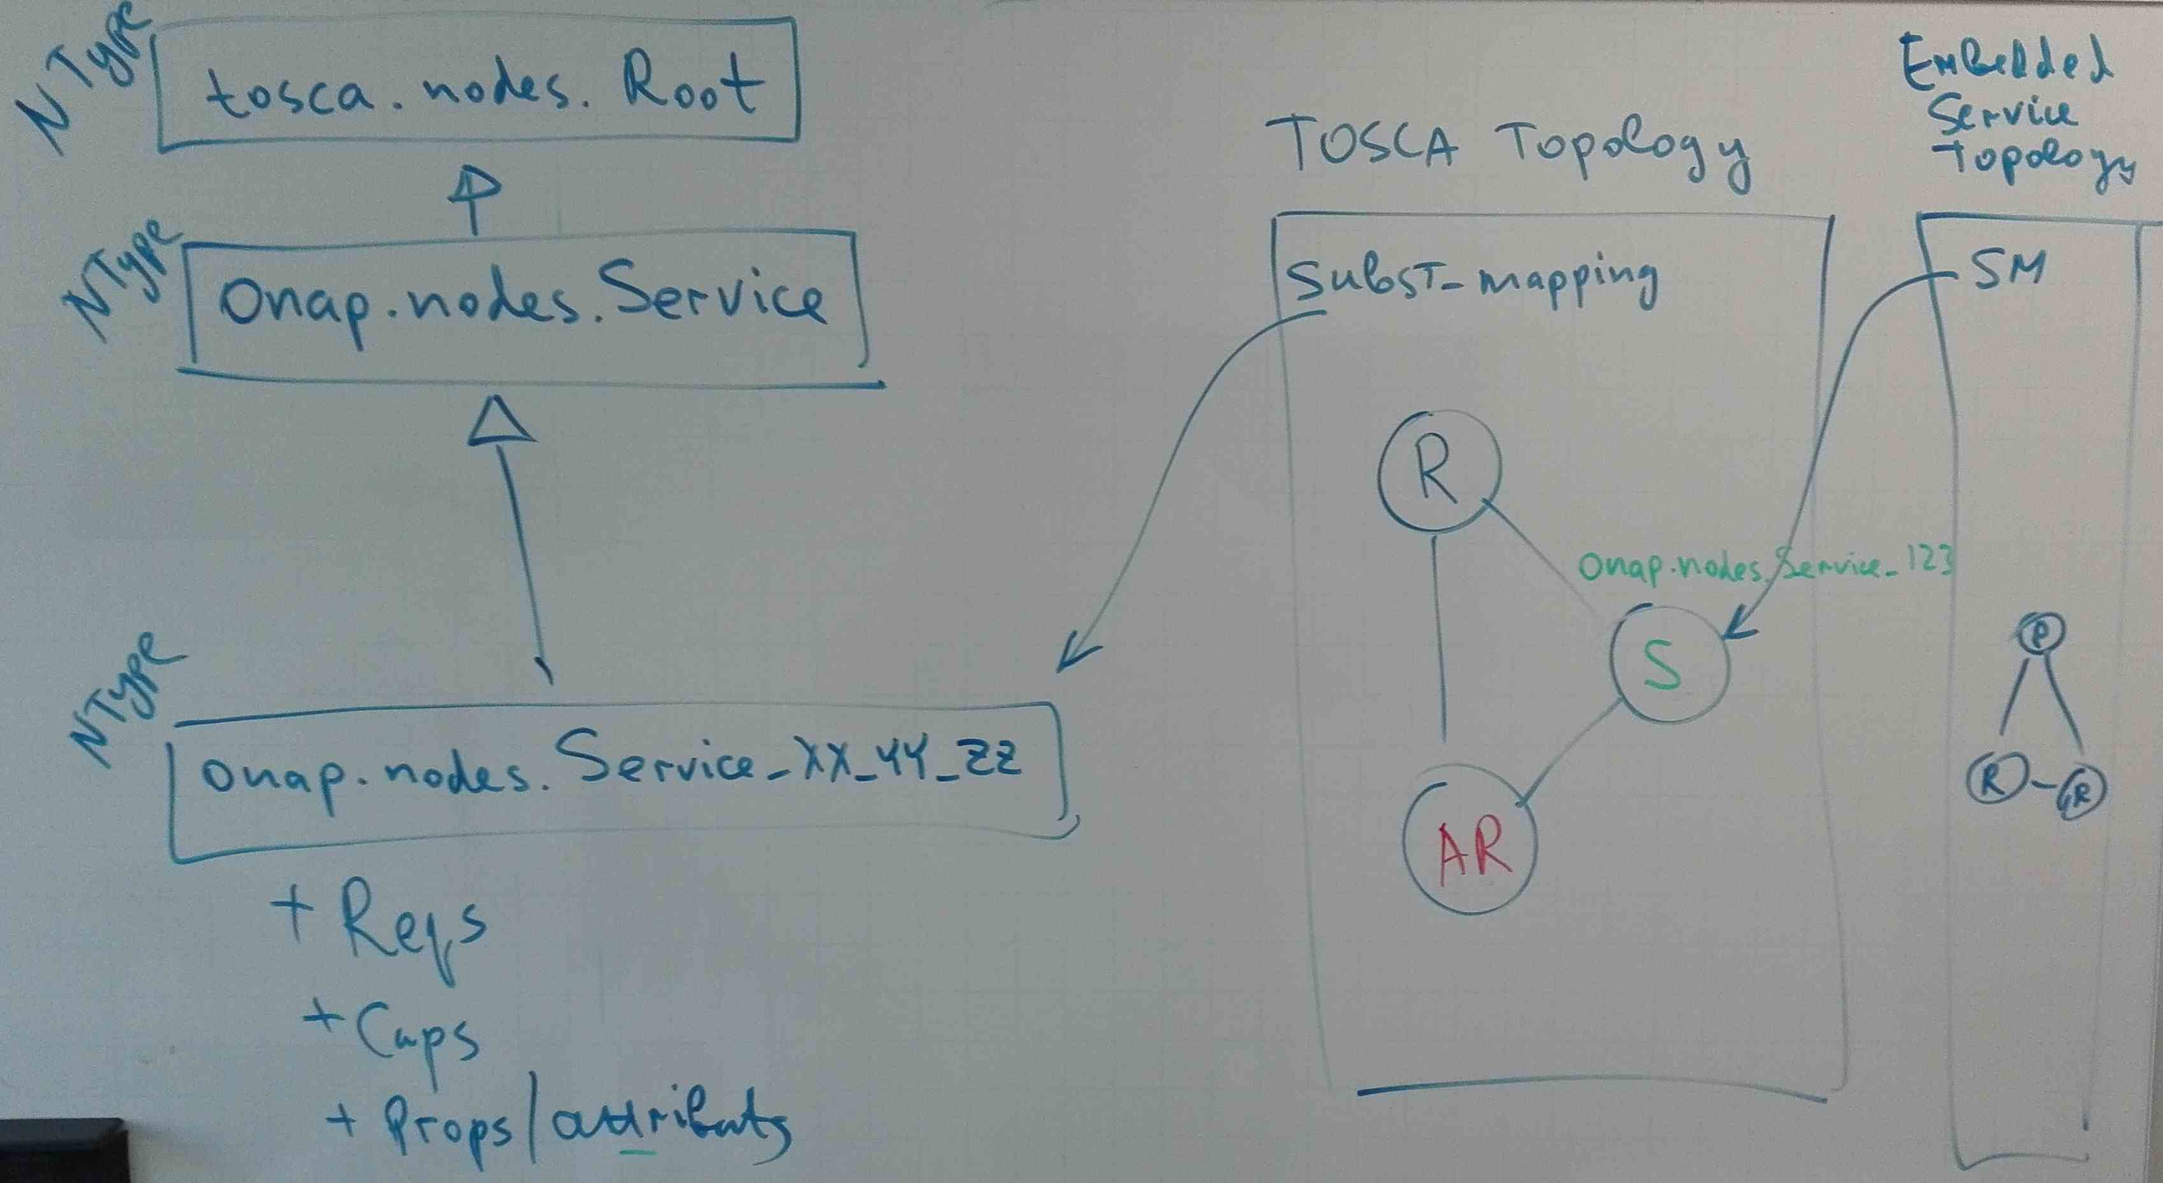
ONAP Embedded Service Model
Full reuse of the ONAP Simple Service Model
  Type, topology, substitution mapping
  Same abstract node type (onap.nodes.Service) used as a base
  Same VL and CP types to use with the topology
The embedded services are represented as nodes in the topology
The Service CSAR is self-contained, brings everything including the nested service(s)

Slide 5
ONAP Shared Service Model
Through AR, Allotted Resources
… to be continued

Slide 6
Requirements
Ability to model different service types:
  Stand-alone
  Complex services:
    Embedding – a complex service exclusively owns nested services
    Sharing – a complex service refers to an independently existing external service
Support for abstract resources and VLs inside the service – for run-time resolution
Support for recursive orchestration

