Slide 1
Concerns to be addressed in the data modeling area
Michela Bevilacqua
- June 25th, 2018

Slide 2
1) Separation of Concerns: Design/Run time
Design Time and Run time models have to support specific area of concerns.
  The new proposed model intend to be implemented in SDC, is therefore focused on the design time model only?
  which class/node types will be used at design time?, which at run time ? How then they are in relation to ?
  Have a look to IFA15 :
    Logical model = run time model, Deployment model = design time model

Slide 3
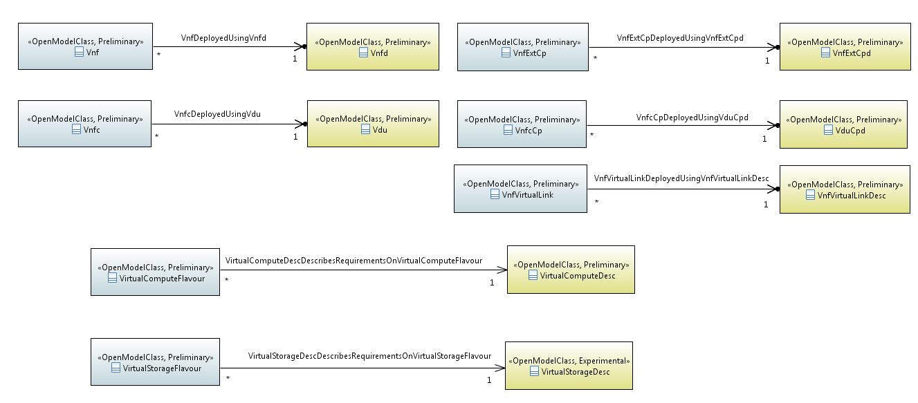
IFA015
fvInformationModel::NFVCoreModel::VirtualNetworkFunctionDomain::VnfModule::Vnf
NfvInformationModel::NFVCoreModel::VirtualNetworkFunctionDomain::VnfModule::Vnfc
NfvInformationModel::NFVCoreModel::VirtualNetworkFunctionDomain::VnfTemplateModule::Vdu
NfvInformationModel::NFVCoreModel::VirtualNetworkFunctionDomain::VnfTemplateModule::SwImage

Slide 4
2) Integration points/functional decomposition
Current ONAP architecture lack of
  Integration points definition,
  ONAP component functional decomposition.
    SO can assumes multiple role but not having clearly defined functional decomposition and integration points, it is not possible identifies what is the model scope against any modular approach.
We agreed to have a common information model and multiple data models in ONAP where each component may define its own data model.
  A functional decomposition and data model scope per functional component should be progressed before any model evolution (e.g. rational , this will help also running ONAP in edge cloud)

Slide 5
3) VNF Lifecycle operation in VNFD
VNF Lifecycle operations provided in a VNFD are not supported in ONAP R2,
They must to be introduced in R3 according to ETSI SOL001
  How VNF vendors lifecycle operation will be executed in the ONAP platform ?
  How vendor extensions (e.g. new parameters) will be supported

Slide 6
4) Limitation identified in the Onboarding model
Any TOSCA issues identified in ONAP onboarding model (ETSI SOL001) should be fixed in the ETSI model instead of justify the introduction of a new internal model.
  ETSI has already demonstrated a quick reactive capability in managing HPA proposal from companies involved in ONAP.

