Slide 1
VNF Test Platform (VTP)
ONAP VNFSDK Casablanca
Christopher.Donley@huawei.com
Kanagaraj.manickam@huawei.com
victor.gao@huawei.com

Slide 2
Objective
LFN/ONAP wants test platform where VNF packages could be certified using ONAP requirements to drive industry adoption
Provide an platform where vendor/operator can develop, deploy, run test cases and query the results
Test cases, test results and VNF should be manageable .i,e with authorization, so only user with given roles is allowed to perform operation like VNF package upload/download, run compliance verification tests, allow only specific VIM for specific users, etc.
Test results should be persisted and should be available for human analysis later via LFN infrastructure.
Provides test flow where author make flow across different test cases for a given program like compliance verification and VNFREQS/SOL0004.
Provide integration with OPNFV dovetail to run test cases across dovetail and VNFSDK.
Deployable as docker container.

Slide 3



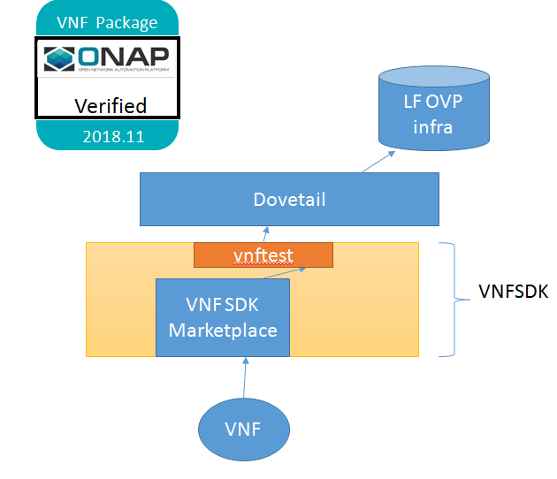
VNF Test Platform (VTP)
Java based
Test case
Java based
Test case
Results publish to
Vendor Test case
Dovetail
vnftest
Python based
Test case
Python based
Test case
Operator
SDC
CVP Test cases
VNF Test Platform
(VNFSDK)
Marketplace UI/ CLI
Vendor
Shell script based
Test case
Shell script based
Test case
Operator acceptance
Test case
VNF package repository
Test
repository
A platform to automate and manage different kind of VNF test cases for given VNF package(s) and provides unified accessibility over CLI, REST API and UI portal for operating the test cases.
Allows to write test cases in different languages like java, perl, shell scripts, python,etc.

Slide 4
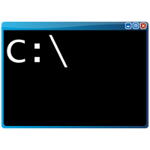

VTP High level architecture
VNF Test Platform
Java based
Test case
Java based
Test case
Web portal/Command console
Java based
Test case
VNF
Market place
(Controller)
Test Center
Operator/user
Test
Runner
(Java based)
gRPC
Test
Runner
(Python based)
Python based
Test case
gRPC
Test
Runner
(Shell based)
Python based
Test case
REST API
Python based
Test case
Vendor/author
Results publish to
Shell script based
Test case
Test (case, flow, result & profile)
repository
Shell script based
Test case
Shell script based
Test case
VNF package repository
Controller provides RESTful service on top of VNF package and Test cases & Test Flows
Test runner provides different execution environment like shell, java, etc, which facilitates authors to write test cases in their know languages like java, shell scripts, etc
Test center would route the execution to the proper Test runner and stores the result of each execution in the Test repository.
User/author can run the test cases/test flows via CLI/Portal/REST API enabled with Authentication & authorization.
Admin/user can upload the test results to the LFN OVP portal
Profile is provided to capture the required inputs for running test cases like VIM details, inputs.
NOTE: Test flow is very unique to this approach.

Slide 5
VTP standalone mode
Results publish to
Python based
Test case
Python based
Test case
3rd party Test cases
VNF Test Platform
(VNFSDK)
Marketplace UI/ CLI
Operator
VNF package repository
Test
repository
Platform can also be used standalone (without Dovetail) to support 3rd party lab testing. Labs can write their own
tests and connect to the Marketplace to upload/download VNFs, run tests, and query results.

Slide 6
VTP Vendor engagement mode
Python based
Test case
Python based
Test case
SDC
VNF Test Platform
(VNFSDK)
VNF package validation test cases
Vendor
VNF package repository
Test
repository
Could also be used by operators as their vendor engagement tool. In this case, SDC connects to Marketplace using
REST API. It can upload/download VNFs, run tests, and query results.

Slide 7
VTP with Dovetail
Results publish to
Python based
Test case
Python based
Test case
ONAP Test cases for CVP
VNF Test Platform
(VNFSDK)
Dovetail
vnftest
user
VNF package repository
Test
repository
Platform can also be used with Dovetail to run test cases between dovetail and VCP.
Vnftest container will be packed with VCP cli, which will helps to run given testcase/flow

Slide 8
Run dovetail test cases from VNFSDK
User
Dovetail CLI
Marketplace UI
VNFSDK
CLI
SDC
Dovetail
Testtool1
Testtool2
Testtool3
……
VTP
VNF test platform
Dovetail
Plug-in
VNF Package
Validation
VNF Lifecycle Test (in ONAP)
VNF Function test (in ONAP)
Dovetail CLI is integrated into VtP and User can run dovetail tests from Portal, CLI and even SDC if required in future?
Dovetail integration
Standalone
SDC

Slide 9
Run VNFSKDK test cases from Dovetail
Dovetail CLI
User
Dovetail
vtpcli/
vnftest
container
Testtool1
Testtool2
Testtool3
……
VTP
VNF test platform
VNF Package
Validation
VNF Lifecycle Test (in ONAP)
VNF Function test (in ONAP)
VtP is integrated into dovetail using vnftest container, which helps to invoke VNFSDK test cases from dovetail
Dovetail mode

Slide 10
VTP integration with existing projects

Slide 11
VTP High level architecture (Beijing -> Casablanca)
VNF Test Platform
Java based
Test case
Java based
Test case
Web portal/Command console
Java based
Test case
ONAP CLI
VNF
Market place
(Controller)
Test Center
Operator/user
VNFSDK
refrepo
Test
Runner
(Java based)
gRPC
Test
Runner
(Python based)
OCLIP engine
Python based
Test case
gRPC
Test
Runner
(Shell based)
Python based
Test case
REST API
OCLIP
command profile
Python based
Test case
Vendor/author
VNFSDK
Marketplace portal
Results publish to
Shell script based
Test case
Test (case, flow, result & profile)
repository
Shell script based
Test case
File system
Shell script based
Test case
VNF package repository
Postgres db

Slide 12
VNFSDK standalone mode ( for SDC)
User
Marketplace UI
VNFSDK
CLI
SDC
VNFSDK
refrepo
VTP
VNF test platform
VNF Package
Validation
VNF Lifecycle Test (in ONAP)
VNF Function test (in ONAP)
Vnfsdk /validation
Vnfsdk /functest
Vnfsdk /lctest
Dovetail integration
Standalone
SDC

Slide 13
Integration of VNFSDK projects with VTP
User
Dovetail CLI
Marketplace UI
VNFSDK
CLI
SDC
Dovetail
VNFSDK
refrepo
Testtool1
Testtool2
Testtool3
……
VTP
VNF test platform
Dovetail
Plug-in
VNF Package
Validation
VNF Lifecycle Test (in ONAP)
VNF Function test (in ONAP)
New YAMLs
Vnfsdk /validation
Vnfsdk /functest
Dovetail CLI is integrated into VtP and User can run dovetail tests from Portal, CLI and even SDC if required in future?
Vnfsdk /lctest
Dovetail integration
Standalone
SDC

Slide 14
Integration of Dovetail with in VTP
Dovetail CLI
User
Vnfsdk /dovetail-integration
Dovetail
vtpcli/
vnftest
container
VNFSDK
refrepo
Testtool1
Testtool2
Testtool3
……
VTP
VNF test platform
VNF Package
Validation
VNF Lifecycle Test (in ONAP)
VNF Function test (in ONAP)
Vnfsdk /validation
Vnfsdk /functest
VtP is integrated into dovetail using vnftest container, which helps to invoke VNFSDK test cases from dovetail
Vnfsdk /lctest
Dovetail mode

Slide 15
Thank you

Slide 16
VTP component level Technologies (Dublin)
VNF Test Platform
Java based
Test case
Java based
Test case
Web portal/Command console
Java
Java based
Test case
VNF
Market place
(Controller)
Test Center
Operator/user
OCLIP
gRPC
Test
Runner
(Java based)
OCLIP
Test
Runner
(Python based)
gRPC
Python based
Test case
nodejs
gRPC
Test
Runner
(Shell based)
Python based
Test case
Python based
Test case
REST API
Python
Angularjs
Vendor/author
Shell/Perl/etc
Shell script based
Test case
Shell script based
Test case
Shell script based
Test case
HTTP
VNF package repository
mongo
sFTP
Test YAML
repository
.
All components are marked with underlying Technologies

