Slide 1
ONAP TOSCA Driven Orchestration

Slide 2
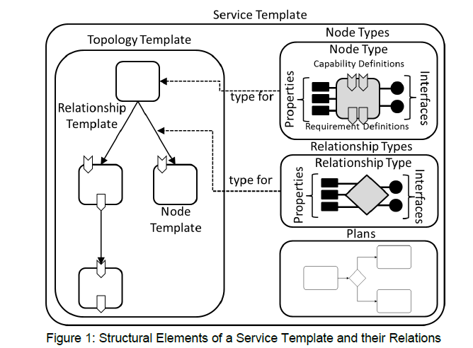
Terminology

Slide 3
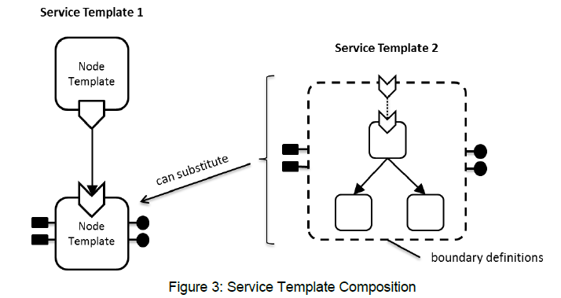
Terminology

Slide 4
Orchestrator Functional Internal View
APIs labeled on slide relative to SO for reference only.
Key
OE-x
SO External API
OI-x
SO Internal API
SO-SO communication across ONAP instances looks like an External API.
SO-SO communication within a single ONAP instance is via Micro Services Bus.
Service Design & Creation
OE-11
OE-4
Data Collection, Analytics, and Events
Event Correlation
Dashboard OA&M
External API
OE-5
OE-1
OE-2
OE-3
API Handler
Request
Handler
Allotted Resources case
Store
Request
Select Recipe
Map Request Data to Recipe & Invoke BPEL Execution
Track
Requests
OI-2
OI-3
OI-4
OI-5
OI-8
ONAP Optimization Framework
Orchestrator
Data Store
Orch Execution Engine (BPMN/TOSCA)
OE-6
Service Models
Orch Service
& Resource
Catalog
BPMN
DB
Service Level
SDC Distribution Client
OI-15
OI-7
Complex Services case
OI-13
OI-6
OI-1
Resource
Models
Request DB
OI-16
Micro Services Bus / Data Movement
Micro Services Bus / Data Movement
Scale
Asgn
Actv
Active & Available Inventory
External Registry
LCM
Resource Level Orch
OE-7
OI-10
OI-9
OI-14
OI-12
Resource/Controller Adapters
OI-11
Select Adapter Template
SDNC
Common
Map Data to Template
Infrastructure/Network Adapter
Controller Adapter
Execute Transaction
Controller functions common to both SDN-C and Generic NF Controller (OE-10a for LCM, OE-10b for App Configuration). Note that these may actually be separate APIs for SDNC and GenNFC
Controller functions specific only to SDN-C. E.g., “Assign Network Resources” for the VNFs in a L4+ Service.
OE-9
OE-10a
OE-10b
OE-8
Multi-Cloud
SDN Controller
Generic NF Controller

Slide 5
Layers of TOSCA Orchestration
(Original Approach)
Instantiate
Service_Request
Service
Service Template
Build
Service Level Orchestration
ANF
Service Template
Build
Resource Level Orchestration
PNF
Service Template
Build
SO
Network
Service Template
Build
VNF
Service Template
Build
VF Module
Service Template
Assign
Request
MultiVIM
Build
Cloud Workload Level Orchestration

Slide 6
High Level TOSCA Organization
(Original Approach)
Service
Service Template
Build (inputs)
VNF
Service Template
Build (inputs)
VF Module
Assign (inputs)
Service Template
Request (inputs)
Network
Build (Inputs)
Build (inputs)
Service Template
Build (inputs)
Build (inputs)
PNF
Allotted Resource
Service Template
Service Template

Slide 7
Major TOSCA Orchestration Gaps - (Original Approach)
Conversion from onboarding to runtime model needs work
The sequencing of Node Templates within a Topology Template is not based on Requirements/Capabilities between the Nodes, but rather based on hard-coded heuristics or properties. Need to fix this.
Lifecycle operations should be modeled in TOSCA, including the inputs and outputs of those operations.
The inventorying of object instance attributes should be driven from TOSCA attributes

Slide 8
Level of Abstraction in VNF Model that Drives ONAP “Assign”
vVNF
“Add-On VDU”
“vVNF” VNF Model
Attributes:
Bandwidth=200mbps
VM_{Bn+1}
0..8
extoam_net_id
VM_{Bn}
Each vVNF instance is comprised of 2-18 VM_{B} backend server VNFs.
Virtual Host requirements, such as NUMA, Rack Level Anti-Affinity/Affinity Grouping, etc. are captured as attributes of the VMs.
VM₂
extoam_net_id
“Reachability” requirements, such as L2/L3, Dynamic address assignment, SRIOV, etc. are captured as attributes of the connections.
VM₁
intdataplane_net_id
“Base VDU”
extdataplane_net_id
VM_{A}

Slide 9
VF Module Modeling (Original and Current Approach)
VF Module Service Template
Topology Template
Node Types
Inputs:
The inputs to a VF Module Topology Template would be comprised of basically the same sort of parameters that one would expect to find in a HEAT ENV.
NodeType: Standard “tosca.nodes”
  Properties
    Standard TOSCA properties
  Interfaces
    Standard “tosca.interfaces”
Each Node in the VF Module Topology Template is of a standard TOSCA node type. The relationships between these Nodes are standard TOSCA relationships. ONAP would be the Orchestrator for the “Assign” and “Request” Plans. “Assign” would cause the Orchestrator to call SDNC to make assignments, “Request” would cause Orchestrator to retrieve those assignments and map into the input params of the Service Template to send to MultiVIM.
The Orchestrator for the other Plans (such as the “Build” Plan) can be a standard off-the-shelf TOSCA orchestrator. However, this orchestrator should be within the “separation of concerns” space of the Cloud Provider, and not the responsibility of ONAP. However, ONAP would be responsible for providing the Input parameter values to the Cloud Provider with the Plan request (e.g., Build).
Relationship Types
RelationshipType: Standard “tosca.relationships”
  Properties
    Standard TOSCA properties
  Interfaces
    Standard “tosca.interfaces”
Plans
Assign_VFMod
Request_VFMod
Other, standard TOSCA Plans (e.g., Build)

Slide 10
VNF Modeling (Original Approach)
VNF Service Template
Topology Template
Node Types
Assign
NodeType: VF Module
  Properties
    ScalingAspect
    MaxScaleLevel
VF Module Service Template
Inputs:
The inputs to a VNF Topology Template are those required for the VNF-level Orchestration Plans.
Request
Each Node in the VNF Topology Template is of Node Type “VF Module”. These VF Modules have “Depends On” relationships between them. The Orchestrator determines the order in which to Request VF Modules based on the relationships, and not based upon any specific “Base” versus “Add-On” property. Because a VNF can have different “scaling aspects”, these relationships may need to be “scaling aspect” specific. (Not if we assume each VF Module appears in only a single “scaling aspect”.)
Relationship Types
Need to work through how to model a “Scaling Level”.
Depends On
Plans
Build_VNF

Slide 11
Service Modeling (Original Approach)
Service Service Template
VNF
Service Template
Build
Topology Template
Node Types
NodeType: VNF
  Properties
    InitialScaleLevel
NodeType: PNF
NodeType: AllottedResource
NodeType: Network
Inputs:
The inputs to a Service Topology Template are those required for the Service-level Orchestration Plans.
PNF
Service Template
Build
Each Node in the Service Topology Template is of Node Type “VNF”, “PNF”, “AllottedResource”, or “Network”. These Nodes have “Depends On” relationships between them. The Orchestrator determines the order in which to deploy a Node based on the relationships. Because the sequencing of the Node “Assign” may need to be different than Node “Create”, these relationships may need to be Plan specific.
Relationship Types
AllottedResource
Service Template
Build
Depends On
Plans
Build_Svc
Network
Service Template
Build

Slide 12
Service Level TOSCA Orchestration: “Build Plan”
(Original Approach)
The sequencing is currently hard coded based on Resource Type, but should rather be determined from TOSCA dependencies between the Node Templates.
Instantiate
Service_Request
Service Level Flow
The mapping of “Build” input data from the “service context” of the Service needs to be TOSCA model driven.
Determine Sequencing
Assign Svc
Instance
Create
Config Svc
Instance
Activate Svc
Instance
Decompose
Home
Loop Thru Resources
OOF
Assign Service Instance
TBD
Activate Service Instance
Decompose Service
VNF
Service Template
Build
Does not support decomposition of Services comprised of Allotted Resources and PNFs.
Network
Service Template
Build
ANF
Service Template
Build
Create service-instance object in A&AI, orchestration-status = Inventoried
Call SDN-C Assign (the mapping of input data should be from TOSCA)
Update service-instance object in A&AI, orchestration-status = Assigned
PNF
Service Template
Build
Update service-instance object in A&AI, orchestration-status = Active

Slide 13
VNF Level TOSCA Orchestration: “Build Plan”
(Original Approach)
The sequencing is currently hard coded based on Resource Type, but should rather be determined from TOSCA dependencies between the Node Templates.
“Build”
VNF Request
Determine Sequencing
VNF Level Flow
Assign VF Mod
Instance
Request VF Mod
Instance
Assign VNF
Instance
Config VNF
Instance
Activate VNF
Instance
Loop Thru VF Modules
Assign VNF
TBD
Activate VNF
Create generic-vnf object in A&AI, orchestration-status = Inventoried
Call SDN-C Assign (the mapping of input data should be from TOSCA)
Update generic-vnf object in A&AI, orchestration-status = Assigned
Call Controller Configure
Update generic-vnf object in A&AI, orchestration-status = Configured
Assign VF Module
Request VF Module
Create vf-module object in A&AI, orchestration-status = Inventoried
Call SDN-C Assign (the mapping of input data should be from TOSCA)
Update volume-group object in A&AI, orchestration-status = Assigned
Call Controller Activate
Update generic-vnf object in A&AI, orchestration-status = Active
Call SDN-C to get vf-module assignments
Generate Heat parameters and call Heat to create object in cloud
Update vf-module object in A&AI, orchestration-status = Created

Slide 14
vCPE Example (Original Approach)
vCpeResCust Service Service Template
Topology Template
Node Types
NodeType: VNF
  Properties
NodeType: PNF
  Properties
NodeType: AllottedResource
  Properties
  NodeType: Service
BRG
(PNF)
(activate)
vG
(VNF)
(assign)
Relationship Types
(assign)
Depends On
Requirement/Capability
(requirement/
capability)
TunnelXConn
(ANF)
Plans
vGMux
(Service)
Build_Svc

Slide 15
vCPE Example (Original Approach)
vG VNF Service Template
Topology Template
Node Types
NodeType: VF Module
  Properties
    Requirements: TunnelXConnCapability
base_vcpe_vgw
(VF Module)
Relationship Types
Depends On
Plans
Build_Vnf

Slide 16
vCPE Example (Original Approach)
base_vcpe_vgw VF Module Service Template
Topology Template
Node Types
NodeType: Neutron Port
  Properties
NodeType: Nova Server
  Properties
vgw_private_0_port
(Neutron Port)
vgw_private_1_port
(Neutron Port)
vgw_private_2_port
(Neutron Port)
Relationship Types
Depends On
Plans
Assign
Request
Build (not executed by ONAP)
vgw_0
(Nova Server)

Slide 17
vCPE Example (Original Approach)
vGMux Infra Service Service Template
Topology Template
Node Types
NodeType: Service
  Properties
    Capabilities: TunnelXConnCapability
vBNG
(VNF)
(assign,
activate)
(assign,
activate)
BRG_BNG
(Network)
Relationship Types
Depends On
Plans
Build_Svc
BNG_MUX
(Network)

Slide 18
vCPE Example (Original Approach)
vBNG Infra Service Service Template
Topology Template
Node Types
NodeType: VNF
  Properties
NodeType: Network
  Properties
vBNG
(VNF)
(assign,
activate)
(assign,
activate)
BRG_BNG
(Network)
Relationship Types
Depends On
Plans
Build_Svc
BNG_MUX
(Network)

Slide 19
New Requirement
Service A – Service Template
VNF A.1
VNF A.3
Original Approach:
Build Service A:
  Build VNF A.1
    Assign VNF A.1
    Create VNF A.1
    Activate VNF A.1
  Build VNF A.2
    Assign VNF A.2
    Create VNF A.2
    Activate VNF A.2
  Build VNF A.3
    Assign VNF A.3
    Create VNF A.3
    Activate VNF A.3
New Requirement Approach:
Assign Service A:
  Assign VNF A.1
  Assign VNF A.2
  Assign VNF A.3
Create Service A:
  Create VNF A.1
  Create VNF A.2
  Create VNF A.3
Activate Service A:
  Activate VNF A.1
  Activate
  Activate VNF A.3
VNF A.2

Slide 20
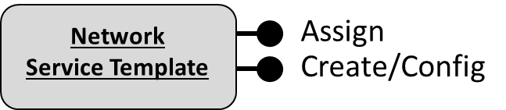
High Level TOSCA Organization (New Approach)
Service
Service Template
Assign (inputs)
Create (inputs)
Configure (inputs)
VNF
Service Template
Assign (inputs)
Activate (inputs)
Create (inputs)
Build (inputs)
Configure (inputs)
VF Module
Service Template
Assign (inputs)
Activate (inputs)
Still exists
Request (inputs)
????
Assign
Assign
PNF
Service Template
Configure
AllottedResource
Service Template
Create/Config
Activate
Activate

Slide 21
VNF Modeling (New Approach)
VNF Service Template
Topology Template
Node Types
Assign
NodeType: VF Module
  Properties
    ScalingAspect
    MaxScaleLevel
VF Module Service Template
Inputs:
The inputs to a VNF Topology Template are those required for the VNF-level Orchestration Plans.
Request
Each Node in the VNF Topology Template is of Node Type “VF Module”. These VF Modules have “Depends On” relationships between them. The Orchestrator determines the order in which to Request VF Modules based on the relationships, and not based upon any specific “Base” versus “Add-On” property. Because a VNF can have different “scaling aspects”, these relationships may need to be “scaling aspect” specific. (Not if we assume each VF Module appears in only a single “scaling aspect”.)
Relationship Types
Need to work through how to model a “Scaling Level”. Is that a separate TOSCA Service Template per Scale Level? Or what?
Depends On
Plans
“Assign” and “Create” Plans orchestrate the “Assign” and “Request” interfaces of the VF Module Nodes based upon the relationships in the Topology Template. The “Configure” and “Activate” Plans do not call VF Module Node interfaces at all, but rather call VNF-level interface exposed by a Controller. How do you model VNF-level interfaces in a VNF Service Template?
Build_VNF
Assign_VNF
Create_VNF
Configure_VNF
Activate_VNF

Slide 22
Service Modeling (New Approach)
Service Service Template
Assign
VNF
Service Template
Create
Topology Template
Node Types
Configure
NodeType: VNF
  Properties
    InitialScaleLevel
NodeType: PNF
NodeType: AllottedResource
NodeType: Network
Inputs:
The inputs to a Service Topology Template are those required for the Service-level Orchestration Plans.
Activate
Assign
PNF
Service Template
Configure
Each Node in the Service Topology Template is of Node Type “VNF”, “PNF”, “AllottedResource”, or “Network”. These Nodes have “Depends On” relationships between them. The Orchestrator determines the order in which to deploy a Node based on the relationships. Because the sequencing of the Node “Assign” may need to be different than Node “Create”, these relationships may need to be Plan specific.
Activate
Relationship Types
Assign
Depends On
AllottedResource
Service Template
Create/Config
Plans
Activate
Build_Svc
Assign_Svc
Create_Svc
Configure_Svc
Activate_Svc
The “Build” Plan orchestrates the “Assign”, “Create”, “Configure”, and “Activate” interfaces of the Resource-level Nodes based upon the relationships in the Topology Template. The other Plans orchestrate just the respective interface of the Resource-level Nodes.

Slide 23
Service Level TOSCA Orchestration: “Build (and other) Plan(s)”
(New Approach)
Service
Service Template
Assign
Create
Configure
Instantiate
Service_Request
Activate
Service Level Flow
Build
Assign Service
Create Service
Configure
Activate
Decompose
Home
Assign Service_Instance
OOF
Configure Service_Instance
Activate Service_Instance
Decompose Service
Configure Service Instance
Create Service_Instance
Assign Service Instance
Configure
Resources
Assign
Resources
Assign Svc
Instance
Loop Thru Resources
Activate Service Instance
Loop Thru Resources
Create Service Instance
Activate Resources
Create
Resources
NF
Service Template
Configure
Assign Service Instance
Loop Thru Resources
Loop Thru Resources
NF
Service Template
Assign
NF
Service Template
Activate
VNF, PNF, Ntw
Service Template
Create

Slide 24
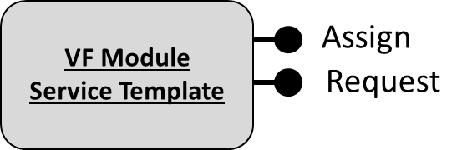
VNF Level TOSCA Orchestration: “Build Plan”
(Original Implementation)
Assign VNF Instance
Request VNF Instance
Assign VF Module
Create VF Module
Activate VF Module
Assign VNF
Instance
Loop Thru VF Modules
Loop Thru VF Modules
Assign Vnf
Request Vf Module Create
Activate Vf Module
Assign Vf Module
Create vf-module object in A&AI, orchestration-status = Inventoried
Call SDN-C Assign
Update volume-group object in A&AI, orchestration-status = Assigned
Send an VF-Module activate request to SND-C (REALLY??? WHY??)
Update the vf-module object in A&AI, orchestration-status = Active
Create generic-vnf object in A&AI, orchestration-status = Inventoried
Call SDN-C Assign
Update generic-vnf object in A&AI, orchestration-status = Assigned
Call SDN-C to get vf-module assignments
Generate VF Module Template (or HEAT) input parameter instance values (e.g., ENV) and call Cloud Orchestrator (e.g., OpenStack HEAT) to create object in cloud
Update vf-module object in A&AI, orchestration-status = Created

