Slide 1
Casablanca Release Highlights
Oct , 2018

Slide 2

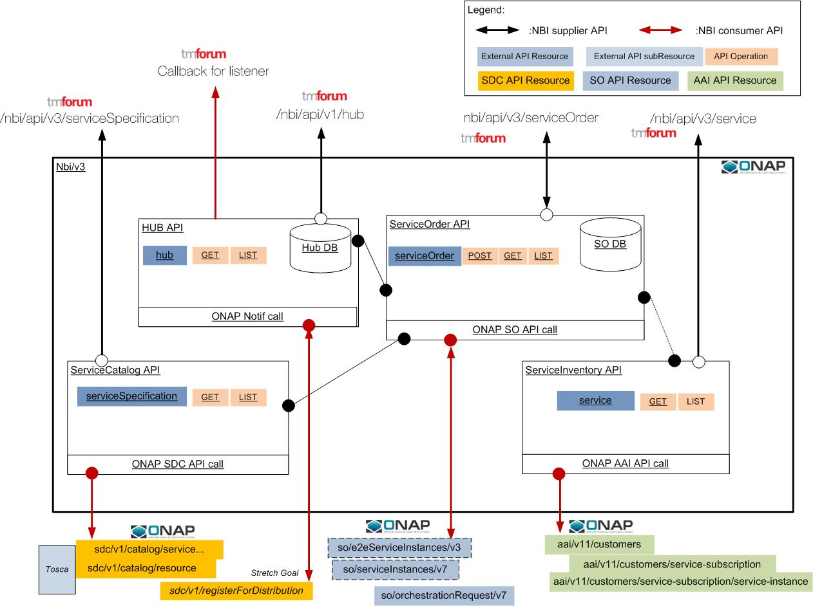
External API
Add TMF-based notification (HUB/EVENT) at least for Service Order
Expose NBI API to ONAP MicroServiceBus (directory)
Tackle service modification UC though serviceOrder (minimum)
Improve Service Order API to manage E2E service provisioning
Integrate NBI in a complete E2E use case (CCVPN)
Legato Operations
(North):
Query service catalog
Query serviceability
Create Service
Modify Service
Delete Service
Service Inventory operations
Interlude Operations
(East-West):
Query service catalog
Create Service
Modify Service
Delete Service
Service Inventory operations

