Slide 1
Casablanca Release Highlights
November , 2018

Slide 2
Casablanca Highlights
Release Features | Business | Technology
CCVPN Use Case | Cross Domain and Cross Layer VPN. Peering Orchestration Between SPs
5G Use Case | Deployment of the hybrid 5G Radio Network (PNFs & VNFs). Optimization of the deployed 5G network. OOF Placement. Edge Analytics
AAI | History Data, SR-IOV support | Casandra and Janusgraph, RethinkDb
APPC | LCM Action Reboot
CCSDK | Controller Design Studio for SDNC and APP-C/VFC | ODL "Oxygen"
CLAMP | New Dashboard | View DMaaP Events
CLI | Run commands remotely with new gRPC server and validate CSAR from command console.
DCAE | New DataFile Collector | Now uses PNDA! VES 7.0 Upgrade
Documentation | New Look, Mobile Support, "Report issue" button
External API | MEF and Legato Support | Enhancements for CCVPN also
HOLMES | New Rules UI | More scripts based
Integration | CI/CD with Daily Summary, Container Optimization, Offline Deployment | Docker best practices
Multi-Cloud | Expanding supports of infrastructures (VIM/Cloud) | Integration with SO. Automates onboarding of edge clouds
MSB |  | Istio/Envoy Service Mesh PoC
OOM | Chart Repository, Resource Limits | Supports k8s backup using Heptio Ark
Policy | Auto Scale Out, HPA, CCVPN, 5G OOF PCI | New Guard & Actor/Recipe Policies, Policy Service Distribution, Apex PDP Ingest, Control Loop Coordination
POMBA | New Project: Post Orchestration Model Based Audit | Optional
SDC | 3 new "studios": DCAE, Workflow, Controller | SOL-004 compliant CSAR
SDNC | Site Failure Resiliency via Geo-graphic Redundancy with auto-failover | Notifications send via DMaaP
SO | PNF Orchestration Support, HPA Support. SO-Monitoring component for Flows | enhanced microservices approach
UUI | GUI for CCVPN, network service lifecycle management and VF-C package catalog.
VF-C | NS Orchestration now supports PNF, HPA. Integrates with OOF | SOL003 Alignment. Standalone DB Microservice
VNFSDK | Added Support for LFN Compliance Verification Committee (CVC) | Introduced the VNF Test Platform (VTP) for VNF testing, and in casablanca, VNF package testing based on ETSI SOL004

Slide 3
ONAP Casablanca Architecture
(High-Level View with Projects)
Version 3.0.3 7/31/2018
Modeling (Utilities)
Integration
Benchmark / Container Images
VNF Requirements
VNF Validation Program
Notes:
rop L0-3 for SDNC and 4-7 for APPC.

Slide 4
Two New
USE CASES

Slide 5
CCVPN(Cross Domain and Cross Layer VPN) USE CASE
CCVPN by ONAP Peering Orchestration Between SPs
ONAP (CMCC)
ONAP (VDF)
SOTN Controller
SD-WAN
Controller
SOTN Controller
SD-WAN
Controller
Internet
uCPE
vCPE
vCPE
CPE
Site
Connection（ E-Line）
Site
Site
Connection（ E-Line）
Site
UNI
UNI
UNI
UNI
CCVPN use case is to realize connections between different ONAPs.
The Joint CCVPN PoC demo was demonstrated at ONS-EU in Sep 2018.
11

Slide 6
5G USE CASE
  Deployment of the hybrid 5G Radio Network (PNFs & VNFs)
    Complete PNF Support
    Platform Enhancements to Deploy Edge PNF & Virtual Radio Network Functions (e.g. CU)
      PNF PlugNplay, Configuration Enhancements, Performance Analysis & Optimization
  Optimization of the deployed 5G network
    OOF enhancements for optimal placement of edge resources
    Edge Analytics to Support 5G Network Optimization

Slide 7
PROJECT
Summary

Slide 8

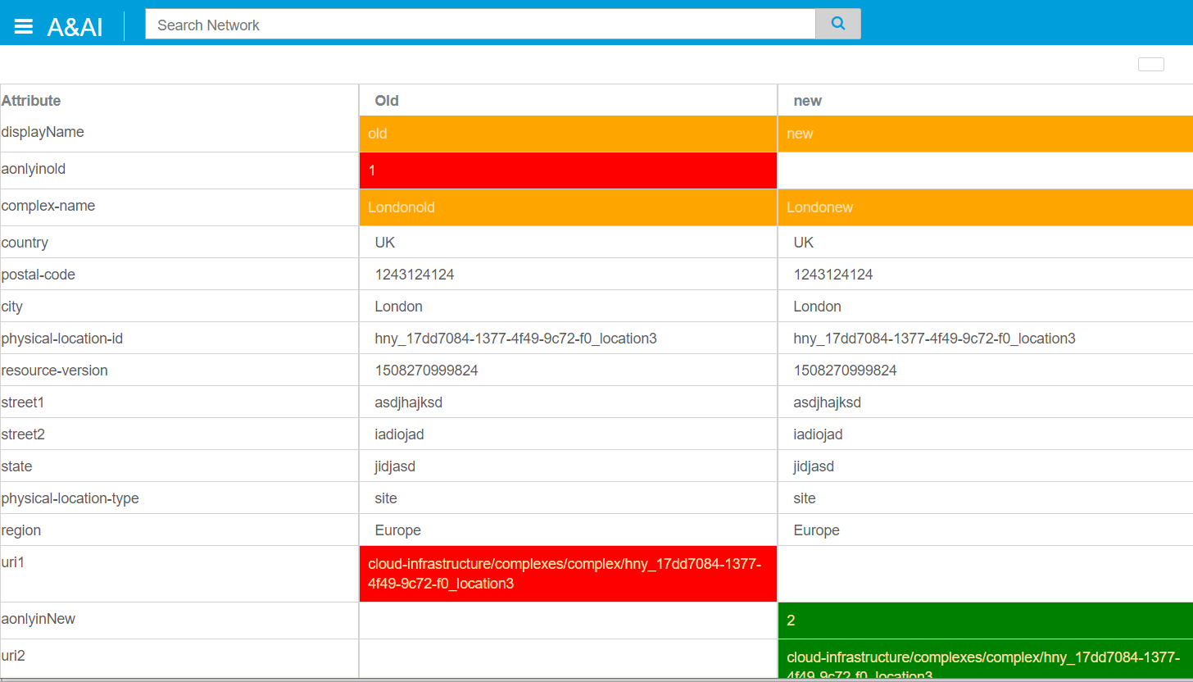


AAI
Upgrade HBase and Titan to Cassandra & Janus Graph Upgrade and add RethinkDB
Add SR-IOV to the AAI data-model
Historical View – see when ONAP data changed
Note: AAI Historial Data backend is available, but the UI is pending.
Notes:
Note:

Slide 9
APPC
Add support for new LCM Action Reboot and enhancement existing LCM actions
  Add Reboot support to APP-C Client Library as well as support to enable payloads in the response for Healthcheck, UpgradePrecheck, and UpgradePostcheck
  Support OpenStack actions Start, Stop, Reboot and Restart at the VNF levels
  Add feature in Design Services to support Reboot LCM command
  Enhance Ansible support by enabling granular parsing of response messages
  Support HealthCheck response with Payload which contains detailed status coming from VNF
  Support UpgradePreCheck and UpgradePostCheck responses with Payload which contain detailed status coming from VNF
  DistributeTraffic for migration of traffic from source to destination with appropriate input parameters. The payload would then be passed to the downstream Ansible server to take appropriate actions.

Slide 10

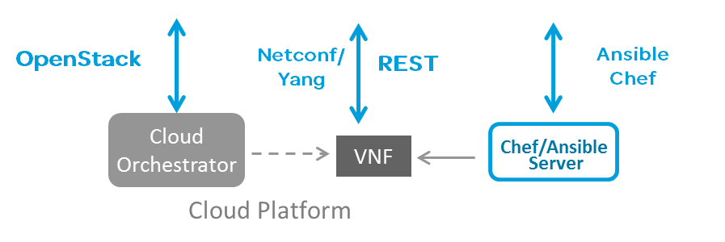
CCSDK
Controller Design Studio
  common design tool to support both SDNC and Generic L4-7 NFs (APPC, VFC) Controller integrated with SDC
Upgrade to ODL ‘Oxygen’
Template Meshing μS
Data Sources
A&AI
MD-SAL
Database
Etc..
Resource Resolution Bundle
East/West API
Data Sources
DESIGN TIME
μS Naming
μS IP Assign
μS VLAN Tag
μS MAC Address
Etc..
Controller
Design Center
(Backend)
Runtime
Catalog
Controller Framework (CCSDK)
Controller
Design
Center GUI
Generate Templates
Populate Data Dictionary
Create Controller Service Models aka blueprint
SDNC *
Network Controller
Generic L4-7 NF
Templates
API
API
SDC Integrated User Experience
SDC Design Catalog
Network Adapters
Application Adapters
Common Data
Dictionary
μS
Controller
Design Artifacts
Cloud Sites (many edge sites)
Legend:
Platform components contributed POST Casablanca
Existing Run Time Application Instance in ONAP
VNFs
VNFs
VNFs
VNFs
RUN TIME

Slide 11
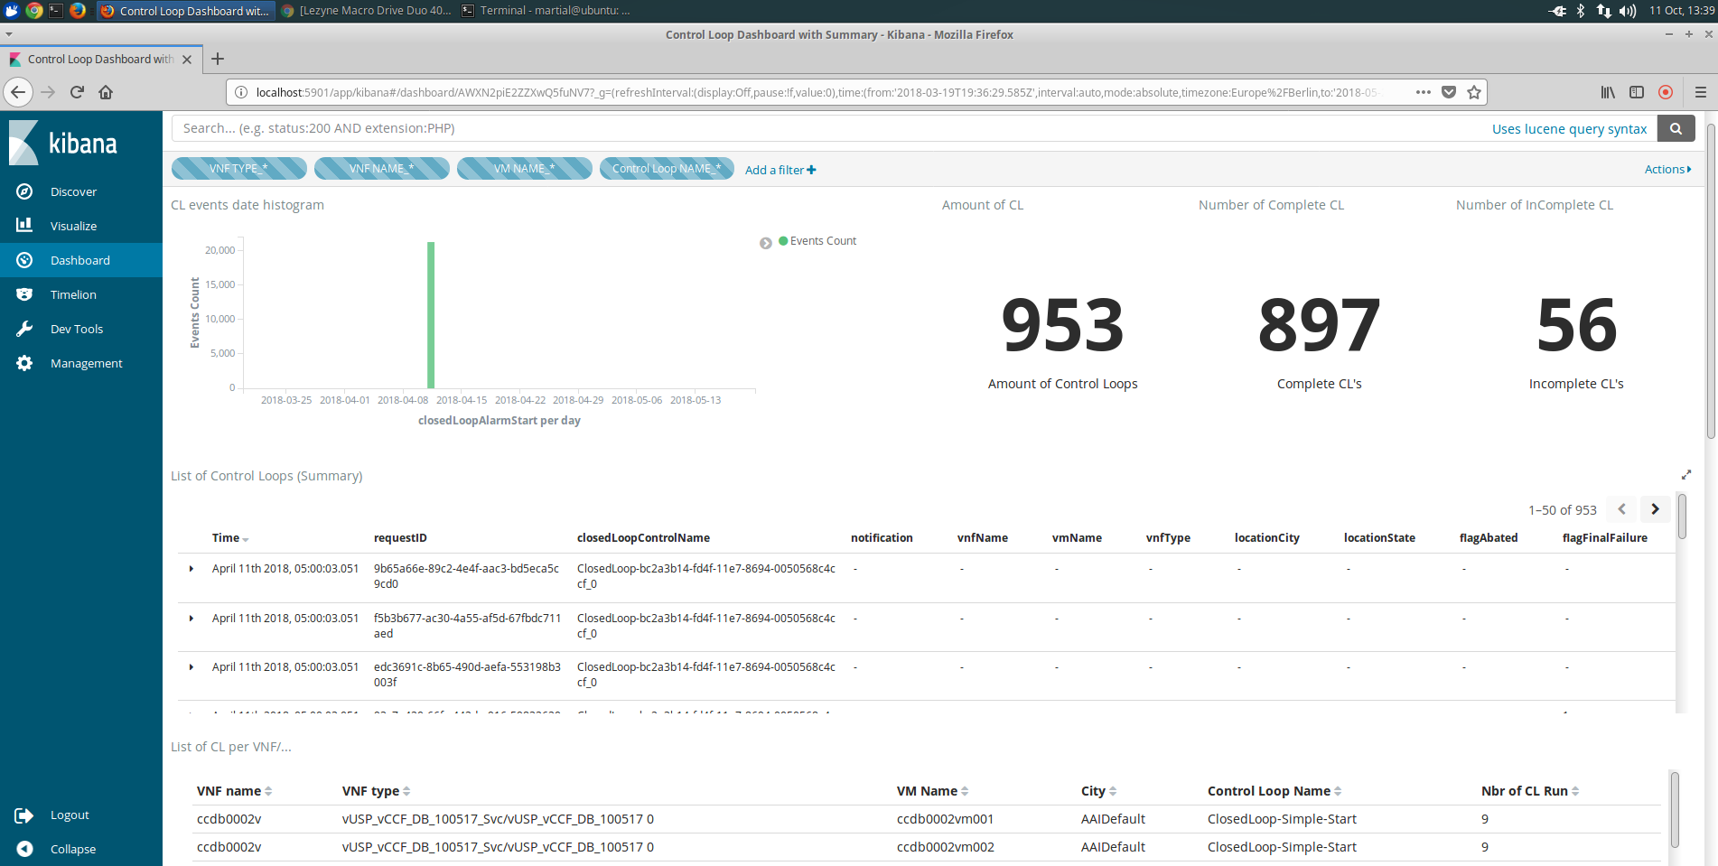
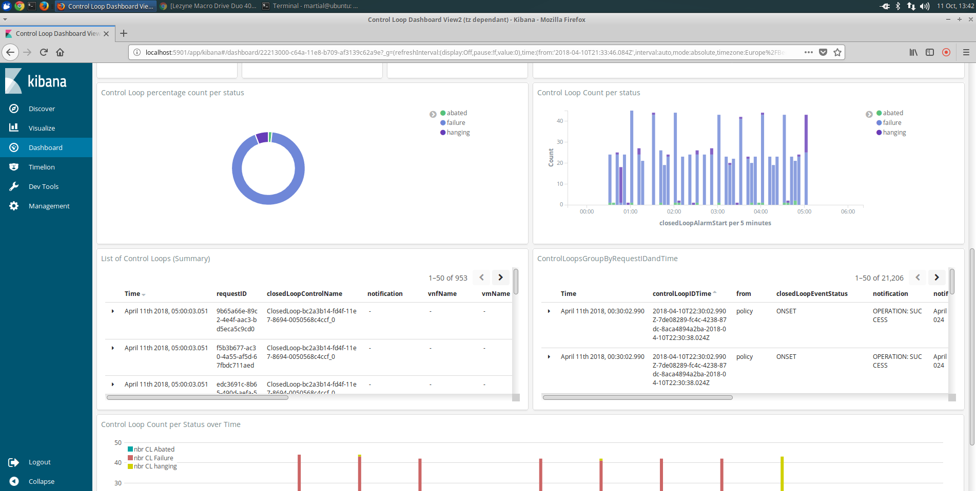
CLAMP
Control Loop Dashboard
  View DMaaP events exchange during runtime Control Operations(DCAE/Policy/APPC/…).
  Filter/Slice/Dice through Control Loop Events.
Work
in
Progress

Slide 12
CLI
Added gRPC server in ONAP CLI to run the commands remotely.
ONAP CLI is now enabled with additional support with VNFSDK to validate the CSAR packages directly from ONAP command console
VNFSDK/ VNF Test Platform (VTP) is using the OCLIP for the providing the Test center and test runner features as part of it.

Slide 13

DCAE
PNDA
  Introduce PNDA (http://pnda.io) as the analytics engine
  Enables a wide variety of big data technologies
HV VES
  Enhance DCAE performance measurement (PM) data collection to support near real-time (order of seconds) data. Introduce a high-volume VES collector using a persistent connection (TCP socket), support a new data encoding (GPB).
VES 7.0 upgrade
PRH Microservice
  Introduce PNF Registrator Handler (PRH) services for listening on the PNF Ready VES notification and updating A&AI and SO.
SNMP Trap Collector
  Generic SNMP trap collector added into DCAE collector suite. This can be used for legacy xNF event collector through standard SNMP interfaces.
DataFile Collector Service
  New μS provides collection of 3GPP bulk PM files and publishes to DMaaP Data Router ‘3GPP PM’ feed. Suitable for non real-time data collection, e.g. PM data files, logs, etc.
Notes:
Develop new PM-Mapper MS to receive the data file collected and published into DMAAP-DR and transform that into VES for further processing with analytics/correlation systems in DCAE

Slide 14
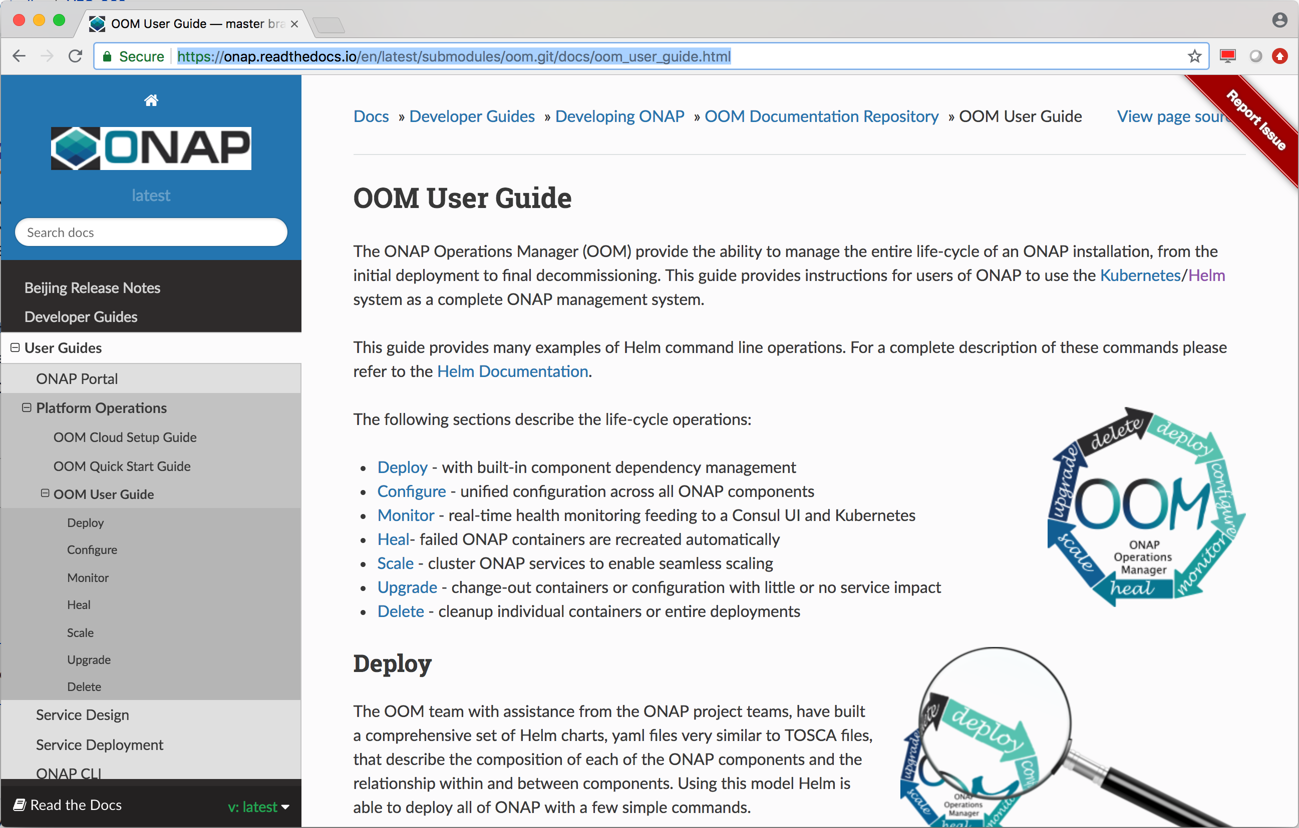
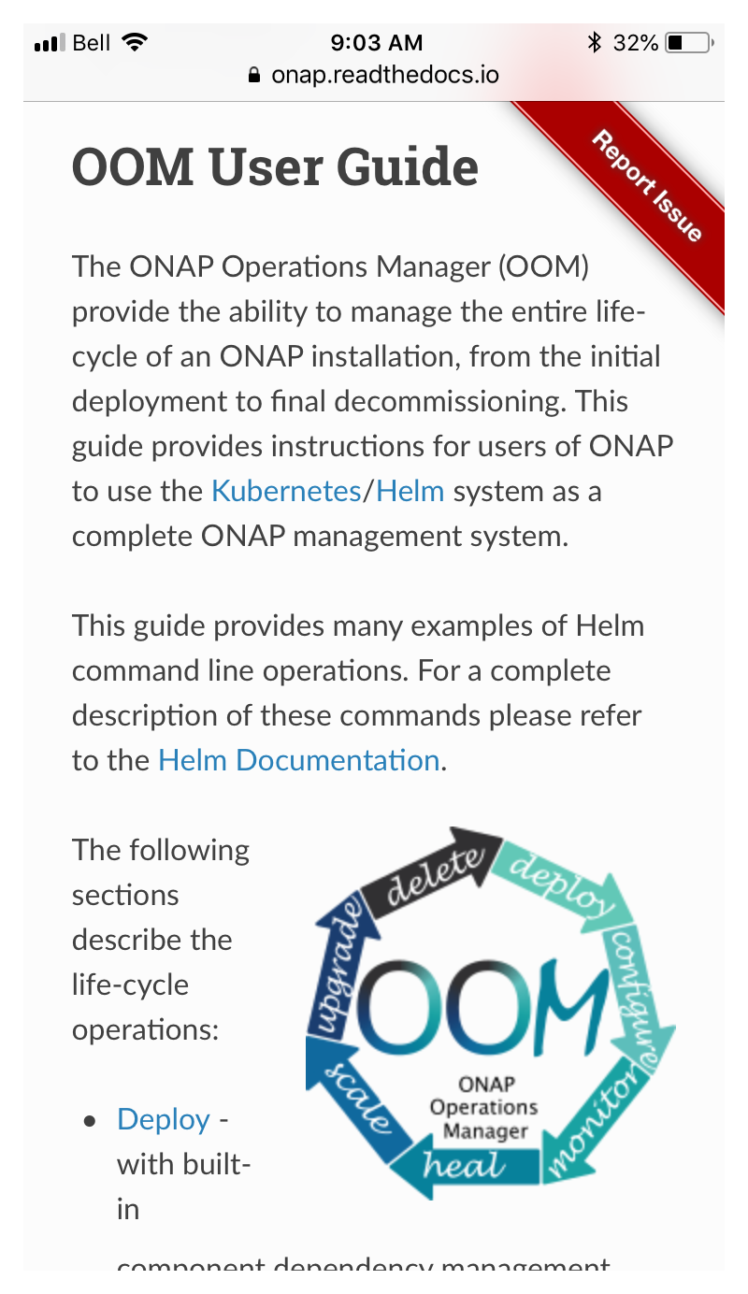
Documentation
New look
Easier to read via the web and mobile devices
‘Report Issue’ link allows reader to open a Jira bug report

Slide 15

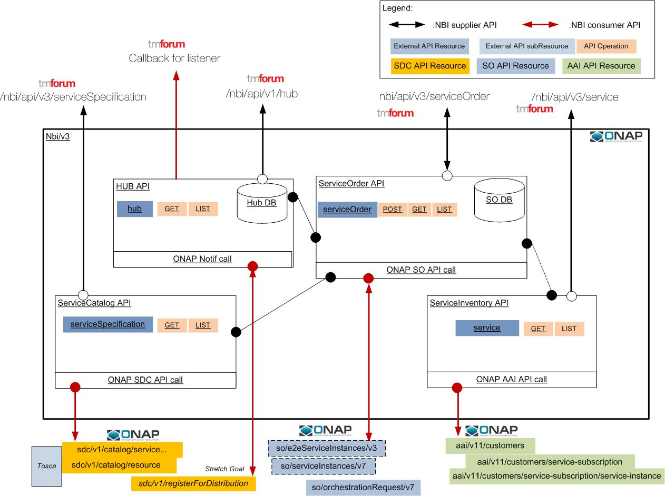
External API
Legato Operations
(North):
Query service catalog
Query serviceability
Create Service
Modify Service
Delete Service
Service Inventory operations
Add TMF-based notification (HUB/EVENT) at least for Service Order
Expose NBI API to ONAP MicroServiceBus (directory)
Tackle service modification UC though serviceOrder (minimum)
Improve Service Order API to manage E2E service provisioning
Integrate NBI in a complete E2E use case (CCVPN)
Interlude Operations
(East-West):
Query service catalog
Create Service
Modify Service
Delete Service
Service Inventory operations

Slide 16
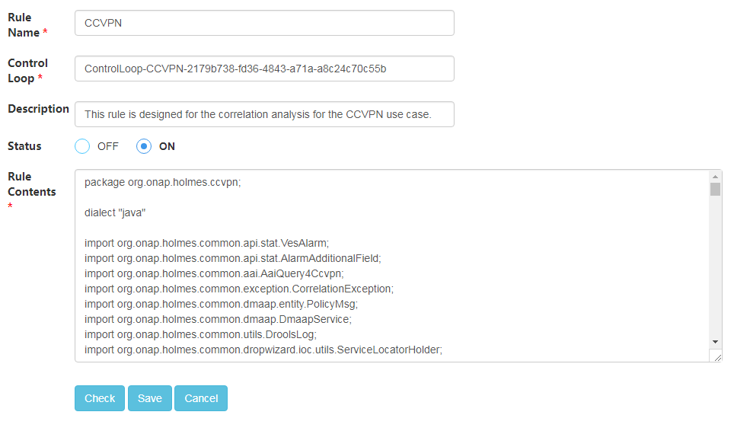
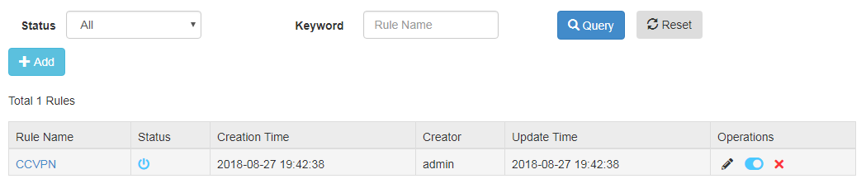
HOLMES
Provided a GUI to ease rule management
Improved flexibility for new scenarios by making Holmes more scripts-based
Added support for CCVPN alarm correlation

Slide 17
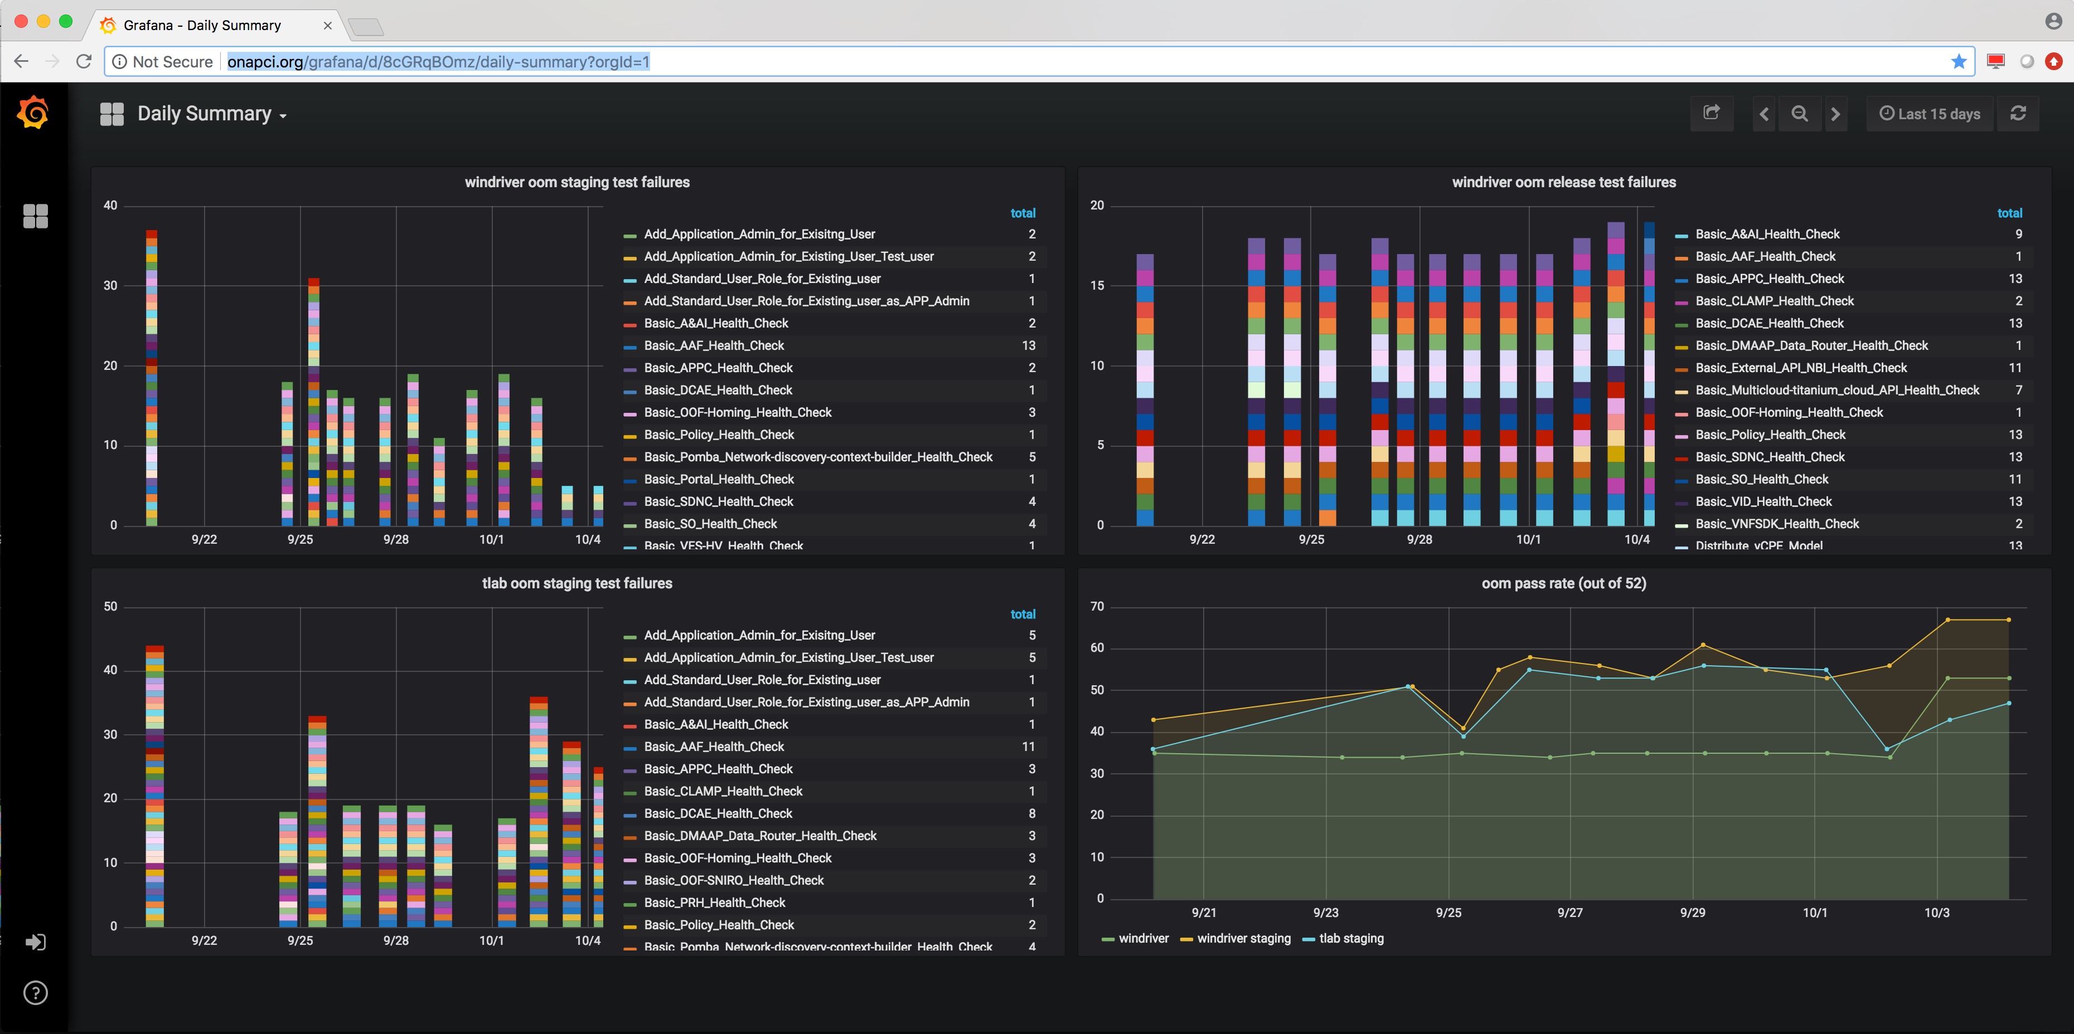
Integration
CI/CD with Daily Summary
  functional tests + health checks
Container Optimization
  define Docker best practices
  minimize container size
Offline Deployment
  deploy ONAP without direct internet access
Work
in
Progress

Slide 18
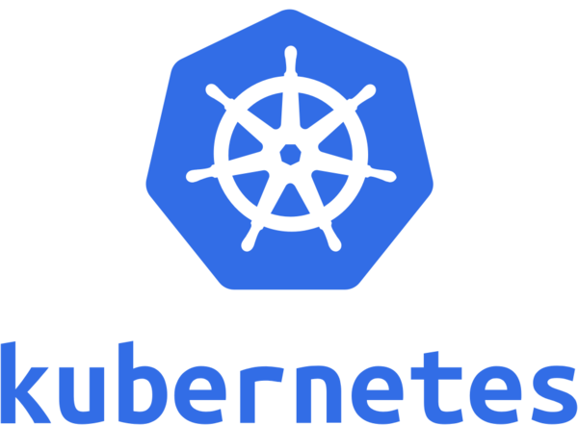
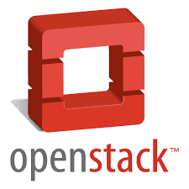

Multi-Cloud
SO
OOF
Functional Enhancement
    Integration with SO:
      Enables centralized representation of Cloud Regions
      Offloads workload template updating from SO to specific MultiCloud plugin
    Upgrade API version from v0 to v1
      Enables consistent ID of a cloud region
Expansion of infrastructure supports
    OpenStack Ocata, Pike
    Wind River Titanium Cloud R5
      Automate the onboarding of multiple edge clouds
    VMware VIO 5.0
    (PoC) Azure
    (PoC) Kubernetes
APPC
VF-C
VES
AAI
FCAPS
Infra workload
VNF Resource LCM
Provider Registry
Multi-Cloud
broker
plugin for openstack
plugin for Titanium Cloud
plugin for VIO
plugin for azure
plugin for k8s
Note: The K8s and Azure plugins are not integrated with other ONAP components in this release.
Work
in
Progress
Work
in
Progress

Slide 19
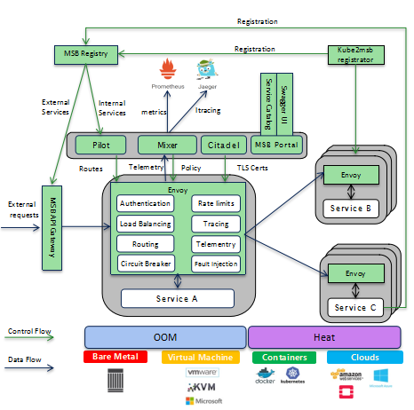
MSB
Istio Service Mesh Proof of Concept to manage ONAP microservices. Istio Service Mesh is a dedicated infrastructure layer to connect, manage and secure microservices, which brings the below benefits to facilitate the ONAP S3P goals:
Stability and Reliability
    Timeout & Retries
    Circuit breaker
Security
    Secured communication with TLS
Performance
    Latency aware load balancing with warm cache
Observability
    Metrics measurement
    Distributed tracing without instrumenting application
Manageability
    Routing rule
    Rate limiting enforcement
Testability
    Fault injection to test resilience of the services

Slide 20
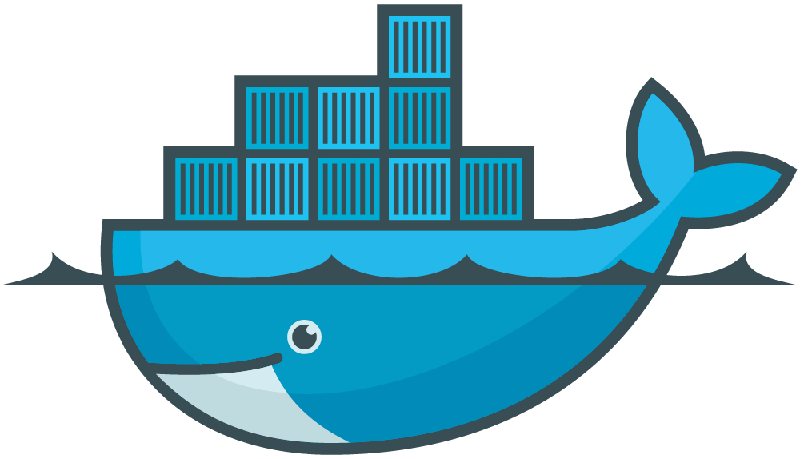

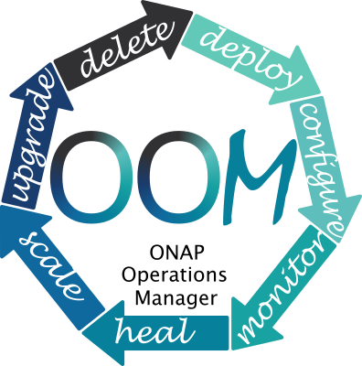
OOM
Chart Repository
  ONAP provides a central chart repository avoiding the need to build local Helm repositories
Persistent Storage / Storage Classes
  pluggable persistent storage technologies to expand beyond static host path configuration + NFS backend
  provide support for GlusterFS as the first storage class provisioner
Resource Limits
  CPU and Memory limits to Helm Charts in order to improve Pod placement based on resources available in a Kubernetes Cluster
Common "shared" Helm Charts
  mariadb-galera cluster, postgres cluster, & cassandra
Platform Resiliency
  backup and restore of entire K8s deployment – Heptio Ark
  Node Selectors for Pod placement (place components on specified nodes)

Slide 21
Policy
Support the Auto Scale Out functional requirements
    Added support for new guard policies for min/max instances
    Utilized existing frequency limiter guard policies
    Checking for PROV_STATUS=Active
  Added a new Policy SDC Service Distribution Application
    Currently supports HPA specific optimization policies
  Ingested new Apex PDP Engine
    Available for testing as standalone
    Met S3P criteria for performance, stability and resiliency
  Flexible control loop coordination facility POC work added
  Enhanced blacklist guard by providing a way to import a spreadsheet of blacklist servers
  CCVPN use case Control Loop support for SDNC Reroute action
  5G OOF PCI use case Control Loop support for SDNR ModifyConfig action
  Added https and AAF/CADI to current MVP applications (Drools, Xacml, Policy GUI, PAP)
  Added model for SDNC Naming Policies
  Enhanced Drools PDP Performance Tests
  Established XACML PDP Performance Baseline
  Added new Control Loop recipe for SO VF Module Delete

Slide 22
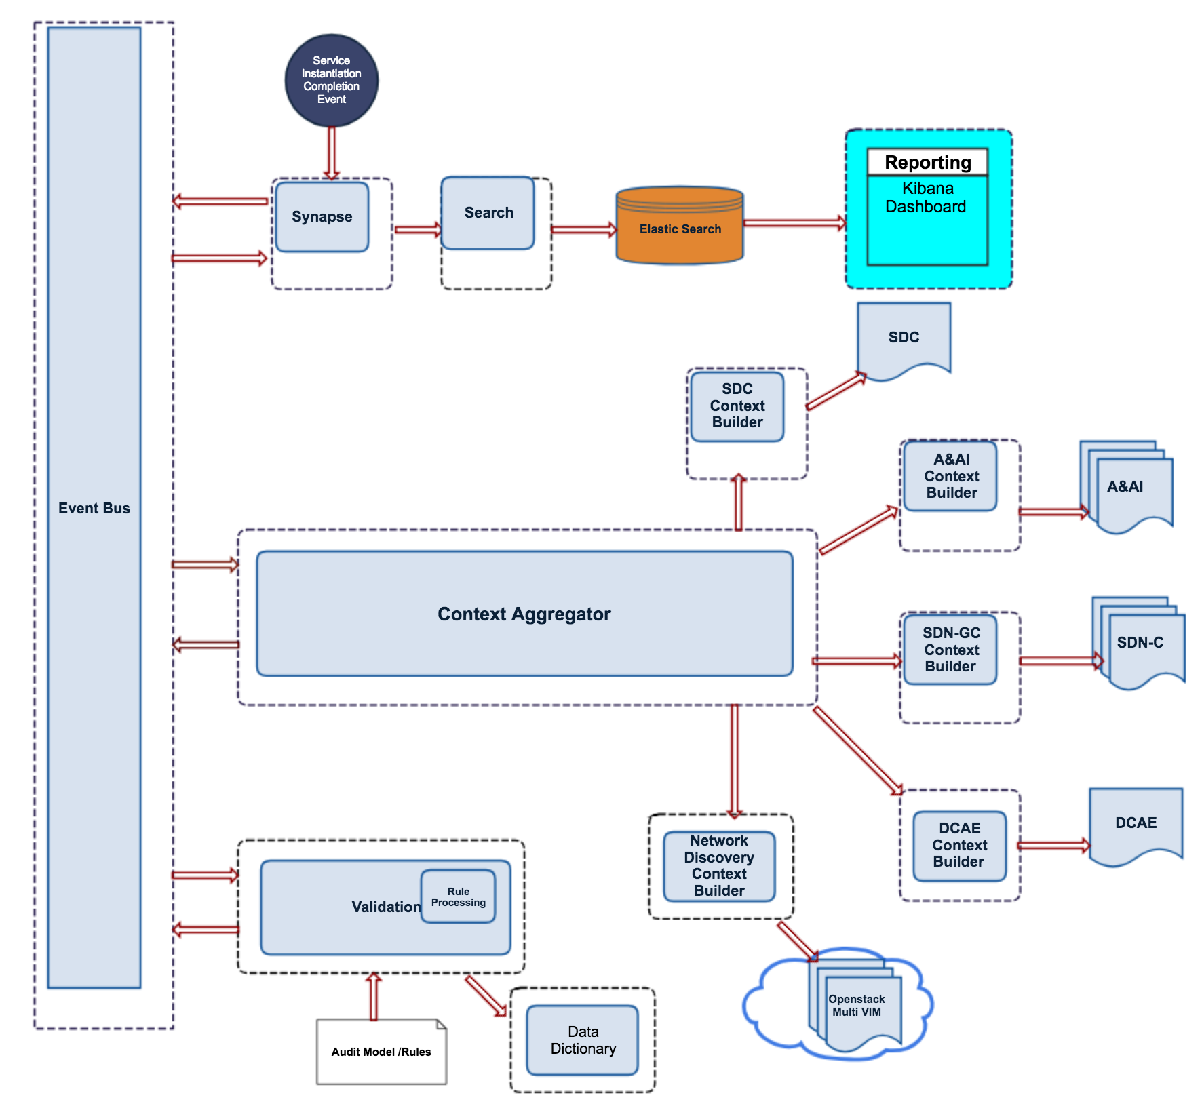
POMBA (Post Orchestration Model Based Audit)
An event-driven auditing platform that tests the data integrity across NFV orchestration environment and NFV infrastructure using model driven approach and reports on any data integrity issues found.
New
Project
POMBA Architecture

Slide 23
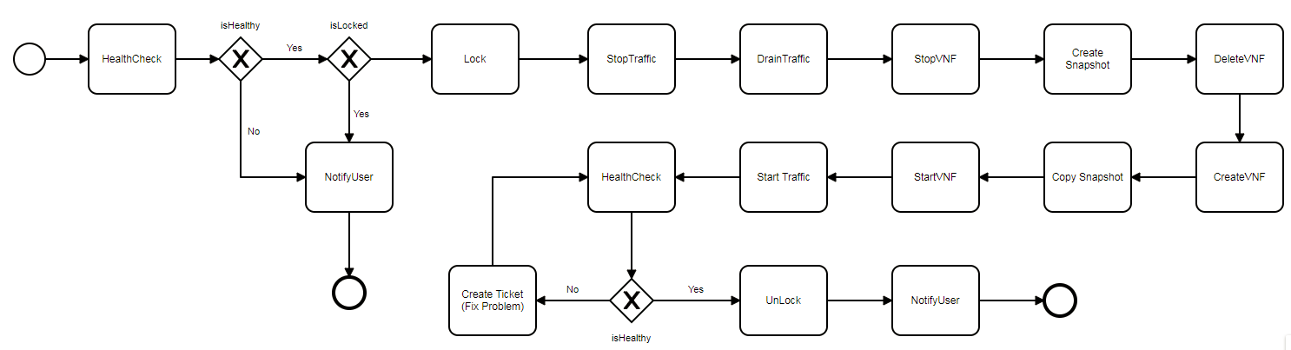
SDC
3 New Design Studios
  DCAE Design Studio
  Workflow Designer (shown)
  Controller Design Studio
On-board ETSI NFV-SOL 004 TOSCA YAML Cloud Service Archive (CSAR) files
  enable use of standard TOSCA defined VNFs (in addition to OpenStack Heat Orchestration Templates)
ActivitySpec Catalog
CreateVNF
DeleteVNF
ConfigureVNF
StopVNF
StartVNF
LockVNF
UnlockVNF
StopTraffic
DrainTraffic
ResumeTraffic
HealthCheck
createSnapshot
copySnapshot
CreateTicket
NotifyUser
1. Activity are Developed by developer & ActivitySpec is On-boarded to Catalog
2. Workflow Designed in SDC using Workflow Editor and BPMN Artifact is generated
SDC
SDC
Firewall VNF
4. Distribute
SO
5. Deploy Workflows
Operations
Instantiate
3. Workflow Associated to VNF Operations
VID
6. Initiate VNF Operation
Upgrade
SO
7. Execute Workflow Associated to Operation
Workflow Designer

Slide 24
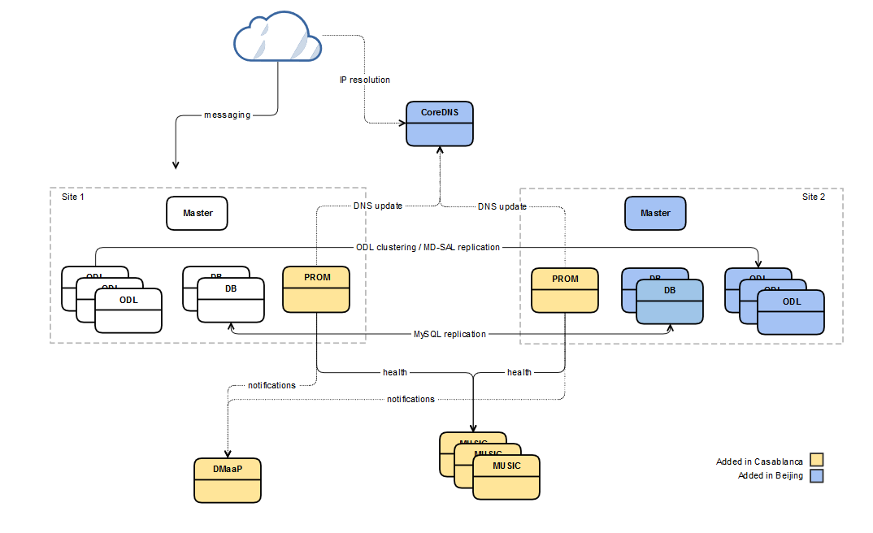

SDNC
Site Failure Resiliency via Geo-graphic Redundancy with auto-failover
  Active / Standby model
  CoreDNS resolves requests to the current primary ODL server
active
standby
Notifications send via DMaaP
  Site Health Issue detected
  Site Health Issue cleared
  Site Switch initiated
  Site Switch (catastrophic failure) initiated

Slide 25
SO
New internal μServices architecture (shown)
PNF Orchestration Support
New Scale Out Functionality
Hardware Platform Awareness (HPA)
  HPA aware SO Homing requests to OOF
  e.g. Deployment of VNF requiring SR-IOV (as specified in a TOSCA VNFD) is supported as Multi-Cloud and AAI extract hardware capabilities and OOF matches request to infrastructure
SO-Monitoring component allows a user to have a detailed monitoring view of the Camunda BPMN workflows that have run, or are running
nodeport
service
SO
pod
api-handler-infra
child pods
pod
pod
so-catalog-db-adapter
so-sdc-controller
pod
so-bpmn-infra
pod
pod
so-request-db-adapter
so-sdnc-adapter
pod
pod
so-mariadb
pod
so-vfc-adapter
so-openstack-adapter

Slide 26
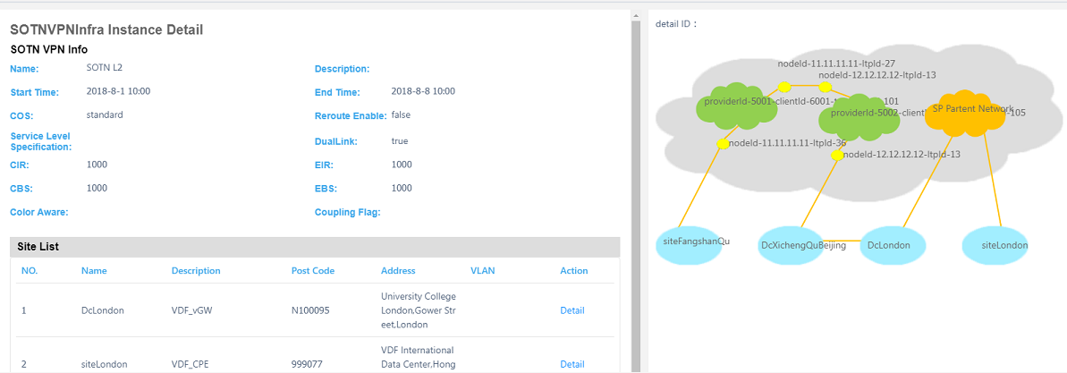
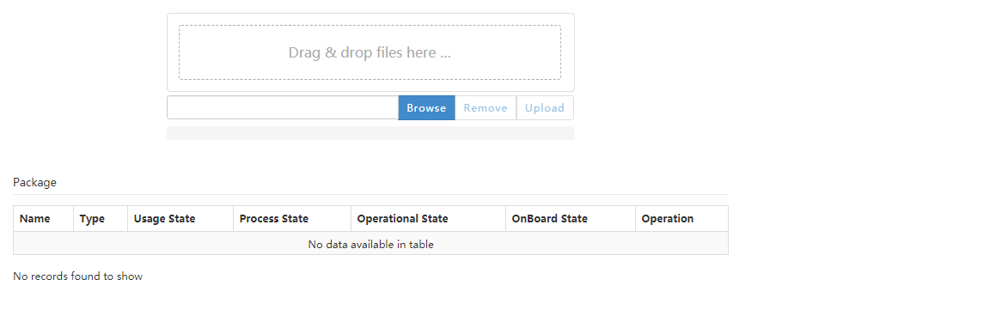
UUI
Provided GUI for CCVPN use case instantiation and termination.
Provided GUI for network service lifecycle management.
Provided GUI for VF-C package catalog.

Slide 27
VF-C
Functional Enhancement
    NS Orchestration Supports PNF
      NSLCM supports NSD, composed of VNF, PNF, and VL
      Catalog supports PNFD and updates NSD DM
      Hardware Platform Awareness (HPA) Support
      integrate with OOF, and VF-C sending HPA homing requests to OOF and OOF return homing decision to VF-C.
      VF-C can parse R2+ TOSCA MODEL which includes HPA feature
Standard Alignment
    SOL003 Alignment
      GVNFM support SOL003 API, including
    Create/Instantiate/Operate/Terminate/Delete/Query VNF Instance
    VNF LCM Operation subscriptions and notification.
      Catalog support SOL003 related API, including
    VNF Package content upload/Download
    Create/Delete/Get VNF Package
    Maturity Enhancement
    Standalone DB Microservice
    Separate databases from VF-C components and provide standalone database microservices
UUI
SDC
SO
Catalog
NSLCM
GVNFM
Driver
OOF
Drivers
DB
ESR/AAI
Multivim
SVNFM
EMS
Note1: components listed here don’t contain all VF-C components, only used to highlight Casablanca work .

Slide 28
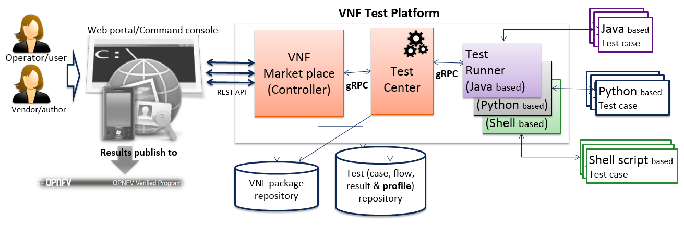
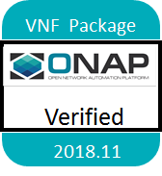
VNFSDK
LFN CVC test support
Introduce VTP (VNF Test Platform) framework for test
Better integration with OPNFV Dovetail (VTP)
Experimental integration with OPNFV Dovetail
Preliminary implementation of VNF requirements
Support CSAR packaging SOL-004 option 1 (CSAR with TOSCA-Metadata directory)
Support HPA schema validation

