Slide 1
BBS-Broadband Service
Use case proposal for Dublin release
Sponsors: Swisscom, Huawei, Nokia

Slide 2
Objectives
What are we trying to do in ONAP
  Develop a set of Broadband Services designed to deployed across different locations (e.g., Central Office, Core) and technology domains (e.g., Access, Edge) within the locations.
    The same service design is deployed using against network resources implemented by different vendors.
What we are trying to do with the BBS Use Case and CloudCO
  Integrate TR-384 CloudCO Framework and ONAP for Broadband Services based on Application Note: Cloud-CO-APPN-446 : ONAP Integration for HSIA Service (Access)
    Use the design pattern of the Application Note as basis (i.e., use of Domain Specific Management and Control elements)
    We varied the use case based on an operator’s actual deployment scenarios that highlight advantages of an automation platform like ONAP (Zero touch service activation, ONT Relocation)
Why is it important to show the ONAP to CloudCO integration
  Shows how standards organizations and open source projects can collaborate:
    Integrate the framework architecture
    Feedback the APIs to relevant interfaces for standardization

Slide 3
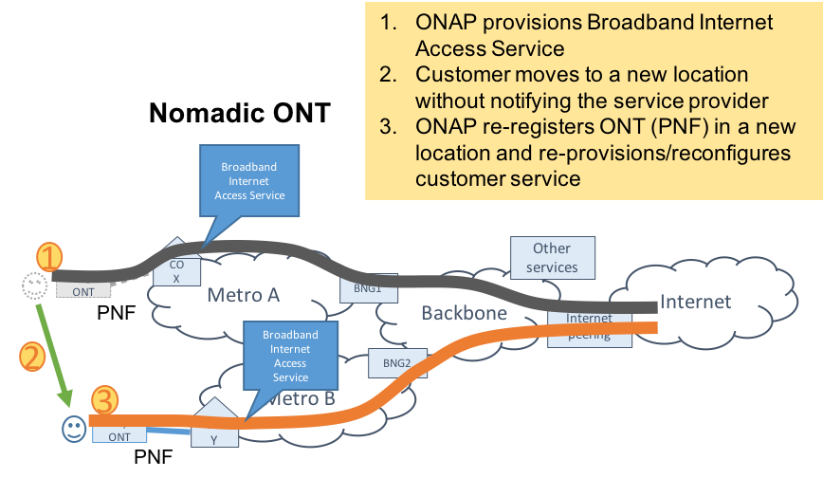
Broadband Services Use Case: Dublin
The Nomadic ONT scenario is a “zero-touch” activation scenario both for initial service activation and for when the user moves their location taking their ONT/RG along with them.

Slide 4
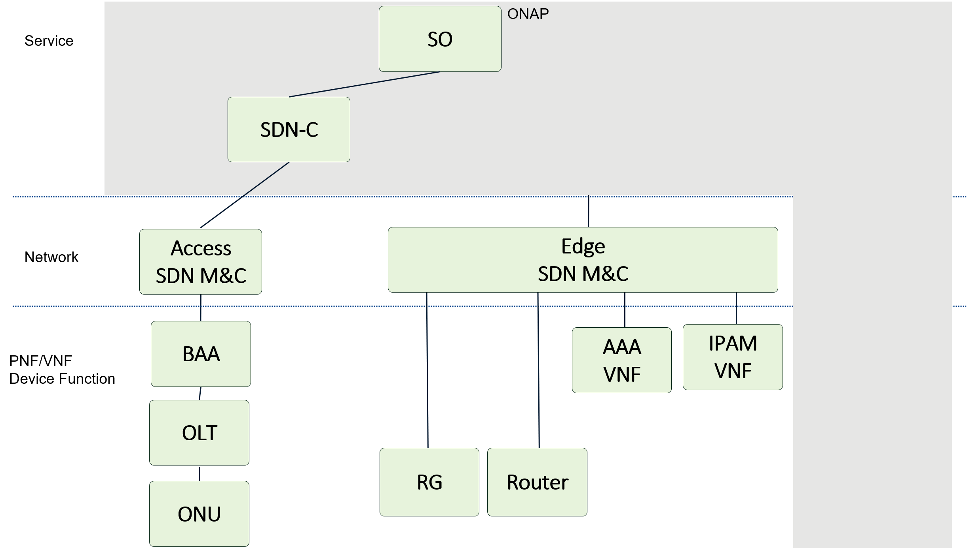
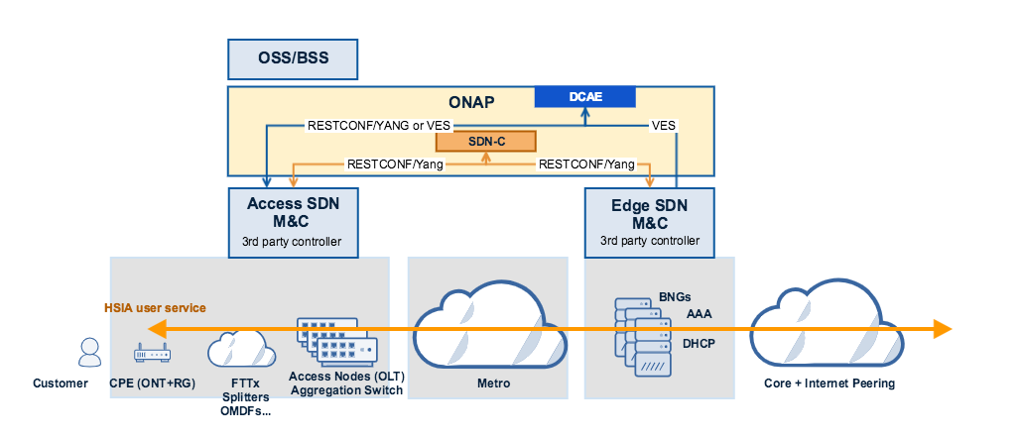
System Topology – Some Differences
The application note did not consider
  Interactions with the Edge SDN M&C
    Needed for provisioning the AAA, IPAM and Router
    Needed for events in zero touch activation
  Did not consider the events needed for zero-touch activation to DCAE
In BBS the residential gateway function is hosted on the ONT

Slide 5
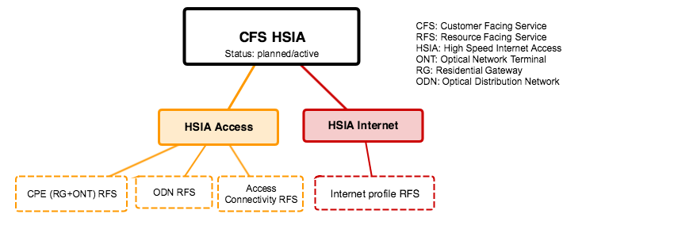
Services used in BBS for a HSIA service
HSIA Service is comprised of resource facing services for the Access domain. In addition there is a HSIA service profile that is applied across domains.

Slide 6
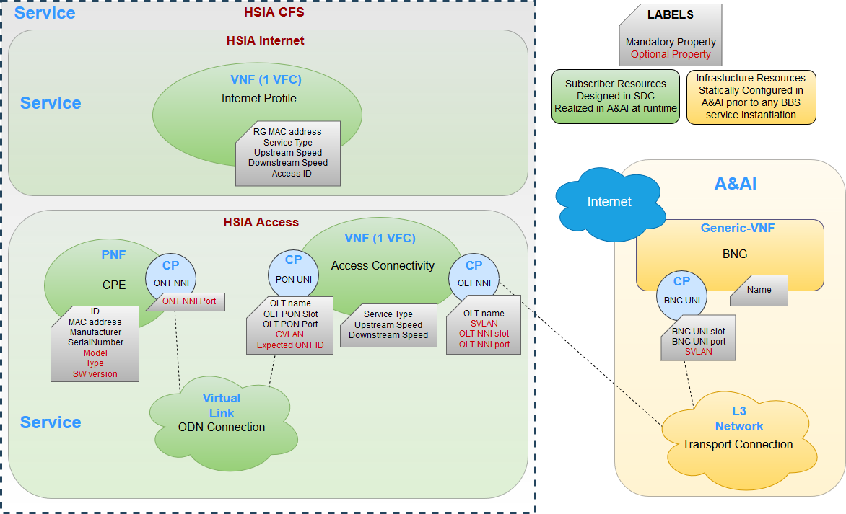
BBS Service Model

Slide 7
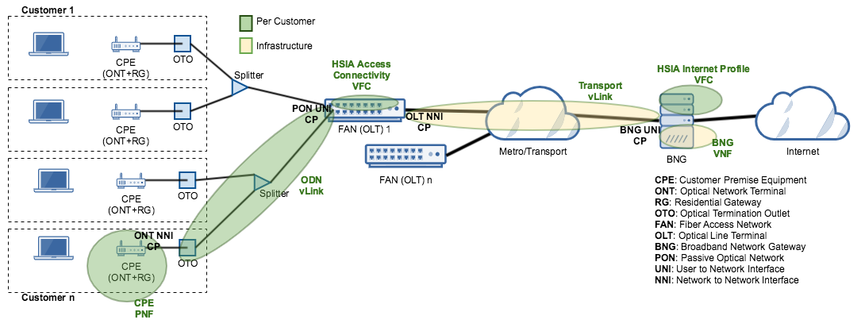
Service Instantiation
The HSIA Access RFS and Internet Profile RFS are customer specific services – 1 instance per customer
The HSIA Edge is a set of infrastructure resources – 1 instance for many customers. The resources are not modelled as a service; simply installed in ONAP

Slide 8
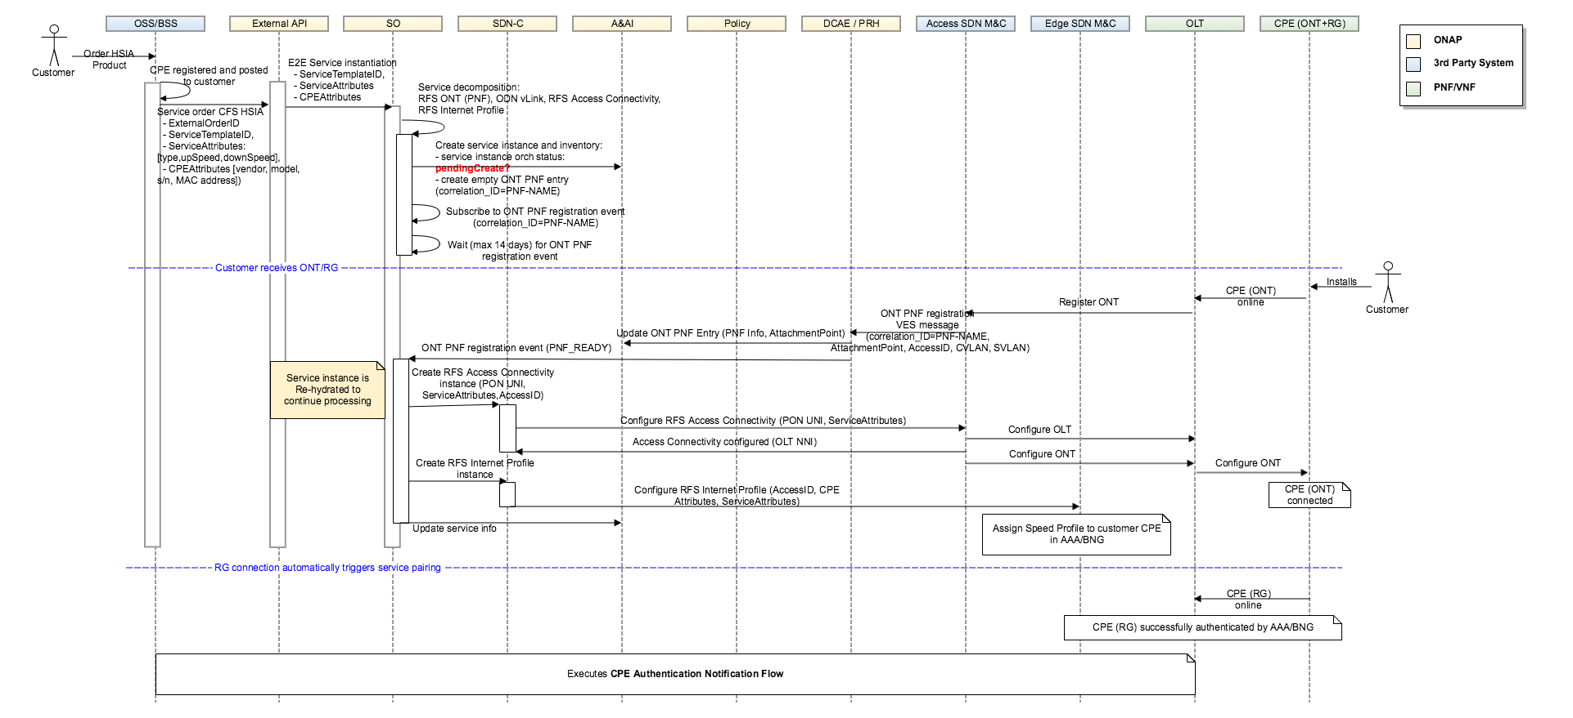
Service Activation Flow - ONAP

Slide 9
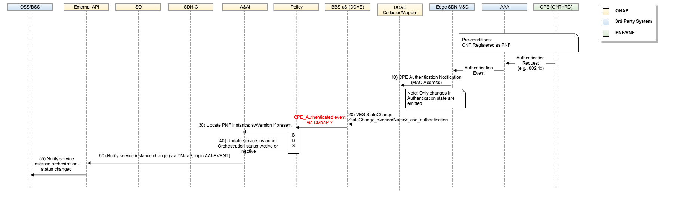
Service Activation Flow – ONAP (Continued)

Slide 10
Feedback to the BBF

Slide 11



Open Source Innovation to Standardized Solutions
Using open source reference implementations as part of the feedback cycle….
Open Source
Development and Test
End User Deployment
Open Source approach
Use case/deployment scenario
Point or single use case solutions
Single
Use Case Solutions
Open Broadband innovation
Use case/deployment driven: Member Open Source projects (BAA, Starfish, etc.)
YANG
Data Models
Staging | Testing | Integration
BBF member-driven innovation
Generalized requirements, standardized frameworks, services, attributes, software
Interop &
Certification
BBF Mass Market Solutions

Slide 12
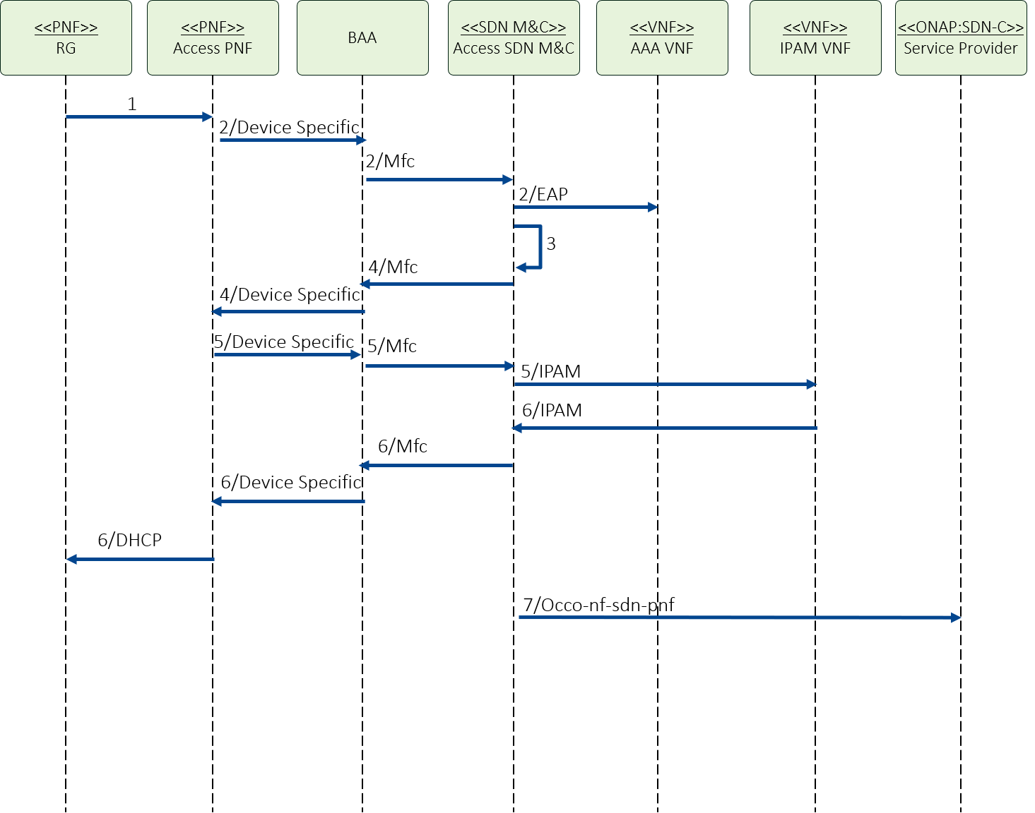
Service Activation Flow – CloudCO Application Note
Access SDN M&C: Service Activated was reported(7) in ONAP this is the Edge SDN M&C based on the CPE Authentication Event and it goes to DCAE instead of SDN-C
Access SDN M&C: Port Attachment was reported from the trigger in step 1 to support zero-touch. There is actually a configuration change (that is part of the service creation) that happens. The events reports got to DCAE

Slide 13
Service Activation Flow - ONAP

Slide 14
Service Activation Flow – ONAP (Continued)

Slide 15
Potential standardization action items
Access M&C to SDN-C (Occo-nf-sdn-access-m&c):
  CPE (ONT/ONU/DPU) registration: only for new or changed port attachment point changes
Access M&C to DCAE (Occo-nf-sdn-access-m&c):
  Configure access connectivity (CRUD)
Edge M&C to SDN-C (Occo-nf-sdn-access-m&c):
  Configure access profile (CRUD)
Edge M&C to DCAE (Occo-nf-sdn-access-m&c):
  CPE Authentication event (state change) authenticated/unauthenticated
Update Application Note to reflect ONAP flows
  Zero-touch
  Include Edge SDN M&C
  Future: Service change; topology discovery; service monitoring (FYI)

Slide 16


Thank you

