Slide 1

BBS: Broadband Services Orchestration with ONAP
David Pérez Caparrós (Swisscom),
Chaker Al-Hakim (Huawei),
Tim Carey (Nokia)

Slide 2
Outline
BBS use case. Motivation (David)
BBS in ONAP Dublin release (Chaker)
BBS: Using standards to help create an interoperable ecosystem (Tim)

Slide 3
Broadband Service (BBS) orchestration with ONAP

Slide 4



Why ONAP?
(Switzerland’s leading telecoms company)
Best customer experience
We want to inspire our customers by providing them with the best service at all times, regardless of their location.
Operational excellence
We want to be better prepared for new business activities and optimise our infrastructure.
New growth
We want to develop our core business and open up new areas of business.
https://www.swisscom.ch/en/about/company/portrait/vision-values-strategy.html

Slide 5

Where to start?
Fixed networks
4.2 million
homes and businesses connected
with ultra-fast broadband
Window of opportunity
Ambitious expansion targets
Fibre-optic technologies in every district in Switzerland by end-2021
Digital pioneer in Europe
Compliance with the EU's digital agenda for 2020 –
99% of all households covered with at least 30 Mbps
2 million customers on All IP
Call filter, HD sound quality, fixed network to go, simplified business communication

Slide 6
ONAP & Fixed Broadband Services: BBS
ONAP as global service orchestration and automation platform
  Model-based, meta-data & policy-driven automation, service agnostic…
New use case in ONAP Dublin release:
  BBS (Broadband Service)
  ONAP for the design, provisioning, life-cycle management
  and assurance of multi-gigabit internet access customer
  facing services
  Open standards: BBF CloudCO, TMF OpenAPIs
  Automation & orchestration challenge: Nomadic ONT
Best customer experience
Operational excellence

Slide 7
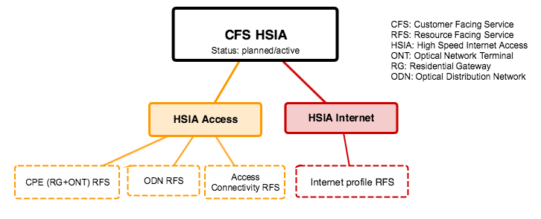






BBS overview
BSS
Customer Portal
Access Domain M&C
Edge Domain M&C
HSIA
10Gbps
Customer Premises
(CPE/ONT)
Backbone office
(BNG, AAA, DHCP)
Internet
Metro
Central Office
(OLT, Agg)

Slide 8
BBS in ONAP Dublin release

Slide 9
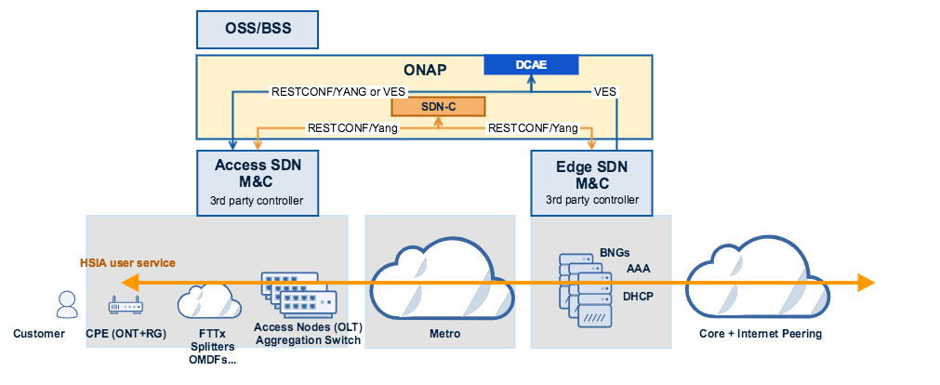
…this was our Goal

Slide 10
Domain Expertise - Service
Some team members had :
  In-depth Service expertise
  A clear understanding of the new service capabilities to be added
  Are involved in other standards org that could also benefit from our Usecase

Slide 11
.. Domain Expertise - Service Provisioning
Other team members were knowledgeable in:
  3rd-party controller layer
  Provisioning flows
  Networking

Slide 12
Domain Expertise - ONAP Platform
The rest of the team brought on:
  ONAP knowledge and expertise
  Good understanding of many ONAP components
  Good understanding of new features being introduced in the next ONAP release

Slide 13
BBS Usecase Development timeline
The work began in the November, 2018 timeframe (M0)
  Started out as 3 Different Teams
A weekly meetings were set up starting on November 18, 2018 (T0)
Some pairwise technical discussions had taken place prior to the November start date between Swisscom and Nokia.
The core Usecase team was formed with resources from Swisscom, Nokia and Huawei
Project timeline created, weekly meetings started
Many follow-up meetings were needed/required where the team would meet every day until open issues were closed
Initial focus was on understanding the business problem that we were attempting to solve
Requirements discussions started in earnest early December (M1 - t0+8w)
  Created a usecase project wiki
  Prepared materials for usecase discussions and sub-committee/TCS approval
  Modeling discussion
  Nomadic ONT Service provisioning flow Discussion
Dublin Release Milestones:
  M0: 11/15/2018
    11/30/2018 Project Submitted
    12/13/2018 Project Proposals Approved
  M1: 01/17/2019 Project Planning
  M2: 02/24/2019 Functionality Freeze
  M3: 03/14/2019 API Freeze
  M4: 04/11/2019 Code Freeze
  RC0: 05/02/2019
  RC1: 05/16/2019

Slide 14
BBS Usecase Development timeline
Developed Modeling proposal for BBS Usecase team review
Began the Requirements discussion and the ONAP Dependencies. (i. e. 5G PnP – PNF support)
Identified functionality gaps
Planned Test lab build-out
Presented the usecase at DDF, Paris
Finalized the BBS Data Model
Monitored the status of the 5G PnP usecase (dependency)
Setup daily calls to resolve showstoppers/Critical requirement issues
Passed M2 Milestone
Additional A&AI/Modeling discussions, DCAE uS, APIs, Topology discussion
Decided on doing a demo at ONS2019
Passed M3 (Mar 14 – t0+12w) – API Freeze
Dublin Release Milestones:
  M0: 11/15/2018
    11/30/2018 Project Submitted
    12/13/2018 Project Proposals Approved
  M1: 01/17/2019 Project Planning
  M2: 02/24/2019 Functionality Freeze
  M3: 03/14/2019 API Freeze
  M4: 04/11/2019 Code Freeze
  RC0: 05/02/2019
  RC1: 05/16/2019

Slide 15
BBS Usecase Timeline – ONS-2019 Demo
18 Weeks into this effort, we have enhanced or added new functionalities to the following ONAP components:
  ExtAPI
  DCAE: BBS uS / PRH
  Policy
  SO
  SDN-C
  AAI
  SDC / Model
  Test Lab
We’re able to support a BBS Demo with the code we’ve already developed
Still more development to be done
Dublin Release Milestones:
  M0: 11/15/2018
    11/30/2018 Project Submitted
    12/13/2018 Project Proposals Approved
  M1: 01/17/2019 Project Planning
  M2: 02/24/2019 Functionality Freeze
  M3: 03/14/2019 API Freeze
  M4: 04/11/2019 Code Freeze
  RC0: 05/02/2019
  RC1: 05/16/2019

Slide 16
Key Takeaways and observations
You always start out as many different teams
Try to become one Large Cohesive team asap
Gain a common understanding of the use case as early as possible
Document gaps and develop workarounds as you go
Create a list of additional functional requirements and try to develop it as part of the use case effort
Share status and share often
Track your dependencies
Have fun doing it and make new friends, we did

Slide 17
Contribute back to the ONAP Community
Document gaps and develop workarounds
  Minimize or eliminate throwaway code altogether
  To the extent possible, Code a new workaround as a new uService so it can be reused
Develop a list of functional requirements
  When possible:
    Code the new requirement as a uService and contribute it back to the proper ONAP component
      As an example: SO Service Instance update function or
    Provide the additional resource to fully implement and test the new capabilities
Now that you’ve gained more experience in the ONAP platform, try to contribute back to the community

Slide 18
BBS: Using standards to help create an interoperable ecosystem

Slide 19

The “Open” path toward Cloud native solutions
Cloud native
5
Webscale ready
Lifecycle-mgmt automation
Modular, scalable and reusable components
Multi-vendor, multi-domain, network slicing
Agile operations with DevOps & continuous software delivery
2
3
4
Carrier grade
Open development
working together to introduce new features, products and services
1
Open data model
Self-detect device capabilities and gain analytic flexibility
Carrier-grade
Open data
shared data to improve network health and customer experience
99.9999% reliability
Product lifecycle management
Based on strong standards and interoperability
Converged multi-service platform
Open standards
created and controlled to achieve programmability and interchangeability
Carrier-grade products,
or making open source (HW/SW) carrier-grade
Open ecosystem
Software modularity and multi-layer innovation in micro-services architecture
Based on strong standards and interoperability
Converged multi-service platform
Enabling the transformation to a digital service provider

Slide 20







Using Open Source and Standardization in BBS
Open Source
Standardization
Implementation and validation
Specification (architecture and solutions)
SA5
Provide uniform, comprehensive platform for orchestration and automation
Definition of service APIs for OSS/BSS external interfaces
Architecture and solutions for the management of 3GPP based networks and services
Provide integrated and compatible NFV-I reference platform. Integrate together with ONAP
NFV
Architecture and solutions for the automated management and orchestration of VNFs
Architecture and solutions for the management of broadband networks and services
Provide a policy engine used to configure and monitor services
Open source standardizes implementations, standards define interfaces and ensure compatibility between implementations

Slide 21
BBS: Standardization Objectives
Use the Broadband Forum’s TR-384 CloudCO Framework based on Application Note: CloudCO-APPN-446 : ONAP Integration for Residential Broadband HSIA Service
    Use the design pattern of the Application Note as basis (i.e., use of Domain Specific Management and Control elements)
    Vary the use case based on an operator’s actual deployment scenarios that highlight advantages of an automation platform like ONAP (Zero touch service activation, ONT Relocation)
    Feedback the APIs for the relevant interfaces for standardization
Use TMForum’s APIs for External APIs:
    Focus initially for service creation, activation and monitoring between ONAP and BSS
    Feedback through ONAP external APIs gaps (e.g., service operation status) and feature requests
Use 5G Use Case work based on 3GPP specifications:
    Focus on PNF PnP and Relocation

Slide 22
BBS: Standardization Objectives
Use ONAP’s Service Design and Creation environment using the ETSI NFV artifacts:
  Creation of Broadband services using ONAP’s SDC and expressed through ETSI NFV TOSCA resource and service definitions.
    Resources: TOSCA model based on ETSI SOL001
    Services: NFV TOSCA Model
  Feedback through ONAP modelling gaps (e.g., service substitution) and feature requests (e.g., attribution of virtual links)

Slide 23
Thank you!

Slide 24
