Slide 1
VNF Compliance Verification proposal
Chris Donley & Steven Wright
June 19, 2018

Slide 2
VNF Compliance/Verification Program (CVP)
LF Networking is providing a testing program to demonstrate SDN/NFV capabilities and interoperability
Program began with OPNFV Verified Program
  Supports both self-testing and third-party lab testing
  Initial version will test VIM+NFVI
We propose expanding the program in 2018 to include VNF compliance
  Requirements and tests defined by ONAP
  Test framework provided by OPNFV (Dovetail)
  Back-end infrastructure provided by Linux Foundation

Slide 3
CVC Structure
LFN Board
Notes:
Board delegated compliance/verification responsibility to CVC
Test content is the responsibility of the TSCs
Test framework will continue to be hosted in OPNFV (Dovetail), and will support x-project requirements
CVC will work with the testing groups in each community to ensure alignment and transparency
TSCs are involved by developing and approving test content
TAC
…
Compliance Verification Committee
Framework
OPNFV TSC
ONAP TSC
OPNFV
ONAP
test
VNFs
ODL
FD.IO
ODL TSC
FD.IO TSC
test
test

Slide 4
VNF Compliance Verification Notes
Program is designed to raise the bar over time
  Versions are date-stamped to make comparisons easy
  We will make updates as new requirements and new tests are published
Allows both self-testing and third-party lab testing
  Larger vendors will likely self-test
  Smaller vendors will turn to labs for help
ONAP will define VNF Requirements and tests
  Under ONAP TSC guidance

Slide 5
Business value of VNF verification for vendors and operators
Service Providers
  Builds ecosystem for ONAP-compliant VNFs
  Helps ensure general interoperability and base level functionality
  Reduces testing load
  Shortcut for RFPs
Vendors
  Defines industry threshold for demonstrating ONAP onboarding
  Simplifies interoperability
  Helps identify priorities for future development

Slide 6
Continuum of testing
VNF Packaging
Lifecycle/Onboarding Tests
Functional Tests
Other (performance/security/etc.)
We Are Here

Slide 7
Proposal
Offer VNF Compliance Verification under LFN CVP/OVP* Program by End-of-Year (following Casablanca release)
  Requirements specified in VNFReqs
Program will consist of both Badging and Testing components
  Testing
    Framework provided by OPNFV Dovetail
    Test engine and TOSCA tests provided by VNFSDK
    HEAT tests provided by VVP (executed in VNFSDK)
  Badging addresses areas not covered by test tools
  Results from both will be available on the same web portal
* Branding/naming TBD

Slide 8

VNFSDK for LFN/OVP VNF Compliance testing
VNF vendor uses pkgtools to package VNF
VNF vendor or lab uploads vnf
VNFSDK runs OVP test suite
  Requirements/testability from VNFReqs
Results are reported to LF through Dovetail
VNFs get compliant logo (as appropriate)
Operators see list of compliant VNFs on LF portal
VNF Package
LF OVP infra
Verified
2018.11
Dovetail
vnftest
VNF SDK Marketplace
VNFSDK
VNF

Slide 9
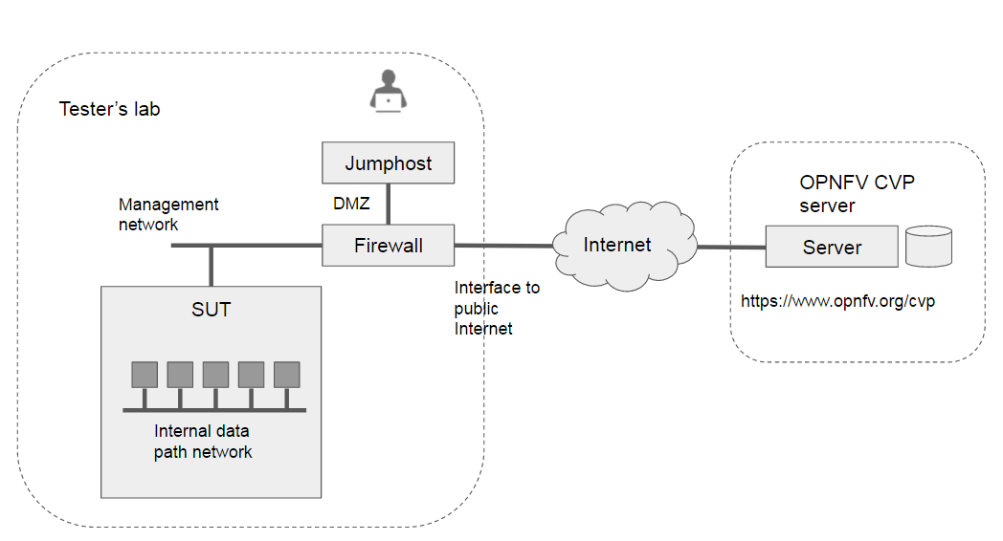
More on Dovetail
Test API with openID auth

Slide 10
Badging Motivation
Existing compliance testing through VVP/VNFSDK covers a fraction of the VNF Requirements
  Testing beyond VNF Package validation is challenging
  Some requirements not testable
Self-certification of requirement compliance can streamline onboarding
  Badging can easily convey self-certification level
A centralized repository of VNF badges/self-certification responses would be valuable to service providers
Model on the existing LF CII Badging website functionality
VNF Documented
VNF Package
VNF Life Cycle
Badged
Verified
Verified
2018.11
2018.11
2018.11

Slide 11
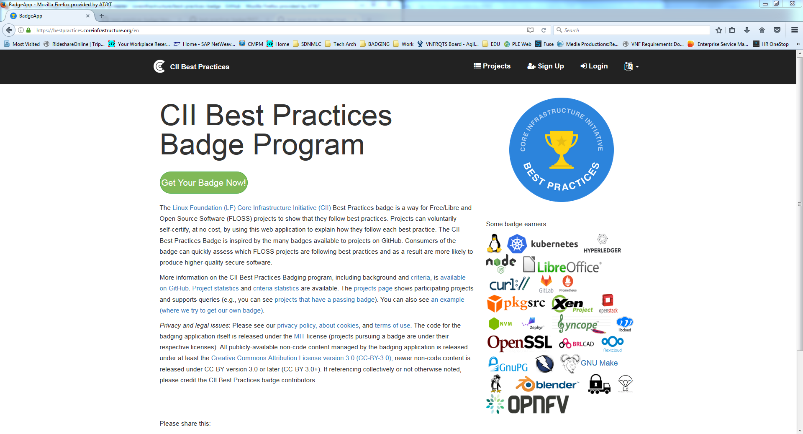
ONAP VNF
VNF Documented
Badged
2018.11

Slide 12
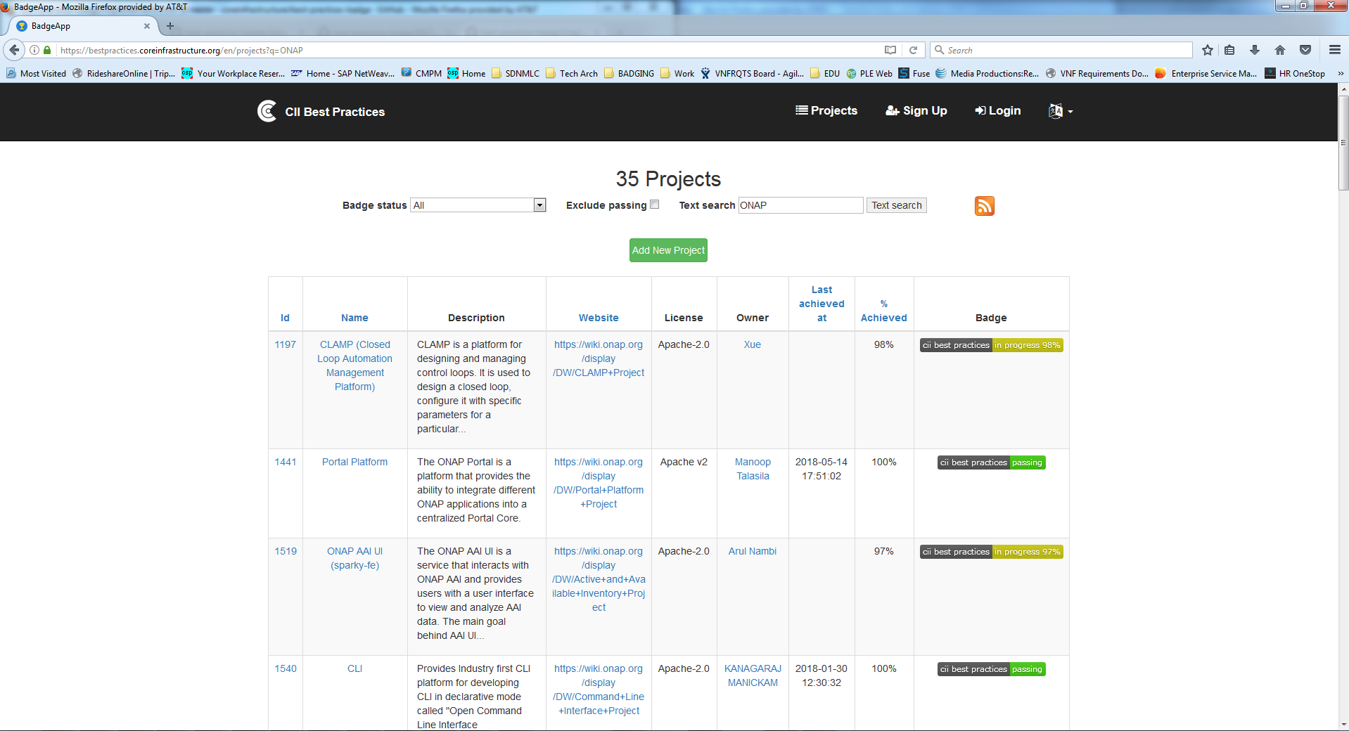
VNFs
vLB
vFW
vDNS
vSBC

Slide 13
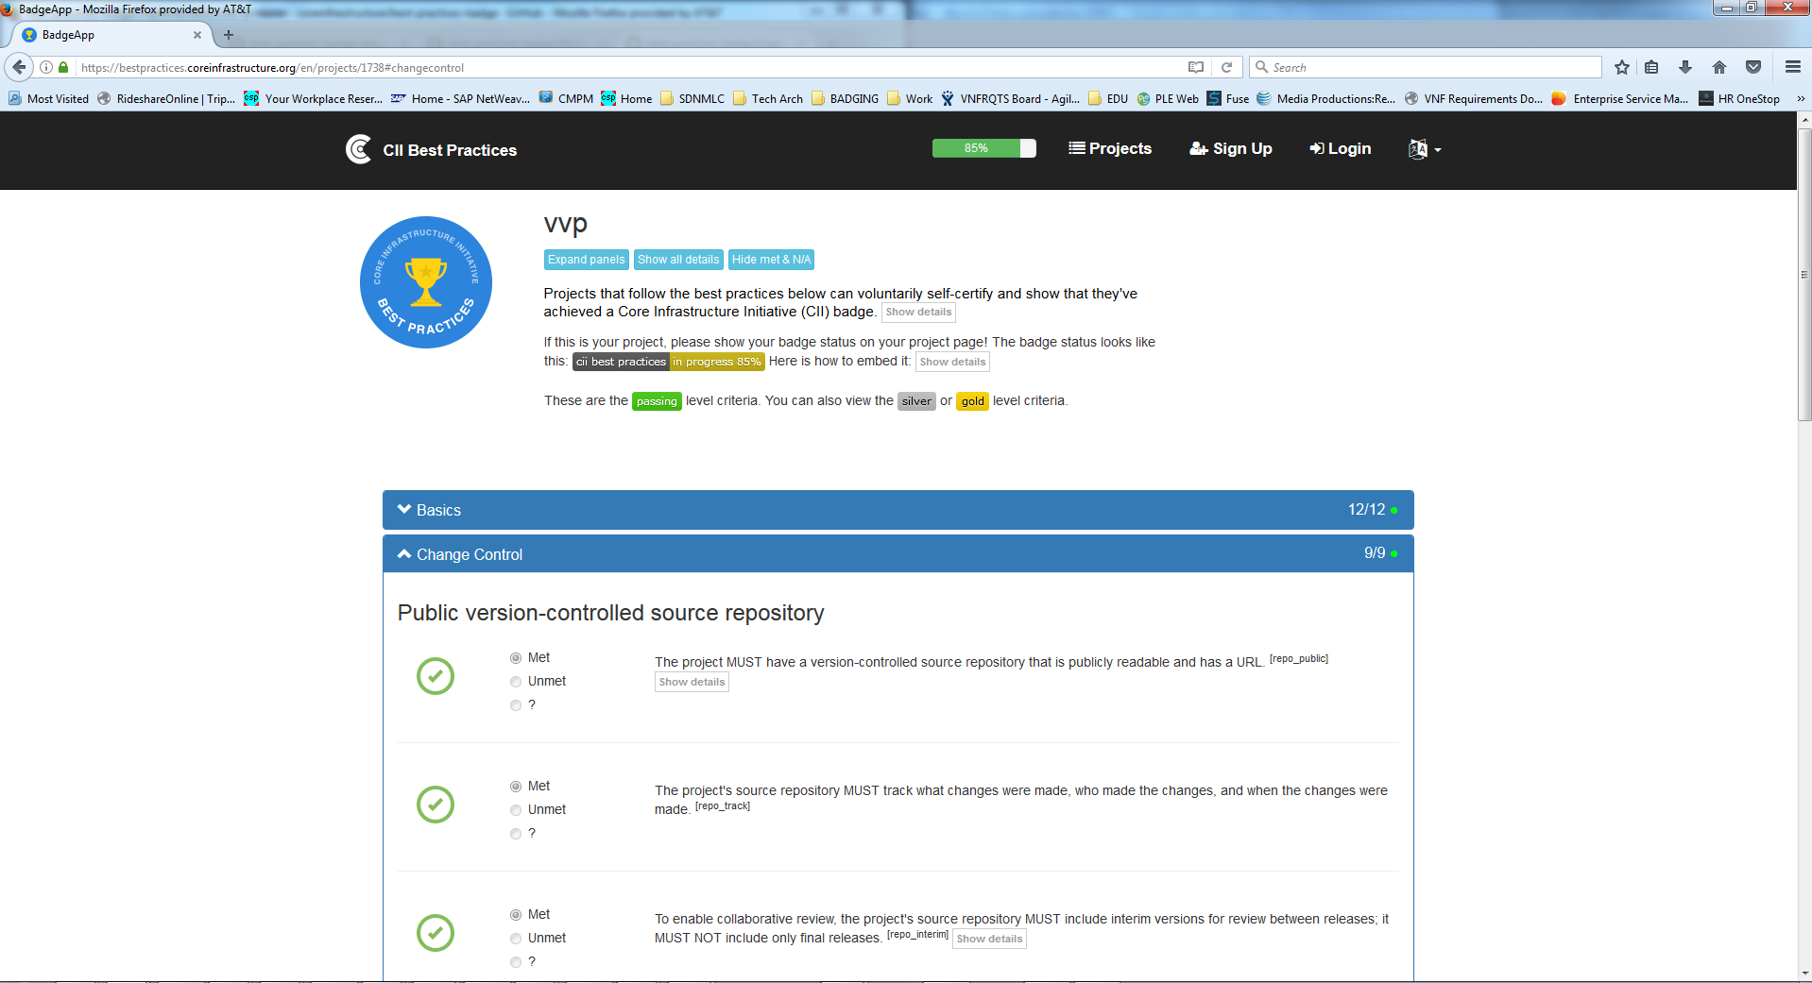
vDNS
VNF Documented
Badged
2018.11
R-74712 The VNF MUST utilize FQDNs (and not IP address) for both Service Chaining and scaling.
R-41430 The xNF MUST support ONAP Controller’s HealthCheck command
R-19624 The xNF MUST encode and serialize content delivered to ONAP using JSON (RFC 7159) plain text format

Slide 14
Questions?

