Slide 1


ONAP NF Modeling in SDC
for Casablanca (R3, 4Q 2018)
NF (VNF/PNF) Modeling for R3
SDC Project
Sept 14, 2018 version 6

Slide 2
Modeling ONAP Links
PAGE | LINK
Use case proposal: 5G- RAN deployment, Slicing, SON | https://wiki.onap.org/display/DW/Use+case+proposal%3A+5G-+RAN+deployment%2C+Slicing%2C+SON
5G Functional Requirements Tracking | https://wiki.onap.org/display/DW/5G+Functional+Requirements+Tracking
Casablanca Release Requirements | https://wiki.onap.org/display/DW/Casablanca+Release+Requirements
NFModeling-SDC_R324Jul2018v1 | https://wiki.onap.org/display/DW/Casablanca
Service Design & Creation (SDC) Portal Page | https://wiki.onap.org/display/DW/Service+Design+and+Creation+%28SDC%29+Portal
Common about NFs (PNFs & VNFs and allotted NFs Info-model level “base”) | https://wiki.onap.org/display/DW/Abstract+Base+IM+Class+for+Network+Function
SDC Artifacts | https://wiki.onap.org/display/DW/SDC%2Bsupported%2Bartifact%2Btypes
Working with SDC | https://wiki.onap.org/display/DW/Working+with+SDC
Micro-Services Onboarding Wiki | https://wiki.onap.org/display/DW/MicroServices+Onboarding

Slide 3

PNF PnP: MODELING ENHANCEMENTS
DESCRIPTION
PNF MODELING – Modeling enhancements to support 5G PNF in ONAP. Model Inheritance definitions for PNF. SDC modeling improvements from Beijing PnP use case. Updated NF Model to include software_versions. Integration of software_versions
PNF SHARING – SDC model updates for PNF characteristics focusing on PNF inter-connectivity. (Dublin)
PNF-SDK – SDK provided from Vendors. This will help modeling the Physical “Box” (PNF) and network functions. (Dublin)
CDT ENHANCEMENTS - Improving CDT to handle complex config templates, multiple templates per PNF, identify different sources for template data, integrating CDT into SDC, expanding CDT usage to other controllers. (Dublin)
PROJECTS
SDC, CDT

Slide 4

PNF ONBOARDING / PNF PACKAGE
DESCRIPTION
PNF Onboarding and PNF Package
PNF PACKAGE DEFINITION – Defining PNF Onboarding Package. Extending framework to work with PNFs. Defining PNF Package framework.
  PNF ARTIFACTS DEFINITION – Vendor specific/provided artifacts to add to the (new PNF) package. (Dublin)
  PNF ARTIFACTS DISTRIBUTION – Artifacts are in Dublin
PROJECTS:
SDC, APP-C

Slide 5
TERMS, CONCEPTS & PRINCIPLES
ONAP and NF Plug and Play for 5G RAN
5G Use Case Team

Slide 6




MODELING PRINCIPLES
Planner Personnel
Optimization
Network Planning
SERVICE MODEL
Services
Application Data
Operational Operator
Functional Aspects
Run-Time
ONAP Service vs ETSI/OPENO/3GPP Service
Orchestrating ONAP component & resources
NF Interconnectivity, chaining, relations
Provider Personnel
Operators
Technicians
Vendor Personnel
Technician
Developers
Product Support
RESOURCE MODEL
Physical Resources
Application Data
Operational Operator
Physical Aspects
Run-Time
Data/Information model
VNF and PNF resources
(ONAP) PLATFORM MODEL
ONAP Personnel
“Roles” (Operator
Governor
Designer
Administrator
Tester)
NF Interconnectivity
ONAP Platform-level information
Design-time Operator
Templates
Meta-data
SDC Design Studio & Catalog
ONAP Components (SO, A&AI, APPC/SDNC etc)
Inventory, Events

Slide 7
INFORMATION HANDLING PRINCIPLES
DESIGN TIME INFORMATION
Design-time Operator
NF Interconnectivity
ONAP platform & component information
Templates
Meta-data, TOSCA semantics (policies, cap/req)
Design Time Model
Control Loop / Closed loop model
RUN-TIME INFORMATION / APPLICATION DATA
Run-Time Attributes, Run-Time Model
Accessing NF instance for ONAP components
Instance of a NF
Application Data
Operational Operator
Functional Aspects
Orchestrating ONAP component & resources
States & modes
CONFIGURATION INFORMATION
Service Parameters
Run-Time parameters
Functional Configuration
Data Consistency & Data Validation

Slide 8
Aug 21, 2018
(NK Shankar)
PCI Discussion
If ONAP needs to know about PCI to
Perform control loop functions, ONAP needs to know
As part of a process flow.
(Arash Hekmat)
5G Architecture
Configuration kept in SDNC/SDNR
Source of 5G configuration information.
Control designer studio feature to CDT in Casa/R3
Adding XML or JSON template for configuration to CDT
CDT would move to SDC Design Studio (additional cap)
Consume model/create artifacts.
When you have config you config a port IP@,
Resource Resolution.
Dictionary of resources.
Parameters are tagged ($, #) resolve @ Run time.
As resource resolution SDNC > templates > data dictionary
Resolves parameters to configure NF >
Protocol to write config (Ansible, Chef, Netconf)
UI Data dictionary/parameters to resolve at run-time

Slide 9

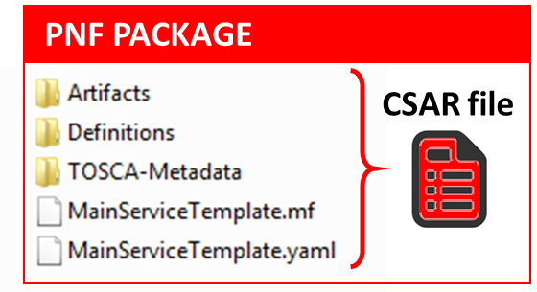

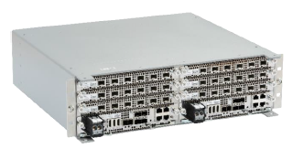
VERSION CONCEPT
Diagram of Software Version Management for a PNF
PNF-Descriptor (version)
Vendor Provided
PNFD version = 6
PNF-Package (version)
Minimal PNFPackage version = 7.1
(SDC Versions the Package)
PNF Software (version)
[Detected Software, Expected Software]
DETECTED PNF S/W – [Partition1 “Active”] 12345
[Part 2] 67890 [Recovery Partition] 00010
ONAP EXPECTED PNF S/W 3.0 (modeling)
PNF Hardware (version)
Hardware Version
Firmware Version
Product Model version
Vendor Release – VID match PNF avail in system
S/W version management – Use casa
Troubleshoot
Network Analysis
Correlation Version
Error Checking
Modeling informational
Network Planning
OPENStack – Image Repository in Glance. In VNF service designer request different version of S/W than is one in PNF itself

Slide 10
ASSETS MANAGED (WIKI)
Resource: a fundamental capability, implemented either entirely in software, or as software that interacts with a hardware device. Each Resource is a combination of one or more Virtual Function Components (VFCs), along with all the information necessary to instantiate, update, delete, and manage the Resource. A Resource also includes license-related information. There are three kinds of Resource:
  Infrastructure (the Cloud resources, e.g., Compute, Storage)
  Network (network connectivity functions & elements); example: a Virtual Network Function (VNF)
  Application (features and capabilities of a software application); example: a load-balancing function
Service: a well formed object comprising one or more Resources. Service Designers create Services from Resources, and include all of the information about the Service needed to instantiate, update, delete, and manage the Service
Product: includes one or more Services packaged with commercialization attributes for customer ordering, billing, and issue resolution. Products are created by Product Managers, and can have one or more "category" attributes assigned by Product Strategists.
Offer: bundling of Products with specific Marketing configurations for selling to customers

Slide 11
SDC COMPONENTS (WIKI)
There are four major components of SDC:
The Catalog is the repository for assets at the Resource, Service and Product levels. Assets are added to the Catalog using the Design Studio.
The Design Studio is used to create, modify, and add Resource, Service, and Product definitions in the Catalog.
The Certification Studio, available in a future release, is used to test new assets at all levels. It will be used for sandbox experimentation, and will include support for automated testing.
The Distribution Studio is used to deploy certified assets. From the Distribution studio, new Product assets, including their underlying Resources and Services, are deployed into lab environments for testing purposes, and into production after certification is complete. In a future release, there will be a way to export Product information to external Business Support Systems for customer ordering and billing.

Slide 12
SDC COMPONENTS (WIKI)
1. Resource Model
(The one, which is defined in SDC, and defines those relevant resource parameters, which characterize services running on top of that resources, or allows these resources to bring relations to other resources in a service definition) Possibly, this is as well an interaction model – how different VNFs interact with each other, what relations are they building?
2. Inventory Model
(The one, which defines, which configuration/instance parameters are stored per resource/service instance – e.g. concrete IPs or Serial Numbers, that are assigned to concrete instances)
3. Configuration Model
(The one, which defines, which configuration parameters are required/exposed as application parameters to e.g. controllers)
4. Event “model”
(How the events, that we`re generating look like – what are their structres/elements/ what is the meta-data that is used around them?)
A side-effect of this one is “interaction model” – so which actions are we taking, when we discover, that there is something wrong with the xNF based on this model contents.

Slide 13
VNF vs PNF Comparison
TOPIC | VNF | PNF
Concept | Application fulfills the role of a network function. | It is a network element, a physical entity, which can implements the role of a network function.
Physical Characteristic | Application without dedicated hardware; Virtualized applications require specific capabilities; Run on different vendor servers. SRIOV, Inter-DPDK. Hardware capabilities. | Has an actual physical asset that is deployed and associated directly with the PNF.
On-boarding | To onboard a VNF is to “bring it into ONAP” i.e. the VNF images, component VNF-C provide descriptors of these NFs. Deployment model, # components, functions. Configuration parameters. VNF is not tied or optimized for a specific hardware, only requiring perhaps some capability to be supported. | For PNF provide the descriptors. Only provide the meta-data. PNF S/W specifically optimized to run on dedicated hardware. (Now) Not the software image. (Future) ONAP will provide the software image repository.
Plug and Play | The model triggers the orchestration. | (See this slide package for PNF Plug and Play) at the end of PnP the PNF can provide service.
Characteristics | 5G CU could be a VNF since there is no need to have an association to a physical environment. | 5G DU must be PNF. PNFs are Elements which may need to interact with the physical environment. PNF is “High-Touch” technology. E.g. Emit radio waves in a geographical area.
Configurability & Deployment | Easily adaptable to functions that you expect. E.g. Packet gateway to reconfigure as different NFs. Services easily create instances reconfigures including deployments (for different applications). Use a different instances of the VNF to provide a new service. For a VNF you can easily “delete” and “create” a new VNF to perform a new function. Configured dynamically. | PNF has a “fixed” set of capabilities but can’t easily reconfigure it. One PNF in multiple services. Different capabilities exposed by the PNF. Reuse the same PNF with different services configuration. For a PNF you would not “destroy” a PNF but rather re-configure it. Can be configured dynamically.
ONAP Interaction | ONAP is started with VNF. VNF is “deployed” on-demand. Control from the ONAP perspective when a deployment of a VNF happens. DCAE – same Configure – Chef, Ansible | PNF do not “deploy” application. Do not use multi-VIM. Only “configure” the application, the PNF is deployed. A technician goes to site and “deploys” a PNF. DCAE – same Configure –Implementation of PNF client. Communication protocol, Client
Design Time Modeling | Model VNF. Templates. Onboarded before. In Run-time. Make sure properly identify specific PNF instance already deployed. Vs a dynamically created instances. VNF instances could be created & instantiated dynamically. SDC may assumed instantiation of network function. | PNF cannot be instantiated, a PNF is only instantiated when it “powers up” and connects to ONAP. Service Orchestration. PNF is instantiated by nature of a PNF installation & commission procedure.
Service Orchestration | VNF cloud, #VM resources consumption, define components implement different functions. Where & What will be deployed. | Physical location, pre-provisioned capabilities, performance monitoring. Components installed. RUs for specific functions.
Resources | VNF dynamically assigned resources. | PNF statically associated (hardware) resources.
Capacity | VNF Capacity can be dynamically changed | PNF is static (number of cells supported)

Slide 14
NF Modeling in SDC
IN CASABLANCA (R3)
ONAP and NF Plug and Play for 5G RAN
5G Use Case Team

Slide 15



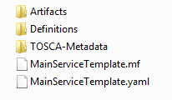

Design Time (ONAP)
SDC
SDN-C
SDN-R
APP-C
DCAE
AAI
SO
1
Resource Definition
CASABLANCA
PNF Onboarding Package
PNF type
INPUT: PNF Descriptor (PNFD) (Vendor Provider)
ACTION: User builds a resource definition customizing vendor’s PNF description. “blue print” of PNF
OUTPUT: SDC Resource Definition
2
Service Definition
2
Service Definition
2
Service Definition
Customization
of Resource Definition
CASABLANCA
PNF Modeling Enhancements
INPUT: SDC Resource Definition
ACTION: Designer: Customizes the SDC Resource Definition with service specific parameters. Define the PNF types “object Model” e.g. 5G DU, 4G, Legacy DU. Infrastructure services, services for PNF.
OUTPUT: Service Definition
NF PACKAGE
CSAR file
3
Type Modeling Artifacts Distribution
Listener
UEB Listener
Service Change Handler
Listener
INPUT: SDC Service Definitions
ACTION: Type Modeling Artifact (from SDC) are distributed to other ONAP components (DCAE, SO, AAI). SDC artifacts include policies & Work-flows related to that type are defined.
Context-sensitive distribution based on PNF type.
OUTPUT: ONAP components are prepared to manage PNFs of that new type.
Vendor Specific Step

Slide 16
STEP | DESCRIPTION
1 | RESOURCE DECLARATION – A user on the VID performs a Resource Declaration. This uses the Service definition created in SDC. The user on the VID can define known information about the PNF. The user can (optional) provide the following information PNF RESOURCE Definition Resource Type – Type of Resource. NEW type: PNF (pre-defined in SDC) NAME – Name of the PNF type CATEGORY – e.g. Infrastructure TAGS – User-definable tags (default name of the PNF) DESCRIPTION – Textual description CONTACT ID – Designer (user of ONAP) VENDOR – PNF Vendor (e.g. Nokia) VENDOR RELEASE – Vendor release VENDOR MODEL NUMBER – PNF Model value (link to A&AI) EVENTS – Monitoring Event definitions. Define design-time templates. CLAMP (runtime monitoring), DCAD (design time design template attach to VNF). Define templates & attach them. Note: The user may provide whatever information in the above fields they know. Note: Consumer vs Enterprise deployments. Consumer systems pre-registered, distributed throughout a region. For a consumer deployment you might not know the MAC address/Serial number (PND IF) until the PNF connects to ONAP.
2 | SERVICE Definition (uses a PNF) NAME – Name of the Service (mandatory) CATEGORY – e.g. Network L1…L4, VOIP call Control, Mobility TAGS – User-definable tags (default name of the PNF) DESCRIPTION – Textual description of service (mandatory) CONTACT ID – Designer (user of ONAP) (mandatory) PROJECT CODE – ID (mandatory) Ecomp-Generated Naming – Name Naming Policy – Policy to be used to assign a name to a service by SO/SDNC SERVICE TYPE – Type of service SERVICE ROLE – The Role of this service. ENVIRONMENTAL CONTEXT – distributed environments Specific Service(?) – PNF, allotted resource from a CU Service The “basic” model are extended. Inherit (OO) from existing model. Vendor takes standard node types and creates their own extension. CDT (Configuration Design Tool) (GUI) to build artifacts to be used by APP-C (Tosca models) for a configure Template.
3 | DISTRIBUTION – Event Monitoring Templates distributed. (?)

Slide 17
PNF PnP: MODELING ENHANCEMENTS
DESCRIPTION
PNF MODELING – Modeling enhancements to support 5G PNF in ONAP. Model Inheritance definitions for PNF. SDC modeling improvements from Beijing PnP use case. Updated NF Model to include software_versions
PNF SHARING – SDC model updates for PNF characteristics focusing on PNF inter-connectivity. (Dublin)
PNF-SDK – SDK provided from Vendors. This will help modeling the Physical “Box” (PNF) and network functions. (Dublin)
CDT ENHANCEMENTS - Improving CDT to handle complex config templates, multiple templates per PNF, identify different sources for template data, integrating CDT into SDC, expanding CDT usage to other controllers. (Dublin)
PROJECTS
SDC, CDT

Slide 18
PNF ONBOARDING / PNF PACKAGE
DESCRIPTION
PNF Onboarding and PNF Package
PNF PACKAGE DEFINITION – Defining PNF Onboarding Package. Extending framework to work with PNFs. Defining Package framework.
  PNF ARTIFACTS DEFINITION – Vendor specific/provided artifacts to add to the (new PNF) package. (Dublin)
  PNF ARTIFACTS DISTRIBUTION
TOSCA Meta data - main service template, TOSCA template.
Artifact Package. Separated by types of artifacts. Separations by folder for different types. Place artifacts in categories. Anyone can choose which artifacts to receive.
Definitions – Specifies definitions such as CM, FM and PM definitions
Protocols Supported – PNF package. CM Protocol is in PNF onboarding package. (Chef, Ansible, NetConf)
Controller – What is the PNF controller
PROJECTS:
SDC, APP-C

Slide 19
NF SDC & Modeling
Project Impacts Overview
ONAP and SDC NF Modeling for 5G RAN
5G SDC Project

Slide 20
PROJECT IMPACTS FROM ONBOARDING
ONAP Project | IMPACT
SDC/ Modeling | Modeling Project - (No License management impact – See Futures Section) [See follow-on Slides “MODELING”]
VNF-SDK (PNF-SDK) Validation | PNF PACKAGE DEFINITION PNF packages similar to VNF packages. PNF Descriptors, artifacts. In PNF not doing deployment process in SDC. Only PNF configuration. Model a PNF. Onboard PNFs (create templates service configuration). Orchestrate a service on a PNF. Service provisioning. Life cycle: Template/service orchestrated. For PNF every PNF vendor makes this package. Need specific PNF properties. Image details. ONAP updates the image. VALIDATION OF A SDK PACKAGE VNF-SDK (validation, Package definition, verification tool) – package compliant. Allows creation/validation of packages. PNF-SDK validates the package.
WORK FLOW (SDC) | Create work-flow for PNF (Srini) SDC Impacts related to work-flow. ACTION: Sample Work-flow for PNF. vCPE, PnP (Sub) W/F are supported in R3. 5G RAN W/F R4.
MONITORING (SDC) | Monitoring definitions – SDC has a side monitoring template designer. Way to define monitoring alarms etc; In AT&T there is a project; IN ONAP code is there finalizing code; pluggable modeler for monitoring. DCAE as part of onboarding specify what VES template. DCAE-DS [Design Studio] define microservices for monitoring. How is PNF monitored & correlated. If [x] goes down how is this correlated. SDC would define the Modeling what needs to be monitored and how they would correlated with other events from other NE. Thresholds. [Baby step to process get an alarm from PNF, YAML file describes fault VES event, Fault meta-data; alarms generate]. Alarms raises are documented in SDC. Upload an “Artifact” file (Alarm Dictionary / Fault Meta-data / YAML, YANG). Vendor Specific. Demo and separate discussion. How monitored – processing in DCAE-DS (Design Studio time). Based on design time data DCAE is done in. (No open point for Casablanca R3)

Slide 21
DCAE-DS IMPACTS
OVERVIEW - DCAE-DS generates the templates for monitoring the models. DCAE-DS is model-driven. It specifies which monitoring microservice are utilized in monitoring a specific service model. Cloudify blueprints specify the requirements on micro-service and are configured by a user. Configurations are distributed to components who subscribe to that specific type of artifact.
DCAE-DS TEMPLATES – monitoring templates composition of micro-service to be used (open/closed loop). The templates are Cloudify Blueprints. E.g. Micro-Service collectors, analytics, monitoring. VES collectors, holmes. A micro-service that is part of a monitoring flow that a designer can design that can be reused for difference service models. A building block represented by TOSCA models. First needs to be represented by development team. Monitoring template certified.
DCAE-DS GUI - DCAE-DS is a pluggable designer in SDC provides a GUI to the user that selects/composes the micro-services, or use predefined templates, for specific flows. E.g. SNMP type of flow or different protocol. User can configure different micro-services according to requirements to the model.
PNF PLUG AND PLAY – Cloudify Blueprints (for a [1:X] service) has (UUID, Micro-service values, Properties, service specific policies). What are we trying to Monitor? SDC Service-Package attached to VF-Level.

Slide 22

MODELING IMPACTS
Notes:
1) EXTERNALS - Not trying to model the internals of PNFs. What is exposed by the box is what is modeled.
2) INTERRELATIONS - Focus on relations of PNFs/VNFs. Interworking between PNFs/VNFs.
3) VISIBILITY - CP/UP visibility
Not M-Plane (as this is 3GPP standardized)
4) MODELING ANALYSIS - Modeling activity to assess PNF, and check SDC model is sufficient to cover Casa use cases if additional parameters need to be added (e.g. relations between other NFs). Expanding the “Release 0 model” for Casa. PNF type vs PNF instance. Design-time vs Run-time model.
Suggested VES Event Entry - Fault’ Domain Datatypes
For Alarm Dictionary Index (in Dublin)
Alarm Dictionary Index | number | No | Alarm Dictionary Index, (since optional if left blank would mean dictionary is not used)

Slide 23
PNF PACKAGE
PNF has no onboarding package.
Just model the PNF from the modeling screens.
PNF PACKAGE
CSAR file
CSAR – decompile info stored in SDC model.
In VNF flow. Onboard the VNF. VNF cataloged as a version to be used. Check-in/check-out. After onboarding can add more artifacts and certify the VNF. A “building block” to be used in different services. Generic, the structure will be the same. E.g. 2000 ports vs 10 ports. “Ports”. How to comm w/ PNF what to do w/ PNF. Specific work-flow or configuration. PNF & VNF similar. SO will orchestrate, already exists in ecosystem.
Modeling of the Service. E.g. Connection point what will connect to the PNF.
ARTIFACTS
DEFINITIONS
PNF – 5G Base Stations
Backhaul Ports – PNF & VNF and want to communicate. In a VNF can describe a port a TOSCA. Model onboarded understand what can connect to what. CP connections. Can see they can connect. Model needs to capture info for modeling parts representing connections. Model allow someone designing service to connections. Or requirements from VNF/PNF from the model. A virtual link. One VNF & PNF connected via virtual network/link.
PNF Work-flows – initialization, triggered when connecting to PNF. Configuration/registration that needs to be done. DNS pre-loaded. Location. Policies attached to PNF, High volume # of PNF deployments, port-allocation. Capabilities. Triggered by orchestrator as part of the instantiation.
PNF Policies -
Tilt – (Antenna Tilt - RF) – not related to PNF / VNF communicate.
Software Version
Modeling Project, VNF-SDK (validation, Package definition, verification tool) – package compliant

Slide 24

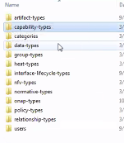
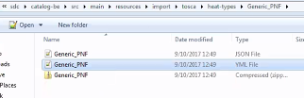
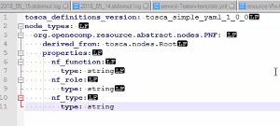
SDC MODELING (Design Time) – Casa R3
SERVICE
SERVICE TEMPLATE
1
1
1
Artifact-Types
Capability-Types
Categories
Data-Types
Group-Types
Heat-Types
Interface-Lifecycle-Types
NFV-Types
Normative-Types
ONAP-Types
Policy-Types
Relationship-Types
Users
N
N
PNF
RAN DU
TEMPLATE
Generic PNF TEMPLATE
PNF TEMPLATE
(OO Inherit & Extend)
Connection Point
N
PNF-Descriptors
Vendor Specific
Template
Controller Type
[“common fields”] …
Vendor-field1

Slide 25

gNB Model (R4)
OPTION 1
gNB SERVICE
Infrastructure
SERVICE
CU SERVICE
DU SERVICE
1 … N
VNF
CU-CP-H
CU
PNF
VNF
CU-CP-L
X2
VNF
CU-UP
OPTION 2
“Services”
5G “Features”
IoT Management
5G Wireless (Voice) Service
5G Wireless (Data) Service
MBMS
5G SERVICE
CU-PNF
CU-VNF
PNF (DU)
xN
RESOURCES

Slide 26
SDC MODELING (Design Time) – Casa R3
5G SERVICE
SERVICE TEMPLATE
1
1
1
Artifact-Types
Capability-Types
Categories
Data-Types
Group-Types
Heat-Types
intfc-Lifecycle-Types
NFV-Types
Normative-Types
ONAP-Types
Policy-Types
Relationship-Types
Users
N
TEMPLATE
N
N
Network
Functions
Network
Functions
RESOURCES
RAN DU
RAN CU
N
PNF-Descriptors
Vendor Specific
Template

Slide 27
PNF DEVICE Node Type
Network
Function
Network
Function
Network
Function
PNF Device
PNF device located physically at a location
Network Function is a resource utilitizing PNFs or VNFs
Multiple NF w/ Licenses
SERVICES (UML) “has a” 1…N PNFs & VNFs.
(conceptually) What is the difference between a NF & a Service?
NF supports the creation of a service.
NF = RESOURCE

Slide 28
gNB Model (R4)
“Services”
5G “Features”
5G SERVICE
gNB SERVICE
IoT Management
5G Wireless (Voice) Service
5G Wireless (Data) Service
MBMS xyz-features
(Licensing)
Infrastructure Service
1
1
N
N
Meta-
RESOURCES
Network
Functions
Network
Functions
PNF-
Device
CU-PNF
CU-VNF
PNF (DU)
xN
Concrete-
RESOURCES
Catalog
During orchestration time
Find CU/DU-PNF resources catalog
Then Homing function
NF Global types derived DU/CU-NF
Implementations of CU/DUs
Associating CU-instances w/ specific [set of] DU instances

Slide 29
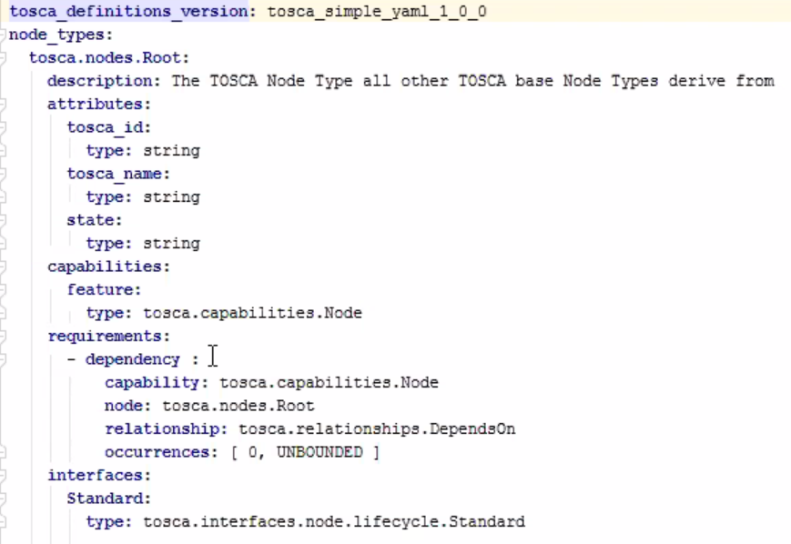
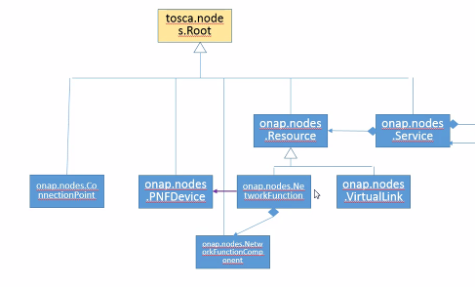
Tosca.nodes.Root
DATA MODEL
VNF Internal Models
TOSCA Based
Heat Based
Standard TOSCA node Root
Complex
X
(Existing) Connection Points
PORT or NIC
Linking
Connectivity between different service
LINK between Connection Points
Every Connection Pt connects to a Virtual Link
But a VL may be connected to more one CnPt
TRUNK MODE
10 VNICs off a NIC each VNIC is a CnPt
and each NIC is a CnPT
DOMAIN, CONTEXT Martin Fowler
VM ComputeHost has NICs
Binding
Component
e.g. Transcoder
Meta Data
NF Policy
VNF/PNF identified by dependency on PNFDevice
SOFTWARE ACCELERATION
DPDK, SW Pinning. EPA (enhanced platform awareness)
Transcoder(s) is a NF w/ SBC [session boarded controller] based on through-put.
Session boarded controller DIAMETER, ROUTER
Typically done in H/W. Specialized NIC (bearer traffic) for Higher Bandwidth
could be done in S/W doesn’t make sense to do in S/W. Purpose-built H/W. Intel Telco FPGAs/ASIC.
session board controller, is a network device. [Fred Feisullin VZW]
https://wiki.onap.org/display/DW/Enhanced+Platform+Awareness+Capability
Anatoly Katzman (Monday 10AM data modeling)

Slide 30
X

Slide 31
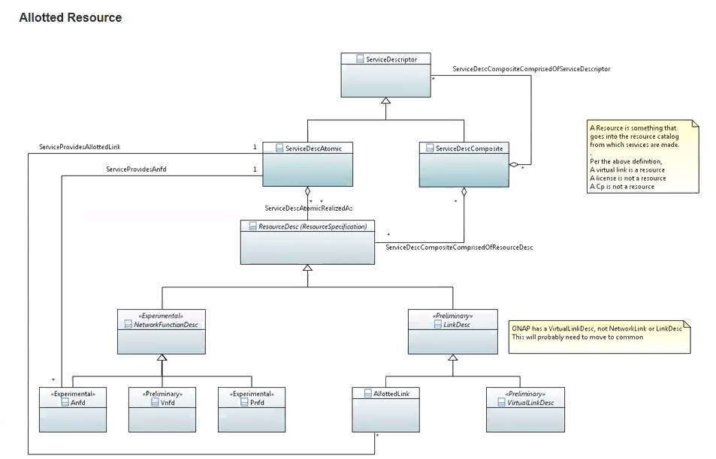

Slide 32

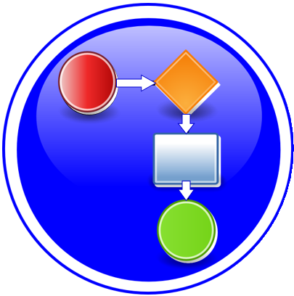
Modeling a Service
TOSCA Root
Node
Service
1
1
N
N
Connection
Point
PNF
Device
1
1
Network
Function
Virtual
Link
Ports / NICs
Connectivity
NF
Component
Complex
NF
Component

Slide 33
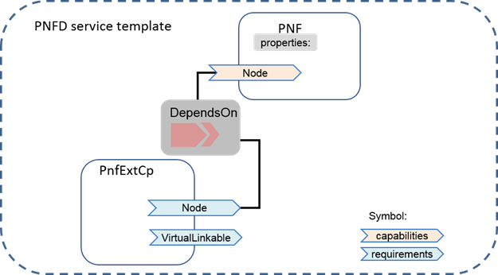
ETSI (SOL1) NF Model
solution is to onboard the PNF-Descriptor
What will be onboarded & shared w/ run-time components
ETSI (SOL1) differs from internal model
How models will be used by UC
How we can use an ETSI model PNF-based for VCPE U/C (HEAT template)
want to onboard a TOSCA template INSTEAD of HEAT Template.
For PNF Instantiation

Slide 34
NFD DESCRIPTOR (PNFD, VNFD)
ONAP and SDC NF Modeling for 5G RAN
5G SDC Project

Slide 35
PNF Descriptor
PNFD Definition in ETSI-NFV-IFA014v242
Attribute | Qualifier | Cardinality | Content | Description
pnfdId | M | 1 | Identifier | Identifier of this Pnfd information element. It uniquely identifies the PNFD.
functionDescription | M | 1 | String | Describes the PNF function
provider | M | 1 | String | Identifies the provider of the PNFD.
version | M | 1 | Version | Identifies the version of the PNFD.
pnfdInvariantId | M | 1 | Identifier | Identifies a PNFD in a version independent manner. This attribute is invariant across versions of PNFD.
name | M | 1 | String | Provides the human readable name of the PNFD.
pnfExtCp | M | 1..N | PnfExtCpd | Specifies the characteristics of one or more connection points where to connect the PNF to a VL. See clause 6.6.4.
security | M | 0..1 | SecurityParameters | Provides a signature to prevent tampering.
geographicalLocationInfo | M | 0..1 | Not specified | It provides information about the geographical location (e.g. geographic coordinates or address of the building, etc.) of the PNF. The cardinality 0 is used when the location is unknown.
From Potential PNF template for PNF S/W management & change management (Lixiang,YaoguangWang, ChangMing Bai Hwawei)

Slide 36
Basic Content of PNF template PNF-D (DESCRIPTOR)
Contents | Description
pnfdId | Identifier of this Pnfd information element. It uniquely identifies the PNFD.
provider | Identifies the provider of the PNFD.
PNFD version | Identifies the version of the PNFD.
pnfdInvariantId | Identifies a PNFD in a version independent manner. This attribute is invariant across versions of PNFD. (pnfdInvariatnId would be inside the meta-data in ONAP)
name | Provides the human readable name of the PNFD.
security | Provides a signature to prevent tampering.
pnfInformation | Describes the PNF information
pnfSoftwareVersion | Software Version supported PNFD.

Slide 37
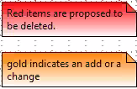
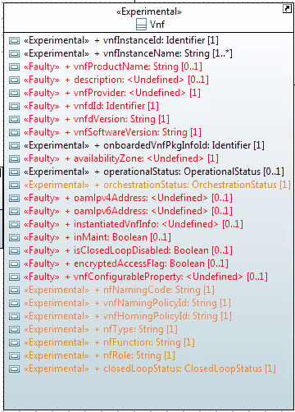
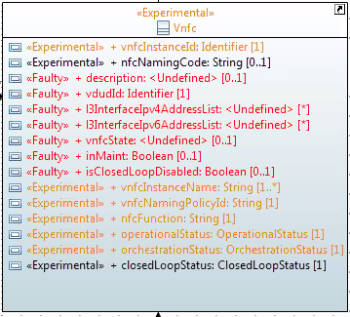
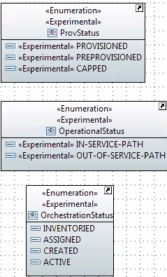
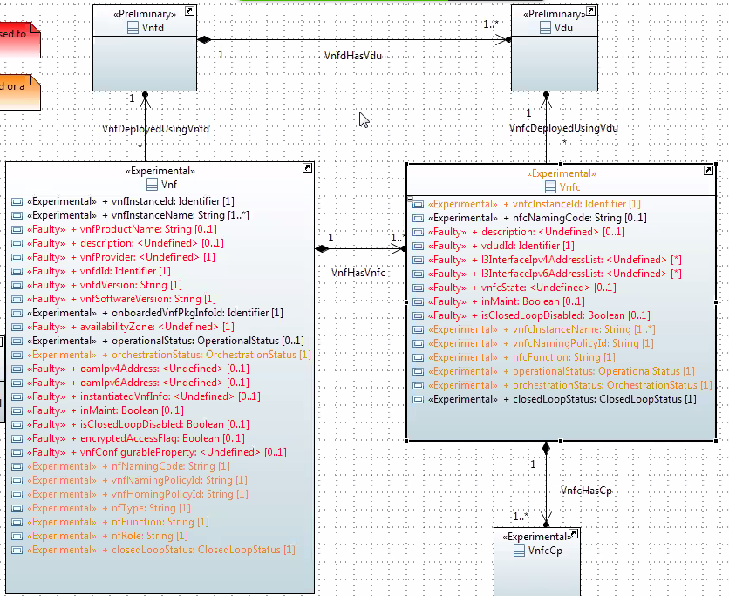
VNF Information Model

Slide 38
NF MODEL
ONAP and SDC NF Modeling for 5G RAN
5G SDC Project

Slide 39
SDC PNF MODEL (R3 Casablanca)
Contents | Description
pnfId* | Identifier of this Pnf information element. CORRELATIONID (A&AI). ACTION: Discuss further
pnfType (template)* | Type of Resource. NEW type: PNF (pre-defined in SDC)
Category* | PNF category, e.g. infrastructure
Vendor (template)* | Identifies the vendor of the PNF. MANDATORY
Name* | Provides the human readable name of the PNF.
vendorrelease * | Vendor release. MANDATORY
vendormodelNumber* | PNF Model value (link to A&AI)
functionDescription* | Describes the PNF function
software_versions | The EXPECTED software to be supported by the PNF. (see TOPIC: SWVersionList)
Sept 4 ACTION – SDC working with integration team that will use software_versions. Ben will ask on the Thursday (SW Upgrade Use Case Call)
ACTION – Coordinate Modeling Calls? (For Michael Lando) (Tues) “Merge” every once in a while to Sync up. Contact: Deng Hui
*Already supported in Beijing
From Potential PNF template for PNF S/W management & change mgmt. (Lixiang,YaoguangWang, ChangMing Bai Hwawei)

Slide 40
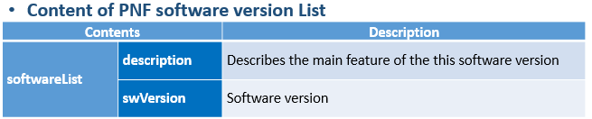
TOPIC: SOFTWARE_VERSIONS (R3)
July 31, 2018 Discussion about software_versions
TOPIC:
software_versions in the PNF Model (in Casablanca R3)
Problem Statement: How will it be defined in SDC
Objective want to have a list of S/W versions
SOLUTION
Will be a property (STRING)
REASON: Meta-Data can’t have lists so modeled as a Property.
TOSCA model has different sections
Notes: Vendor/resource version as META-DATA for NF
If this is a property has different set of validations
Properties are model information
Inputs to set properties.
Meta-Data (section of TOSCA model of PNF)
Constraints can be imposed upon Properties
An enhancement on “meta-data” which you can impose
Proper / valid values upon the Properties.
New DATATYPES would need to go through Modeling Sub-committee
Discussion
Linda Horn (Nokia) “don’t we only need ONE Expected S/W version?”
Li Xiang (CMCC) “we need a list”
DESCRIPTION for software_versions – to highlight features in a SW version.
e.g. the set of Services the S/W is targeted for.
STRING

Slide 41
TOPIC: Use Cases for SWVERSIONLIST (R3)
Use Cases that use Software Version LIST | Description
Troubleshooting | Troubleshooting software defects and tracking & isolating problematic software
Network Analysis | Metrics, Data-mining, analysis on PNF and VNF based on software developments.
Correlation Version | KPI, Performance, and operational analysis based on software version and regional correlation.
Error Checking | Mis=deployed software, error correction and analysis.
Modeling informational | Modeling software versions and feature planning
Network Planning | Regional and area planning for software deployment and rollout.
Software Management & Inventory | Feature roll-out and tracking, software management and inventory tracking
Software Upgrade (Network wide) | Service Provider wants to upgrade a network (or fallback a network) to a new software version. Region #1 – v1; Region #2 – v2.

Slide 42
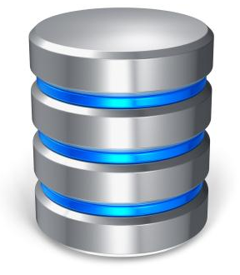
TOPIC: Use Cases for SWVERSIONLIST (R3)
DRIVE PARTITIONS
5G DU
(PNF)
Version 2018-09A
Partition1 (Active)
DU
Version 2018-09B
Partition2 (Inactive)
SUBCOMPONENTS (R4+)
PNF
Version 2018-09A
Sub-Component-1
Version 2018-09B
Sub-Component-2
TANDEM CHASSIS CONFIGURATIONS
MULTI-PNF
DAISY CHAIN DEPLOYMENT
PNF
4G PNF
Version LTE2018-09A
DU
Version 2018-09A
Sub-Frame DU#1
DU
5G PNF
Version 2018-09B
DU
Sub-Frame DU#2
Version 2018-09A
5G PNF
DU
Version 2018-09B
DU
Sub-Frame DU#2

Slide 43
TOPIC: Use Cases for SWVERSIONLIST (R3)
Use Cases that use Software Version LIST | Description
Software Upgrade (Network wide) | Service Provider wants to upgrade a network (or fallback a network) to a new software version. Region #1 – v1; Region #2 – v2.
Area #1
Modelled for NF
Software Version
2018-09A
Area #2
Modelled for NF
Software Version
2018-09A
A planner is responsible for an ONAP deployment that covers a set of areas, in this case #1 and #2.
For this particular use case/application (of this parameters), a class of PNFs is allowed to have a set of Software versions in this case 2018-09A and 2018-09B.

Slide 44
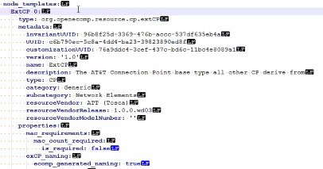
SDC PNF MODEL (R4) Dublin+
Contents | Description
pnfId* | Identifier of this Pnf information element. CORRELATIONID (A&AI). ACTION: Discuss further
pnfType (template)* | Type of Resource. NEW type: PNF (pre-defined in SDC)
Category* | PNF category, e.g. infrastructure
Vendor (template)* | Identifies the vendor of the PNF. MANDATORY
Name* | Provides the human readable name of the PNF.
vendorrelease * | Vendor release. MANDATORY
vendormodelNumber* | PNF Model value (link to A&AI)
functionDescription* | Describes the PNF function
software_versions (opt) | The EXPECTED software to be supported by the PNF. (see TOPIC: SWVersionList) Introduced in R3/Casas
pnfExtConnPt (modelling def. of connection pt not a template) | Specifies the characteristics of one or more connection points where to connect the PNF to a VL. Align ETSI SOL-001. ML: connection pt model in TOSCA TEMPLATE not as properties.
contactId (metadata) | Designer (user of ONAP) ML: Need for this, Audit/tracking, User creates audit log not associated with model itself. 19-Jul – REMOVE THIS PARAMETER
PackageVersion | The version of the PNF Package. 19-Jul – Not going to onboard the PNF, model it from scratch. Define in SDC.
NF Controller | Controller for PNF (APP-C, SDN-R, SDN-C, VF-C)
Technology Domain | Technology Domain
NF (Type)
Technology Domain
Function
Primary Role
Cloud Instance
Territory/Region

Slide 45
TOPIC: R3 NF YAML DEFINITIONS
August 7, 2018
PROBLEM STATEMENT:
We need to Store a YAML registration event in the SDC Catalog.
Note: The YAML registration event is necessary to validate emitted by PNF Is expected
Emitting what it is supposed to be emitting.
SOLUTION (Casablanca R3)
Manually uploaded to different systems
If no monitoring defined, can define information manually
PnP FLOW (updated Wiki)
[Added Note & PNP-1310] in Wiki
https://wiki.onap.org/display/DW/5G+-+PNF+Plug+and+Play
LONG TERM SOLUTION
PNF Onboarding – Packages
(See roadmap section)

Slide 46
RAN CONCEPT
ONAP and SDC NF Modeling for 5G RAN
5G SDC Project

Slide 47




5G RAN NETWORK ARCHITECTURE
ONAP Run Time Management
SO – Service Orchestrator
SDN-C – Service Design Network Controller
DCA&E – Data Collection Analytics & Events
A&AI – Available & Active Inventory
APP-C – Application Control
OSS
BSS
SO
SDN-C
DCAE
A&AI
APP-C
Core Network Elements
Disaggregated Core
UPF
SMF
UDM
AUSF
Back Haul
Centralized
Cloud
Internet
External Content
UPF – User Plane Function
SMF – Session Management Function
UDM – Unified Data Management Function
AUSF – Authentication Service Function
RAN Network Elements
5G
Application
Ecosystem
CU-CP-H
CU
RAP
Antenna
CU-CP-L
DU
RAU
RF
Edge
Cloud
CU-UP
DU
RU/TSP
Mid Haul
CPRI
RAP – Radio Access Point
RU – Remote Radio Unit
DU – Distributed Unit (5G Base Unit)
CU-UP – Centralized User Plane
CU-CP – Centralized Control Plane (low and high)
UE

Slide 48
5G RAN NETWORK ARCHITECTURE
ONAP
Management – Design Time
ONAP
Management - Runtime
RAN Network Slice Segment (NSSIs)
Transport Slice Segments (NSSIs)
Core Slice Segments (NSSIs)
RAN Abstraction Model
Transport Abstraction Model
Core Abstraction Model
ONAP Run Time Management
OSS
BSS
SO
SDN-C
DCAE
A&AI
APP-C
Core Network Elements
Disaggregated Core
UPF
SMF
UDM
AUSF
Back Haul
Centralized
Cloud
Internet
External Content
RAN Network Elements
5G
Application
Ecosystem
CU-CP-H
CU
RAP
Antenna
CU-CP-L
DU
RAU
RF
Edge
Cloud
CU-UP
DU
RU/TSP
Mid Haul
CPRI
UE

Slide 49
Associating a Controller for a NF
ONAP and PNF Plug and Play for 5G RAN for Dublin R4
5G Use Case Team

Slide 50
NF Controller (R3 Casablanca)
PROBLEM STATEMENT
Associating the ONAP Platform Controller (APP-C, SDN-C, VF-C)
for a NF
RESULT
e.g. SO knows which API to use for NF controller
LCM policy engine, DCAE, Change management, S/W Download
NF
OTN PNF (CCVPN), Router PNFs (Optical Domain), 5G DU RAN (Wireless Domain) are PNFs are relevant
SOLUTION (R3 Casablanca)
SDN-C, Hard-Code controller to PNF.
“Hard code” Generic-API (PNF Plug and Play UC)
_______________________________________________________
OBJECTIVES (Long-Term Goal)
As automated as possible
Using discovery if possible
Flexible operator could design PersonaA for PNF1, PersonaB for PNF2
Take into consideration the capability & functions of the Controller
In general, would not want different controllers handling same NF instance (avoiding race conditions, conflicts, …).

Slide 51
NF Controller Concepts
ONAP Deployment
j
ONAP Platform Controller (Run Time)
VF-C
SDN-C
SDN-R
APP-C
[New/Future]
X controller
Technology
Domain
Wireless
RAN
Optical
IoT
PNF-A
PNF-B
PNF-C
VNF-A
VNF-B
VNF-C
PROBLEM DESCRIPTION
Pictured above are three different kinds of PNFs. In orange are wireless (RAN) base stations, such as 5G DU units and their corresponding 5G VNFs. For Optical, there are SOTN PNFs for example as used in the CCVPN use case. Then pictured in green are IoT PNFs. These might include things like smart home units, smart doorbells and the like.
Each of these PNFs fall into a domain category, Wireless, Optical, IoT. These categories are just example categories. There will be many other divisions.
Each of these categories of PNFs & VNFs will have attending Controllers.
For any service provider, (w/ a mix of different vendor NFs, they will have the same Controller)

Slide 52
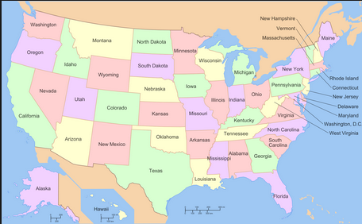
NF Controller Concepts
ONAP PLATFORM CONTROLLERS (Persona)
(SDN-C (SDN-R), VF-C, APP-C, xyz-C)
DESCRIPTION
ONAP Platform-Type controllers are SDN-C, SDN-R, VF-C and APP-C. These are specific types of ONAP projects that are controllers to NFs.
Regional CONTROLLER (Instances)
Regional Deployment (instances) of Controllers
DESCRIPTION
Regional Controllers are specific instances of ONAP platform-type controllers deployed to a particular region or responsible for a particular region. For example SDN-C deployment #1 responsible for the western part of a country, and SDN-C deployment #2 responsible for the eastern part of a country
External (to ONAP) CONTROLLERS
(OSS): EMS, NMS, Vendor proprietary controllers, etc
DESCRIPTION
ONAP External Controllers that reside outside of ONAP that perform management functions with the PNF and VNFs. Incl. Vendor-proprietary controllers e.g. SDN-C
j
ONAP Deployment
ONAP Platform Type Controllers
VF-C
SDN-C
SDN-R
APP-C
ONAP Deployment #1
ONAP Deployment #2
SDN-C
SDN-C
VF-C
VF-C
APP-C
APP-C
PNF
External Controller,
EMS, NMS

Slide 53
NF Controller PROPOSALS (Goal)
PROPOSAL #1
NF Model (SDC Design Studio)
DESCRIPTION
To have the Controller as an attribute as a NF model is specified in the NF Model. Differences between PNFs & VNFs. The PNF has a req for a physical device, VNF does not. Both NFs need controllers.
Objection to model in SDC is that the VID user may not know the controller. The model designer & The Network Engineering should know.
Problem #1 - Requires designer to know the controller
Problem #2 - How is this managed (a hard-coded list) e.g. a 3rd party External Controller
PROPOSAL #2 (REJECTED)
Policy Driven
DESCRIPTION
A policy is designed which has the Controller used by the NF.
Problem #1 – That’s not what the policy function does
Meta-Data of the Table (combined w/ idea #3)
Run-time Policy (to take up additions)
PROPOSAL #3 (ACCEPTED)
Dynamic Association (Table-Driven Approach)
DESCRIPTION
Table-Driven Look-up solution based on NF function type. For example a controller may support a particular technology domain (wireless/wireline/optical). Controller support domain and auto-populates the tables. Could be a GUI in SDC (a run-time catalog table). The Table could be onboarded. Design-time field. The PNF needs to have a “Technology” domain (a user or designer). Specific images (S/W loads) to specific Controllers.
NOTES/IDEAS
1 “ONAP platform type Controller” SDN-C (SDN-R) VF-C APP-C
2. Domain Controller - Controller-Instances (regional dependent)
ONAP deployment [controller] – Domain Controller – ONAP Controller
OTN PNF = “optical” domain = controller-z
OTN PNF w/ S/W load 1.1.1.2 = controller-X
OTN PNF w/ S/W load 1.1.1.3 = controller-y
Scale, US/Europe, W-E coast. REGIONAL
3. Vendor / External Controller
Question – who defines the “Domain”. Defined by Service Provider.

Slide 54
Dynamic Association Approach
Design Time / Model Level
Tech Domain | NF (PNF/VNF) | ONAP Platform Controller | Function (API)
Wireless | E// 5G DU | SDN-C | SDN-C Generic API
Wireless | Nokia 5G DU | SDN-C | SDN-C Generic API
Wireless | Huawei 5G DU | SDN-C | SDN-C Generic API
Wireless (Vendor xyz) | Xyz 5G DU | SDN-C | SDN-C
Wireless Subdomain 1 | Xyz 5G DU | VF-C | VF-C
Wireline | Wireline PNF | APP-C | APP-C Assign > APP-C Modify Config Restart Stop/Start
Optical | OTN PNF#2 | SDN-C | SDN-C
Wireless | PNF-12345 | SDN-C [hardcode] | (function 1)
Wireless | PNF-12345 | APP-C | (function 2)
SO Recipe different controller per flow
Lifecycle Management vs CM
SSH key to NF to authenticate controller
Data structure/Platform-Application Data
Mechanism that SP to configure for their operation
Choose to have APP-C vs SDN-C to do something
Controllers configured to handle domain & function
Controllers could publish to the table
Controller register to give provide input for auto-population
Controller when created can state its capabilities
Data Dictionary
Tool
Create/Store Data Types
Components can register
references tables Maintain by operations

Slide 55
Dynamic Association Approach
CONTROLLER REGISTERS IS ABILITIES
In Run-time the controller
can “register” with the
Dynamic Association Handler
which would specify its capabilities
Controller created specifies its abilities.
When you onboard a controller
It should self-identify the capabilities
It supports. SDNC might support modify config doesn’t support stop/start LCM.
SO Work-flows. Not only at controller level but at different level (resource level).
SAS – A service comes up, dependencies / capabilities. Based on capabilities resolve dependencies & corresponding API used.
PNP “on the fly” addition. 3rd party controller. OSDF/SAS Technology based.
Registry w/ Table-metaphor is dynamic. Do controller stuff in controllers. Bootup time register controller. Possible to Re-run registry (during runtime). Register/ Re-Register/ Deregister.
Table should be outside of SO or in Consul. E.g. Healthcheck where SO is not involved. Anyone should be able to do a look-up. CC-SDK.
RUN TIME CATALOG (SDC created artifacts) vs CONSUL (Southbound of ONAP controller & capabilities)
VNF is a collection of VFCs. VNF one API endpoint. All VFCs are within same cloud instance. A service can be composed of VNFs from multiple vendors or the same.
CONTROLLER
Technology Domain
Service Provider Specified
Function
e.g. Assign, Modify, Config, Stop/Start
Primary Role
Primary/Secondary Role
Cloud Instance
CLLI
Territory/Geo-Region
Service Provider Specified

Slide 56
Dynamic Association Approach
PNF Plug and Play
VNF Instantiation
A NF is a VNF or PNF that can interact with a Controller.
Corner Case: VNF w/ multiple VNF-Cs spanning multiple regions.
Service provider defines “Major” technology domains (e.g. Wireless), the Vendor can define “Minor” technology domain (e.g. 5G RAN)
“Lookup” we have a NF … and its part of this xyz Domain.
DU in SDC (Model)
DU in A&AI (Instance)
SO looks up what controller should be used?
DU says “I’m in this tech domain”
Tech domain are “main lookup key”
Function are supporting attributes
SO would know the Cloud Region, Territory.
When it comes time to call a controller.
Via Homing & Complex-Object
QUERY into the “Table” returns Tech domain-Function – Primary – Cloud –Georegion
SDC, VID, OOF, A&AI dependencies.
NF
Technology Domain
Service Provider Specified
Function
e.g. Assign, Modify, Config, Stop/Start
Primary Role
Primary/Secondary Role
Cloud Instance
CLLI
Territory/Geo-Region
Service Provider Specified
Capacity Planning Org (Design)
Design of network / PLAN
Mapping of Controller span of control
Input into ONAP
SDC design
VID Select W/F
Option to select Controller type
Scaling Health-Check W/F
Association in Database to make W/F visible
R3 Casa: W/F SO will be given Controller
R4 Dub: SO populate controller-NF table

Slide 57
Dynamic Association Flow
CONTROLLER
Technology Domain
Function
Controller Registers
Primary Role
Cloud Instance
Territory/Region
NF
Technology Domain
PNF Plug and Play
VNF Instantiation
Function
Primary Role
Cloud Instance
Territory/Geo-Region
Tech Domain | NF (PNF/VNF) | ONAP Platform Controller | Function (API)
Wireless | E// 5G DU | SDN-C | Generic API
 | Nokia 5G DU | SDN-C | Generic API
 | Huawei 5G DU | SDN-C | Generic API
Wireless | Xyz 5G DU | SDN-C | SDN-C
SO
Population Function
Run Time

Slide 58
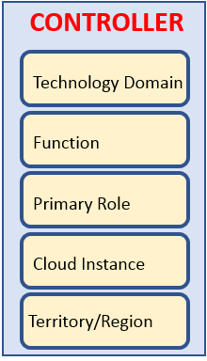
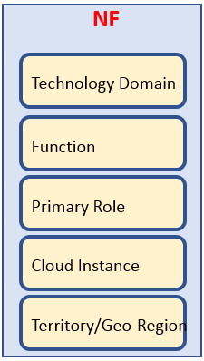
STEP 1:
INSTANTIATE CONTROLLER (ONAP Installation)
WHO: Capacity/Network Planning Team (Service Provider), ONAP Installation Team (Service Provider)
1a. The Table is Created with no value (Empty)
1b. SP provisioning/setup of ONAP instance/installation. i.e. SO, SDN-C, APP-C configuration
1c. SP Create instances of ONAP Platforms Controller (SDN-C, APP-C, VF-C)
1d. Onboard Profile Controller (tech fun role cloud instance loc)
1e. Filling in the Controller part of Table.
1f. SO spins up, Controller Registration MSvc, Controller spins up it uses the CRMS.
STEP 2 (DESIGN TIME ACTIVITIES)
WHO:
SDC Design Studio, CDT, DCAE-DS … etc
1a. Input to SDC TOSCA template from VNF-SDK (or manual) that specifies what the NF needs from a controller and NF properties
1b. Onboarding xNF-D, Defining Models & Artifacts, Updating SDC Catalog
1c. NF information put into the SDC artifacts/CSAR Package
1d. (optional) SDC could also update the Controller section of the table (by specifying controller information). Tool/Script to controller information if necessary (due to typos, adaptations for congestion, migrations, new technology domains, etc).
1e. SDC distributes Artifacts (CSAR) to ONAP components & listeners
1f. Process of ingesting the model (SDC artifacts), SO populates the table (NF part of the table “new”, UPDATES the rest of the table from Optional updates [in step 1d.]).
STEP 3: (RUN TIME OPERATION)
1a. Components in ONAP (e.g. SO, policy) USE the table to find the appropriate controller & APIs for a NF.
1b. When policy’s action require a controller look at the table.
When policy’s action is to consult w/ SO it knows how to talk to SO
EXAMPLE: Message from NF, executing a Use Case. e.g. Threshold > NF > DCAE > Policy > Action > SO: Controller to interact w/ NF

Slide 59
ONAP Instantiation / Onboarding Controllers
DESIGN TIME:
INSTANTIATE CONTROLLER (ONAP Installation)
WHO: Capacity/Network Planning Team (Service Provider), ONAP Installation Team (Service Provider)
1. EMPTY TABLE – In ONAP Build, an Empty Table is Created with no values
2. ONAP INSTANCE - SP provisioning/setup of ONAP instance/installation. i.e. SO, SDN-C, APP-C configuration
Tech Domain | NF (PNF/VNF) | ONAP Platform Controller Instance | Function (API)
3. CONTROLLER INSTANCES - SP Create instances of ONAP Platforms Controller (SDN-C, APP-C, VF-C)
4. ONBOARD CONTROLLERS - Onboard Profile Controller (tech domain, function, role, cloud instance, territory/region)
5. CONTROLLER PART OF TABLE - Fill in the Controller part of Table.
6. SO - SO spins up, Controller Registration MSvc, Controller spins up it uses the Controller Registration Micro-Service (CRMS).
CONTROLLER
Technology Domain
Function
Primary Role
Cloud Instance
Territory/Region

Slide 60
Dynamic Association – Design Time
SDC
Tech Domain | NF (PNF/VNF) | ONAP Platform Controller Instance | Function (API)
Wireless | E// 5G DU | SDN-C | Generic API
Wireless | Nokia 5G DU | SDN-C | Generic API
 | Huawei 5G DU | SDN-C | Generic API
Wireless | Xyz 5G DU | SDN-C | SDN-C
STEP 1: DESIGN TIME
WHO: SDC Design Studio
WHO: Service Operator
INSTANTIATE CONTROLLER (Design Time)
1. xNF-SDK - Input to SDC TOSCA template from xNF-SDK (or manual) that specifies what the NF needs from a controller and NF properties. VNF SDK describe attribute functionalities needed within the TOSCA model those capabilities are mapped into a controller based on the table.
2. Onboard – Onboard xNF-D, Defining Models & Artifacts, Updating SDC Catalog
3. CSAR - NF information put into the SDC artifacts/CSAR Package
4. SDC UPDATES - (optional) SDC could also update the Controller section of the table (by specifying controller information). Tool/Script to controller information if necessary (due to typos, adaptations for congestion, migrations, new technology domains, etc).
5. DISTRIBUTE - SDC distributes Artifacts (CSAR) to ONAP components & listeners
6. INGEST MODEL - ONAP Components ingesting the model (SDC artifacts), SO populates the table (NF part of the table “new”, UPDATES the rest of the table from Optional updates [in step 1d.]).
STEP 2: DESIGN TIME
NF MODEL (Design Time)
NF Model ingestion/onboarding
NF part of table updated (Vendor Class of NF)
CSAR > VNF SDK
NF (Type)
Technology Domain
Function
Primary Role
Cloud Instance
Territory/Region
NF PACKAGE
CSAR file

Slide 61



Dynamic Association – Run Time
STEP 3: (RUN TIME OPERATION)
1. USE TABLE - Components in ONAP (e.g. SO, policy) USE the table to find the appropriate controller & APIs for a NF.
2. POLICY ACTION - When policy’s action require a controller look at the table. When policy’s action is to consult w/ SO it knows how to talk to SO. EXAMPLE: Message from NF, executing a Use Case. e.g. Threshold > NF > DCAE > Policy > Action > SO: Controller to interact w/ NF
Tech Domain | NF (PNF/VNF) | ONAP Platform Controller Instance | Function (API)
Wireless | E// 5G DU | SDN-C | Generic API
Wireless | Nokia 5G DU | SDN-C | Generic API
 | Huawei 5G DU | SDN-C | Generic API
Wireless | Xyz 5G DU | SDN-C | SDN-C
Run
Time
Catalog
SO
Controller
P
M-Service

Slide 62

Stage 5: PNF Activation Steps (ONAP)
PNF
(DU)
SDN-C
Controller
SO
DCAE
AAI
35
Network Assignments
35A
Updates with Network Assignments
35B
Network Assign Complete
Tech Domain | NF (PNF/VNF) | ONAP Platform Controller Instance | Function (API)
Wireless | PNF – ModelX | SDN-C “A” | Generic API
Wireless | PNF – ModelY Region A | SDN-C “A” | Generic API
Wireless | PNF – ModelY Region B | SDN-C “B”
SDN-C “A”
PNF#305
PNF#306
PNF#307
36
Configure Service
#35-#38 PNF Configuration
Ansible (SSH), NetConf, Chef
37
Service Configuration
Sends Config Parameters (optional)
CASABLANCA
Service Configuration Improve
38
Update with Configuration Info
39
Service Configured
40
Service Running
#39-#43 Normal Flow
41
Monitors Service
42
Service Monitored
43
Inform OSS
Vendor Specific Step

Slide 63
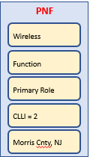
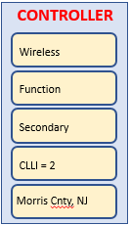
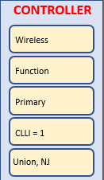
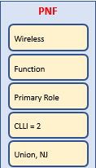
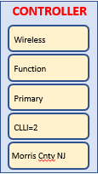
Tech Domain | NF (PNF/VNF) | ONAP Platform Controller Instance | Function (API)
Wireless
Wireless
Wireless
Wireless
Wireless
PNF #305
SSH/FQDN – Config params.
A&AI(?)
Association PNF#305 to SDN-C “A”
SDN-C “A”
SDN-C “C”
Nokia PNF Model-X
Nokia PNF Model 1
CONTROLLER
CONTROLLER
Nokia PNF Region-A
Vendor
Wireless
Wireless etc
Wireless etc
Function
Function
Function
Primary Role
Primary
Primary
Service Provider
Network Planner
CLLI = 1
CLLI = 2
CLLI = 2
Morris Cnty, NJ
Morris Cnty, NJ
Union, NJ
SDN-C “B”
Nokia PNF Model-Y
Nokia PNF Model 1
CONTROLLER
Nokia PNF Region-B
Wireless
Wireless
Function
Function
Primary Role
Secondary
CLLI = 2
CLLI=2
Union, NJ
Morris Cnty NJ

Slide 64
Oct 25, 2018
PNF Instance w/ A&AI instance in Table
Controller has a config DB so it is always stateful.
Problem during Instantiation Time ; Problem AFTER Instantiation Time.
Tech Domain | NF (PNF/VNF) | ONAP Platform Controller Instance | Function (API)
Wireless | PNF – ModelX | SDN-C “A” | Generic API
Wireless | PNF – ModelY Region A | SDN-C “A” | Generic API
Wireless | PNF – ModelY Region B | SDN-C “A”
 | PNF – ModelY Region B | SDN-C “B”
PNF #305
SSH/FQDN – Config params.
Nokia PNF Model-X
Nokia PNF Region-A
SDN-C “A”
NF (Type)
CONTROLLER
Nokia PNF Model-Y
SDN-C “B”
Technology Domain
Technology Domain
Nokia PNF Region-B
CONTROLLER
Function
NF (Type)
Function
Technology Domain
Primary Role
Technology Domain
Primary Role
Function
Cloud Instance
Function
Cloud Instance
Primary Role
Territory/Region
Primary Role
Territory/Region
Cloud Instance
Cloud Instance
Territory/Region
Territory/Region

Slide 65
DISCUSSION
NOTE: Once initial instantiation takes place & mapping, that mapping needs to be maintained for the lifecycle of the NF.
Q: Stability of Table? Will answers change?
A: For same data in will get same answer out.
A: Updates to the table can be made
Q: (Ben) case: conflict race condition (operator#1 updating / operator#2 updating table).
A: Transaction control
ONAP installation team updates. Should own data integrity of the table.
Maria DB transaction control.
Q: (Oskar) case: granularity of look-up, look-up based on a specific action.
Restart but can’t do config modify.
For a particular instance of NF handled by one controller instances.
Cases w/ dynamic look-up hard to guarantee.
If you have granularity on operation-level get two answers depending on which operation you want to perform.
Locking in A&AI to block other things.
Operations lock out ONAP from doing changes while maintenance
Course locking/ Finer locking (future)
NF#12 two active Policies
Policy #1 Restart Policy #2 Config-Modify. Trigger at same time.
Table lookup > Get Controller Instances.

Slide 66
NF Controller PROPOSALS (Goal)
DESIGN-TIME
SDC – Design Studio
Onboard a resource (type, role, function, [tech domain])
Deduce tech domain? From type-role-function?
Operator specifies the Technology Domain of the NF
Operator specified the Technology domains
(or possibly Techdomain is deduced from type-role-function)
Service Provider defines the possible Technology Domains
Assign every NE and Service to a Technology Domain
TD1 = SDN-C TD2 = VF-C manually modeled, table created.
TechDomain to ONAPPlatformController
SDC – Model “mapping” > Catalog
RUN-TIME
As a NF registers, the (managing ONAP entity e.g. SO for PNF) would look up the TD > OPC mapping)
3 Technology Controllers (Wireless, Enterprise, Other)
When generate controller it populates the table.
Dynamically populate table

Slide 67
Who Chooses the Controller?
Who Choose the ONAP controller type for the NF?
j
ONAP Platform Controller (Run Time)
VF-C
SDN-C
SDN-R
APP-C
Technology
Domain
Wireless
RAN- Vendor1
Wireless
RAN-Vendor2
PNF-A
PNF#305
PNF-A
PNF#306
VNF-A
VNF-A
Wireless
RAN-Vendor3
PNF-A
VNF-A

Slide 68
NF Controller - Notes
Identifying the NF controller
For VNF is part of the Call Flow
VNF gets orchestrated through recipe & DG & Yang models
(assumption is SDNC is the controller)
VNF can have own domain controller
DG pass control VN adaptor to 3rd party controller
PNF controller to be discovered as part of the PnP Flow
Provision PNF manually specify the Controller
SO passes to APPC service instance
SO pulls service info
PNF (CU) must be configured first
CU configuration process (could identify the ONAP controller)
PNF (routers, access pts, RAN 5G DU, CU)
- SDN-C, VF-C, x-controllers
- ONAP SO needs to know what API & Controller for PNF.
-

Slide 69
NF Controller - Notes
NOTES: July 17th Modeling Discussion
Seshu
We have talking of a TOSCA event-based flavor given
To the WF entity-based;
SO Trying to adapt – The NF controller modeled-
User on client side selects the controller (also has problems)
If not the UI, the modeler who can understand this is the case
Information that something is a missing point – trying to
Can we have a understanding in des-time; for the controller
SDN-C, APP-C, VF-C, GNF-C etc
Resources compatible w/ this resource type
A designer driven
Designer may not know
PNF PNP does not use OOF
This is a RECURRENT problem (also encountered in Scaling use case)
Alex Vul
PLACEMENT POLICY – POLICY FRAMEWORK
Design times generic, bind specific VNF
Map to OOF.
Mechanism exists.
Log des; phys infrastructure; binding between 2 (by OOF)
Heirarchical orchestration
Policy design by a Human Operator, designs the policy of PNF.
Designer doesn’t know controller;
Chaker AlHakim
Restate the problem
Add an attribute in A&AI
Register a SERVICE. Add service in A&AI.
Best way to register the service controller is providing.
Creating the service don’t know physical/virtual resources.
Srini Vellanki
Workflow designer
SERVICE MODEL – which controller to use

Slide 70
A&AI (Reference)
ONAP and PNF Plug and Play for 5G RAN
5G Use Case Team

Slide 71
ACTIVE INVENTORY (A&AI) R3/Casa
ACTIVE & AVAILABLE INVENTORY (A&AI) PROJECT IMPACTS
New A&AI PNF Parameters | PNF GEOLOCATION - geographical location (e.g. coordinates or address of the building, etc.). Latitude/Longitude. THIS ALREADY EXISTS VIA ASSOCIATION TO THE “COMPLEX” OBJECT. The Complex Object represents a BUILDING or location with geographical information. The AAI PNF will have a UML association to the Complex object.
Software Version | DETECTED SOFTWARE PNF VERSION(S) – swVersionList. R3 Casablanca – This will be a list of software versions. In Run-Time when PNF registers with ONAP it can report its (list) of PNF Software that is currently has installed. This will be tracked in A&AI entry for that PNF. Entry will also an indication that one is Active. R4 Dublin – proposing software Object which could be linked by SDC and A&AI. swVersion [1…x] (Array) { swVersion (String) activeSw (Boolean) }
Homing | PNF [#1:CU/#2:ONAP] CLOUD HOME (CLOUD SERVER LOCATION) – PNF is served by some regional ONAP cloud servers. Serves in “Rehome” PNF. CLLI Code (specifies location, street address, CloudID, physical server is deployed). [Potentially a list of locations] OOF determine the homing of a NF. Anything you home is determined in the context of a deployment. (Homing) Policy used as a f(service). Data center might have been divided into cloud regions. Service VMME running in NE area (distances, regions, tenants where to instantiate PNF). AAI has COMPLEX node. “Physical Location ID” (8 char CLLI code, lat/long = geolocation info of data center. Cloud region doesn’t span data centers.
External Manager IP Address | External Manager IP Address – provides an additional IP address for the BTS that is vendor-specific and relevant to the OAM management of the BTS. SUGGESTION (from Christina A&AI) model the NMS as a PNF itself (and the NMS will have parameters to represent itself; and then PNF can be associated with it).

Slide 72
S/W Image Repository / R3 Casa
ACTIVE & AVAILABLE INVENTORY (A&AI) PROJECT IMPACTS
S/W Image Repository | S/W Image Repository – Where the S/W is located. Configuration Parameter.

Slide 73
https://wiki.onap.org/pages/viewpage.action?pageId=25431491
Create a Complex Object
PUT /aai/v11/cloud-infrastructure/complexes/complex/clli2 HTTP/1.1 Host: <AAI_VM1_IP>:8443 X-TransactionId: 9999 X-FromAppId: jimmy-postman Real-Time: true Authorization: Basic QUFJOkFBSQ== Content-Type: application/json Accept: application/json Cache-Control: no-cache Postman-Token: 734b5a2e-2a89-1cd3-596d-d69904bcda0a { "physical-location-id": "clli2", "data-center-code": "example-data-center-code-val-6667", "complex-name": "clli2", "identity-url": "example-identity-url-val-28399", "physical-location-type": "example-physical-location-type-val-28399", "street1": "example-street1-700MountainAvenue", "street2": "example-street2-GlenSideRoad", "city": "example-city-MurrayHill", "state": "example-state-NewJersey", "postal-code": "example-postal-code-07974", "country": "example-country-UnitedStates", "region": "example-region-val-28399", "latitude": "111.1", "longitude": "234.2, "elevation": "example-elevation-538feet", "lata": "example-lata-val-28399" }

Slide 74
PNF A&AI Entry
PARAMETER | DESCRIPTION
PNF-NAME | pnf-name is the Key in AAI. pnf-name is the first three letters of the Vendor and PNF serial number. This is a unique identifier for the PNF instance. It is also called the Correlation ID. Note: MAC address & serial number are unique per vendors; not across vendors, so the Vendor name is added to insure uniqueness.
EQUIP-TYPE | The equip-type parameter gives the type of the PNF.
EQUIP-VENDOR | The equip-vendor is an optional parameter which indicates the vendor for the PNF. For example, Nokia or Ericsson.
EQUIP-MODEL | The equip-model is an optional parameter which indicates the model of the PNF.
PNF-ID | UUID = Service provider assigned number from network planner.
MANAGER IP ADDRESS | adds ipaddress-v4-oam; ipaddress-v6-oam This is the “manager IP Address” which for a DU might be a CU IP address; (FYI/ ipaddress-v4-loopback-0).
MAC ADDRESS | This is the MAC address of the PNF. This is a service field.
SERIAL NUMBER | This is the serial number of the PNF. This is a service field.
PROXY IP ADDRESS | This field contains the proxy IP address for the PNF.

Slide 75
PNF Plug and Play
ROADMAP (After Casablanca)
ONAP and PNF Plug and Play for 5G RAN
5G Use Case Team

Slide 76
TOPIC: SWVERSIONLIST (R4+)
TOPIC:
Adding Description to software_versions (after Casablanca R4+)
Problem Statement: Adding Description to SWVersionList
Problem Statement: Add new DATATYPE
(going through the modeling subcommittee)
SOLUTION
Want a DATA STRUCTURE in the TOSCA MODEL for the NF Model
Discussion

Slide 77
(SDC) software_versions data type (R4+)
New Data Type for modeling PNF Software Versions
Software (object)
FIELD | TYPE | DESCRIPTION
software-id | String | Index key for this object
swDescription | String | Descriptive text of the software
swVersion | String | The version of this software
swVendor | String | Vendor for this software
swVersionLabel | String | Semantic label for the software

Slide 78
PNF PACKAGE (R4 DUBLIN)
ALARM DEFINITIONS
WORK-FLOWS
YAML Definitions
(Vendor provided)
Alarm Dictionary
& Sub-tending faults
[Static Info]
Work-Flows
POLICY
UNDER DISCUSSION
MEASUREMENT DEFS
Identify Controller
YAML Definitions
(Vendor provided)
Meas. Dictionary
Measurement
Schema
(Vendor provided)
NF PACKAGE
CSAR file
CONFIGURATION DEFS
Configuration
Schema
(Vendor provided)
YAML Definitions
(Vendor provided)
Need to define a common “template” that all vendors
Provide dictionaries for. DCAE-DS responsible for reading these files. Closed Loop. Vendor describe alarms being sent. Definition what alarms correlated to (collecting, triggers). CLAMP performs analysis, design of who uses it is SDC. Holmes monitoring micro-services (to receive alarms).
Communication STANDARDS we want to support?
[Data Format]
EVENT DEFS
Events
YAML Definitions
(pnfRegistration, HVVes)
PLAYBOOK DEFS
PNF Alarm #22
#22 S/W problem xyz
VES = fault fields; “fault’ domain publish DMaaP
Clamp, Analytic, Holmes – [#22 event]
Dictionary looks up #22 ->
NF Ext Controller
Ansible Playbooks
(Ansible Configuration)

Slide 79
YAML NF REGISTRATION (R4 DUBLIN)
EVENT DEFS
Events
YAML Definitions
(pnfRegistration, HVVes)
YAML Registration – All events a NF supports
Indicates how this NF send the data for that event
ACTION: (Sept 25) What is done w/ a VNF now? for VNF YAML Registration. Architecture Team (Chris Donley, Steve Terrill, Brian Freeman)
DCAE is consuming Artifacts / Registration YAML
METADATA: Map to Meta-data connected to Service to be instantiated for
CONSUMER: DCAE to connect between service & file. What DCAE component will read this information. Who is consuming the information. SERVICE CHANGE HANDLER is the DCAE “LISTENER” of SDC. Anyone can consume the SDC notifications. [Design Time: (now=R3/R4) person looking at YML designing the Policy, [future] policy to auto-read the YML and then a person looks at it, in YML format], go into policy, approved by people, then into tosca-file blueprint to DCAE to implement a policy)
FORMAT: Do they expect same format?
MODIFICATIONS: Does SDC need to do Modifications or processing? [FM] no additional mapping [PM]. Does DCAE-DS or DCAE need any modification to consume the data. [(R3/R4) Nothing needs to be modified. Use as a vendor artifact and is stored “as is”. (future) Vendor may have recommendations. Requirements wanted meta-info stored in YML format. DS & Policy to have “round-trip” YML – interaction w/ policy results reflected back in YML format.] DS SDC GUI. YML loaded in the GUI. Policy-GUI “pending policies”. Approved by designers. CLAMP (GUI) input parms for design template what policy is needed for template. DCAE-DS (GUI) [create re-usable service template]. Events are stored in a database. May have to create schema YMLs can be also be used for schema (to store). (1) what payload & data from xNF. (2) what to do with the data.
DISTRIBUTION - [YML vendor] > Policy GUI, CLAMP, DCAEDS GUI > DCAE Inventory > Cloudify Blueprint [policy database] > SDC distributes cloudify blueprint to policy controller. Controller distribute to micro-service. RUN TIME Clamp/Policy GUI run-time parm for that blueprint. DCAE Inventory pulls the blueprint. Update workflow want to change policy.
SUBSCRIBING - Subscribing to information. (1) new ARTIFACT TYPE can subscribe to that new type, DCAE makes new service, knows to download the new type, (2) all is packaged in the CSAR package.
ARTIFACT TYPE: Application that receives the artifact needs to know what it is. Will DCAE try one way to read, or another. QUESTION do we need a new Artifact Type or can we reuse the DCAE_TOSCA, DCAE_JSON.
API - SUPPORT API to retrieve to get whole Artifact or get part of it based on Event Name out of YML to show, PARSE or show portion.
MERGED GUI – Clamp, Policy, DCAE DS into the SDC Design Studio. These 3 GUI drive the work flow & processing YML registration files.
Control Loop Sub-Committee (Vijay/ Pam Dragosh)
10AM EDT (UTC-4) Wed.

Slide 80
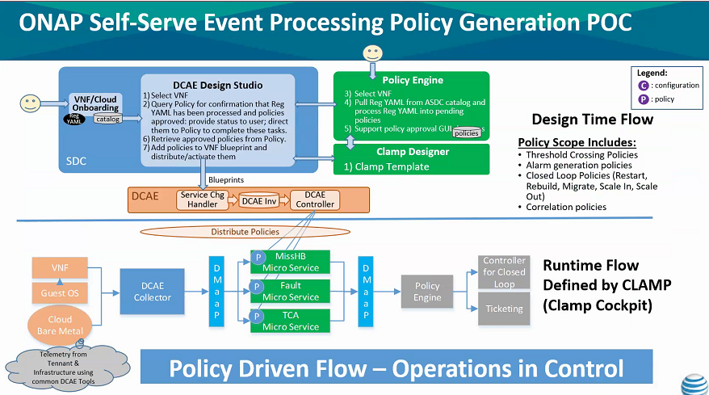
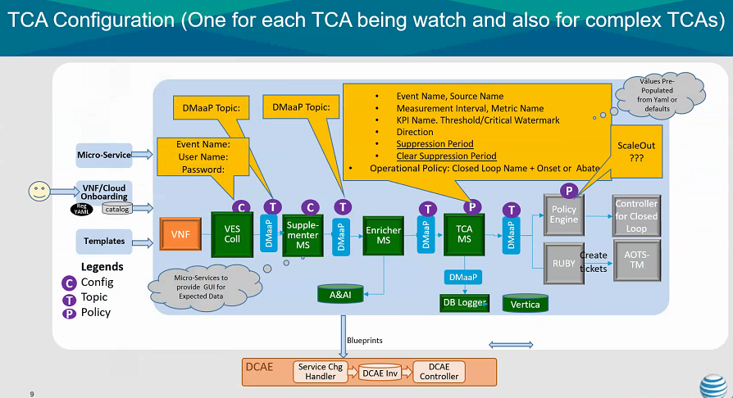

Slide 81

YML Registration File
SDC Catalog
Blueprint
Component Spec
SDC Design
Studio GUI
DCAE-DS
(SDC) GUI
DCAE Inventory
Cloudify Blue-Print
Policy
GUI
Policy Artifact
Policy Database
CLAMP
GUI
PolicyID
DESIGN TIME (Step 1 Policy & YML > Blueprint)
YML registration loaded SDC catalog (Database)
[person] Policy Blueprint SDC DS GUI
Policy Database/DCAE Inventory
Policy/CLAMP GUI are to modify or create the policy blueprint
DESIGN TIME (step 2)
CLAMP design configurations
RUN TIME
DCAE looks into DCAE Inventory gets the Policy Artifact
DCAE VES Collector
Micro-Service
Event Name
Source Name
https://wiki.onap.org/display/DW/MicroServices+Onboarding

Slide 82
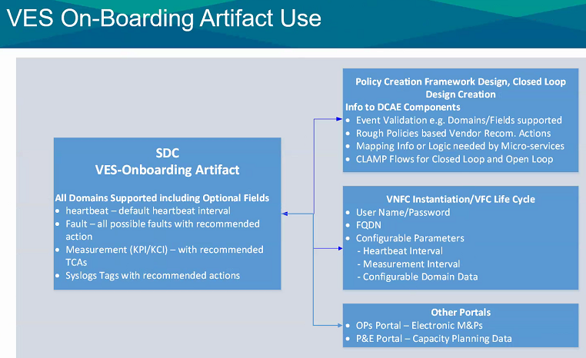
Oct 10, 2018
Any Event that is a valid domain that is formatted properly will be accepted.
And DCAE collector puts it on the DMaaP bus
The Microservice will process (and use the YML registration file)
xNF artifact should be tied to the service
When the service is onboarded to platform
Should indicate what policy is support
These are the specific alarms that I perform analytics on.
Translate that into rules for the services.
Events, Policy flow is a run-time update.
In run-time can change the configuration for that service.
YML registration –
YML is never used in run-time
They are used to define policies that are used in run-time

Slide 83
NOTES OCT 10, 2018 Control Loop Meeting
ATTENDEES - Pamela Dragosh, Martial Ngueko, Vijay VK, Vivian Ye, Adam Krysiak, Alex Shatov, Arash Hekmat, Liam Fallon, Lukasz Grech, Marco Platania, Xin Miao
SDC
Create a Service
Artifacts
Use VES registration to automatically indicate Control loops
Pick & choose
CLAMP & Policy to realize
Control loops – artifact
PNF CSAR
DCAE DS – cloudify blueprint, templates.
tie together microservices,
assign VES artifacts to specific control loop
alarm that I want to use control loop
at this point in template can specify which PNF types are valid
match template to right VES artifact
For how microservice talk to each other
VES registration does that have to be part of DC
Service onboarding (generic)
Policy configuration for individual service
Tailored to control loop
Policy modeling for that service tied to the flow.
Support these VES things.
HELP TIE Artifacts.
QUESTION is there Separate Micro-service per PNF type?
Holmes have global instance
Rule-update.
CLAMP, POLICY, DCAE.
Support in automated way.

Slide 84
Micro service
“Broker”/Mapper
“NF”
Artifacts
YML reg
NF type
Micro service
(Control Loop)
“NF”
What kind of NF are you?
[Nokia PNF]

Slide 85
FM / YAML / Definition for Alarm003 (“Record”)
VES Registration Document
# registration for Fault_vMrf_alarm003
# Constants: the values of domain, eventName, priority, vfstatus
# , version, alarmCondition, eventSeverity, eventSourceType,
# faultFieldsVersion, specificProblem,
# Variables (to be supplied at runtime) include: eventId, lastEpochMicrosec,
# reportingEntityId, reportingEntityName, sequence, sourceId, sourceName,
# startEpochMicrosec
event: {presence: required, action: [ any, any, alarm003, RECO-rebuildVnf ],
structure: {
commonEventHeader: {presence: required, structure: {
domain: {presence: required, value: fault},
eventName: {presence: required, value: Fault_Vmrf-Nokia_Alarm003},
eventId: {presence: required},
nfNamingCode: {value: mrfx},
priority: {presence: required, value: Medium},
reportingEntityId: {presence: required},
reportingEntityName: {presence: required},
sequence: {presence: required},
sourceId: {presence: required},
sourceName: {presence: required},
startEpochMicrosec: {presence: required},
lastEpochMicrosec: {presence: required},
timeZoneOffset: {presence: required},
version: {presence: required, value: 3.0}
}},
faultFields: {presence: required, structure: {
alarmCondition: {presence: required, value: alarm003},
eventSeverity: {presence: required, value: MAJOR},
eventSourceType: {presence: required, value: virtualNetworkFunction},
faultFieldsVersion: {presence: required, value: 3.0},
specificProblem: {presence: required, value: "Configuration file was corrupt or
not present"},
vfStatus: {presence: required, value: "Requesting Termination"}
}}
}}
Fault “record” for Alarm #003
# registration for Fault_vMrf_alarm003
# Constants: the values of domain, eventName, priority, vfstatus
# , version, alarmCondition, eventSeverity, eventSourceType,
# faultFieldsVersion, specificProblem,
# Variables (to be supplied at runtime) include: eventId, lastEpochMicrosec,
# reportingEntityId, reportingEntityName, sequence, sourceId, sourceName,
# startEpochMicrosec
event: {presence: required, action: [ any, any, alarm003, RECO-rebuildVnf ],
structure: {
commonEventHeader: {presence: required, structure: {
domain: {presence: required, value: fault},
eventName: {presence: required, value: Fault_Vmrf-Nokia_Alarm003},
eventId: {presence: required},
nfNamingCode: {value: mrfx},
priority: {presence: required, value: Medium},
reportingEntityId: {presence: required},
reportingEntityName: {presence: required},
sequence: {presence: required},
sourceId: {presence: required},
sourceName: {presence: required},
startEpochMicrosec: {presence: required},
lastEpochMicrosec: {presence: required},
timeZoneOffset: {presence: required},
version: {presence: required, value: 3.0}
}},
faultFields: {presence: required, structure: {
alarmCondition: {presence: required, value: alarm003},
eventSeverity: {presence: required, value: MAJOR},
eventSourceType: {presence: required, value: virtualNetworkFunction},
faultFieldsVersion: {presence: required, value: 3.0},
specificProblem: {presence: required, value: "Configuration file was corrupt or
not present"},
vfStatus: {presence: required, value: "Requesting Termination"}
}}
}}
FM / YAML / Definition for Alarm004 (“Record”)
Fault record for Alarm #004
# registration for Fault_vMrf_alarm003
# Constants: the values of domain, eventName, priority, vfstatus
# , version, alarmCondition, eventSeverity, eventSourceType,
# faultFieldsVersion, specificProblem,
# Variables (to be supplied at runtime) include: eventId, lastEpochMicrosec,
# reportingEntityId, reportingEntityName, sequence, sourceId, sourceName,
# startEpochMicrosec
event: {presence: required, action: [ any, any, alarm003, RECO-rebuildVnf ],
structure: {
commonEventHeader: {presence: required, structure: {
domain: {presence: required, value: fault},
eventName: {presence: required, value: Fault_Vmrf-Nokia_Alarm003},
eventId: {presence: required},
nfNamingCode: {value: mrfx},
priority: {presence: required, value: Medium},
reportingEntityId: {presence: required},
reportingEntityName: {presence: required},
sequence: {presence: required},
sourceId: {presence: required},
sourceName: {presence: required},
startEpochMicrosec: {presence: required},
lastEpochMicrosec: {presence: required},
timeZoneOffset: {presence: required},
version: {presence: required, value: 3.0}
}},
faultFields: {presence: required, structure: {
alarmCondition: {presence: required, value: alarm003},
eventSeverity: {presence: required, value: MAJOR},
eventSourceType: {presence: required, value: virtualNetworkFunction},
faultFieldsVersion: {presence: required, value: 3.0},
specificProblem: {presence: required, value: "Configuration file was corrupt or
not present"},
vfStatus: {presence: required, value: "Requesting Termination"}
}}
}}
FM / YAML / Definition for Alarm005 (“Record”)
Fault record for Alarm #005
# registration for Fault_vMrf_alarm006
# Constants: the values of domain, eventName, priority, vfstatus
# , version, alarmCondition, eventSeverity, eventSourceType,
# faultFieldsVersion, specificProblem,
# Variables (to be supplied at runtime) include: eventId, lastEpochMicrosec,
# reportingEntityId, reportingEntityName, sequence, sourceId, sourceName,
# startEpochMicrosec
event: {presence: required, action: [ any, any, alarm003, RECO-rebuildVnf ],
structure: {
commonEventHeader: {presence: required, structure: {
domain: {presence: required, value: fault},
eventName: {presence: required, value: Fault_Vmrf-Nokia_Alarm006},
eventId: {presence: required},
nfNamingCode: {value: mrfx},
priority: {presence: required, value: Medium},
reportingEntityId: {presence: required},
reportingEntityName: {presence: required},
sequence: {presence: required},
sourceId: {presence: required},
sourceName: {presence: required},
startEpochMicrosec: {presence: required},
lastEpochMicrosec: {presence: required},
timeZoneOffset: {presence: required},
version: {presence: required, value: 3.0}
}},
faultFields: {presence: required, structure: {
alarmCondition: {presence: required, value: alarm006},
eventSeverity: {presence: required, value: MAJOR},
eventSourceType: {presence: required, value: virtualNetworkFunction},
faultFieldsVersion: {presence: required, value: 3.0},
specificProblem: {presence: required, value: "Configuration file was corrupt or
not present"},
vfStatus: {presence: required, value: "Requesting Termination"}
}}
}}
FM / YAML / Definition for Alarm006 (“Record”)
Fault record for Alarm #006

Slide 86
Fault records
N
Heartbeat records
N
Measurement records
N
Mobile Flow Records
N
PnfRegistration records
1
SipSignaling records
N
1
State Change Records
N
YAML REGISTRATION FILE (FM, Heartbeating, Meas, Syslog, Mobile Flow, Sip Signaling, etc)
Separate Registration event PER “NF type” (E//, Nokia, Huawei etc) each PNF has separate presentation onboarded PNF. Building block used in different services.
SysLog records
N
TCA records
N
Voice Quality records
N
CONSUMERS: DCAE, Analytics Applications (?), Custom Plug-ins
Other records
N
• ‘Fault’ for the fault domain
• ‘Heartbeat’ for the heartbeat domain
• ‘Measurement’ for the measurements domain
• ‘MobileFlow’ for the mobileFlow domain
• ‘Other’ for the other domain
• ‘PnfReg’ for the pnfRegistration domain
• ‘SipSignaling’ for the sipSignaling domain
• ‘StateChange’ for the stateChange domain
• ‘Syslog’ for the syslog domain
• ‘Tca’ for the thresholdCrossingAlert domain
• ‘VoiceQuality’ for the voiceQuality domain
NORMALIZE – different definition for different NFs.
DCAE-DS – could be used to modify the YAML registration if necessary

Slide 87
I have PNF two different releases, in release 1 I may have a group of items In dictionary, in release 2 can I provide different one.
PNF Type | Release 1 (S/W version) | Release 2 (S/W version)
E// PNF – FM | FM “records” (YAML registration file) YAMLregfile-E//Rel1 | FM “records” (YAML registration file) YAMLregfile-E//Rel2
E// PNF – PM | PM “records” (YAML registration file) YAMLregfile-E//Rel1 | PM “records” (YAML registration file) YAMLregfile-E//Rel2
Nokia PNF – FM | FM “records” (YAML registration file) YAMLregfile-NokiaRel1 | FM “records” (YAML registration file) YAMLregfile-NokiaRel1
Nokia PNF - PM | PM “records” (YAML registration file) YAMLregfile-NokiaRel1 | PM “records” (YAML registration file) YAMLregfile-NokiaRel1
If just one alarm or one PM changed, could you provide the single “record” or the entire file again?
VNF FM/PM INFO
PROPOSAL
FM/PM info in the CSAR package
SOL 004
General Artifact shared & distributed
Similar to Heat File
No exact representation
For VNF no unified way to specify FM, PM
CM operation

Slide 88
Model#1001
Nokia PNF PACKAGE
CSAR file
Model#1002
YAML REGISTRATION FILE
Nokia PNF
E// PNF PACKAGE
CSAR file
YAML REGISTRATION FILE
E// PNF
Huawei PNF PACKAGE
CSAR file
YAML REGISTRATION FILE
Huawei PNF
Nokia VNF PACKAGE
CSAR file
YAML REGISTRATION FILE
Nokia VNF
E// VNF PACKAGE
CSAR file
YAML REGISTRATION FILE
E// VNF
Huawei VNF PACKAGE
CSAR file
YAML REGISTRATION FILE
Huawei VNF

Slide 89
SDC Artifacts Type
https://wiki.onap.org/display/DW/SDC+supported+artifact+types
Artifact Type | Description | Valid on Component Types
HEAT | HEAT Base template (yaml format). Provided by vendor during on-boarding | VF
HEAT_VOL | HEAT template defining required volumes (yaml format). Provided by vendor during on-boarding | VF
HEAT_NET | HEAT template defining required networks (yaml format). Provided by vendor during on-boarding (deprecated) | VF
HEAT_ENV | HEAT Environment artifact (yaml format, extension “.env”). This artifact is accompanied to HEAT template and containing values to subset of the template’s parameters. First version is provided by vendor, then SDC generates new content according to designer changes | VF / VF instance
HEAT_ARTIFACT | Supplementary artifact referenced in HEAT* template (“get_file”). Provided by vendor during on-boarding | VF
HEAT_NESTED | HEAT file referenced from another HEAT file (yaml format). Provided by vendor during on-boarding | VF
YANG_XML | YANG asset based XML | Service / VF / VFC
VNF_CATALOG | YANG asset based XML | Service / VF / VFC
MODEL_INVENTORY_PROFILE | Inventory Asset (XML format). As from 1610 it is generated by SDC during service certification | Service / VF / VFC
MODEL_INVENTORY_PROFILE | Inventory Asset Named Query Specification (XML format) | Service / VF / VFC
VF_LICENSE | VF License Artifact (XML format). Created during on-boarding of the VF | VF
VENDOR_LICENSE | Vendor License Artifact (XML format). Created during on-boarding of the VF | VF
APPC_CONFIG | configuration artifact | VF
VF_MODULES_METADATA | Json artifact that describes the vfModules of the resource. SDC generates this artifact for every VF instance during the service certification. | Component instance (e.g. VF in Service)
DCAE_TOSCA | TOSCA template used by DCAE (yaml format) | VF / VFCMT (= monitoring template)
DCAE_JSON | JSON description of the DCAE component / template | VF / VFCMT (= monitoring template)
PLAN | Workflow artifact type | Service / VF / VFC

Slide 90
Resource / Service Categories
https://wiki.onap.org/pages/viewpage.action?pageId=38114398
Searching in the SDC Catalog
Category | Sub Category
Network L2-3 | LAN Connectors, WAN Connectors, Router, Gateway, Infrastructure
Network L4+ | Common Network Resources
Application L4+ | Border Element, Database, Application Server, Web Server, Call Control, Media Servers, Load Balancer, Firewall
Generic | Infrastructure, Database, Abstract, Rules, Network Elements
Network Connectivity | Connection Points, Virtual Links
DCAE Component | Analytics, Policy, Utility, Collector, Source, Microservice, Database
Template | Monitoring Template
Allotted Resource | Tunnel XConnect, IP Mux Demux, Allotted Resource, Security Zone, Contrail Route, Service Admin

Slide 91
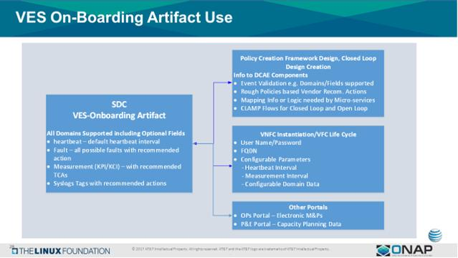

Slide 92
Alarm Dictionary Usage
ONAP
Micro
Service
ONAP
Micro
Service
SDC
1
Alarm Dictionary provided by vendor
5
Microservice processes the VES Event
Alarm Dictionary (Fault VES Definition – YAML)
(Vendor provided)
Alarm #999 map to
VES Event eventName fault_Nokia_nfType_alarmName
Alarm Dictionary
Alarm #999
Alarm Dictionary
(CSAR Package)
Service Change Handler
3
SDC Exports CSAR Package
VES Event eventName fault_Nokia_nfType_alarmName
Alarm #999
2
SDC Design Studio
4
Microservice gets VES Event
1
ALARM DICTIONARY
Fault VES “record” defines all alarms/faults published by NF (VNF or PNF)
See the VES Registration document
SDC DESIGN STUDIO Packages & composes CSAR package
SDC Makes CSAR Package
SDC DISTRIBUTES DEFINITIONS
SDC creates a definition of how to start-up service. SDC exports the CSAR package with the VES Fault to Alarm dictionary mapping definitions.
DEFINITIONS & ARTIFACTS (CSAR PACKAGE)
1. VES-Alarm mapping definition passed by SDC (CSAR Package) to ONAP components
2. DCAE micro-service gets CSAR package
MICRO SERVICE GETS FAULT EVENT
Microservice has subscribed to fault domain DMaaP Topic and receives the VES Fault Event from xNF in run-time.
MICRO SERVICE PROCESSES EVENT
Microservice processes the VES Event using the Alarm Dictionary
Policy/Action resultant from the alarm
2
3
4
5

Slide 93
Alarm Dictionary Usage
ALARM DICTIONARY (Fault YAML File) PURPOSE
DICTIONARY - it allows for a readily accessible body of the entire set of alarms & faults that are managed by a PNF. It would allow for an operator to see all of the alarms & faults of a PNF without having to wait for individual alarms & faults to arrive in ONAP.
Analytics facilitator – A dictionary would allow for a variety of vendor specific (or vendor agnostic) analytics applications to be developed. There are a variety of fields in the Alarm Dictionary that would facilitate such analytics capabilities as correlation, escalation, isolation, recovery actions, self-healing, and life cycle management functions.
GENERAL ANALYTICS – The strength of ONAP is the potential ability to coordinate information from multiple sources, different vendors, and disparate types of NFs. A dictionary can form the foundation for generalized analytics that are vendor agnostic.
FAULT DICTIONARY PURPOSE
FAULTS vs ALARMS - Fault can be a condition encountered in run-time that does not necessarily create a customer-facing alarm. An alarm is intended to result in a visual notification to a service provider to take action. An analogy would be the “Check engine” light in your car which would correspond to an Alarm. A solenoid, a carburetor, or distributor fault all might lead to a “Check engine” light. A driver (service provider) may not be able to directly act on the specific fault (or indeed care about the fault); but when the “check engine” light went on would know to take some action (go to the service station). FRTire-Fault FLTire-Fault RRTire-Fault RLTire-Fault -> TIRE LOW TIRE PRESSURE Alarm

Slide 94
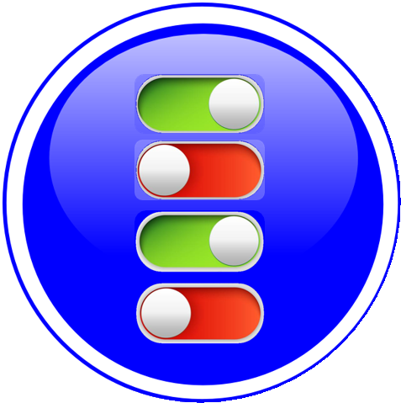
NF ALARM DICTIONARY FIELDS (Template)
ALARM FIELD | DESCRIPTION
Alarm Dictionary Index | Gives the Identifier for the alarm. This is also the Identifier that is used in the VES event so it can be used to associate the event with the definition entry. The VES Event EventID would encode the Alarm number which will correspond to the Alarm Index. EXAMPLE: 12345
Alarm Name | Alarm Name which will be used in the Event Name. Note this maps to the alarmCondition in the VES Fault Event in faultevent fields. EXAMPLE: Synchronization Lost
Event Type * | Indicates the type of alarm. The types are: Communications Alarm, Processing Error Alarm, Environmental Alarm, Quality of Service Alarm, Equipment Alarm, Integrity Violation, Operational Violation, Physical Violation, Security Service Violation, Mechanism Violation, or Time Domain Violation. Note this maps to the eventCategtory in the VES Fault Event in faultevent fields. EXAMPLE: Quality of Service Alarm
Meaning of Alarm | Provides a descriptive meaning of the alarm condition. This is intended to be read by an operator to give an idea of what happened. EXAMPLE: Synchronization has been lost
Effect of Alarm | Provides a description of the consequence of the alarm condition. When this alarm condition occurs. This is intended to be read by an operator to give a sense of the effects, consequences, and other impacted areas of the system. EXAMPLE: Loss in Quality of Service
Managed Object(s) | Managed object (MO) associated with this Alarm. Note this maps to the eventSourceType in the VES Fault Event in faultevent fields. EXAMPLE: Clock (MO)
Probable Cause * | Provides the probable cause qualifier for the alarm. Probable causes are found in 3GPP TS 32.111 Annex B drawn from ITU-T M.3100 and from ITU-T Recommendation X.721, X.733, and X.736 EXAMPLE: lossOfSynchronisation
Probable Cause Number* | Probable Cause Number the numeric value associated with the Probable Cause EXAMPLE: 76
Specific Problem * | (Optional) It provides further qualification on the alarm than probable Cause. This attribute value shall be single-value and of simple type such as integer or string. Defined in ITU-T Recommendation X.733 Clause 8.1.2.2. Note this is the 3GPP Specific problem not be confused with the specificProblem field of the VES Fault Event in faultevent fields.
Proposed Repair Actions* | It indicates instructions for proposed repair actions. These are defined in ITU-T Recommendation X.733 clause 8.1.2.12. EXAMPLE: Action#12 [= Reset the PNF], ONAP Controller does x
Clearing Type | Indicates whether the alarm is automatically or manually cleared EXAMPLE: Automatic
Additional Text* | This field contain further information on the alarm. This attribute provides vendor specific alarm information. A specific condition for this optional population is when an alarm presented by the EM has different values of perceived severity, and / or alarm type. EXAMPLE: Specific data 10
Associated Fault(s) | Indicates the associated faults that triggered this alarm. List of fault(s) associated with the alarm cross indexed against a vendor provided fault information. EXAMPLE: Fault 99999
*3GPP TS32.111

Slide 95
NF ALARM DICTIONARY FIELDS (Template)
ALARM FIELD | STANDARDS | VES FAULT EVENT
Alarm Name | None | maps to alarmCondition in the VES Fault Event in faultevent fields
Event Type * | 3GPP TS32.111 | maps to eventCategtory in the VES Fault Event in faultevent fields
Meaning of Alarm | N/A | N/A
Effect of Alarm | N/A | N/A
Managed Object(s) | N/A | maps to eventSourceType in the VES Fault Event in faultevent fields
Probable Cause * | 3GPP TS 32.111 Annex B ITU-T M.3100 ITU-T Recommendation X.721, X.733, and X.736 | N/A
Probable Cause Number * | 3GPP TS 32.111 Annex B ITU-T M.3100 ITU-T Recommendation X.721, X.733, and X.736 | N/A
Specific Problem * | 3GPP TS32.111. ITU-T Recommendation X.733 Clause 8.1.2.2 | N/A
Proposed Repair Actions* | 3GPP TS32.111 | N/A
Clearing Type | N/A | N/A
Additional Text | 3GPP TS32.111 | N/A
*3GPP TS32.111

Slide 96
NF FAULT DICTIONARY FIELDS (Template)
DEFINITION FIELD | DESCRIPTION
Fault Id | Gives the Identifier for the alarm. This is also the Identifier that is used in the VES event so it can be used to associate the event with the definition entry. EXAMPLE: 99999
Fault Name | Alarm Name which will be used in the Event Name. Note this maps to the alarmCondition in the VES Fault Event in faultevent fields. EXAMPLE: Loss of Synchronization
Fault Description | Provides a descriptive meaning of the alarm condition. This is intended to be read by an operator to give an idea of what happened. EXAMPLE: Synchronization due to PTP IEEE1588 Failure
Managed Object(s) | Managed object (MO) associated with this Alarm. Note this maps to the eventSourceType in the VES Fault Event in faultevent fields. EXAMPLE: Clock (MO)
Effect of Fault | Provides a description of the consequence of the alarm condition. When this alarm condition occurs. This is intended to be read by an operator to give a sense of the effects, consequences, and other impacted areas of the system. EXAMPLE: Loss of synchronization affect QoS
Associated Alarm(s) | Indicates the associated faults that triggered this alarm. List of fault(s) associated with the alarm cross indexed against a vendor provided fault information. EXAMPLE: 12345
Proposed Repair Actions | It indicates instructions for proposed repair actions. These are defined in ITU-T Recommendation X.733 clause 8.1.2.12. EXAMPLE: Reset BTS
Additional Text | This field contain further information on the alarm. This attribute provides vendor specific additional fault information.

Slide 97
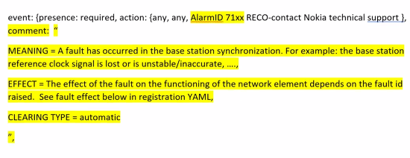
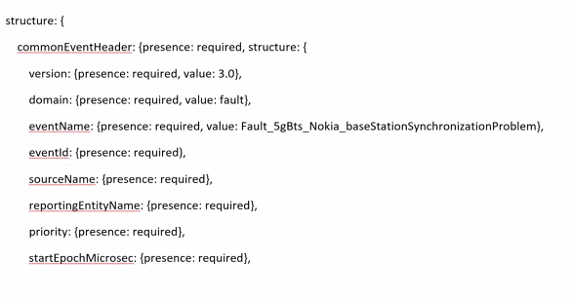
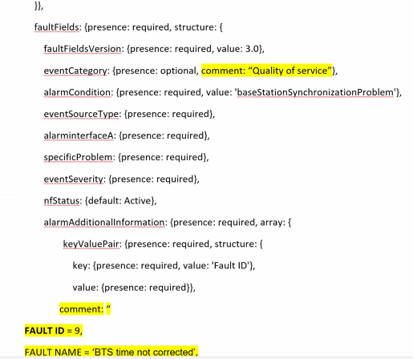
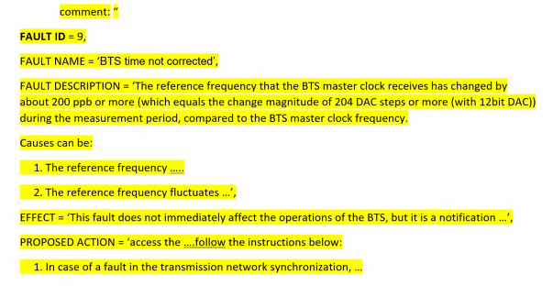
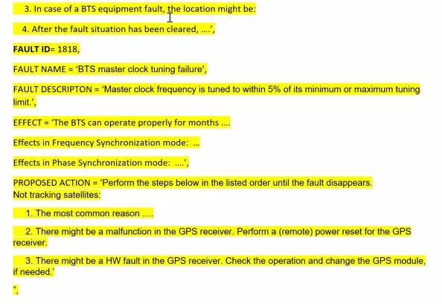

Slide 98
PM Dictionary Usage
ONAP
Micro
Service
ONAP
Micro
Service
SDC
1
PM Dictionary provided by vendor
5
Microservice processes the VES Event
PM Dictionary
(Vendor provided)
PM Measurement #123 map to
PM VES Event eventName
PM Dictionary
PM Measurement #123
PM Dictionary
Mapping Definition
3
SDC Exports CSAR Package
VES Event eventName
Measurement #123
2
SDC Design Studio Maps the PM Dictionary to VES Measurement Event
4
Microservice gets VES Event
1
PM DICTIONARY
PM Dictionary defines all measurements published by xNF (x=V or P)
Based on 3GPP TS32.503, ETSI, and VES document (v6.0) [has Cloud scaling counters]
SDC DESIGN STUDIO MAPS VES FAULT Event to PM Dictionary
SDC Design studio does mapping of PM dictionary entries to VES Fault Events to produce a “mapping” definition in the CSAR package.
SDC DISTRIBUTES DEFINITIONS
SDC creates a definition of how to start-up service. SDC exports the CSAR package with the VES Fault to PM dictionary mapping definitions.
DEFINITIONS & ARTIFACTS (CSAR PACKAGE)
1. VES meas mapping definition passed by SDC (CSAR Package) to ONAP components
2. DCAE micro-service gets CSAR package
MICRO SERVICE GETS MEASUREMENT EVENT
Microservice has subscribed to fault domain DMaaP Topic and receives the VES Fault Event from xNF in run-time.
MICRO SERVICE PROCESSES EVENT
Microservice processes the VES Event using the PM Measurements Dictionary
2
3
4
5

Slide 99
PM Dictionary Usage

Slide 100

APPENDIX
& Meeting Notes

Slide 101
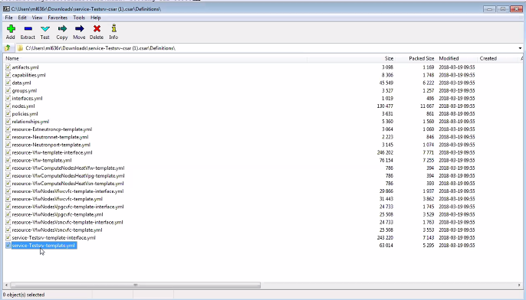
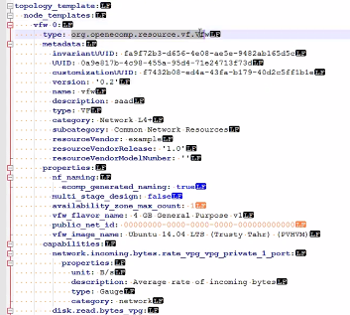
SERVICE LEVEL PACKAGE
Template, TOSCA level template representing some item
On-boarded VNF want instance of that virtual firewall
Place inside all the orchestrator needs

Slide 102
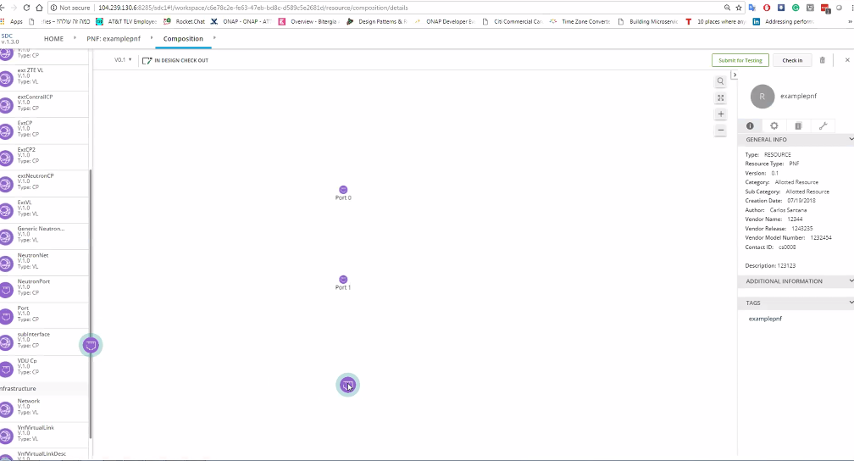
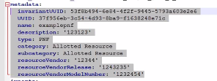
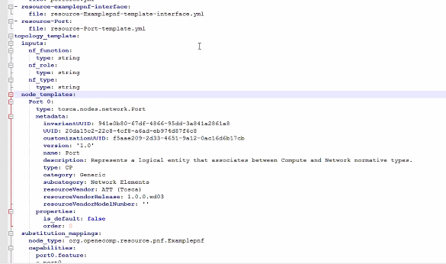
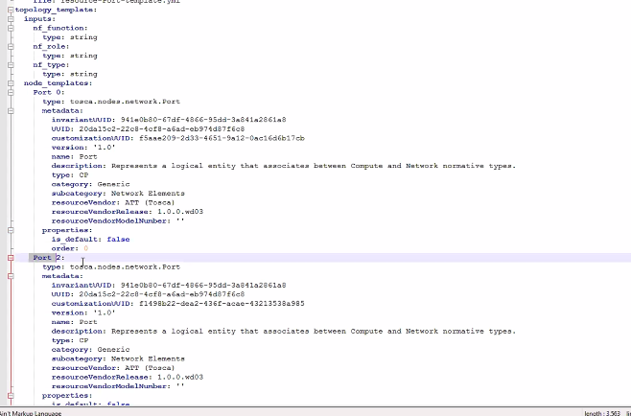
pnfExtConnPt (modelling def. of connection pt not a template) | Specifies the characteristics of one or more connection points where to connect the PNF to a VL. Align ETSI SOL-001. ML: connection pt model in TOSCA TEMPLATE not as properties.

Slide 103
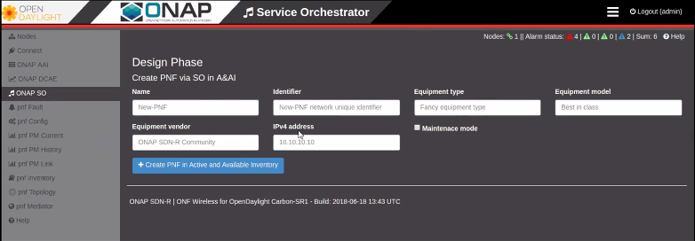
SDN-R in Open Daylight create a A&AI PNF entry

Slide 104
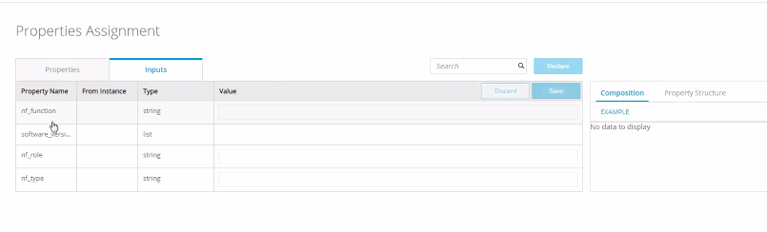
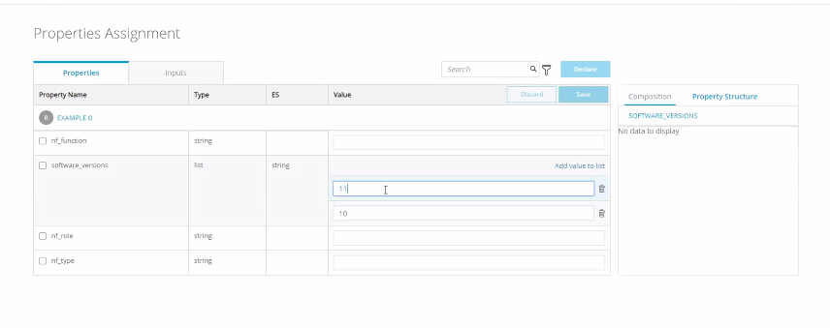
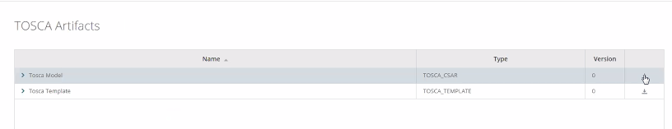
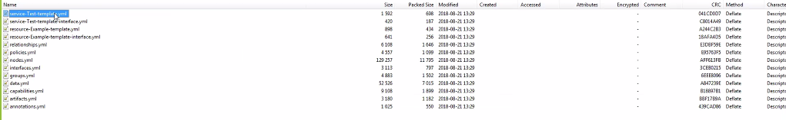
software_versions (SDC Demo)
Demo given by Michael Lando (Aug 21, 2018)
Demonstrating software_versions in SDC Design Studio

Slide 105
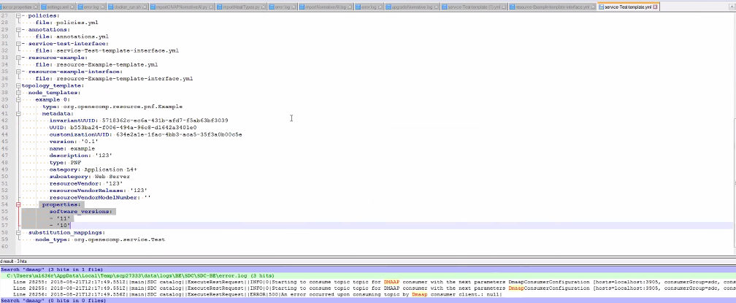
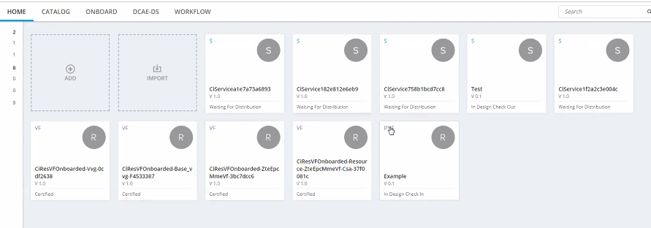

software_versions (SDC Demo)

Slide 106


software_versions (SDC Demo)

Slide 107


software_versions (SDC Demo)

Slide 108



Slide 109



Slide 110



Slide 111





https://confluence.int.net.nokia.com/pages/viewpage.action?pageId=663639069

Slide 112



https://confluence.int.net.nokia.com/pages/viewpage.action?pageId=663639069

Slide 113
https://wiki.onap.org/pages/viewpage.action?pageId=45299064
https://confluence.int.net.nokia.com/pages/viewpage.action?pageId=663639069

Slide 114
TODAY’S MEETING MINUTES
https://wiki.onap.org/pages/viewpage.action?pageId=45299064

