Slide 1
Fine Grained Workload Placement
Applicable to Distributed Edge Clouds & Standard DC Clouds

Slide 2
Workload Affinity and Anti-affinity – Concept
(Show it in slide show mode)
Scenario:
A VNF contains say 2 workloads (say firewall and IPS).
Requirement that both firewalland IPS reside on the same compute node (for performance reasons).
Requirement that replication (scale-out) to be on different zone.
Affnity and Anti-Affinity
FW workload definition will have AntiAffinity expression indicating that the replicas should not be in the same zone.
IPS workload definition will have one affinity and anti-affinity expression. Affinity indicates that IPS workload should be placed with firewall workload. Anti-Affinity indicates that replicas should not be in the same zone
Data Center
Zone1
Zone N
Node1
Node M
Node1
Node X
FW
FW
IPS
IPS
Affinity and Anti-Affinity rules/expressions are normally described in VNFD (HEAT / HELM etc…)

Slide 3
Workload Affinity and Anti-affinity – Challenges
What happens if VNFD has more replicas than the zones supported by DC?
Answer: When the request is sent to the cloud-region, it fails to instanatiate VNF
What happens if a zone does not have enough capacity (say compute nodes)?
Answer: When the request is sent to the cloud-region, it fails to instanatiate VNF
To address above challenges, typically affinity and anti-affinity rules are not made mandatory, rather they are defined as ‘preferred’.
But what if some use case require them to be mandatory? If there are multiple edge-cloud, best thing is to select the cloud-region that satisfies this requirement
Valet in ONAP is the answer

Slide 4
Edge-clouds (for 5G and IOT) and Valet
Today OOF can select one of the cloud-regions (edge-clouds) based on various constraints such as cost of VNF on the edge, distance of edge from subscriber, Hardware platform capabilities of the edge
Valet feature adds additional constrainsts in selecting the best cloud region that satisfy VNF requirements in regards to affinity and anti-affinity rules among the workloads of VNF.
How can this be done – Summary
User : to define policies that indicate the number of zones expected (based on replica count the user expects for his/her VNF)
ONAP (Multi-Cloud) :
  Get hold of (Discover) zones supported by Data centers/Cluster and put them in A&AI.
  Get the capacity information of each zone (periodically and put it in A&AI)
OOF : During instantation of VNF, OOF to check the policies and select the cloud region that supports policy defined number of zones. Also OOF to check the capacity of the zone during hardware/platform requirement check.
Deep Dive
Select the Edge Cloud that satisfies affinity and anti-affinity rules also. Ensure that instantiation at the edge-cloud succeeds

Slide 5
Fine Grained Workload Placement for Distributed Edge Clouds
5G Placement Policy Example
  5G Service/VNF placement example Constraints used by Optimization Framework (OOF)
    5G CU-UP VNF location to be fixed to a specific physical DC based on 5G DU, bounded by a max distance from 5G DU
  Optimization Policy used by OOF
    Choose optimized cloud region (or instance) for the placement of 5G CU UP for subscriber group based on the above constraints
Closely Related Casablanca Stretch Goal
  “Distributed Edge Cloud Infrastructure Object Hierarchy” (https://wiki.onap.org/display/DW/Backup+***+Edge+Scoping+MVP+for+Casablanca+-+ONAP+Enhancements+***+Backup)

Slide 6
Deep Dive : VNF Placement Decision in ONAP
OOF - Valet

Slide 7
What is the Placement Decision?
Homing for a given VNF instance
  Select a target cloud site (or a region)
  Implemented in OOF-HAS as a policy-driven homing service
Placement for virtual servers (e.g., VMs) in each VF module of the VNF instance
  Precisely check capacities of nodes & Select target nodes in the cloud site
  Here, a node is either a cluster of compute hosts (e.g., AZ or rack) or a compute host
Certain placement decisions for tenant’s need are missed between ONAP and platform’s scheduler (e.g., OpenStack Nova)
  e.g., Who will decide a target AZ of a VM for Tenant, who does not know the AZ’s configuration, such as available remaining CPUs, available Host-Aggregates etc.
Notes:
These are tenant-level options, instead of platform

Slide 8
VNFs Placement Requirements
Based on our experience with real VNFs, richer placement capabilities are required
Grouping rule: Affinity, Anti-affinity, Exclusivity (i.e., don’t share resources with others)
  Each group rule is about multiple virtual servers together
  Each virtual server can be involved in multiple grouping rules
Scope of grouping rule:
  DC, AZ, power domain (rack), host
Scope of application:
  VMs within a single VF module, within a single VNF instance, or across VNFs

Slide 9
VNFs Placement Requirements
Example in OpenStack Cloud
VF Module (Heat Template)
Core
Anti-affinity across racks
ToR
ToR
ToR
Placement Policies/Rules
VM1
VM2
VM3
VM1
VM3
VM4
VM5
Valet
Host1
HA1
Host1
Host1
VM5
VM4
Vol
VM3
VM5
VM6
VM2
Exclusivity
within
a Host
Vol
HA2
Resource information
VM6
Host2
Host2
Host2
Affinity within
an AZ
Rack1
Rack2
Rack3
AZ1
AZ2

Slide 10
A VNF Placement Use Case
A real VNF placement requirement (5G Mobility VNF):
Checking capacity and then placing VNF instances, each of which consists of 3 VMs,
in a way of Anti-affinity (across AZs or compute hosts) among VNF instances but Affinity (within an AZ or a compute host) among 3 VMs of each VNF instance
VNF-1
VM
VM
VM
Affinity
VNF-2
VM
VM
VM
Affinity
VNF-3
VM
VM
VM
Affinity
Anti-affinity
Anti-affinity
Anti-affinity

Slide 11


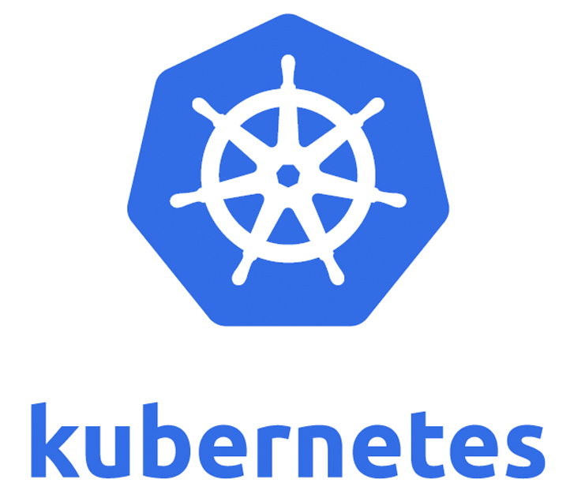
Why a Placement Decision in ONAP?
Consistently deal with different underlying clouds with high-level policies
  private, public, or hybrid clouds
  different platforms such as OpenStack, variant of OpenStack, Kubernetes, etc.
Smoothly combining Placement with Homing decision

Slide 12
Placement Decision Functions
To connect high-level VNF placement requests into underlying cloud resources
Providing precise capacity/quota check (and reservation capability)
Meeting placement policies (Affinity, Anti-affinity, Exclusivity)
  Constraints Solving
Translating universal policy specification into native cloud specification
  e.g., Rack-level Affinity and Anti-affinity -> Azure: Fault-Domain, AWS: Placement-Group
  e.g., Host-level Exclusivity -> Azure: Isolated VM, AWS: Dedicated Host

Slide 13
A Homing & Placement Flow
OOF/HAS+Valet
For Homing &
Placement decision
Policy
A&AI
SDNC
SO
MultiCloud
…
OpenStack
PlugIn
Azure
PlugIn
Homing or Capacity check
Placement of VF module

Slide 14
ONAP Dublin Scope & Project Impact
Scope
  Check rules and capacities in AZ-level (and Host-level optionally)
    Handle Affinity, Anti-affinity, and the mix of rules
    Collect DC resource information from A&AI (and/or collect from the target DC via MultiCloud plugin if necessary)
  Focus on OpenStack cloud (but extend to Azure and AWS cloud eventually in the next release)
Impacted projects
  OOF/HAS, SO (to include new attributes)
  A&AI (to provide new resource information), MultiCloud (OpenStack plugin if necessary for detailed DC resource information)
  Policy & SDC (to include rules), SDN-C (to disable AZ fixing)
Maybe Valet seed code in dark mode until it includes complete code base including unit tests

