Slide 1
VSP Compliance
Vodafone Group
Date: 22 January 2019

Slide 2
SDC UI Flow Option 1
Date: 22 January 2019

Slide 3
SDC | UI Option 1
Remove the “Validation” tab in “Attachments” section.
When user uploads VSP template and clicks on “Proceed to Validation”, the page navigates to new “Validation” screen in Compliance and Certification Checks.

Slide 4
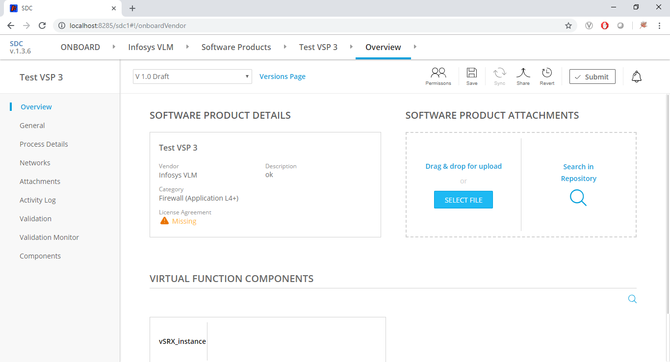
SDC | Upload VSP Template
User uploads VSP template

Slide 5
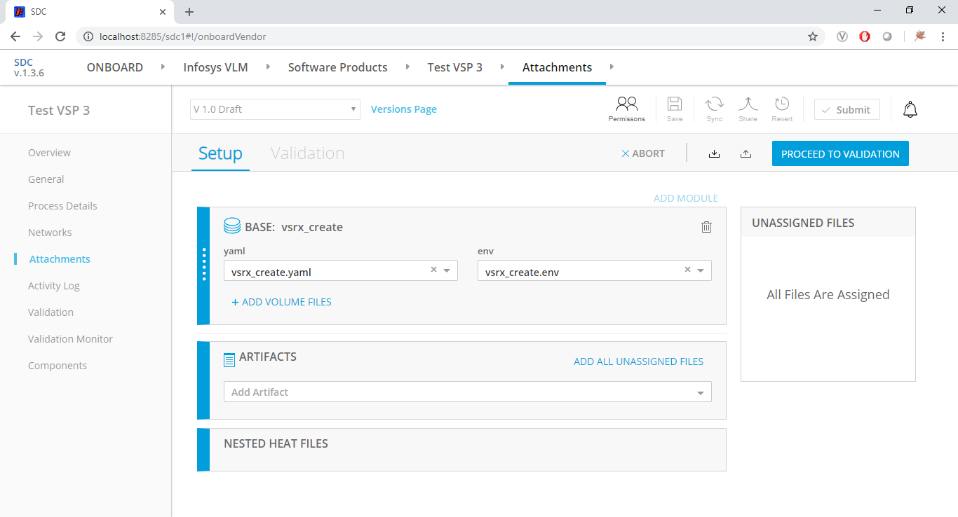
SDC | Proceed to Validation
Remove the Validation tab. Instead navigate to new Validation screen
User is taken to “Validation Screen” when click on “Proceed …” button
Validation Screen navigation link

Slide 6
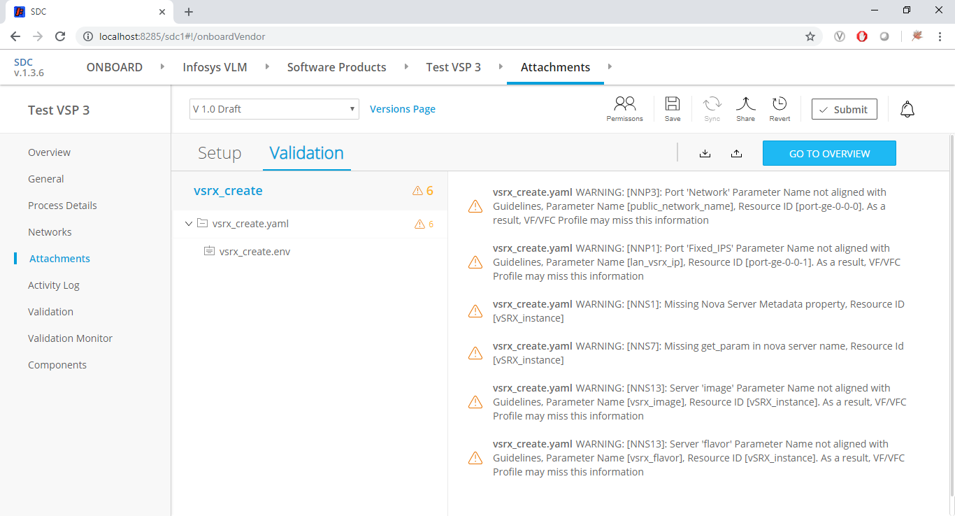
SDC | Remove Validation Tab
Remove the Validation tab.
Add this option on the “Validation Monitor” and “Validation” screens.

Slide 7
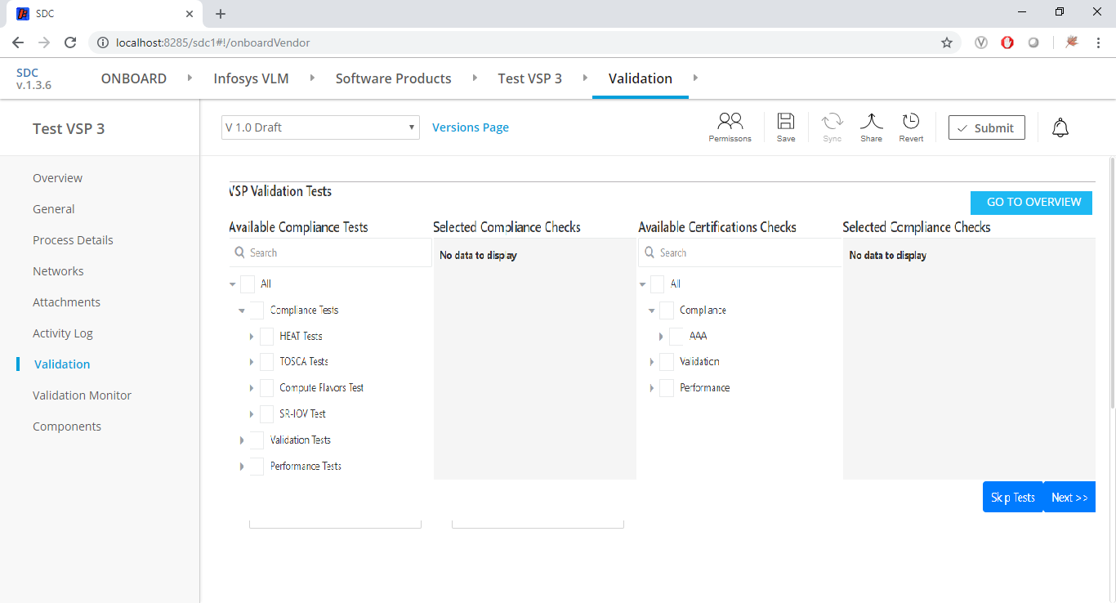
SDC | Validation Checks Selection Screen
Two tabs “Compliance & Certification Checks” and “Inputs”. This layout is for first tab.
User can skip tests. BAU VSP validations will still be executed.

Slide 8
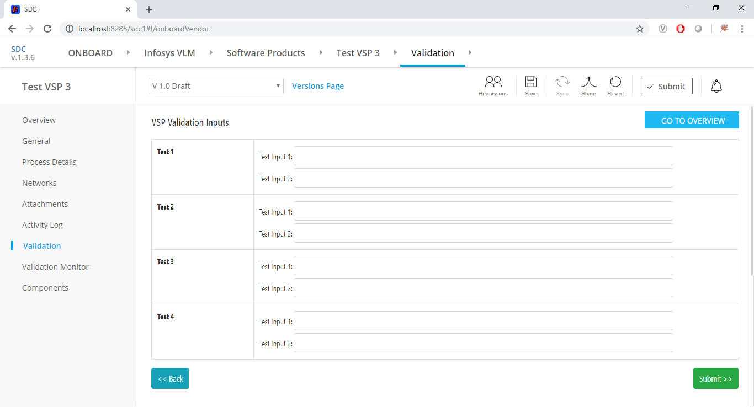
SDC | Validation Checks Inputs Screen
Two tabs “Compliance & Certification Checks” and “Inputs”. This layout is for second tab.
Submit Tests. Navigate to “Validation Monitor” screen.
Back to the first tab.

Slide 9
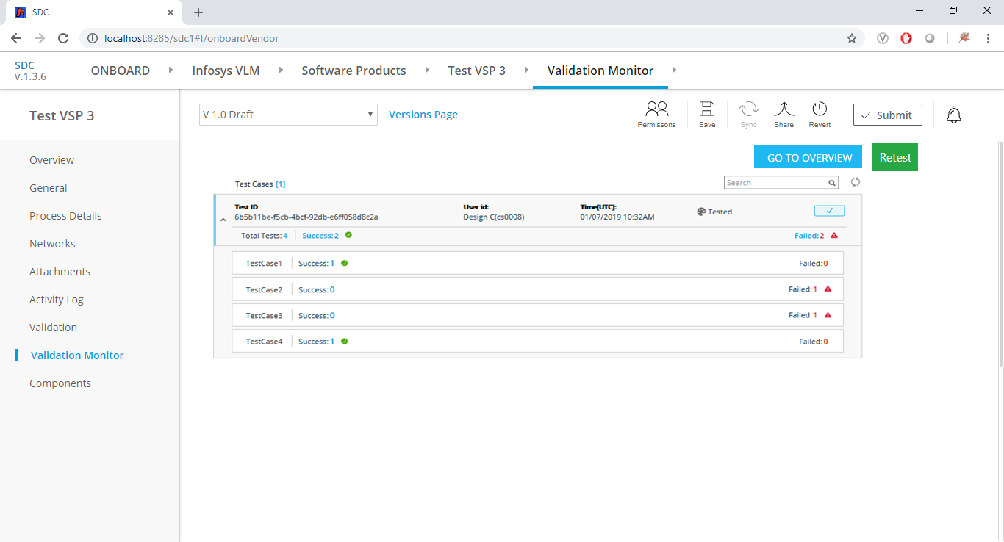
SDC | Validation Monitor Screen
Validation Monitor navigation option.
Optional – Retest of all/selected tests
Test Results – including the BAU SDC validation checks

Slide 10
SDC UI Flow Option 2

Slide 11
SDC | UI Option 2
Retain the “Validation” tab in “Attachments” section (AS-IS)
When user uploads VSP template and clicks on “Proceed to Validation”, the page navigates to the existing “Validation” tab. Adding an another button for Compliance and Certification Checks.

Slide 12
SDC | Upload VSP Template
User uploads VSP template

Slide 13
SDC | Proceed to Validation
Retain the Validation tab.
Navigate to BAU Validation tab.

Slide 14

SDC | Retain Validation Tab
Retain the Validation tab.
Validation Screen navigational link
Add this option navigate to “Validation” screens.

Slide 15
SDC | Validation Checks Selection Screen
Two tabs “Compliance & Certification Checks” and “Inputs”. This layout is for first tab.
User can skip tests. BAU VSP validations will still be executed.

Slide 16
SDC | Validation Checks Inputs Screen
Two tabs “Compliance & Certification Checks” and “Inputs”.This layout is for second tab.
Submit Tests. Navigate to “Validation Monitor” screen.
Back to the first tab.

Slide 17
SDC | Validation Monitor Screen
Validation Monitor navigational option.
Optional – Retest of all/selected tests
Test Results. Note: BAU VSP validation results will not be shown. They were already displayed in existing Validation tab.

