Slide 1
VSP Compliance
Vodafone Group iconectiv
Date: 04 December, 2018

Slide 2
Introduction
Currently, VNF compliance, validation and performance testing happens offline by the “tester” role in SDC. There is no unified mechanism of capturing the compliance details of VNF during the design time process.
The LFN CVC Vision is to provide a unified platform for vendors to perform compliance check, validation test and performance test for their VNFs and undergo a certification process.
Vendors can then distribute the pre-certified VNFs to operators. The operators can on-board these VNFs in ONAP and verify their compliance details by querying a central registry.
This proposal is to add a mechanism in ONAP SDC to query a central registry for VNF certification details and trigger ad-hoc tests to further confirm their integrity.

Slide 3
Rationale
Reduce the risk of VNFs failing to be deployed in the operator’s NFVI.
Allow the VSP on-boarding flow in ONAP to connect with industry standard certification program repositories such as OVP or third-party repositories to perform extra checks before onboarding. This will minimize the local tests required (or even be skipped completely)

Slide 4







Proposal
Pre-certified Vendor VSP
On-board
√
Add to
Resource
Catalogue
…
Designer
Check Compliance &
Certification
2
1
Query: Check what certification
VNF has
OVP
Unified Certification Repository/Portal
VNFs
√ Compliance A
X Compliance B
√ Validation A
X Validation B
√ Performance A
X Performance B
NFVI
√ Compliance A
X Compliance B
√ Validation A
X Validation B
√ Performance A
X Performance B
Certified
NFVI/VIM
VTP
Test
repository
Perform Ad-hoc
compliance check
(Submit for testing)
e.g. operator custom compliance check
Report

Slide 5
Proposal
Certification Query plugin into SDC
  Provide an option in ONAP VSP on-boarding flow (within SDC) to query a “certification repository” and check against certification exists for the onboarded VSP (VNF).
  Display the result/report from certification repository on screen and provide the user an option to proceed or re-submit the VSP.
  For current proposal - designer may be able to proceed anyway subject to BAU validation checks. In future we can block designer from proceeding in case of failures.
Compliance Checks plugin into SDC
  Provide an option in ONAP VSP on-boarding flow (within SDC) to invoke a compliance and validation checks against the on boarded VSP (VNF)
  Display the result/report on screen and provide user option to proceed or re-submit the VSP.
  For current proposal - designer may be able to proceed anyway subject to BAU validation checks. In future we can block designer from proceeding in case of failures.

Slide 6
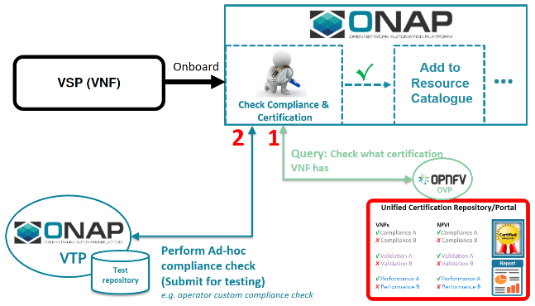
Proposal Summary
https://wiki.onap.org/pages/viewpage.action?pageId=45305743
Add dynamic checks within SDC to (1) Query a certification repository such as OVP to what certification a VNF has undergone and (2) invoke VTP to run custom Ad-hoc testing (checks) against VSP (VNF) prior accepting the VSP (VNF)
Allow queries to VTP and the OVP portal as well as to third-party repositories; thus the APIs will be designed to interoperate SDC with that range of end-points

Slide 7
Key Contributors
Item | Sub-Item | Contributor
Certification Query | SDC Frontend | Vodafone
 | SDC Backend | iconectiv
 | External Repository | iconectiv
Compliance checks | SDC Frontend | Vodafone
 | SDC Backend | iconectiv
 | External Registry | iconectiv

Slide 8
ONAP Project Impact
Project | Feature | ONAP support
SDC FE | Provide functionality on UI to select Certification Query and Compliance Check. The Compliance Check option to further show input parameters for the selected test cases. | Yes – Enhancements to BAU flow
 | Provide functionality on UI to monitor the status/progress of all validations (BAU SDC validation + Certification Query + Compliance Check) | Yes- Enhancements to BAU flow
SDC BE | New SDC BE plugin to invoke REST APIs provided by both Certification repository and registry to support the Certification query as well as Compliance and Certification options selected by user on GUI. | No – New feature

Slide 9
SDC Frontend

Slide 10
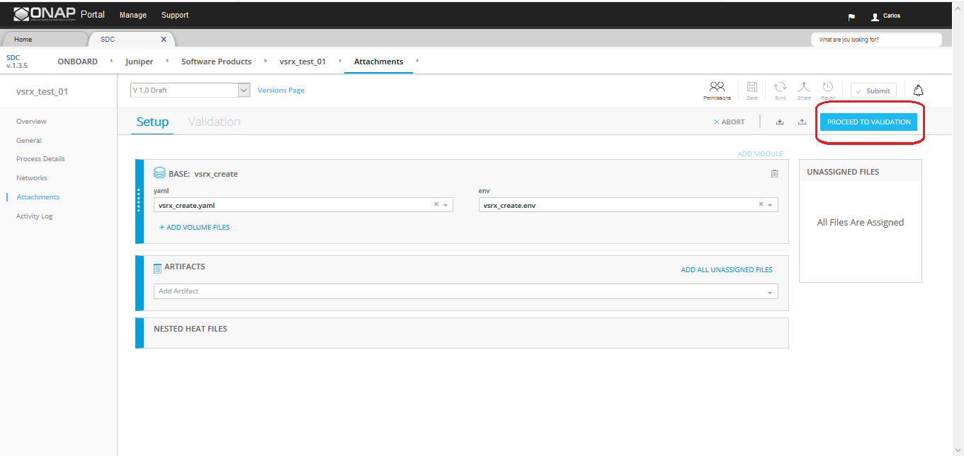
SDC Validation Trigger

Slide 11
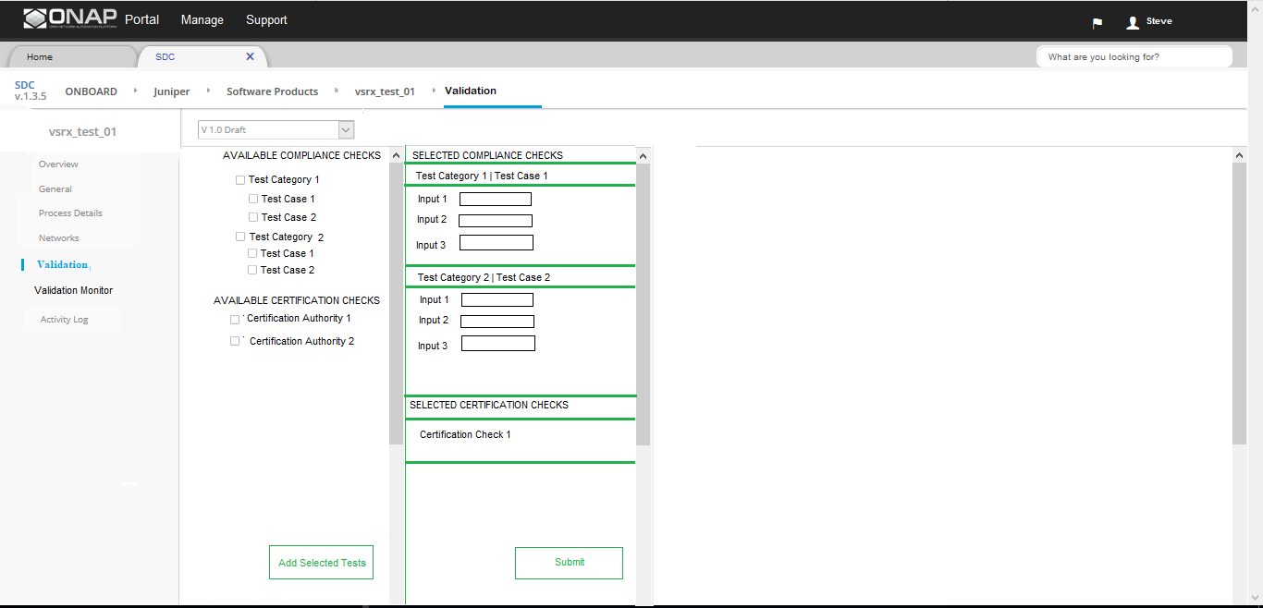
SDC Submit Certification and Compliance Checks

Slide 12
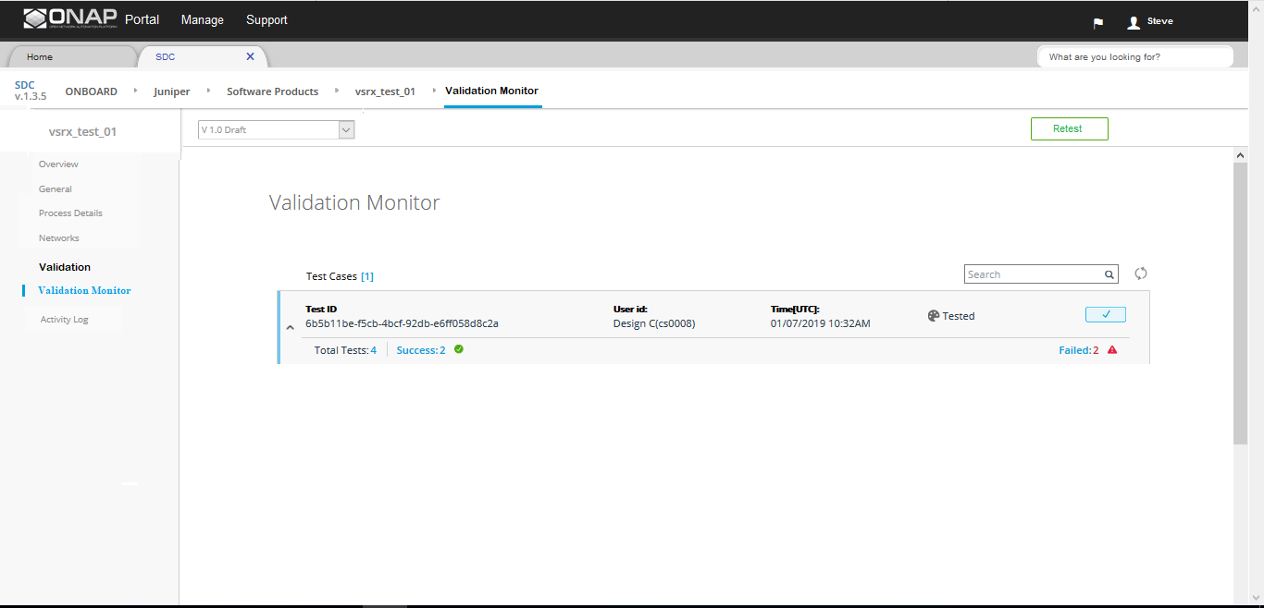
SDC Monitor Validation Summary

Slide 13
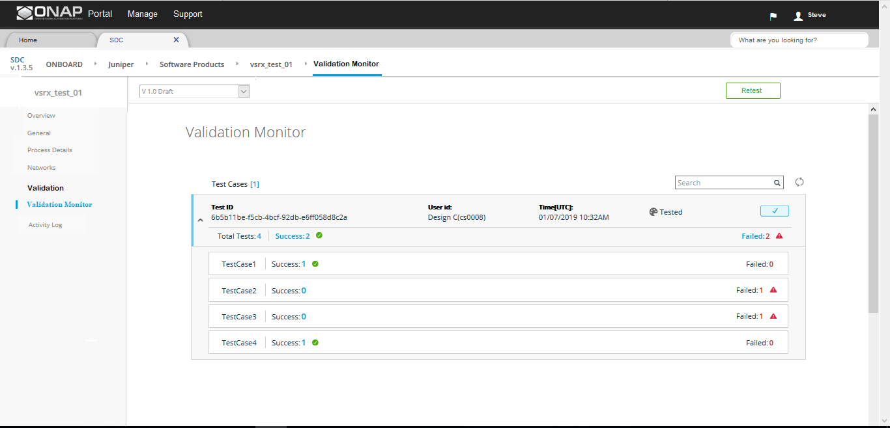
SDC Monitor Validation Details

Slide 14
Execution
Phase I (Dublin Release):
  Registry will be deployed as an external component
  Designer may be able to proceed even if there are failures in compliance/certification checks. Re-submitting the VSP is made optional. However, BAU validation checks built into SDC will still follow BAU flow.
  Future Enhancement Phases:
  Registry to be merged into VTP project.
  Designer will have to re-submit VSP template in case of validation failures for the certification/compliance checks.

Slide 15
JIRA
Issue ID | Description | Link
SDC-1956 | Currently, Metadata values passed by VSR package can contain values that are either not compliance to ONAP standards or not compatible with the installed VID environment that can lead to deployment failures. This proposal proposes to add dynamic checks within SDC to be able to check passed metadata values against a registry that contains the check criteria. the content of the registry can be pre-loaded with standard static criteria, but also can be configured to add custom checks that are related to specific VID deployments. | https://jira.onap.org/browse/SDC-1956

Slide 16
Certifications Query Backend

Slide 17
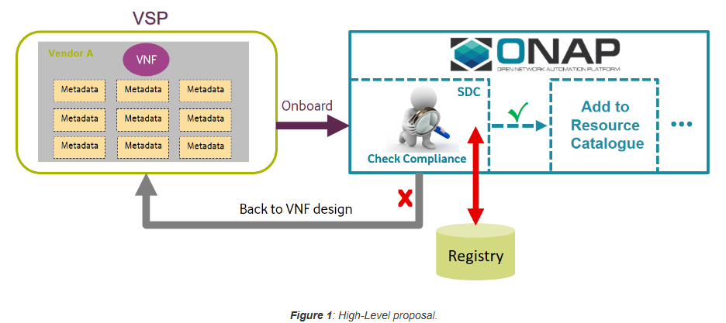
Software Modules
plug-in
Certifications query
iconectiv
hosted
repository

Slide 18
SDC Designer Onboarding Flow
Pre-certified Vendor VSP
On-board
√
Add to
Resource
Catalogue
…
Check Compliance &
Certification
Designer
plug-in
2
1
Query: Check what certification
VNF has
iconectiv
hosted
repository
OVP
Unified Certification Repository/Portal
VNFs
√ Compliance A
X Compliance B
√ Validation A
X Validation B
√ Performance A
X Performance B
NFVI
√ Compliance A
X Compliance B
√ Validation A
X Validation B
√ Performance A
X Performance B
Certified
NFVI/VIM
VTP
Test
repository
Perform Ad-hoc
compliance check
(Submit for testing)
e.g. operator custom compliance check
Report

Slide 19
Design Time Flow
mimic/leverage existing VTP API specification
Registry
Example report content:
  pass/fail results of VNF Template validation against data models, e.g. HEAT, ETSI SOL1 TOSCA
  pass/fail results of VNF validation against VIMs, container managers, e.g. OpenStack, Kubernetes
  pass/fail results of VNF performance tests, e.g. on GSMA standard profile NFVIs
SDC
plug-in FE
SDC
plug-in BE
request (VSPid)
request (VSPid)
fetch certifications report
return certifications report
response
(certifications report)
response
(certifications report)
for user action

Slide 20
Repository Data Provisioning of Certifications Metadata
Registry GUI or CLI
Registry Backend
External Systems
HTTP CRUD operations
POST API
GET API

Slide 21
Deliverables
CERTIFICATIONS QUERY: ONAP DESIGN, SOFTWARE AND DOCUMENTATION
SDC plug-in FE
  invokes query by BE
  displays certifications report to user for user-selectable decision on how SDC proceeds
SDC plug-in BE
  queries registry
  returns certifications report results to SDC plug-in FE
SDC-Repository interface specification
  mimic/leverage the existing VTP API
  design with awareness of OVP Portal as a future end-point
ACTION: what existing plug-in infrastructure can we build on?
SOFTWARE OUTSIDE OF ONAP
repository
  provisioning interface for VNF certifications data
  support SDC queries
  hosted by iconectiv during Dublin release cycle

Slide 22
Compliance Check

Slide 23
SDC Designer Onboarding Flow
Pre-certified Vendor VSP
On-board
√
Add to
Resource
Catalogue
…
Check Compliance &
Certification
Designer
plug-in
2
1
Query: Check what certification
VNF has
OVP
iconectiv
hosted
registry
Unified Certification Repository/Portal
or
VNFs
√ Compliance A
X Compliance B
√ Validation A
X Validation B
√ Performance A
X Performance B
NFVI
√ Compliance A
X Compliance B
√ Validation A
X Validation B
√ Performance A
X Performance B
Certified
NFVI/VIM
VTP
Test
repository
Perform Ad-hoc
compliance check
(Submit for testing)
e.g. operator custom compliance check
Report

Slide 24
Design Time Flow (part 1)
use existing VTP API specification
VTP/Registry
SDC
plug-in FE
SDC
plug-in BE
Example test cases:
- Compute flavor check as to whether it is supported by underlying NFVI … NFVIid would be an input parameter
- SR-IOV PCIe Pass Through to a specific Network Interface Card as to whether that is available in the underlying NFVI
request for test cases list (VSPid)
request for test cases list (VSPid)
fetch test cases list
response (test cases list)
response (test cases list)
request for input parameters (VSPid, user-selected test cases)
request for input parameters (user-selected test cases)
fetch input parameters list
for selected test cases
response (input parameters)
response (input parameters)

Slide 25
Design Time Flow (part 2)
use existing VTP API specification
VTP/Registry
SDC
plug-in FE
SDC
plug-in BE
request for compliance check
(VSPid, user-selected test cases, input parameters)
parse VNF template and extract VNF metadata
check VNF metadata against registry metadata
store pass/fail results for certifications queries
return pass/fail results
request VNF Template
request for compliance check (VSPid, user-selected test cases, input parameters, VNF Template)
response (pass/fail results)
Example test cases:
  Compute flavor check as to whether it is supported by underlying NFVI … NFVIid would be an input parameter
  SR-IOV PCIe Pass Through to a specific Network Interface Card as to whether that is available in the underlying NFVI
response (pass/fail results) for user action
response (no content)
or
async
response (no content)
response (pass/fail results)
response (pass/fail results) for user action

Slide 26
External Registry Data Provisioning of Compliance Metadata
Registry
GUI or CLI
Registry Backend
External Systems
Registry data
  list of test cases for user retrieval and selection
  list of test case input parameters for user retrieval to populate input parameters for the selected test cases
  test case compliance data, e.g., NFVI metadata
HTTP CRUD operations
POST API
PUT API (bulk import file)
GET APIs

Slide 27
Deliverables
NFV INFRASTRUCTURE COMPLIANCE CHECK: ONAP DESIGN, SOFTWARE AND DOCUMENTATION
SDC plug-in FE
  request list of selectable test cases that can be invoked
  request input parameter list for selected test cases
  request Compliance Check
  display results to user for user-selectable decision on how SDC proceeds
SDC plug-in BE
  pass FE request for list of selectable compliance cases that can be invoked to registry and return results to FE
  pass FE request for input parameter list for selected test cases to registry and return results to FE
  pass FE request for Compliance Check to registry, along with VNF Template from VSP, and return results to FE
SDC-Registry interface specification
  use the existing VTP API, to enable integration to VTP as a future end-point
ACTION: Rabi to supply the VTP API specification
ACTION: what existing plug-in infrastructure can we build on?
SOFTWARE OUTSIDE OF ONAP
Registry
  provisioning interface for CSP NFVI profile metadata
  support SDC queries
  parse VNF Template, support both HEAT Template and TOSCA VNF Descriptor
  hosted by iconectiv during Dublin release cycle
ACTION: what existing ONAP parsers can we use, e.g., from SDK
ACTION: confirm which TOSCA VNF Descriptor specification to use … ONAP AID, output of ONAP TOSCA Task Force?

