Slide 1




Modeling to Support Broadband Services
ONAP Modeling
Nov 20 2018 version 1

Slide 2

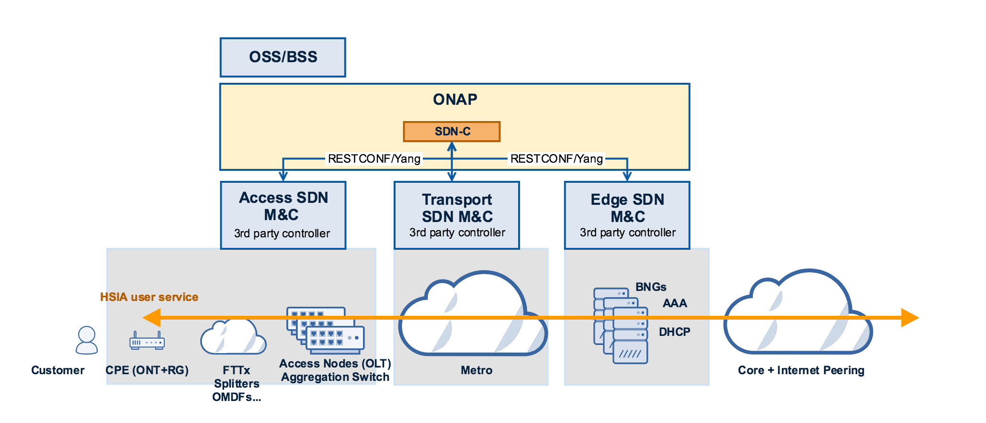
BBS Resources
Transport Network (NF)
(Not used)
<<PNFExtCP>>
ONT
NNI
<<VNFExtCP>>
PON
UNI
<<VNFExtCP>>
OLT
NNI
<<VNFExtCP>>
BNG
UNI
<<VNFExtCP>>
BNG
NNI
Premises
Connectivity
NF
Access
Connectivity
NF
Edge
Connectivity
NF

Slide 3
BBS Resources to PNF, VNFs and Services
Access
SDN M&C
VNF
Edge
Connectivity
VNF
<<PNFExtCP>>
ONT
NNI
<<VNFExtCP>>
PON
UNI
<<VNFExtCP>>
OLT
NNI
<<VNFExtCP>>
BNG
UNI
<<VNFExtCP>>
BNG
NNI
Premises
Connectivity
NF
Access
Connectivity
NF
Edge
Connectivity
NF
ONT
PNF
PON Access
RFS
Transport
RFS
Internet Access
RFS
HSIA
CFS

Slide 4
BBS Premises Detail
<<PNFExtCP>>
ONT
NNI
Premises
Connectivity
NF
ONT NNI: No additional attributes
ONT
PNF
ONT PNF: Vendor, Serial Number, EquipmentID (type), version

Slide 5
BBS Access Detail
Access
SDN M&C
VNF
Access SDN M&C VNF: No unique attribute
<<VNFExtCP>>
PON
UNI
<<VNFExtCP>>
OLT
NNI
PON UNI: OLT ID, Slot ID, Port ID
Fiber Access attributes:
OTO ID
OMDF connector
Splitting ratio
OLT NNI: OLT ID, Slot ID, Port ID
SVLAN_ID
Access
Connectivity
NF

Slide 6
BBS Edge Detail
Edge
Connectivity
VNF
vBNG
VNFC
vAAA
VNFC
vDHCP
VNFC
<<VNFExtCP>>
BNG
UNI
<<VNFExtCP>>
BNG
NNI
Edge
Connectivity
NF
BNG UNI: SVLAN-ID
BNG NNI: IP Address

Slide 7
BBS RFS Attributes
<<VL>>
PON Access
RFS
<<VL>>
Transport
RFS
Internet Access
RFS
PON UNI
Service Type
Upstream Bandwidth
Downstream Bandwidth
CVLAN-ID
A-OLT Name
OLT Slot
OLT Port
ONT Number
ONT Port
OLT NNI
SVLAN-ID
A-OLT Name
OLT Slot
OLT Port
OLT NNI
SVLAN-ID
A-OLT Name
OLT Slot
OLT Port
BNG UNI
SVLAN-ID
VTEP (Tunnel Endpoints):
? To be defined
AAA Policy: ?
DHCP Entry: ?
BNG Entry: ?
BNG NNI:
IP Address

Slide 8
REFERENCES / APPENDIX / BACKUP SLIDES

