Slide 1
CCVPN based Service Function Chaining (SFC)
Aug. 16th, 2019

Slide 2
CCVPN based Service Function Chaining
Description
A network service chaining (SC or SFC), is a capability that uses SDN capabilities to create a service chain of connected network services and connect them in a virtual chain. This capability can be used by SP to set up catalogs of connected services that enable the use of a single network connection for many services, with different characteristics.
This extension use case can be employed in data centers (chaining virtual or physical network functions), carrier networks (services for S/Gi-LANs), and virtual customer edge, including virtual customer premises (vCPE) deployments.
Benefits
One of the benefits of SF, when used in combination with SDN, is optimizing the use of network resources and improving application performance. SDN analytics and performance tools can use the best available network resources and help negotiate around network congestion issues – all in an automated fashion.
Notes:
JIRA Ticket ：https://jira.onap.org/browse/TEST-127?filter=-2

Slide 3

CCVPN based Service Function Chaining
Service Chain Description
vCPE
vFW
vBRAS
Service classifier
Service classifier
Fixed access network
BNG
Internet
SDN
SFC and SDN network service chaining standards are being developed in several industry groups. The Internet Engineering Task Force (IETF) is developing a service function chaining (SFC) architecture to define how network flow classification can be used to route traffic between service functions. The European Telecommunications Standards Institute (ETSI) has a service architecture that uses network forwarding graphs to route traffic between virtual network functions (VNFs) with a network service header. And the Open Networking Foundation(ONF) has proposed a software-defined networking, SDN service chaining framework using OpenFlow.
Notes:
JIRA Ticket ：https://jira.onap.org/browse/TEST-127?filter=-2

Slide 4

CCVPN based Service Function Chaining
Overall Diagram
Scenario:
We would like to see ONAP can provide the capability of above functions. For example, based on the current CCVPN and vFW use case, when customer get service like CCVPN established and want add vFW service, ONAP can automate the way virtual network connections being set up to handle traffic flows. In this case, the SO and SDNC could take chain of services and apply them to different traffic flows depending on the source, destination or type of traffic, which may require a number of manual steps in traditional way.
ONAP
SDNWAN-Controller
Site Service
Site Service
vFW
CPE
vCPE
vBRAS
…
SD-WAN VPN Infra Service
Notes:
JIRA Ticket ：https://jira.onap.org/browse/TEST-127?filter=-2

Slide 5
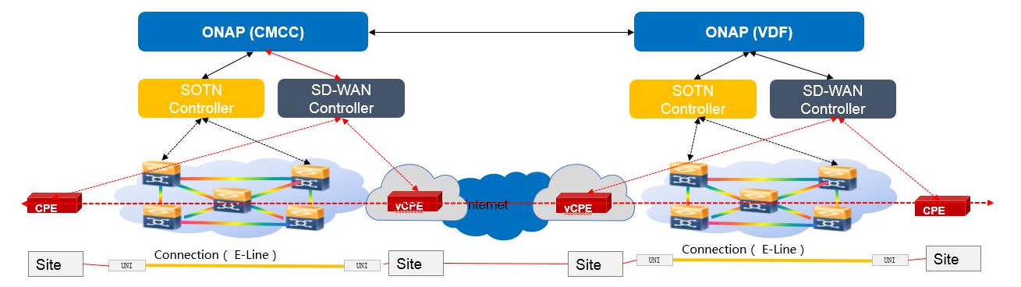
CCVPN based Service Function Chaining
SFC domain
SFC domain

Slide 6
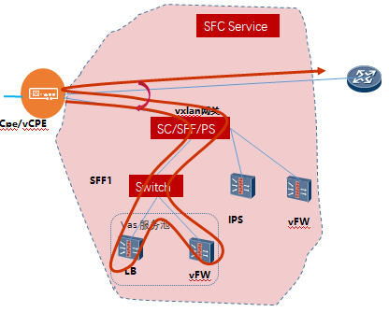
CCVPN based Service Function Chaining
Implementation in ONAP
SFC Service
VNFs：
Processing in ONAP ：
Requirements for ONAP:
one VNF implement SFF function ： SFF has both SC and PS capabilities , meanwhile as a VXLAN gateway.
Other three VNFs：SFF1、LB、vFW
create SFC Service
Distribute to SO、A&AI、VFC等
VNF onboard：SFF、SFF1、LB、vFW
Create VXLAN tunnels ：CPE---SFF，SFF---SFF1
Support SFC service loading dynamically
Support SFC Service LFC management
20

Slide 7
CCVPN SFC Service Instantiation Flow
Notes:
JIRA Ticket ：https://jira.onap.org/browse/TEST-127?filter=-2

Slide 8
CCVPN SFC Service Instantiation Flow
0. SDC design NS with SFC，NS manually written，then put into SDC
1. UUI--->SO: Update CCVPN service with adding new NS
2. SO--->AAI,SDC Catalog: Query AAI and Get Svc Template from SDC Catalog
3. SO--->VFC: Create & Instantiate NS instance (including SFC)
4. VFC--->SDC Catalog: download NS package and VNF package
5. VFC: Calculate SFP
6. VFC: Create NS, VNF,VL
VFC --->MCloud : create VM, network,..... --->openstack,....
7. VFC : create VNFFG,SFC
VFC --->MCloud : port pair, port chain, ... ---->openstack,....
8.VFC ---->AAI: Save resource data to the database
Notes:
JIRA Ticket ：https://jira.onap.org/browse/TEST-127?filter=-2

Slide 9
Thank you!
Notes:
JIRA Ticket ：https://jira.onap.org/browse/TEST-127?filter=-2

