Slide 1
CLAMP Flows for vCPE Use Case in ONAP R1
Ron Shacham AT&T
DRAFT

Slide 2
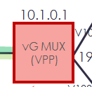
vCPE Runtime Flow R1 - ONSET
Closed Loop Flow
(3) Signature
Drools Policy
(2) VES PM
DMaaP
TCA
PDP
DMaaP
(1) VES
PM
(4) App-C API
Call
CDAP
VES
Collector
DMaaP
Docker
DCAE
Action Execution
(4.5) Gather VM
data
(5) Nova Restart VM
App-C
vGMUX emits VES packet-loss metric not equal to 0
VES Collector forwards message on DMaaP
TCA detects threshold for packet loss and creates
signature for ONSET of condition
(4) Policy matches message’s Control Loop ID to existing
Operational Policy, Sends App-C request for restart VM
(5) App-C sends NOVA command to restart VM
A&AI

Slide 3
vCPE Runtime Flow R1 - CLEAR
Closed Loop Flow
(3) Signature
Drools Policy
(2) VES PM
DMaaP
TCA
PDP
DMaaP
(1) VES
PM
CDAP
VES
Collector
Docker
DCAE
Action Execution
vGMUX emits VES packet-loss metric equal to 0
VES Collector forwards message on DMaaP
TCA detects threshold for packet loss and creates
signature for CLEAR of condition; Policy sends no
further actions to App-C
App-C

Slide 4
Deployment Steps
VES Collector and TCA DCAE Onboarding
CLAMP Closed Loop Configuration
CLAMP Closed Loop Deployment
CLAMP Closed Loop Update

Slide 5
Deployment Steps
VES Collector and TCA DCAE Onboarding
CLAMP Closed Loop Configuration
CLAMP Closed Loop Deployment
CLAMP Closed Loop Update

Slide 6
VES Collector and TCA DCAE Onboarding
Collector and Microservice teams provide onboarding information (Component Spec)
  Metadata
  Interfaces (i.e. DMaaP subscribe/publish)
  Configuration Parameters
  Auxiliary Details
  List of Artifacts
This information is used to generate a blueprint (template for use in CLAMP) and Policy definition

Slide 7
Deployment Steps
VES Collector and TCA DCAE Onboarding
CLAMP Closed Loop Configuration
CLAMP Closed Loop Deployment
CLAMP Closed Loop Update

Slide 8
CLAMP Cockpit
Configuration
Instantiation
Monitoring (Dashboard)
  Statistics about Control Loop
  Visualization
Lifecycle Management
  Stop/Restart Control Loop Operation, Update Configuration

Slide 9
2
User
chooses Svc/
VNF, Template
SDC
3
10
Query services,
VNFs, Templates
4
1
5-6
User
configures
CL – Includes Threshold Rules
and Operational Policies
Test, Certify,
Distribute
Get VES onboarding YAML file
8-9
User
creates
CL
Push blueprint as artifact
(Includes Threshold Rules)
CLAMP Cockpit
11
13
Create and
activate
policies:
TCA
(Includes
Threshold Rules)
and
Operational
7
Policy
Engine
Service Change Handler
12
DCAE NB Interface
DCAE Inventory
Cloudify
(includes plugins)
CDAP Broker
Databus Controller
VES Collector
DCAE
Docker
CDAP

Slide 10
CLAMP Closed Loop Configuration
Step 1: User Creates Closed Loop Model
Step 2: CLAMP queries available service and resources in ASDC catalog. CLAMP also queries available closed loop TOSCA-based templates for configuration
Step 3: User chooses vCPE Service and vGMUX Resource, and VES/TCA template
Step 4: CLAMP downloads VES Onboarding YAML file for vGMUX VNF type

Slide 11
CLAMP Cockpit
vCPE
VNF
vGMUX
VES Collector
TCA
Topic
Operational Policy
Topic

Slide 12
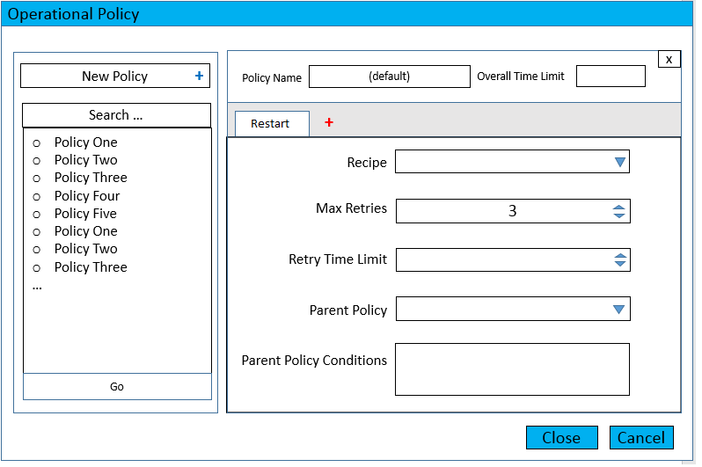
CLAMP Cockpit
vCPE
VNF
vGMUX
VES Collector
TCA
Topic
Operational Policy
Topic

Slide 13
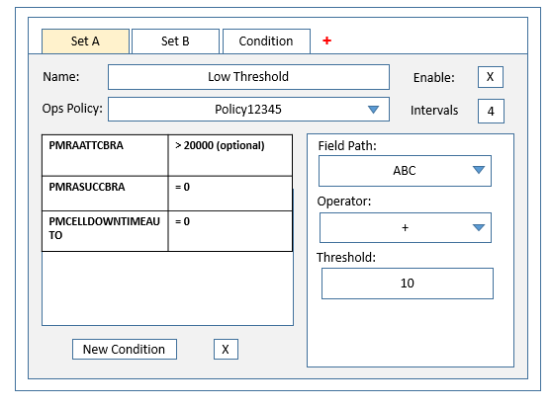
CLAMP Cockpit
vCPE
VNF
vGMUX
VES Collector
TCA
Topic
Operational Policy
Topic

Slide 14
CLAMP Closed Loop Configuration
Step 5: User goes to Operational Policy box, clicks, and creates a new Operational policy. Chooses chain of actions to execute for auto-healing of VM (Restart VM). Saves the policy as Signature1_OpsPolicy
Step 6: User goes to TCA box, and defines the threshold rules, based on available KPIs in VES Onboarding YAML file (downloaded in Step 4). He associates each threshold configuration with the operational policy created earlier, Signature1_OpsPolicy

Slide 15
CLAMP Closed Loop Configuration
Step 7: CLAMP creates separate policies
  Operational (Drools) policy A: ClosedLoopControlName 11111
  TCA Microservice policy referring to ClosedLoopControlName 11111
Step 8: CLAMP generates blueprint based on template downloaded earlier from ASDC. This blueprint includes the correlation rules
Step 9: CLAMP uploads blueprint to ASDC
Step 10: ASDC Service is checked in, tested, certified and distributed
Step 11: Distribution event is sent by ASDC over DMaaP and handled by Service Change Handler (SCH).

Slide 16
CLAMP Closed Loop Configuration
Step 12: A new DCAE Service Type is created in Inventory; stored by Service UUID, resource UUID, artifact Name

Slide 17
CLAMP Closed Loop Configuration
Step 13: CLAMP continually queries for distribution information about control loop
  Query DCAE Service Types for an entry with:
    Service Invariant UUID
    Resource Invariant UUID
    Artifact name
  If an entry is found:
    Transition Control Loop status to “Distributed”
    Store Type ID (dcaeTypeId) for future use, associate it with Control Loop model

Slide 18
Deployment Steps
Holmes DCAE Onboarding
CLAMP Closed Loop Configuration
CLAMP Closed Loop Deployment
CLAMP Closed Loop Update

Slide 19
ASDC
User
chooses to
deploy
15
Deploy closed loop
16,19
CLAMP Cockpit
20,21
Policy
Engine
Service Change Handler
DCAE NB Interface
17
DCAE Inventory
18
Record new instance of control loop
Cloudify
(includes plugins)
CDAP Broker
Databus Controller
VES Collector
TCA
DCAE
Docker
CDAP

Slide 20
Deployment Steps
Holmes DCAE Onboarding
CLAMP Closed Loop Configuration
CLAMP Closed Loop Deployment
CLAMP Closed Loop Update

Slide 21
ASDC
4,5
Disable Ops
Policy,
Re-enable Ops
Policy
Undeploy closed loop
1
6,8,9
CLAMP Cockpit
Update TCA
Config policy
Policy
Engine
Service Change Handler
DCAE NB Interface
DCAE Inventory
2
7
DCAE/Policy Interface
Cloudify
(includes plugins)
3
Databus Controller
TCA
DCAE
CDAP

Slide 22
BACKUP SLIDES

