Slide 1
VF-C Weekly Meeting
Yan Yang
Dec 24 , 2018

Slide 2
Agenda
VF-C committer adjustment
VF-C database migration discussion with OOM team
VF-C Vulnerability Casablanca Release
VF-C requirements collection for Dublin release
Other topics

Slide 3
VF-C committer adjustment
Removed Committer: Xiaodong Ning, Yufei Zhou
New Committer: Li Lai , Bharath Thiruveedula, Ruoyu Ying

Slide 4
VF-C database migration discussion
VF-C DB current implementation (Jinhua )
Discussion

Slide 5
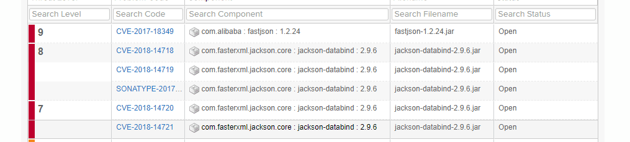
VF-C Vulnerability Casablanca release (1/4)
Critical Security Issues (Level 7 to 10)
https://wiki.onap.org/pages/viewpage.action?pageId=45310630
Emsdriver

Slide 6
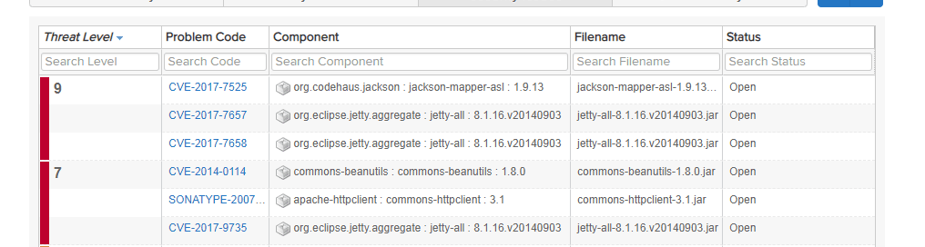
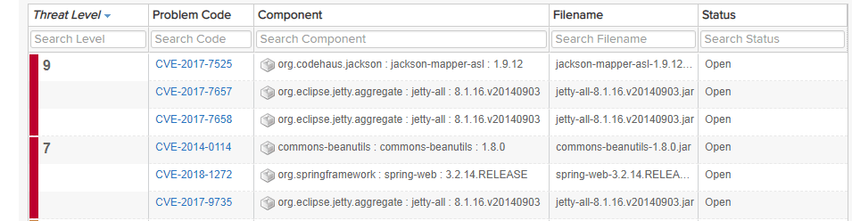
VF-C Vulnerability Casablanca release(2/4)
huawei-svnfm-driver
Multivim-proxy

Slide 7
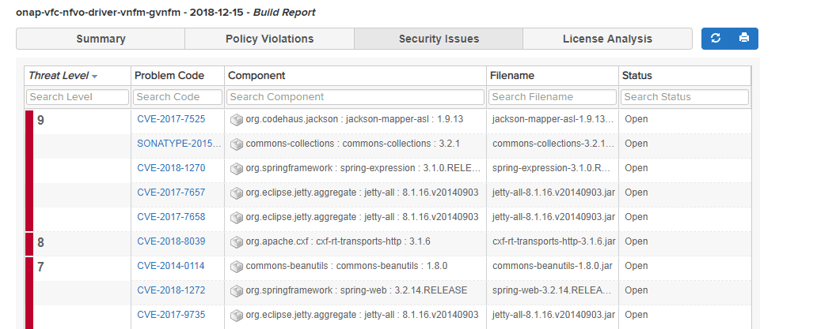
VF-C Vulnerability Casablanca release(3/4)
JuJu-gvnfm-driver

Slide 8
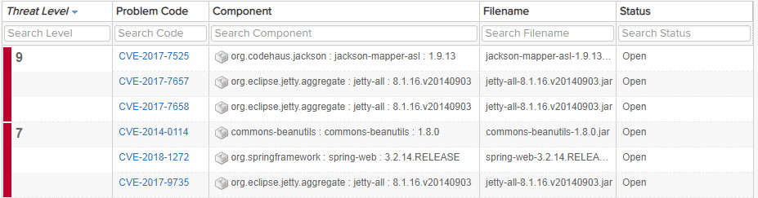
VF-C Vulnerability Casablanca release(4/4)
Resmanagement
Two jira tickets to track:
https://jira.onap.org/projects/VFC/issues/VFC-1204?filter=allopenissues
https://jira.onap.org/projects/VFC/issues/VFC-1203?filter=allopenissues
For “jackson” libraries , Security subcommittee suggest to replace “jackson” libraries with GSON. And the reason is that GSON is a comparable package and a replacement strategy for ONAP.
[Requirement] All projects MUST migrate from the Jackson Data Processor packages to the GSON packages unless the Jackson dependency is inherited from an outside project such as ODL.

Slide 9
VF-C requirements collection for Dublin release
https://wiki.onap.org/display/DW/VF-C+requirements+collection+for+Dublin+release

Slide 10
Other Topics
Bump VF-C version to 1.3.0 in master branch
VNFM driver optimization

