Slide 1


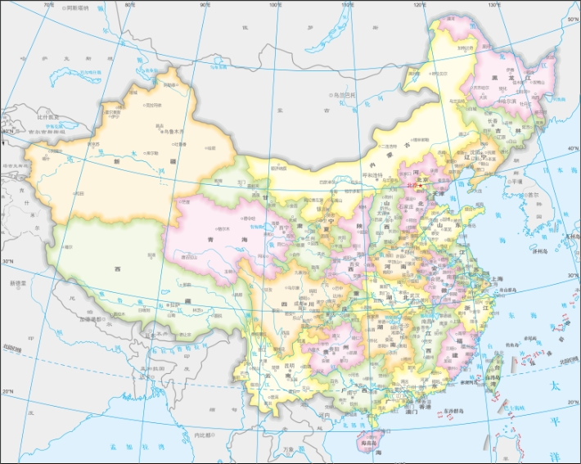
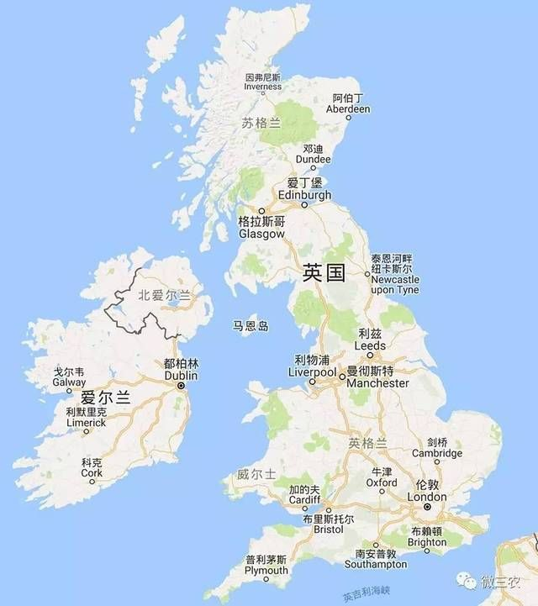



ONAP-Powered Connectivity Service: CCVPN Demo
Cross Operator, Cross Domain, Cross Layer VPN Service
ONAP(CMCC)
ONAP(VDF)
OTN Controller
OTN Controller
SD-WAN
Controller
SD-WAN
Controller
OTN Controller
OTN
Domain1
OTN
Domain2
OTN
Domain
CPE
vGW
vGW
CPE
L3 PNF
L2 Underlay (EoODU)
L3 VNF
Handoff
Handoff
L3 VNF
L2 Underlay (EoODU)
L3 PNF
CCVPN Service

Slide 2
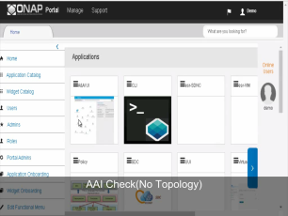
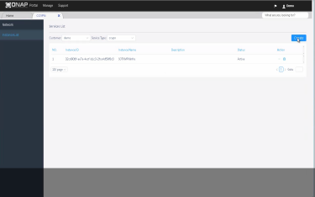
How CCVPN works with ONAP
Topology Discovery
Service Provisioning
Closed Loop
UUI
CCVPN templates
UUI
CCVPN templates
ONAP External APIs
ONAP External APIs
rules
rules
BPMNs
rules
rules
BPMNs
DCAE
Policy Framework
SO
A&AI/ESR
DCAE
Policy Framework
SO
A&AI/ESR
SDN-C
DGs
SDN-C
DGs
OTN Controller
OTN Controller
SD-WAN
Controller
SD-WAN
Controller
OTN Controller
OTN
Domain1
OTN
Domain2
OTN
Domain1
CPE
vGW
vGW
CPE
Beijing
London
Topology
Discovery
Service
Provisioning

Slide 3
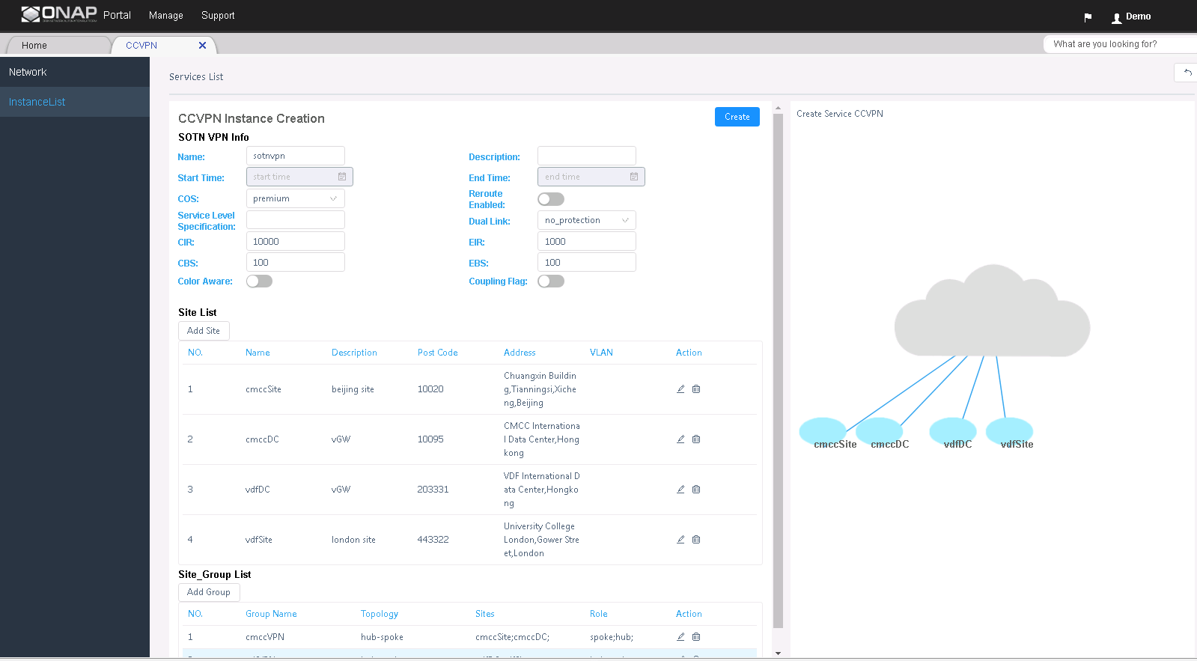
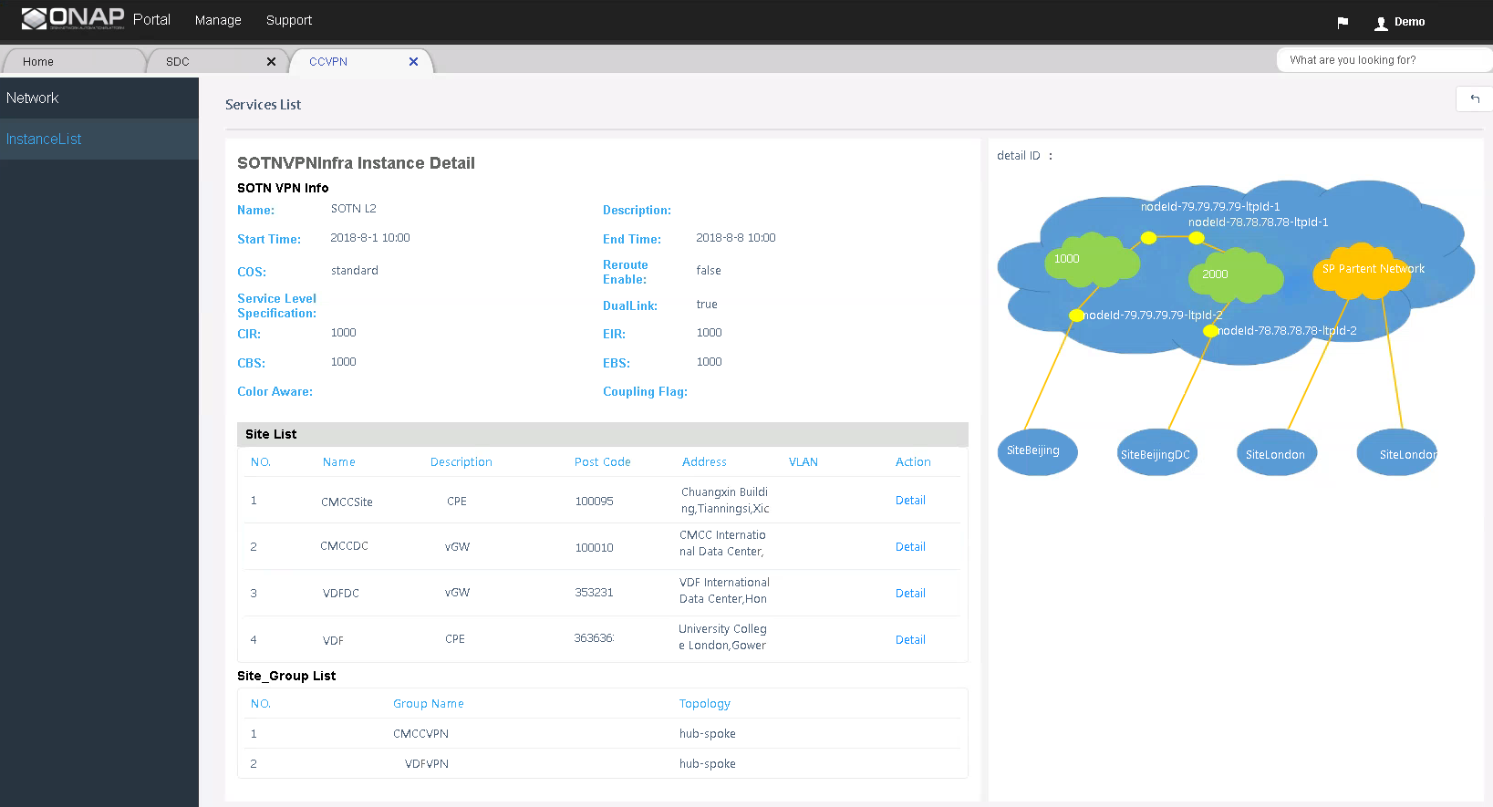
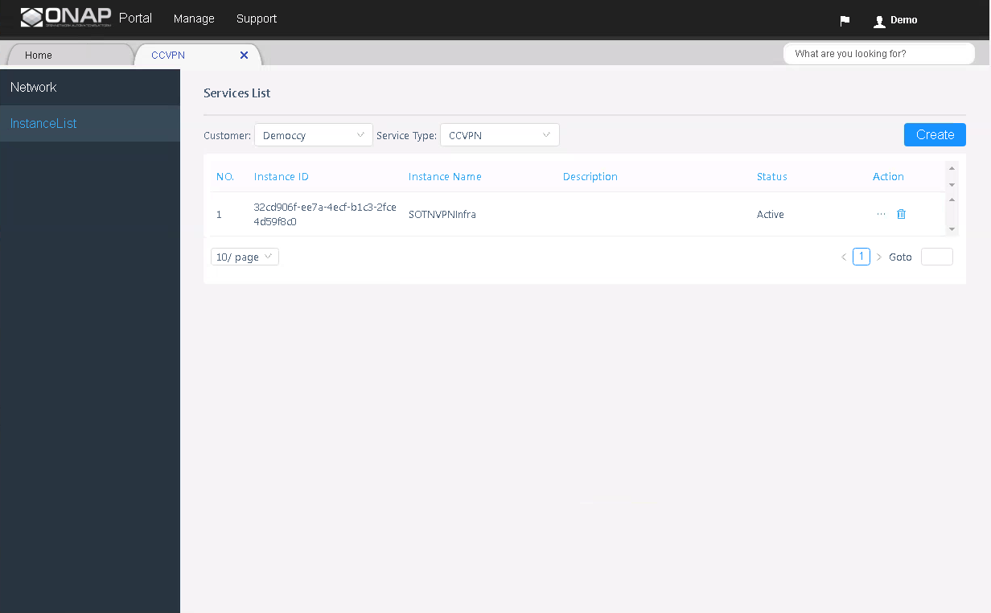
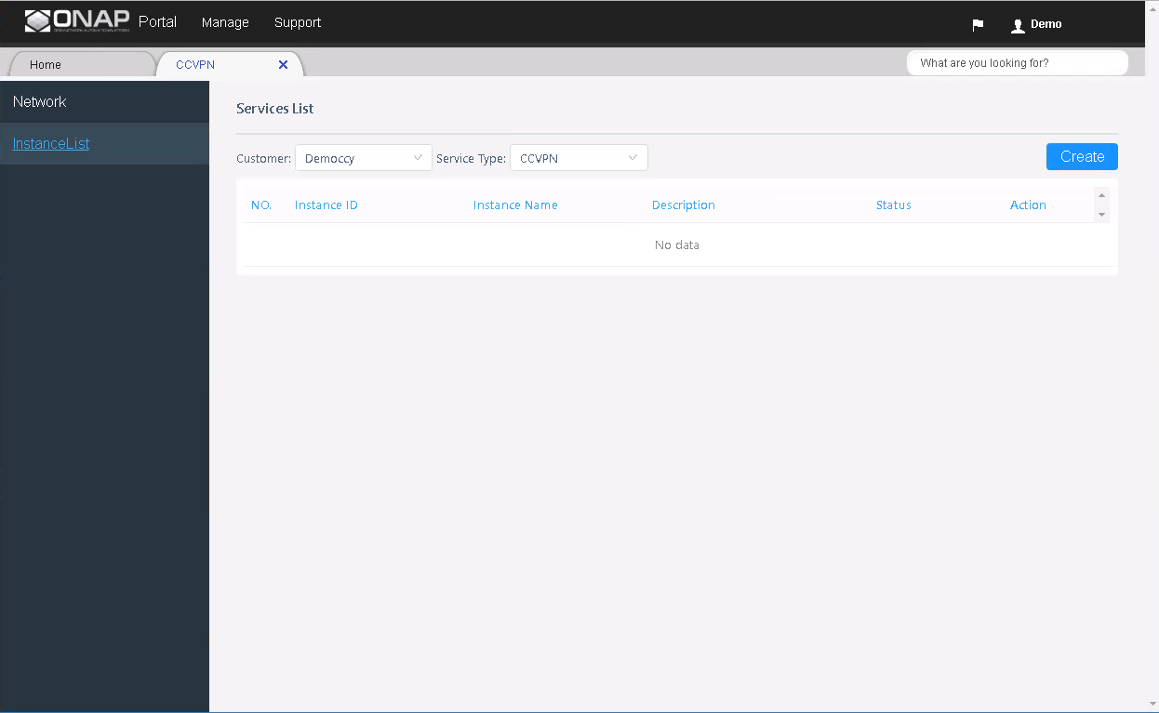
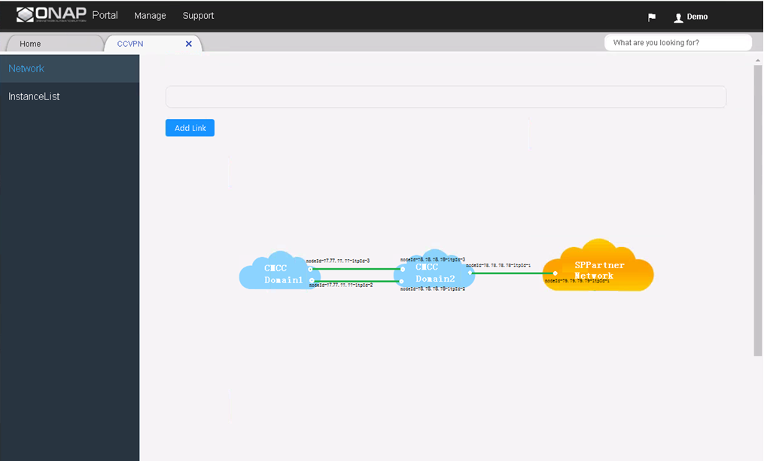
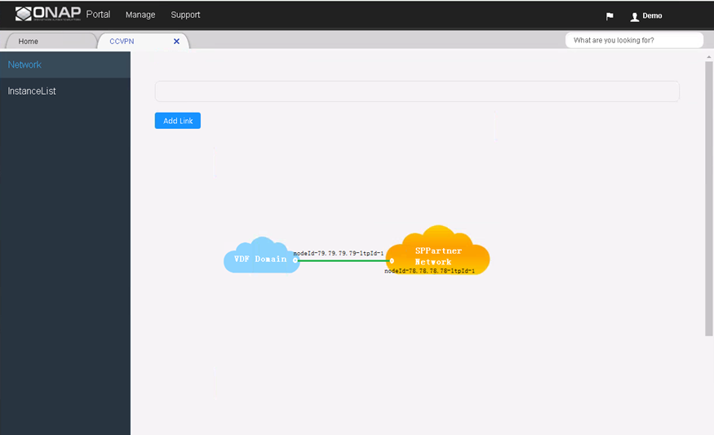
How CCVPN works with ONAP
Cross link2
Cross link1
Topology Discovery
Service Provisioning
Closed Loop
OTN Controller
OTN Controller
SD-WAN
Controller
SD-WAN
Controller
OTN Controller
OTN
Domain1
OTN
Domain2
OTN
Domain1
CPE
vGW
vGW
CPE
London

Slide 4
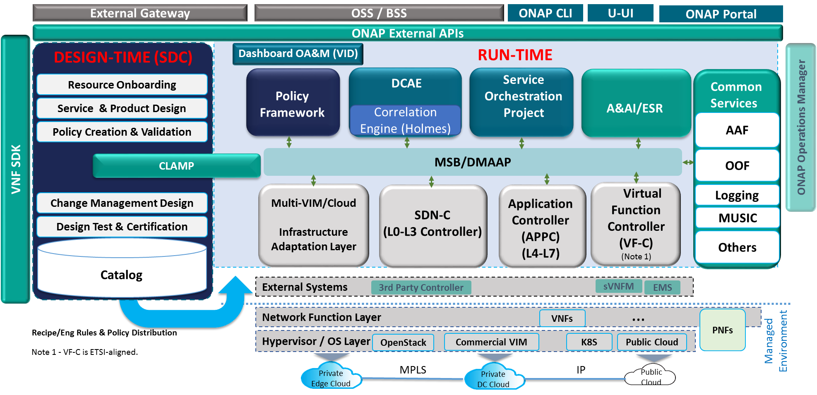

How to make it work: Codeless Solution For CCVPN
1
2
4
3
OTN Controller
OTN Controller
SD-WAN
Controller
OTN
Domain1
OTN
Domain2
CPE
vGW
4 steps to develop CCVPN on ONAP:
Control Logic Design(BPMN/DG)
Analysis/Policy Rule Design
1
Model-based VF Onboarding
2
Service Design
3
4

Slide 5
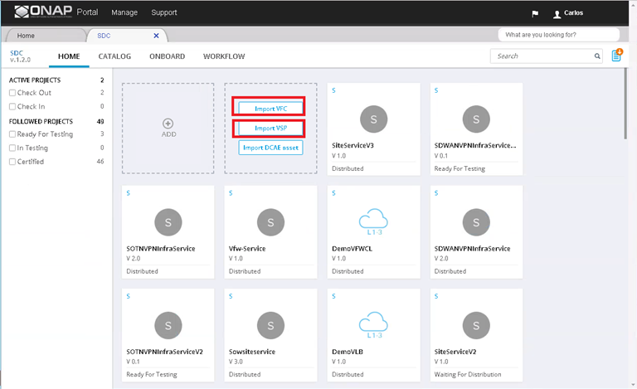
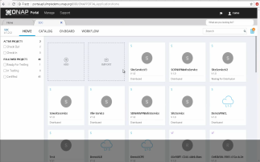
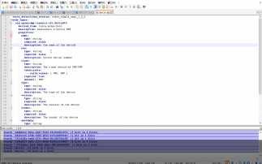
Step1: Model-based Resource Onboarding
CCVPN analysis and decompose scenario to resource definitions
Onboard VNF/Configuration as VF resource
Test VF
VNFs
ONAP(CMCC)
ar1000V.csar
Configurations
OTN Controller
OTN Controller
SD-WAN
Controller
Site.yml
Sotn connectivity.yml
Device.yml
SDWAN connectivity.yml
OTN
Domain1
OTN
Domain2
Sitewan.yml
CPE
vGW
Sitelan.yml
L3 PNF
L2 Underlay (EoODU)
L3 VNF
Sppartner.yml
VNF onboarding
Configuration onboarding

Slide 6
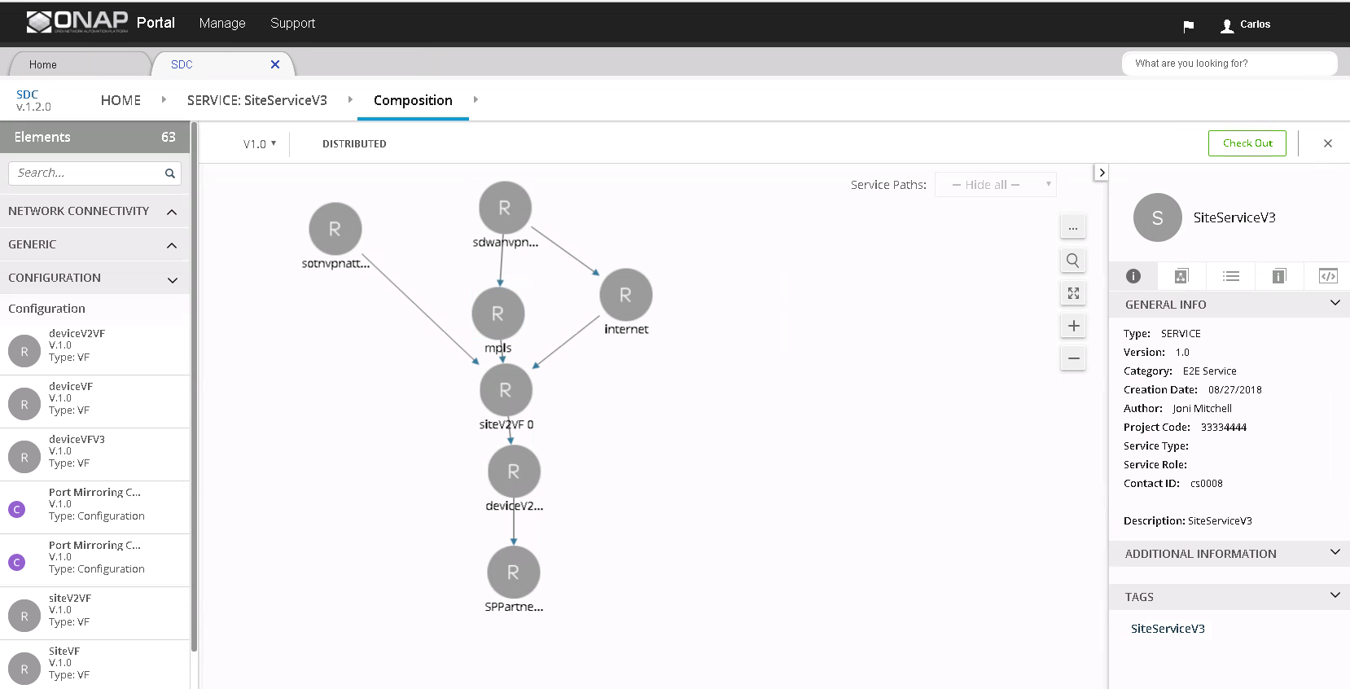
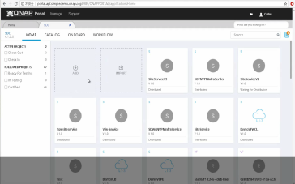
Step2: Service Design
Design service composited by resources
Test service
Distribute service template to run time
Service
Design

Slide 7
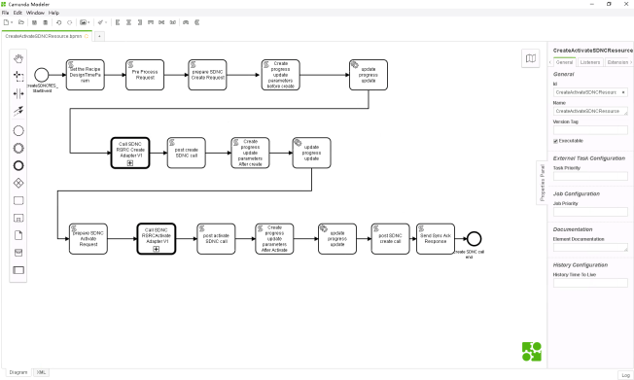
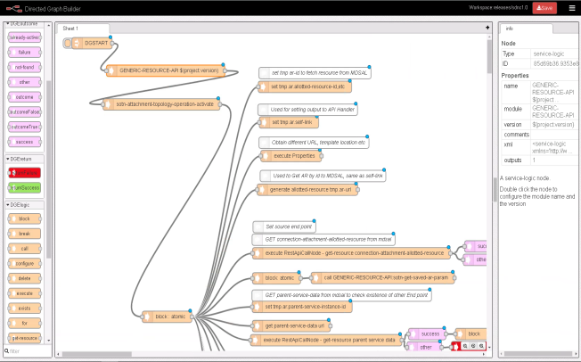
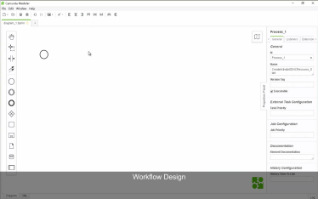
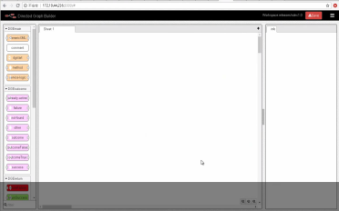
Step3: Service/Resource Flows Design (BPMN/DG)
Service/Resource BPMN workflow design (Vendor Agnostic)
Resource instance DG flow design (Vendor Adaption)
Upload BPMN to SO
Upload DG to SDN-C
Service/Resource workflow design(BPMN)
Resource flow design(DG)
BPMN
Design
DG
Design

Slide 8
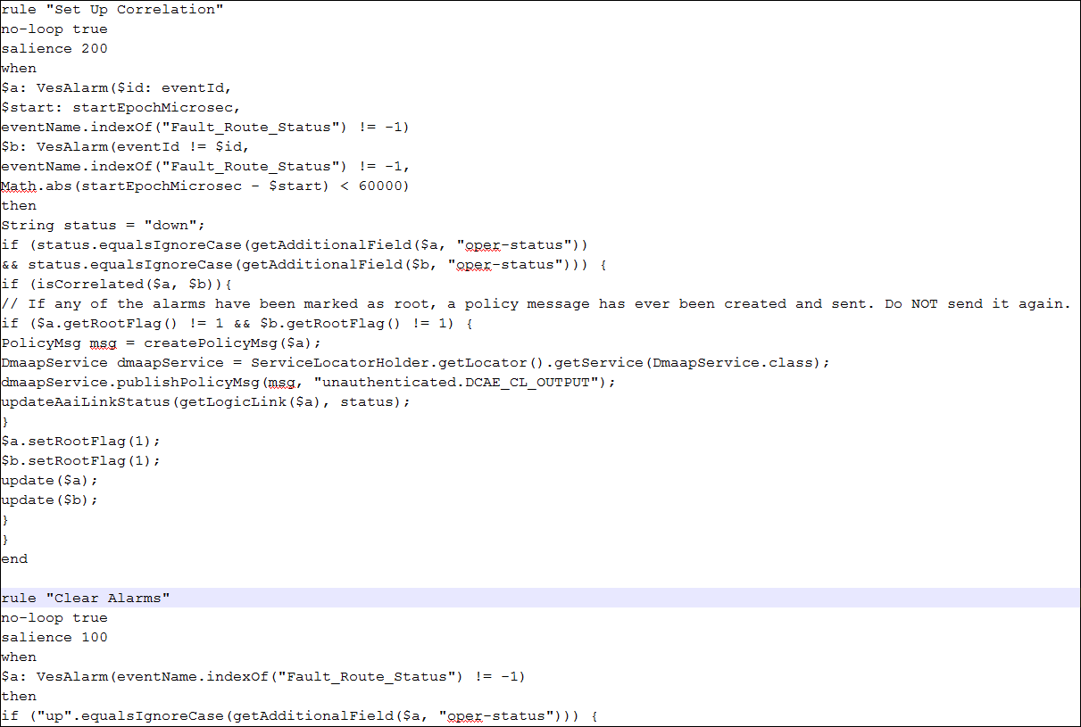
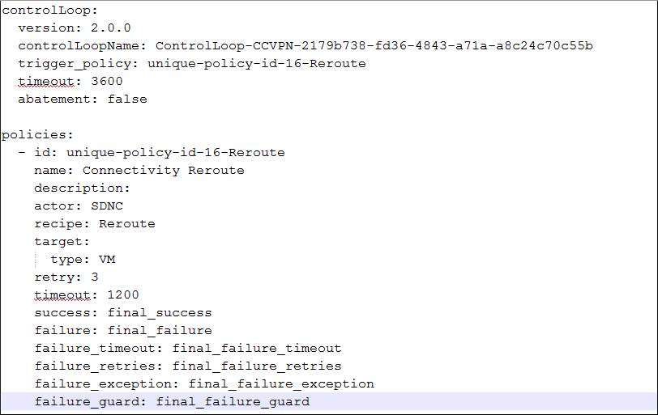
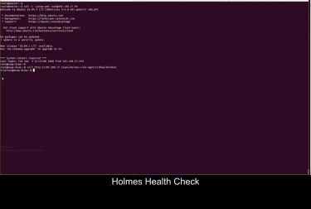
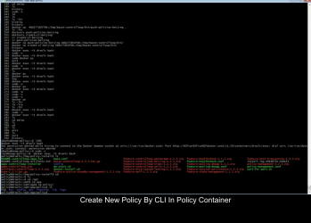
Step4: Analysis/Policy Rule Design
Define data analysis rule
Define policy rule
Upload data analysis rule to DCAE/Holmes
Upload policy rule to Policy
Data analysis rule design
Step 1. Collect alarms
Step2: Analyze the alarms
Step3: trigger a cross-link down event
Policy rule design
We upload the rules by command line now. It have been planed by ONAP to support this operation by Portal.
1.Subscribe with the cross-link down event.
2.Take action to reroute
Analysis rule
upload
Policy rule
upload

