Slide 1
MEF Services Common Model & LSO Legato Interface Profile*
In collaboration with ONAP External API project
* Animated slides
Karthik Sethuraman, NEC
Jack Pugaczewski, CenturyLink
Andy Mayer, AT&T

Slide 2
Overview: MEF approach to Standardized APIs
MEF Service Specifications
SD-WAN
EVC
OVC
L1CS
IP
Others…..
NRM-CON
NRM-OAM
EVC-OVC
SD-WAN
Access
E-Line
SD-WAN
MEF Information Models
Resource
Common
NRM-L1
Others…
Service
Common
L1CS
Others…
Product
Common
EPL/EVPL
Others…
General Common
MEF Core Model
MEF Interface Profile Specifications
NRP
SOAM
Service
Catalog
Service
Inventory
Ordering
Inventory
Quote
Service
Order
Others
…
Presto
Others…
Legato
Others…
Sonata
Serviceablity
Others…
MEF API and Data Schema
YANG schema
OpenAPI schema
JSON schema
OpenAPI schema
JSON schema
OpenAPI schema
Others
…
Presto SDK
ODL UniMgr
Legato SDK
ONAP ExtAPI
Sonata SDK
?

Slide 3
MCM – MEF Core Model
MEF Core Model (MCM) is an “umbrella” information model that provides a base set of object definitions, relationships and reusable patterns supporting the concepts defined in MEF LSO architecture
  Enables similar concepts to be modeled using the same patterns
  It is the primary model from which other MEF information models are extended
MCM’s models the LSO concepts and functions from a Service Provider’s point-of-view.
  This includes interactions between the Service Provider and its Partners, as well as interactions between the Service Provider and its Customers.
  Built from a top-down, bottom-up approach
MCM is available as a MEF standard (MEF 78)

Slide 4
MEF Services Common Model Scope within MEF LSO

Slide 5
MSCM and other Model Relationships

Slide 6
MSCM Information Model
The MSCM is intended to be leveraged at multiple LSO interfaces for multiple API development efforts.
  Sonata, Cantata, Allegro, Interlude, Legato, etc
  Each of these interfaces can leverage the common objects, attributes and relationships defined in the MSCM
MSCM covers multiple MEF service specifications
  SD-WAN Services
  EVC Services (EP-LINE, EVP-LINE, EP-LAN, EVP-LAN, EP-TREE, EVP-TREE)
  OVC Services (ACCESS-ELINE, TRANSIT-ELINE, ACCESS-ELAN, TRANSIT-ELAN)
  Others (IP, L1, Cloud, Elastic, etc)
MSCM is based-on/derived-from MEF Core Model (MCM) constructs
  MCMServiceInterface, MCMServiceEndPoint, MCMOrderedService, MCMPartnerService, etc
MSCM consolidates common types and common objects into models that can be imported by other efforts.
MSCM aims to align with other external SDO models such as ONF Transport API (TAPI)

Slide 7
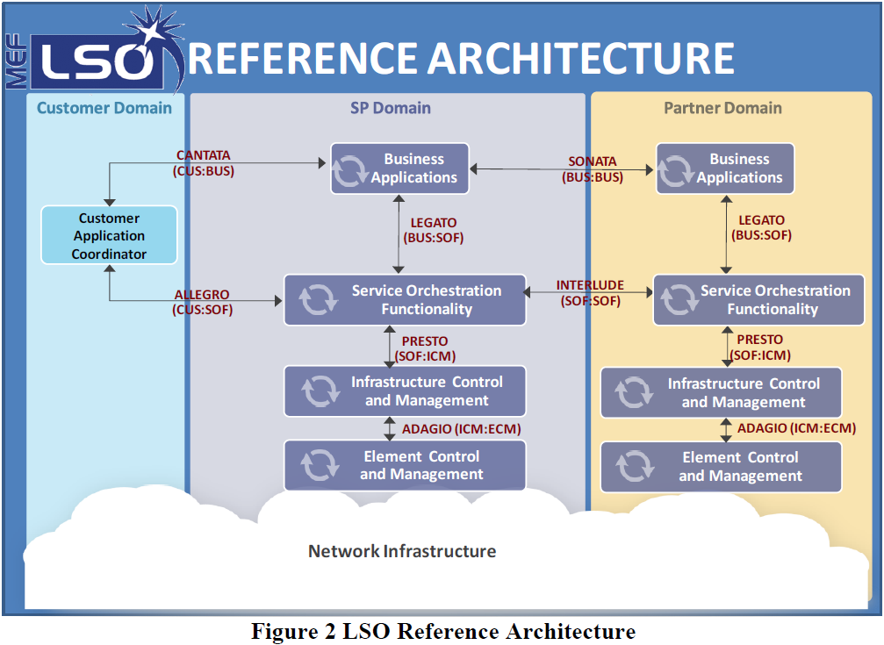
MEF Legato IPS Scope within MEF LSO
Use Case Actors: BA & SOF
Use cases from the perspective of
Client/Requestor: BA
Server/Provider: SOF

Slide 8
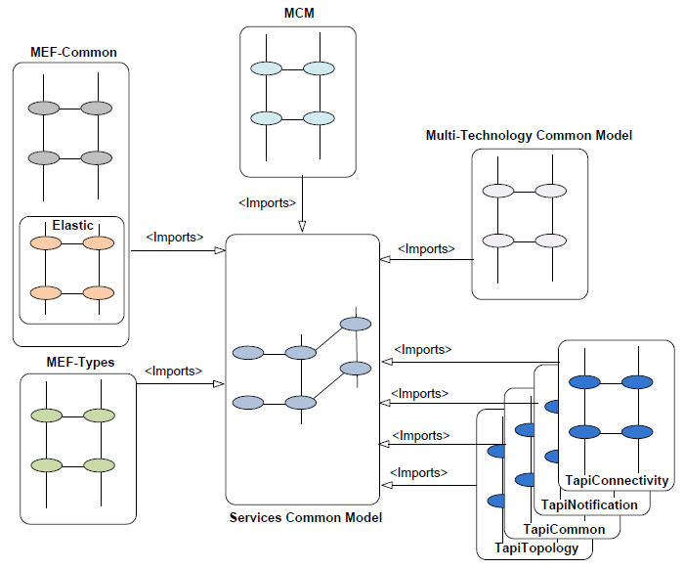
Legato & MSCM Information Models – High Level View
MSCM (Legato payload model)
LSAPI (Legato envelope model)
Service Order
Service Order Item
Service Catalog
<Specify>
Service Specification
Service Instance

Slide 9
Legato Service API Information Model
Generic Service Interface Information Model (envelope)
  Initial draft created from analysis of ONAP External API information model (by reverse engineering ONAP External API documentation)
  Need to evolve terminology definitions, class details, class associations, state machines, sequences, etc
MEF Service Specification Models (payload)
  Current idea is to model MSCM services as Service Specifications that can be retrieved via a Service Catalog API
  May need to prune MSCM Service classes (create an Legato Interface “Profile”)
    No need to curtail to a specific service spec, but can describe a service in the use cases as an example
  MSCM sub-classes MCM & hence inherits all MCM attributes
  Identify mapping between common/similar attributes in MSCM & Legato IM (ONAP ExtAPI based)

Slide 10
MEF Service Specifications Mapping (from MSCM project)
Mapping MSCM to Legato IPS Envelope model
  MSCM Service classes planned to be mapped to Legato Service Specification class
    Using the UML abstraction/specify relationship
Use tooling to generate OpenAPI/JSON Schema
  Auto populate the meta-data fields and meta-data-like fields (category, sub-category)
    @schemaLocation → MEF MSCM Git repo public/published location
    @baseType → MEFServiceSpecification, @type → Specific MEF Service type (e.g. EPL, EVPL, etc)
  Generate Service Specification Characteristic/Value for every MSCM Service class-attribute

Slide 11
MSCM Additional Reference

Slide 12
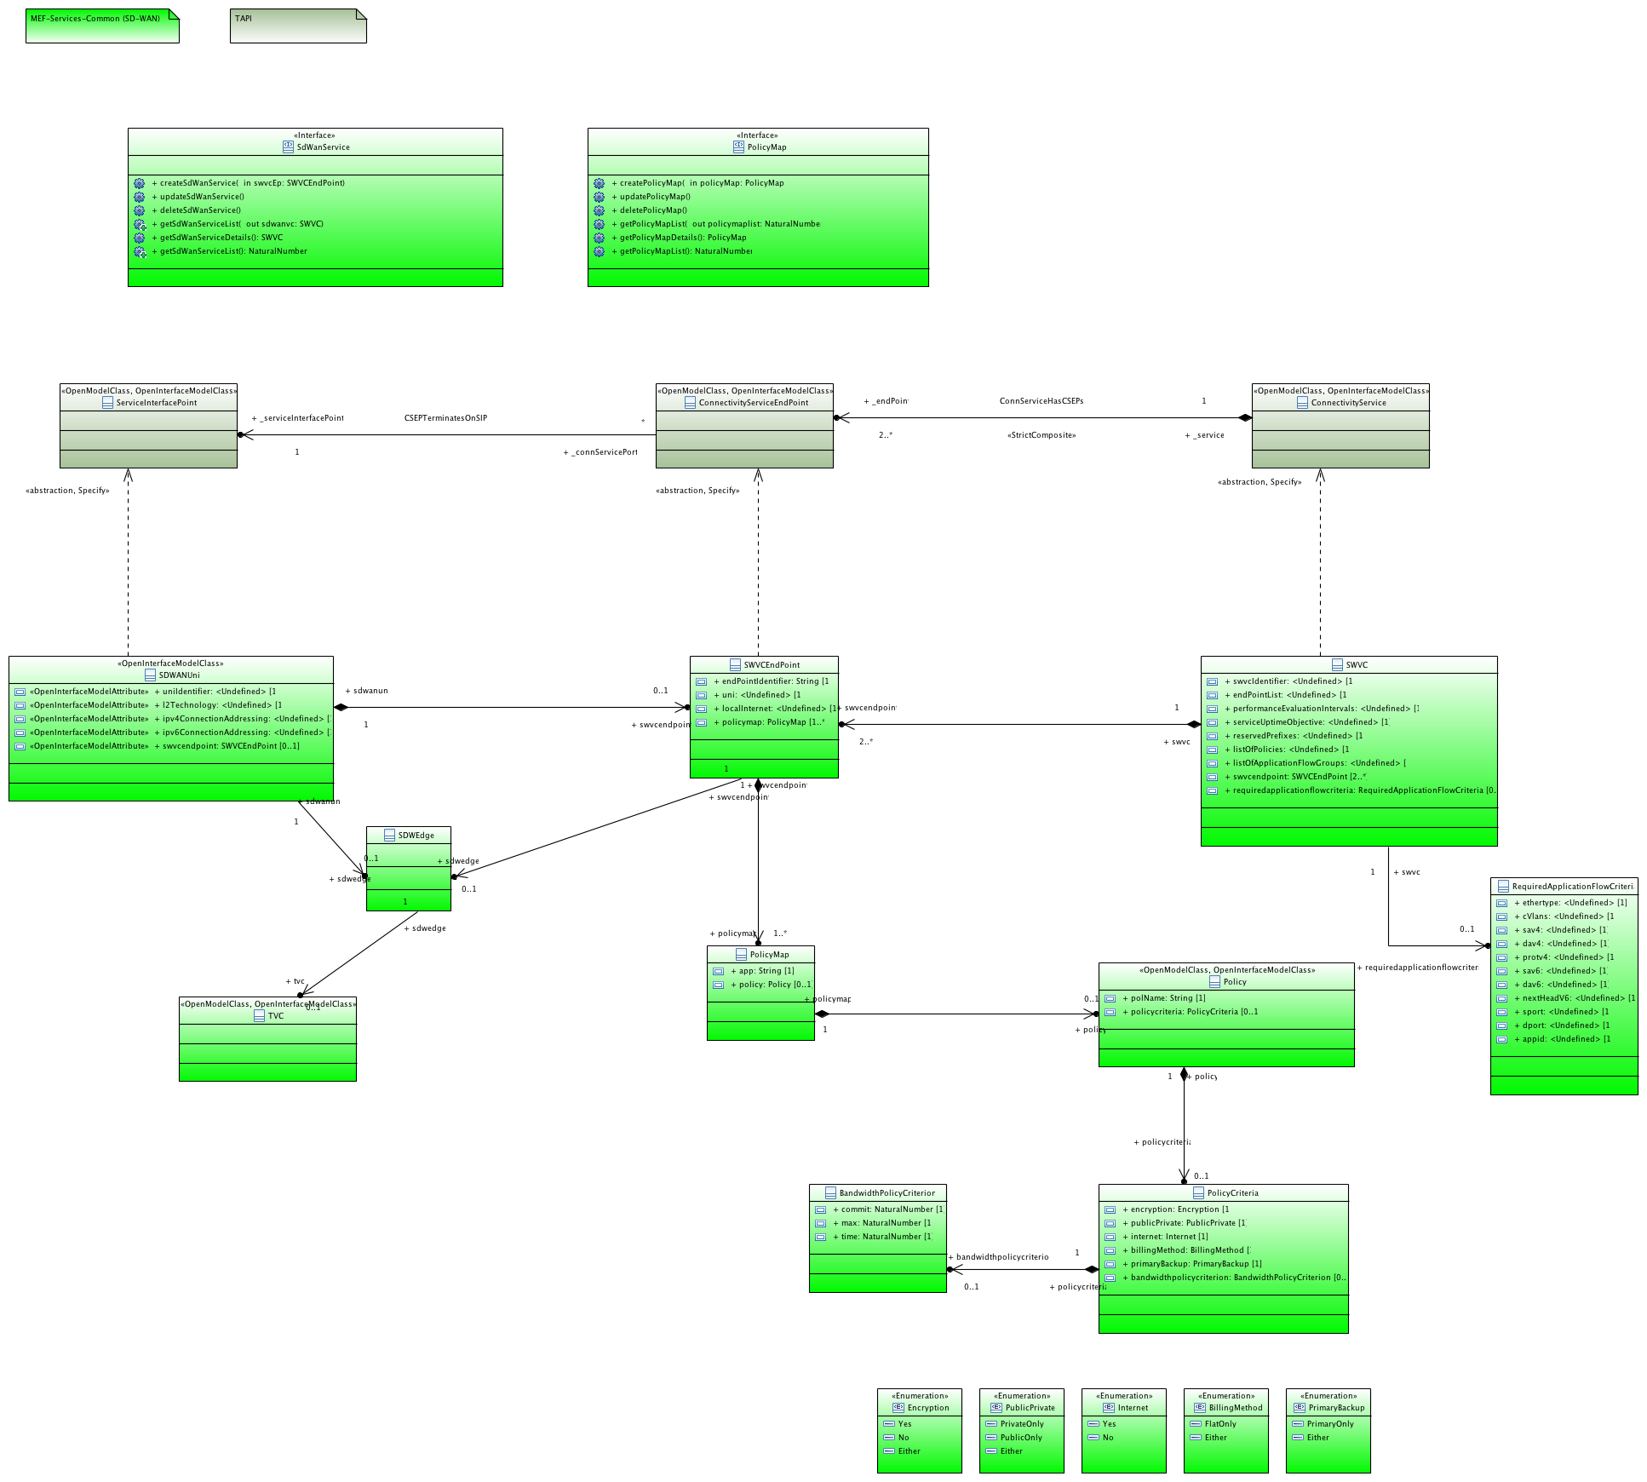
MSCM SD-WAN
DRAFT

Slide 13
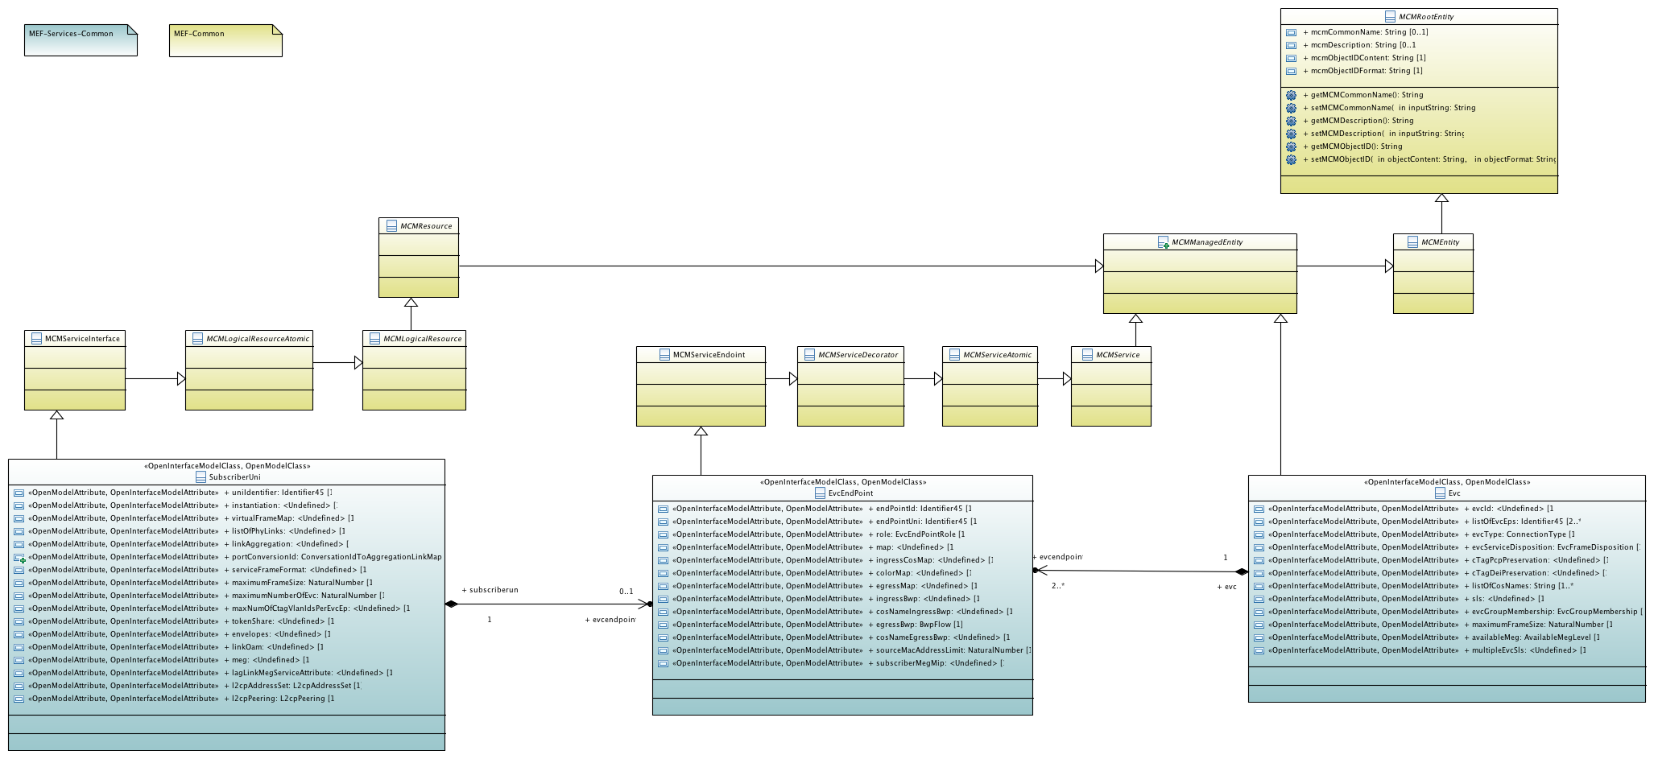
MSCM EVC Model Skeleton
DRAFT

Slide 14
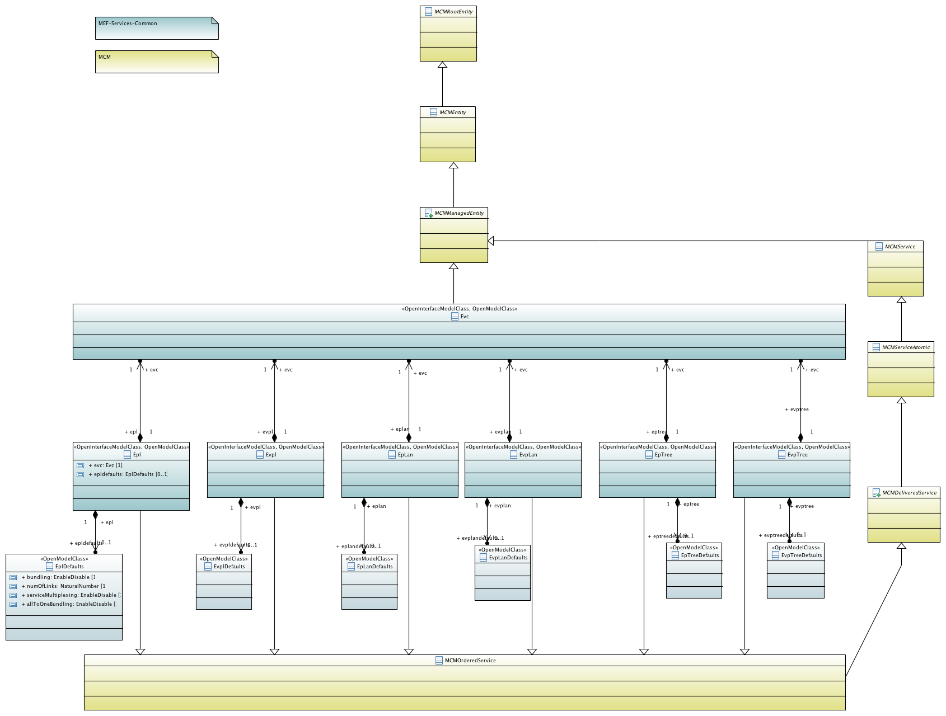
MSCM EVC Services Model Skeleton
DRAFT

Slide 15
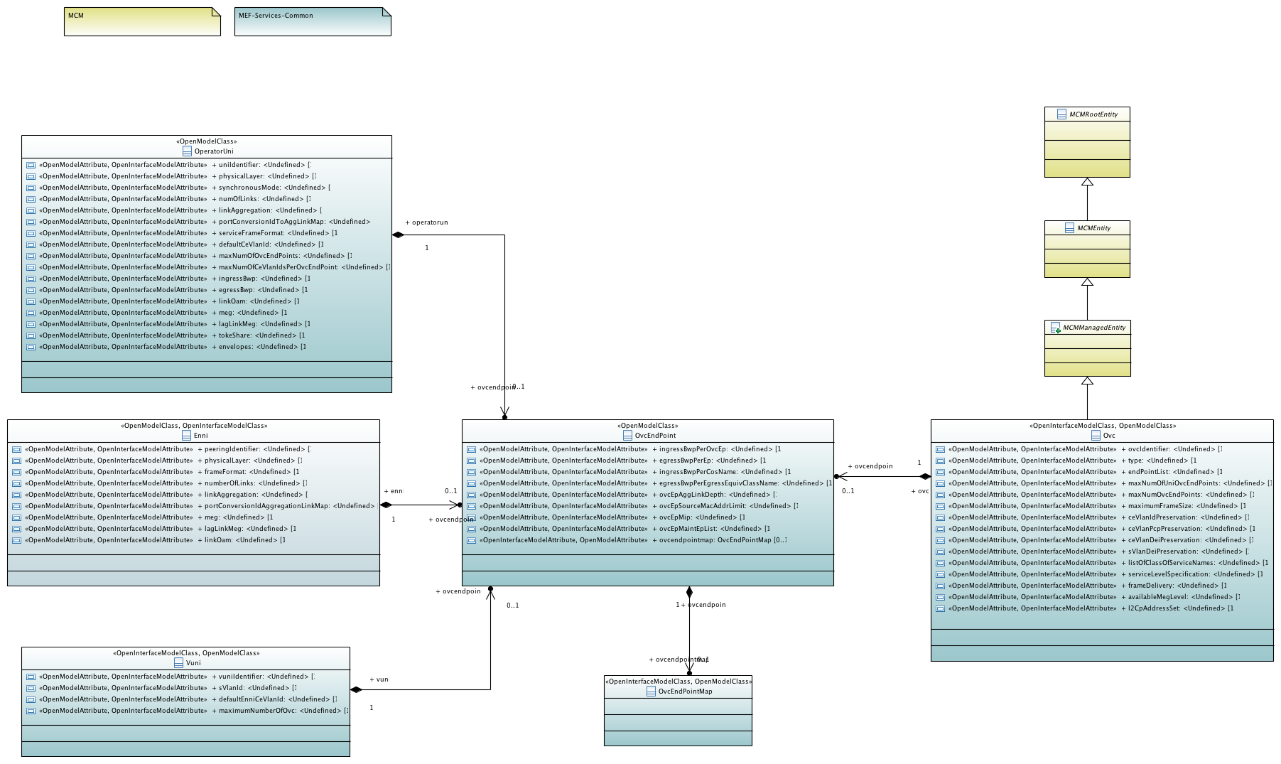
MSCM OVC Model Skeleton
DRAFT

Slide 16
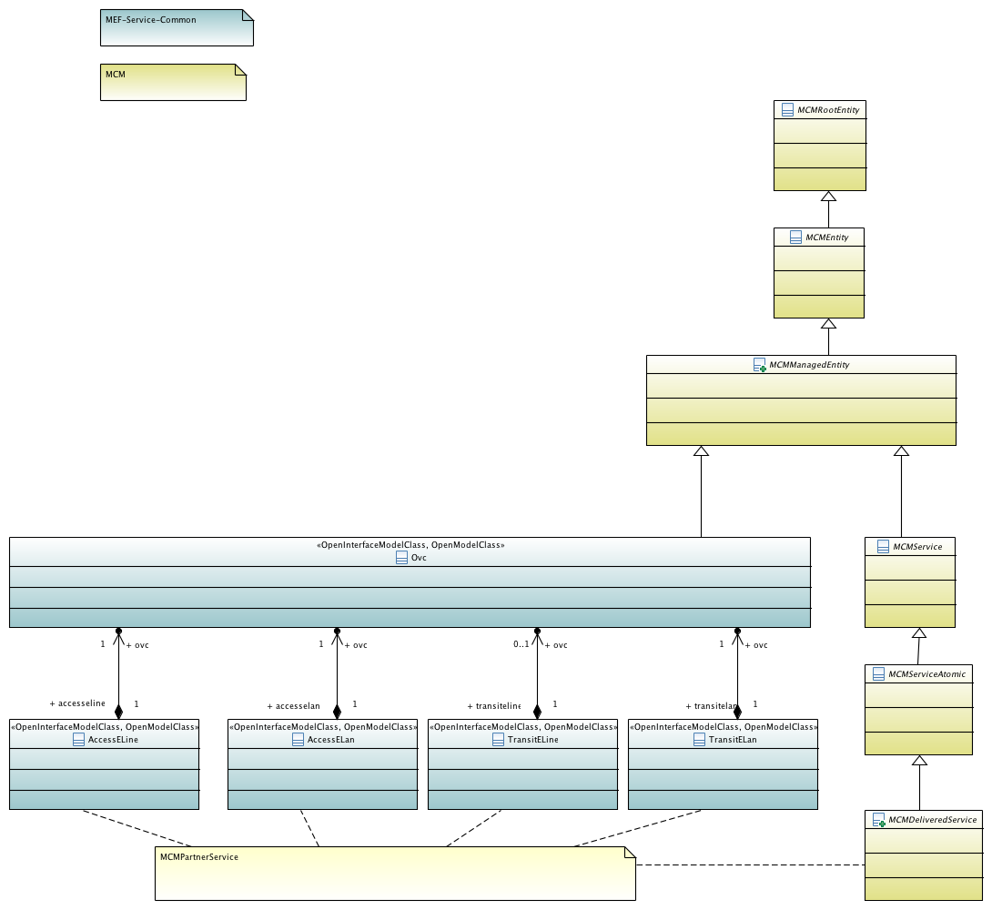
MSCM OVC Services Model Skeleton
DRAFT

Slide 17
LSAPI Additional Reference

Slide 18
Legato IPS Project Scope & Deliverables (all phases)
[L64001_004] Interface Profile Specification for MEF LSO Legato IRP covering
  Service Catalog
  Service Ordering (including Service Instantiation)
  Service Inventory
  Service Topology
  Service Notification
  License Usage
Deliverables
  Interface Profile Specification (IPS)
    Terminology, Requirements & Use Cases
    Information Model (Class, State & Sequence diagrams)
  Interface Implementation Specification (IIS)
    Project proposal calls out ONAP (ExtAPI)
    IM – API data-schema mapping
    Guides & other stuff (plan to follow Sonata template ☺)
  Software Artifacts
    Papyrus UML + Gendoc output
    OpenAPI/JSON schema
* Phase 1 (current) focus items

Slide 19
Use Cases under scope (all phases)
In support of MEF 55 Requirements and Operational Threads
Agile Product/Service design
  Service Catalog & Specification
  Technology & Service agnostic framework/mechanism
Order Fulfillment & Service Control
  Service Configuration and Activation
  Service Control
  Service Inventory and Topology
  Service change Notification and Reporting
Service Activation Testing
Service Problem and Quality Management
Service Usage measurements & reporting (in support of Billing)
* Phase 1 (current) focus items

Slide 20
Support of MEF 55 Operational Threads – Phase 1
Designing and Launching a New Product Offering
  A specification of the Services needed to support Product Instances corresponding to the Product Offering is created and retrieved
Product Ordering and Service Activation Orchestration
  LSO fulfills the order by selecting, assigning, configuring and activating the appropriate Services and associated resources that support the ordered Product Instance
Controlling a Service
  The Customer initiates a request to dynamically control a permitted aspect of its Service (e.g., bandwidth change or implementing traffic filtering controls, etc.).
  LSO uses the defined service constraints and policies to determine if the dynamic control request is permitted.
  LSO effects the necessary changes within its own domain to service the request.

Slide 21
Requirements – Phase 1
Derived from the use case descriptions
Interface requirements as opposed to “business” requirements
English description of interface functions to be supported in implementation-agnostic manner - Includes
  High-level functional behavior/logic
  Pre-conditions/Post-conditions
  Key attributes to be exchanged (input/output), notifications, error/exceptions
In support of following MEF 55, section 8.2 Business requirements
  Fulfillment : R-LSO-RA-3, R-LSO-RA-4,
  Configuration: R-LSO-RA-8, R-LSO-RA-10, R-LSO-RA-11, R-LSO-RA-12
  Control: [R-LSO-RA-13] to [R-LSO-RA-20]

Slide 22
Key Envelope IM Constructs from ONAP ExtAPI
Service Catalog
  Service Specification
  Service Specification Characteristic/Value (drop/don’t -use)
  Resource Specification
  Related Party
  State machines: Lifecycle (Certification) Status & Distribution Status
Service Ordering
  Service Order
  Service Order Item
  Service
  Service Characteristic/Value
  Related Party
  State machines: Order State & Lifecycle State
Service Inventory
  Service
  Service Characteristic/Value
  Supporting Resource
  Related Party
  State Machines: Lifecycle State

Slide 23
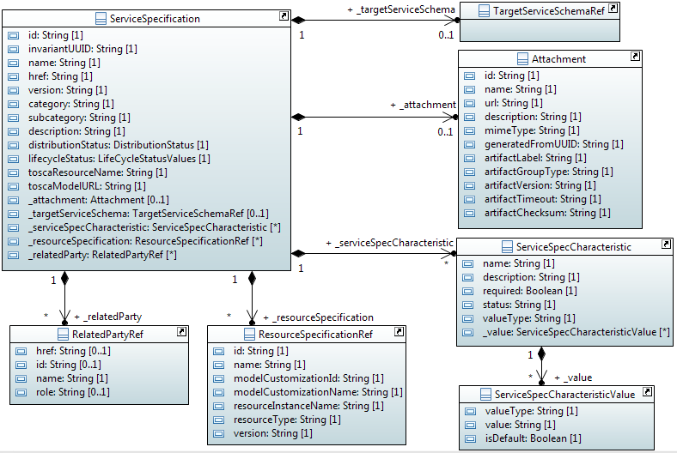
LSAPI Service Catalog model
DRAFT

Slide 24
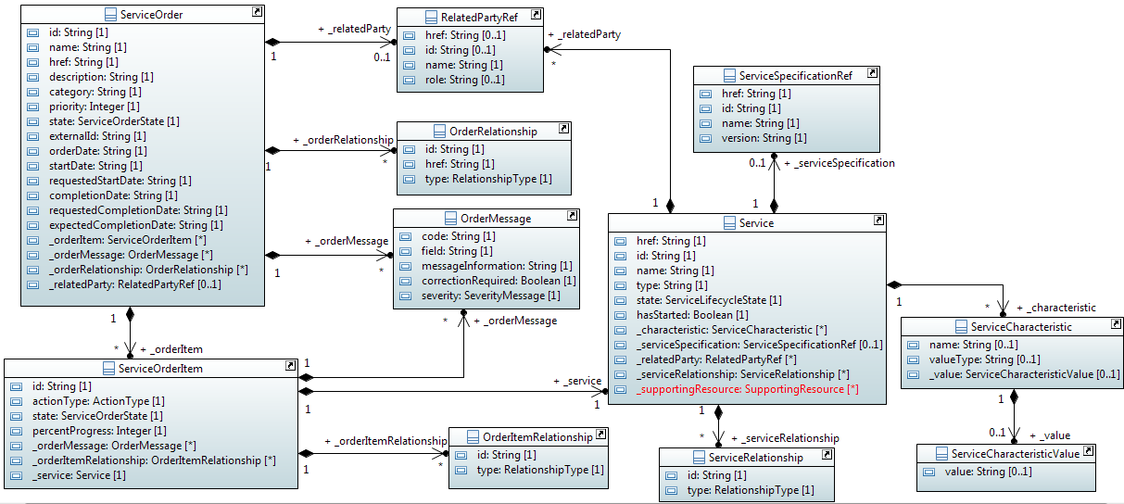
LSAPI Service Order model
DRAFT

Slide 25
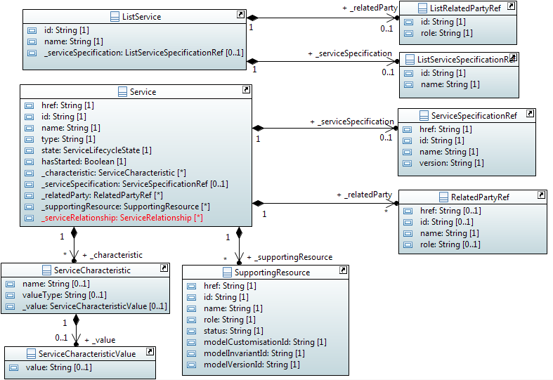
LSAPI Service Inventory model
DRAFT

Slide 26
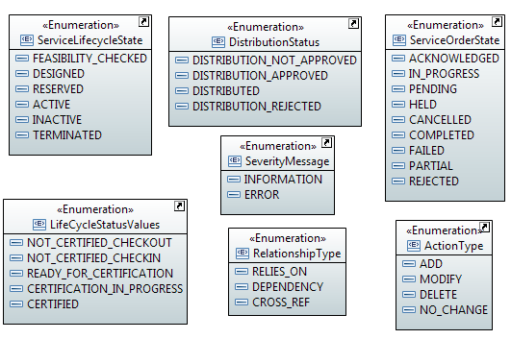
LSAPI Data Types
DRAFT

Slide 27
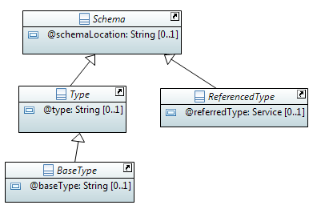
LSAPI Metadata
DRAFT

Slide 28
Project Resources & Meetings
Project Home is on the MEF Member Wiki
  https://wiki.mef.net/pages/viewpage.action?pageId=82231371
Call Details
  https://wiki.mef.net/display/LSO/Legato+IPS+-+Call+Details
  Calls on Wednesdays at 12 PM US Eastern Time(EDT)
Meeting notes are on the wiki:
  https://wiki.mef.net/display/LSO/Legato+IPS+Call+Notes-2019Q1
Contributions are on the wiki:
  https://wiki.mef.net/display/LSO/Legato+IPS+Contributions
Papyrus UML, API, etc are on MEF Github
  https://github.com/MEF-GIT/MEF-LSO-Legato-SDK/tree/master/experimental

