Slide 1
DCAE - Service Components
Onboarding and Lifecycle Management
Vijay VK(vv770d@att.com)

Slide 2
ONAP DCAE R3 ARCHITECTURE
DMAAP
DCAE Services
Consul Cluster
Consul Cluster
Consul Cluster
TCA-Gen2
DCAE Platform
Holmes
TCA
Heartbeat
PRH
Cloudify Manager
SNMP-VES Mapper
PM-Mapper
Config Binding Service
Inventory API
PostGres DB
GPB->JSON
Deployment Handler
Service Change Handler
Policy Handler
SNMP Trap Collector
VESCollector (JSON)
DataFile Collector
HV-VES
DMAAP
xNF
xNF
CLAMP
SDC
Policy
Event Data flow
Deployment
Policy Changes & Configuration flow
Service distribution

Slide 3
Design time specification – Component spec
      Defining input and output structure
      Topic Keys
      Configuration
                Design-time
                Deployment-time
                Policy editable
      Policy Model
      Filesystem mapping
      Port mapping
      Image specification

Slide 4
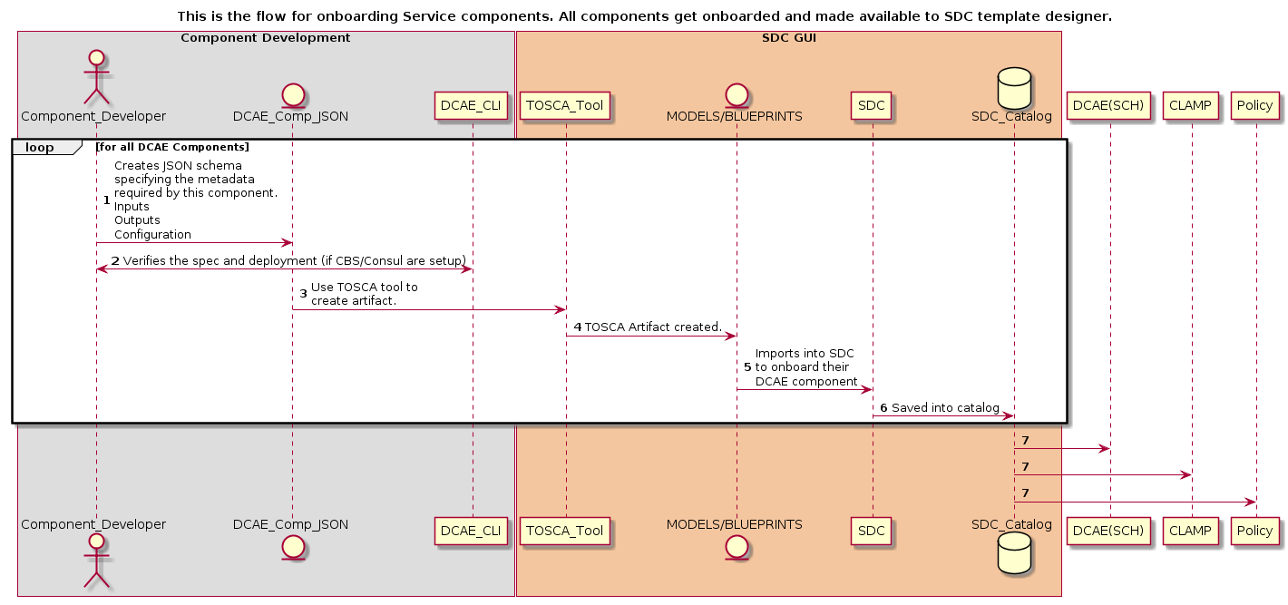
Design time Flow (onboarding)

Slide 5
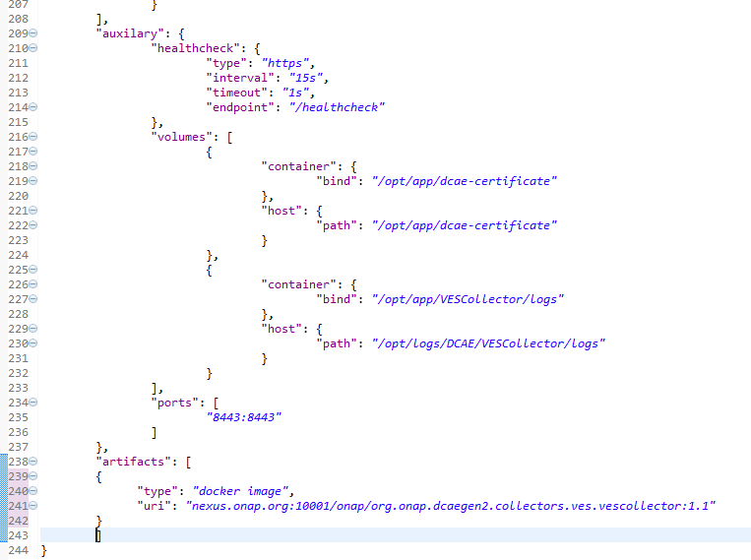
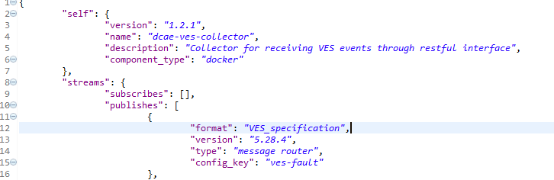
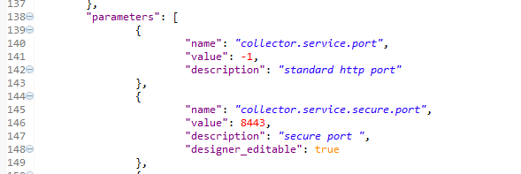
Component spec (Example)

Slide 6
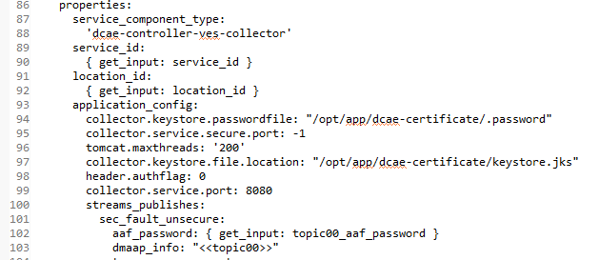
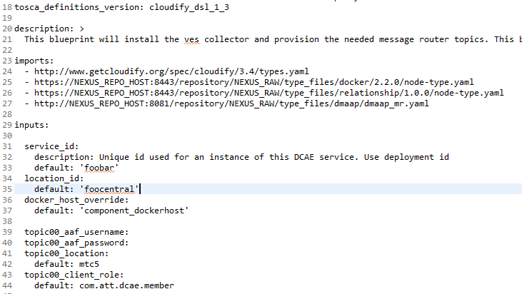
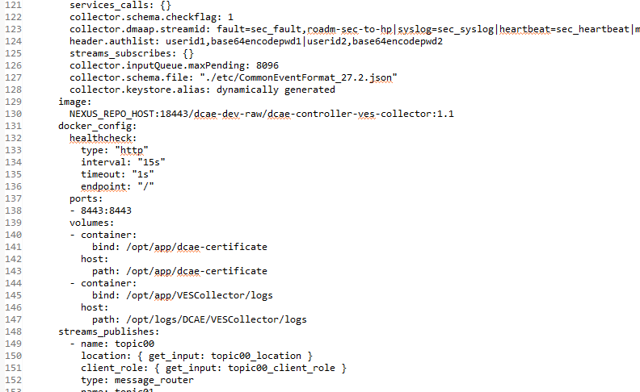
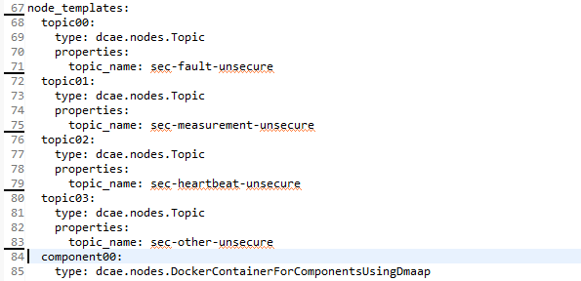
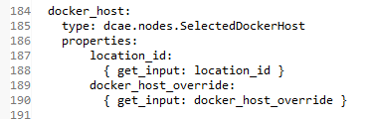
Blueprint (Example)

Slide 7
Service component requirement for Integration
Provide component spec identify the configuration/model
ConfigBindingService Integration
Notification mechanism (optional)
Support s3p (resiliency/security support)

Slide 8
DCAE Platform requirements
Allow new MS/applications/components to be onboarded independently; identify design time and run-time parameters (policy config) during modelling
    Existing modelling use a combination of json->tosca to represent it. Need similar abstracted helm templates generated for onboarded services
Allow Service assurance flow composition and deployment of individual or group of component
Support interface to CLAMP to trigger instantiation of new MS (s)
Support interface between Policy and MS for dynamic configuration update
Complete view of MS and relation maintained at single/multisite K8S scenarios
Hierarchical deployment support
Dynamic topics(MR) and feeds(DR) provisioning and role assignment for MS
Healthcheck of all deployment component to be available for CLAMP/external system
Dynamic reconfiguration of MS based on xNF instantiations
(Dynamic deployment of MS based on xNF instantiation)
Provide an consistent configuration api access for all deployed MS
Infrastructure/VM deployment support (PNDA is not all containerized)
Scaling of MS

